Slide 1
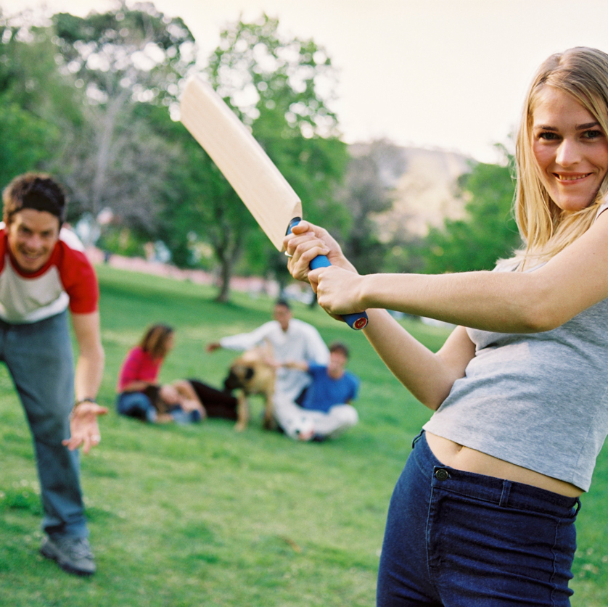
All aboard? Moving towards gender equality
Renee Imbesi
Victorian Health Promotion Foundation

Slide 2
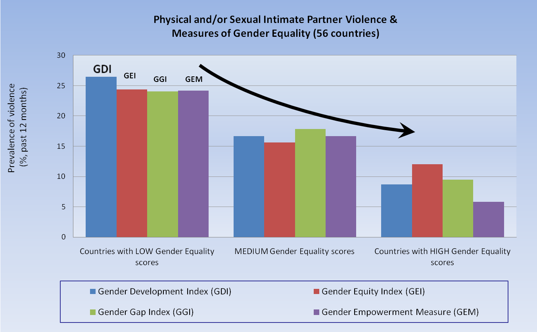
Gender equality and violence
[Source] United Nations Entity for Gender Equality and the Empowerment of Women
www.unwomen.org

Slide 3
Preventing violence before it occurs

Slide 4
Preventing violence before it occurs
While there are minor differences in the specific factors identified in ecological models proposed by various experts to understand violence against women, many identify the unequal distribution of power and resources between men and women and adherence to rigidly defined gender roles as significant underlying factors in the perpetration of this problem.

Slide 5
Themes for action
Supporting equal and respectful relationships between men and women
Supporting non-violent social norms and mediating the effects of prior exposure to violence
Improving access to resources and systems of support

Slide 6
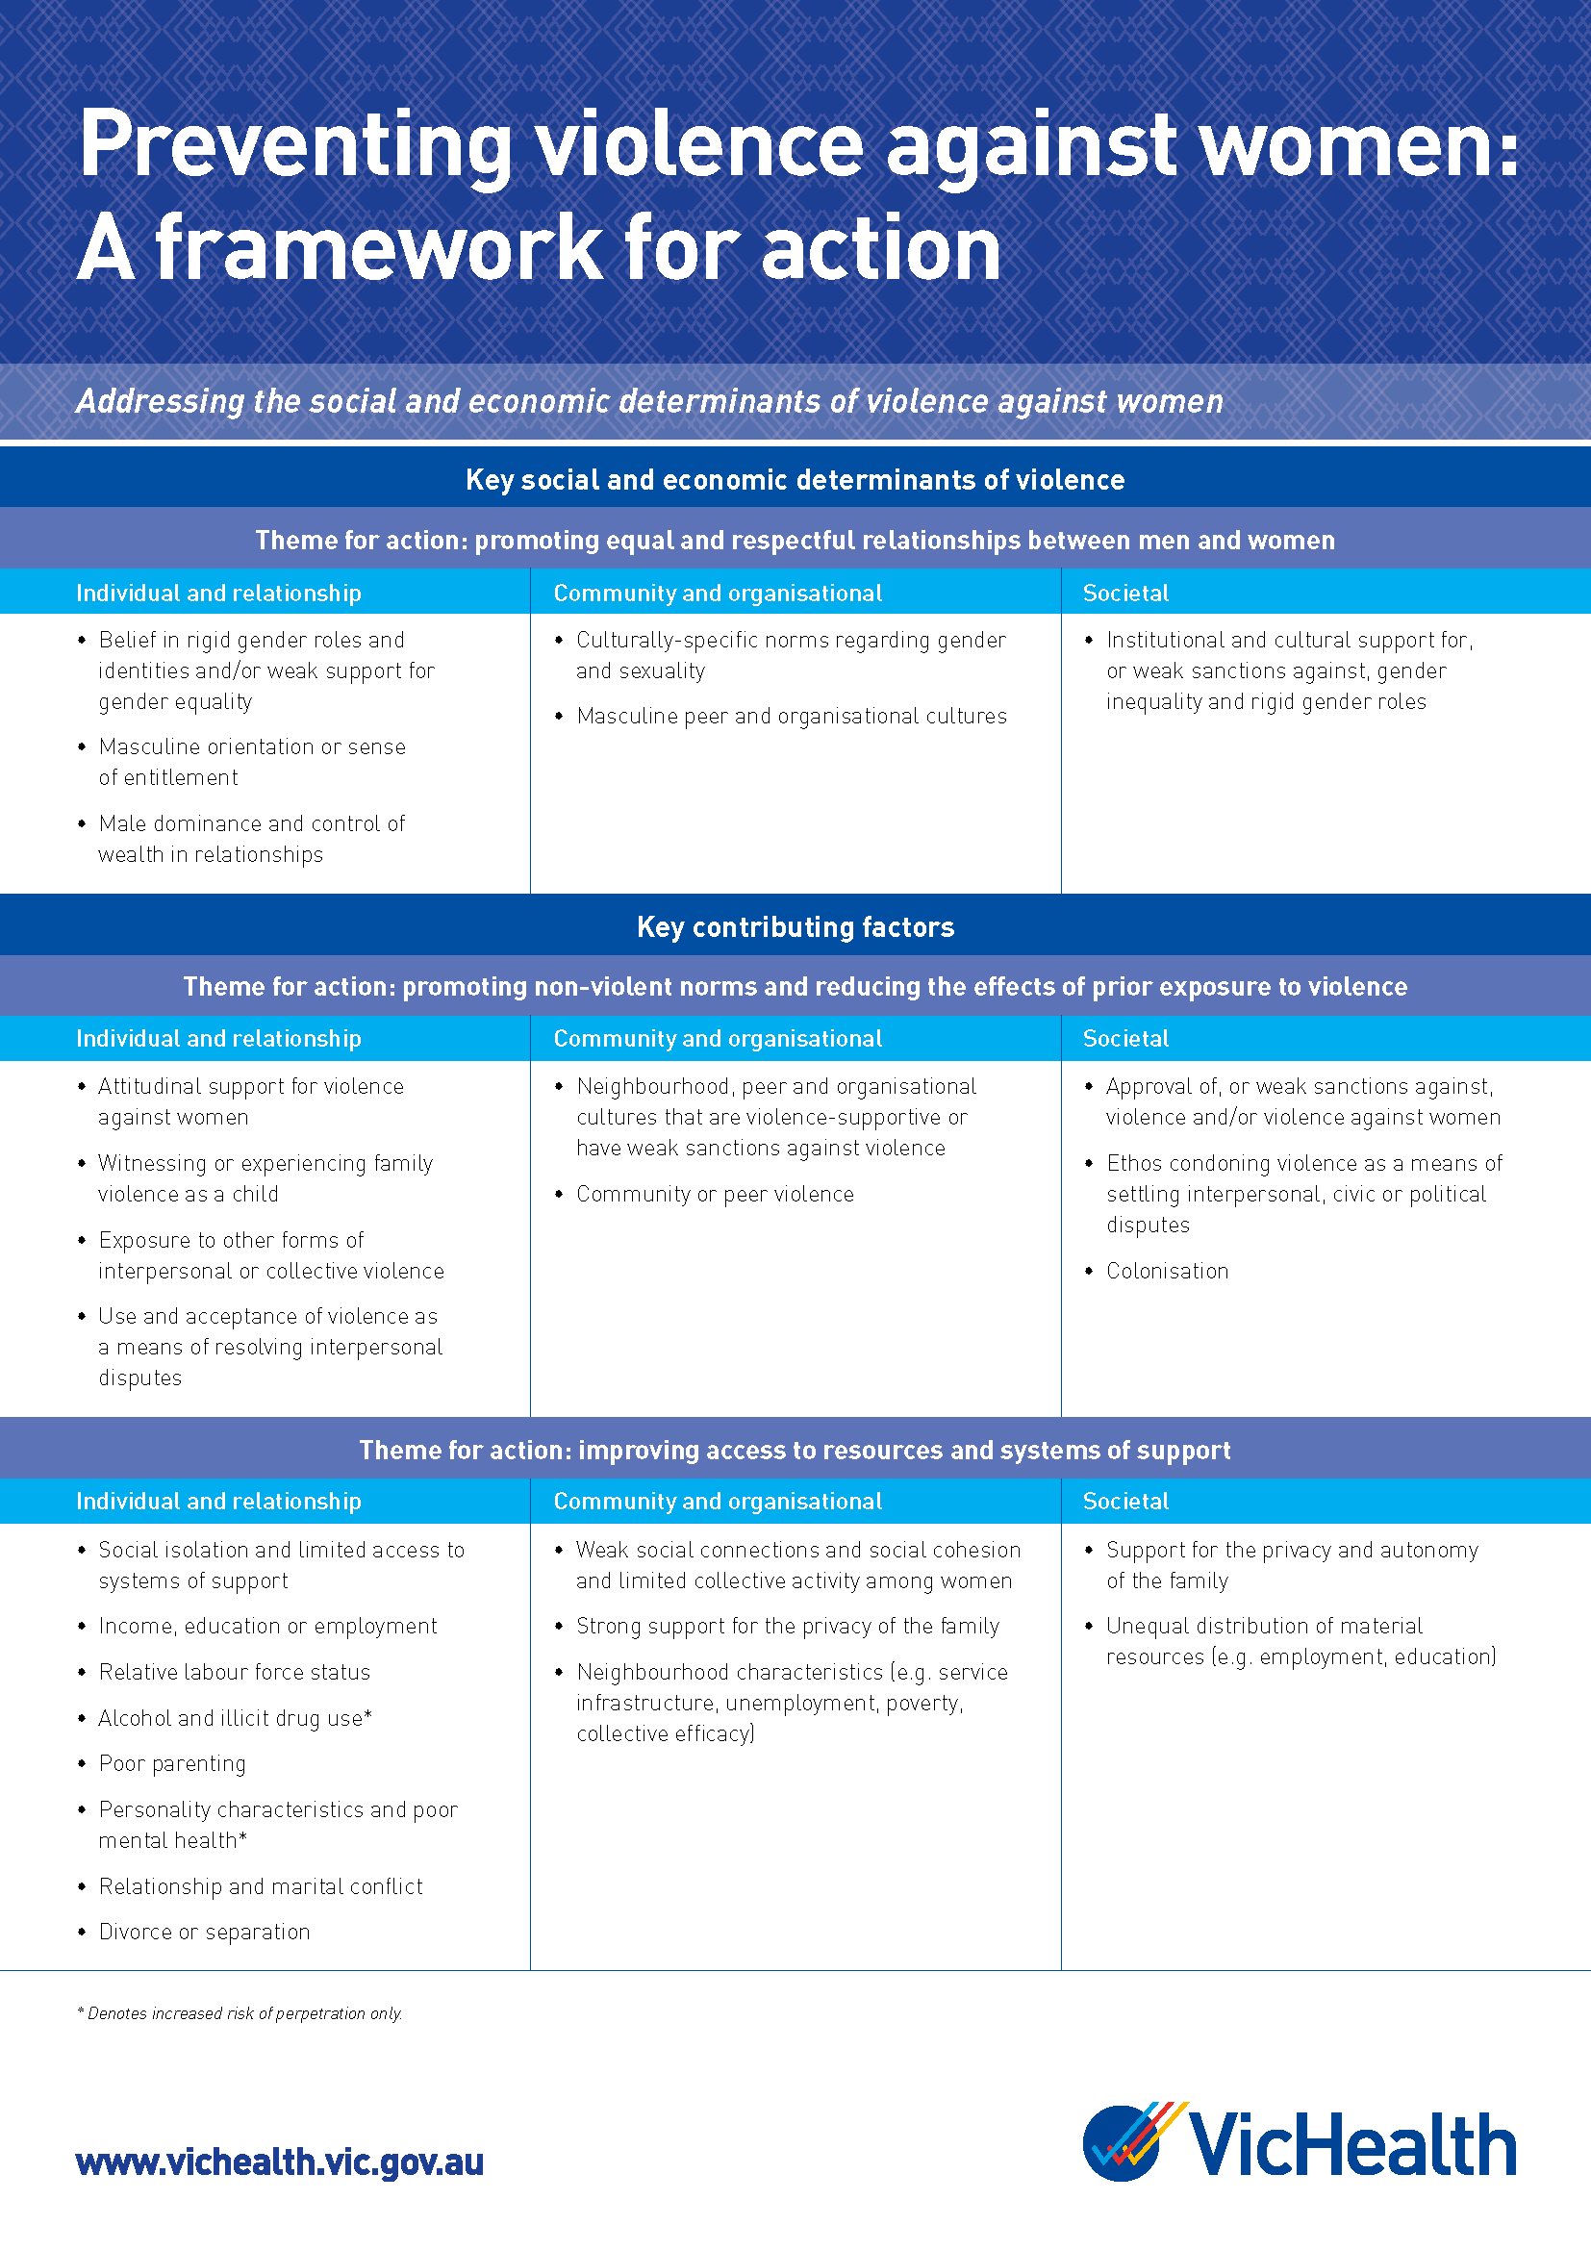

Slide 7
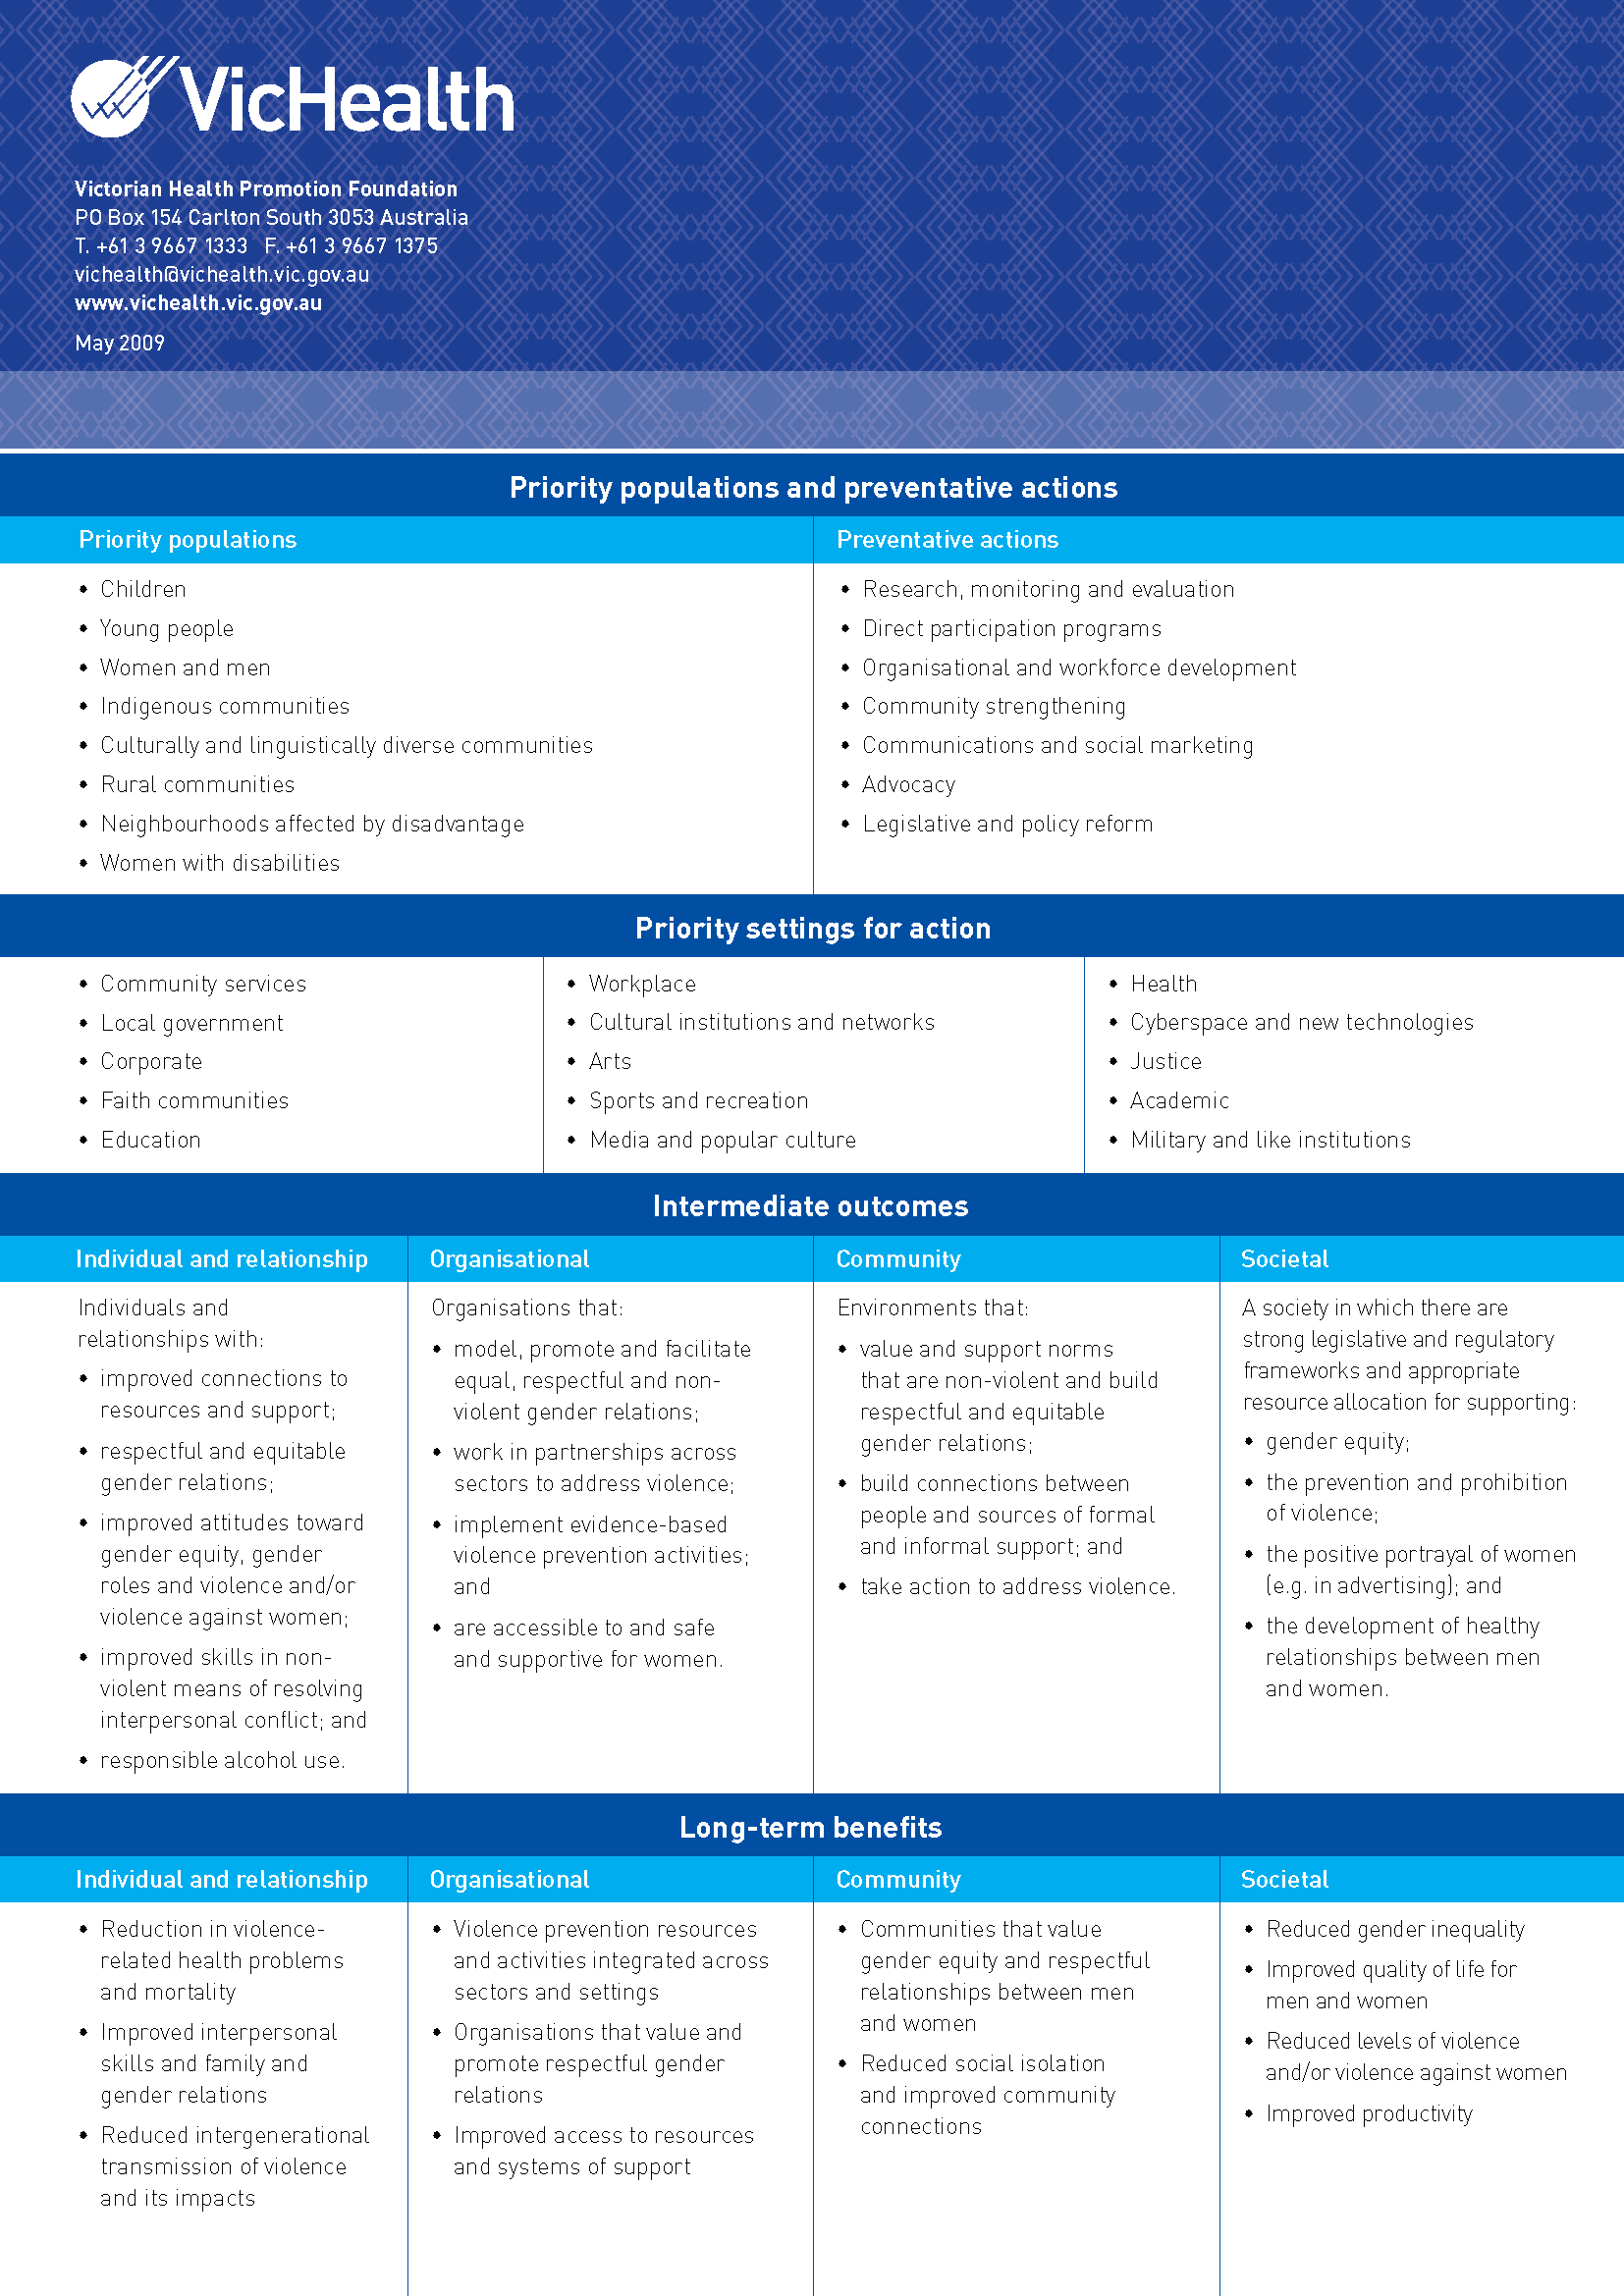

Slide 8
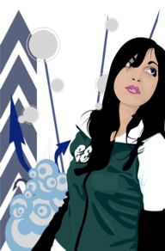
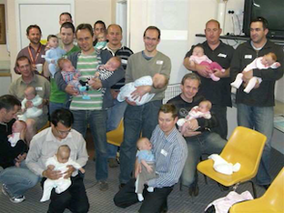
Settings for Action
Sports
Workplaces
Local Government
Schools
Community Health
Notes:
8

Slide 9
Preventing violence before it occurs
Primary prevention efforts are most likely to be effective when a coordinated range of mutually reinforcing strategies is targetted across these levels of influence.
Many of the factors influencing violence cross boundaries traditionally existing between government departments, disciplines and settings.

