Slide 2
The Pauline Gandel Children’s Gallery and The Museum Generation
Kate Brereton and Alex Price

Slide 3
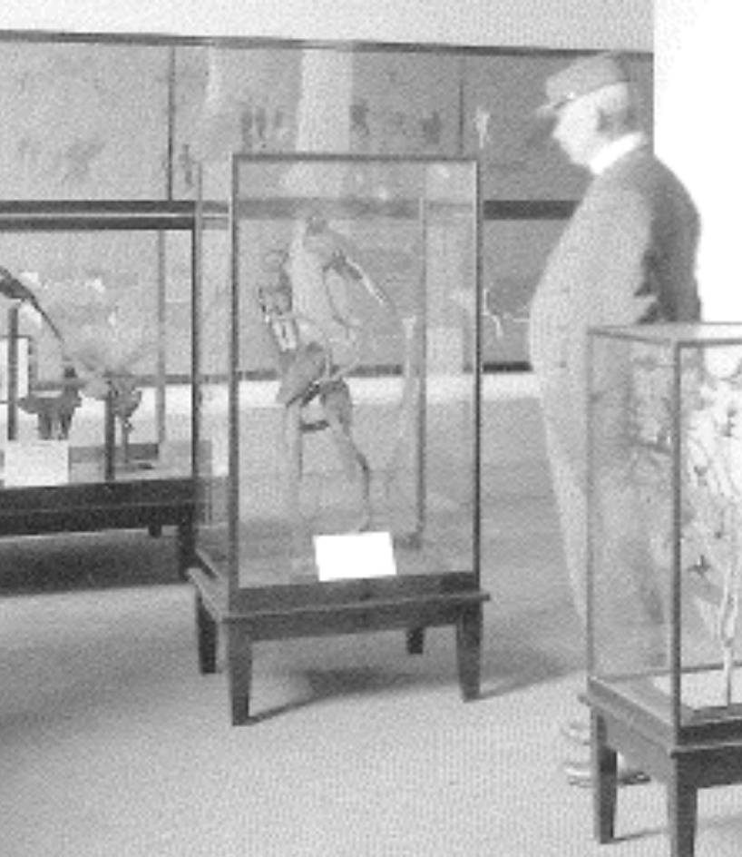
100 Years of Working with Children

Slide 4
The Pauline Gandel Children’s Gallery
The Children’s Gallery is a wondrous place for babies to 5-year-olds where children explore, play and learn.
This unique gallery supports families, carers, educators and children to learn together. The exhibition experiences combine hands-on exploration and discovery, open-ended play-based learning, extraordinary immersive environments and unique museum collection objects.

Slide 5
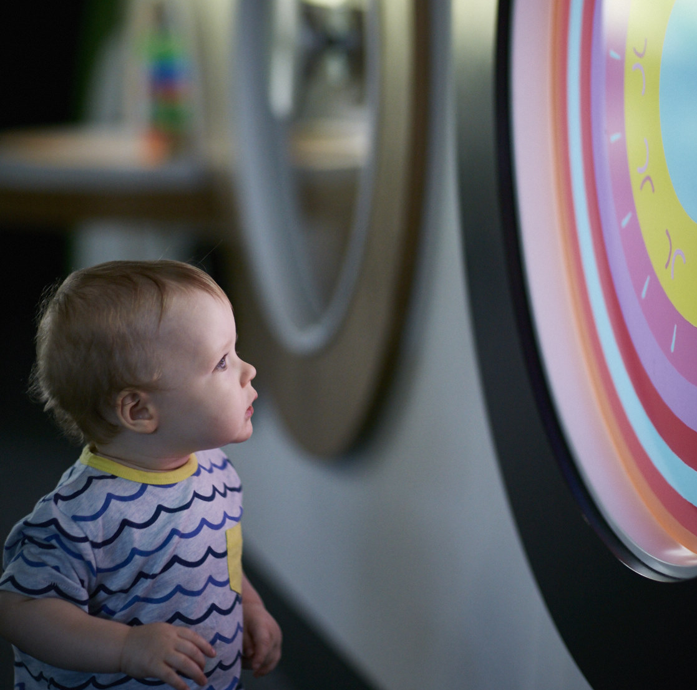
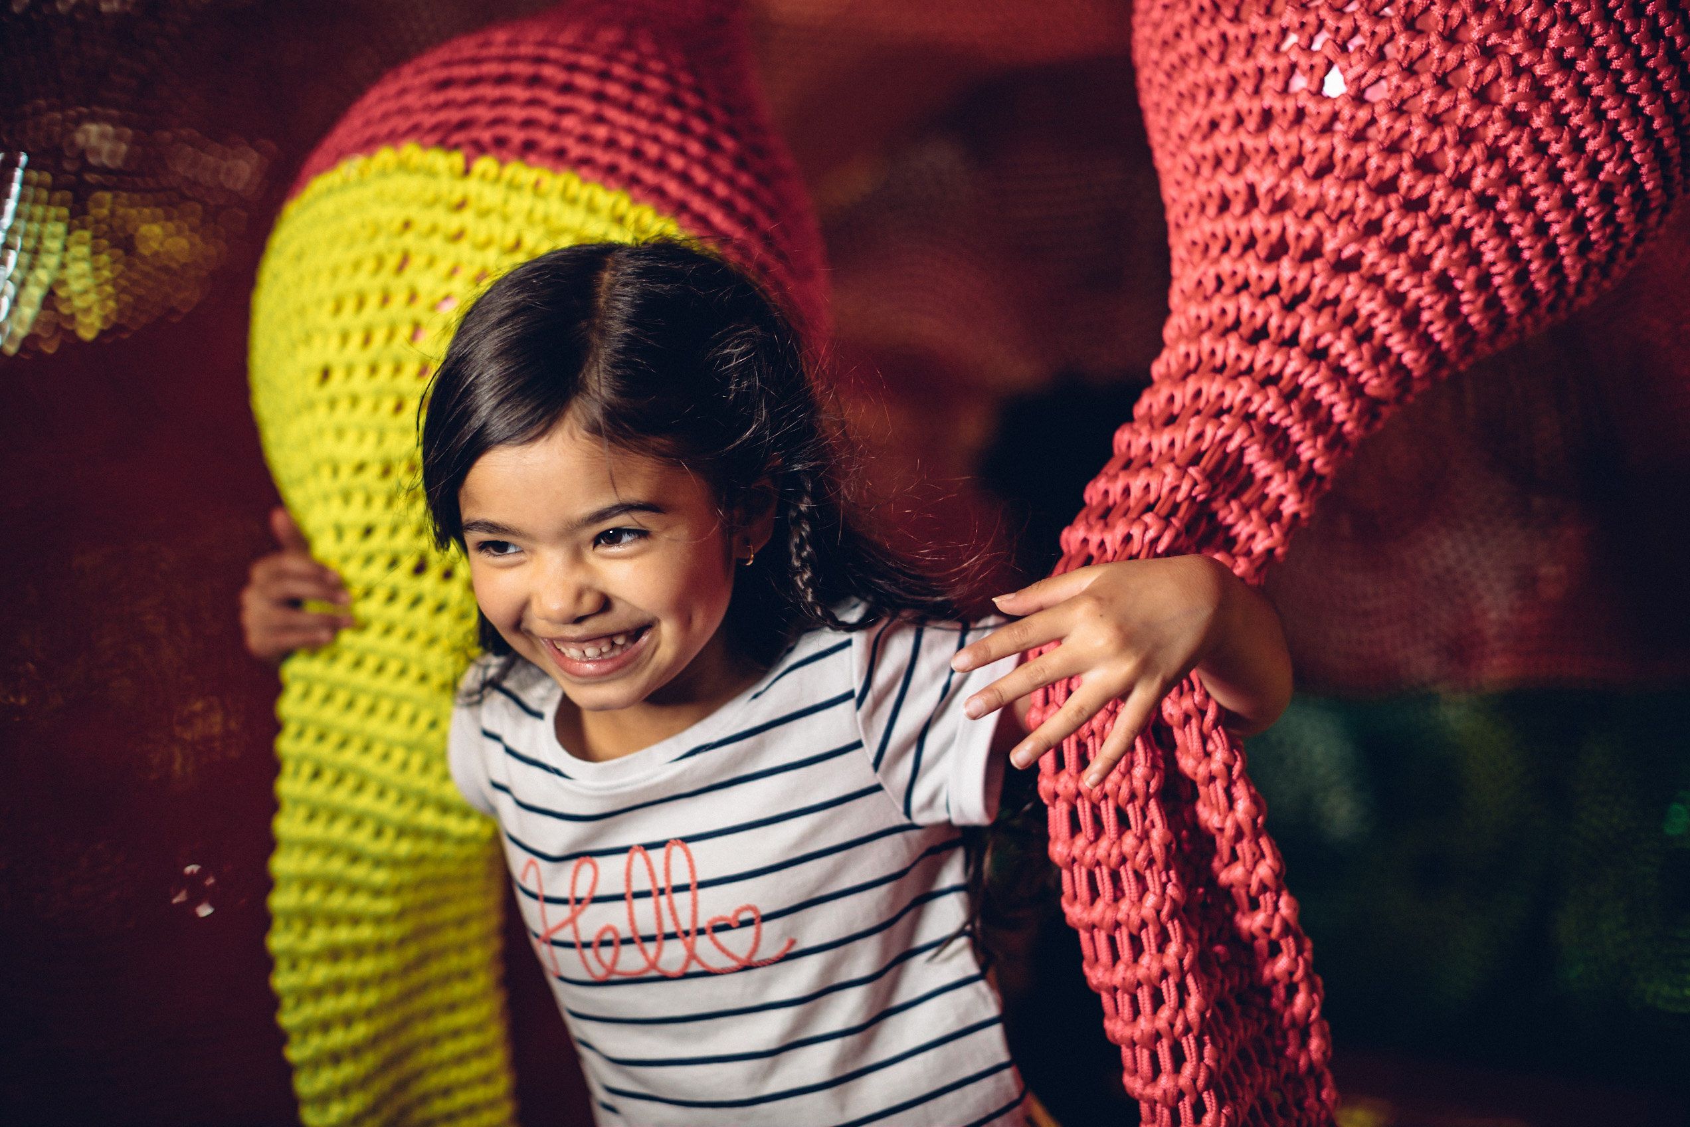
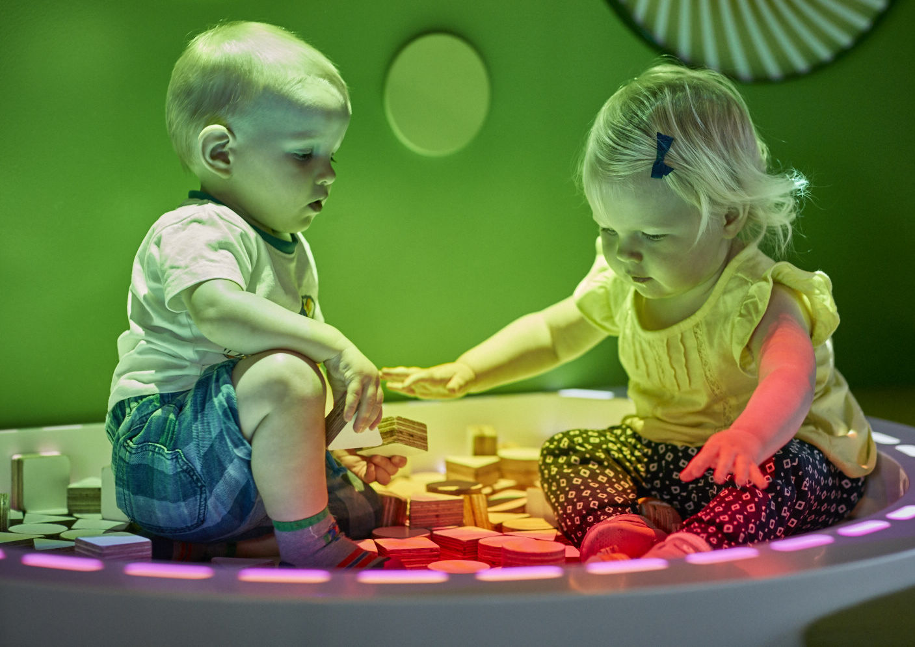
Notes:
Founded in developmental and early learning principles, linked to policy, curriculum and educational models
The exhibition is relevant to this growing audience
Consultation with the needs of the audience
Worked with children as co-creators though
asking
prototyping
observing

Slide 6
The Pauline Gandel Children’s Gallery
Gallery Amenities
Child size toilets alongside adult sized toilets
Café with healthy snacks
Dedicated feeding room
Plenty of comfortable seating and soft carpet for carers of all ages
Enclosed play areas for older children while younger ones are being fed/changed
Ample pram parking

Slide 7
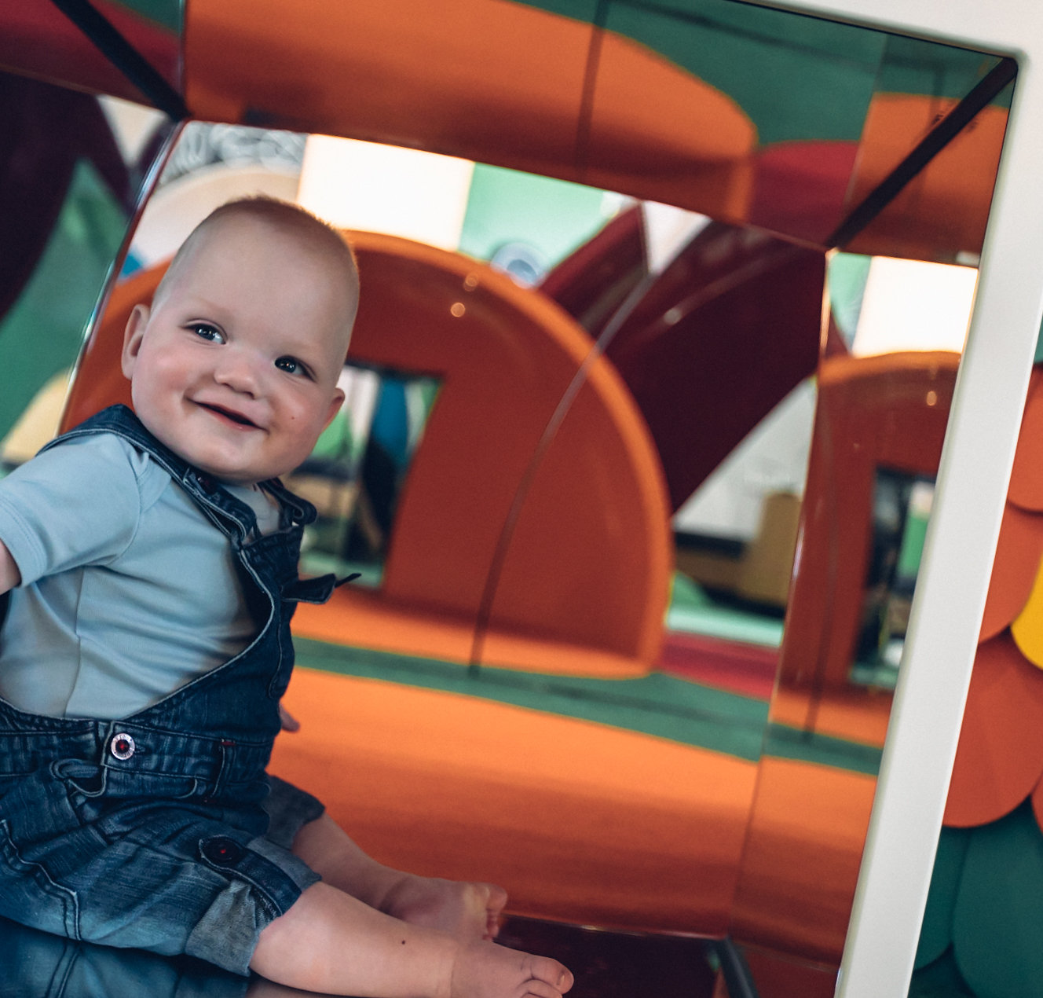
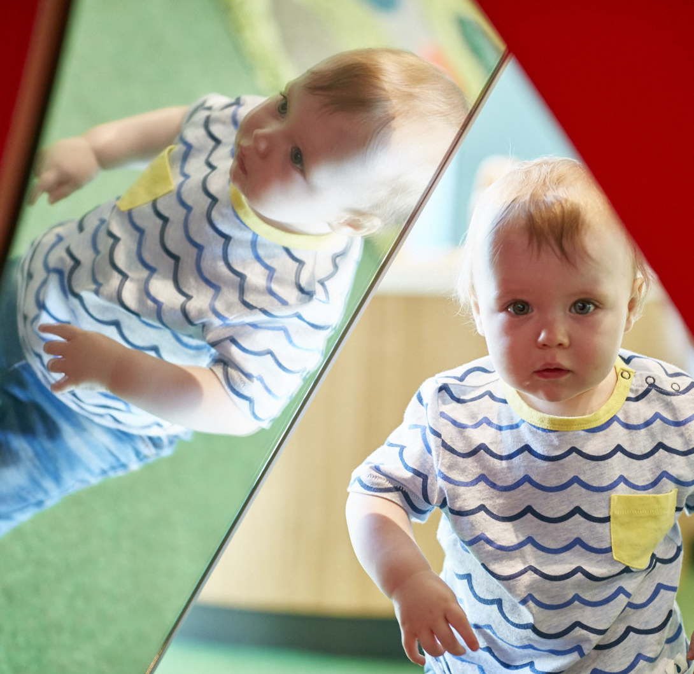
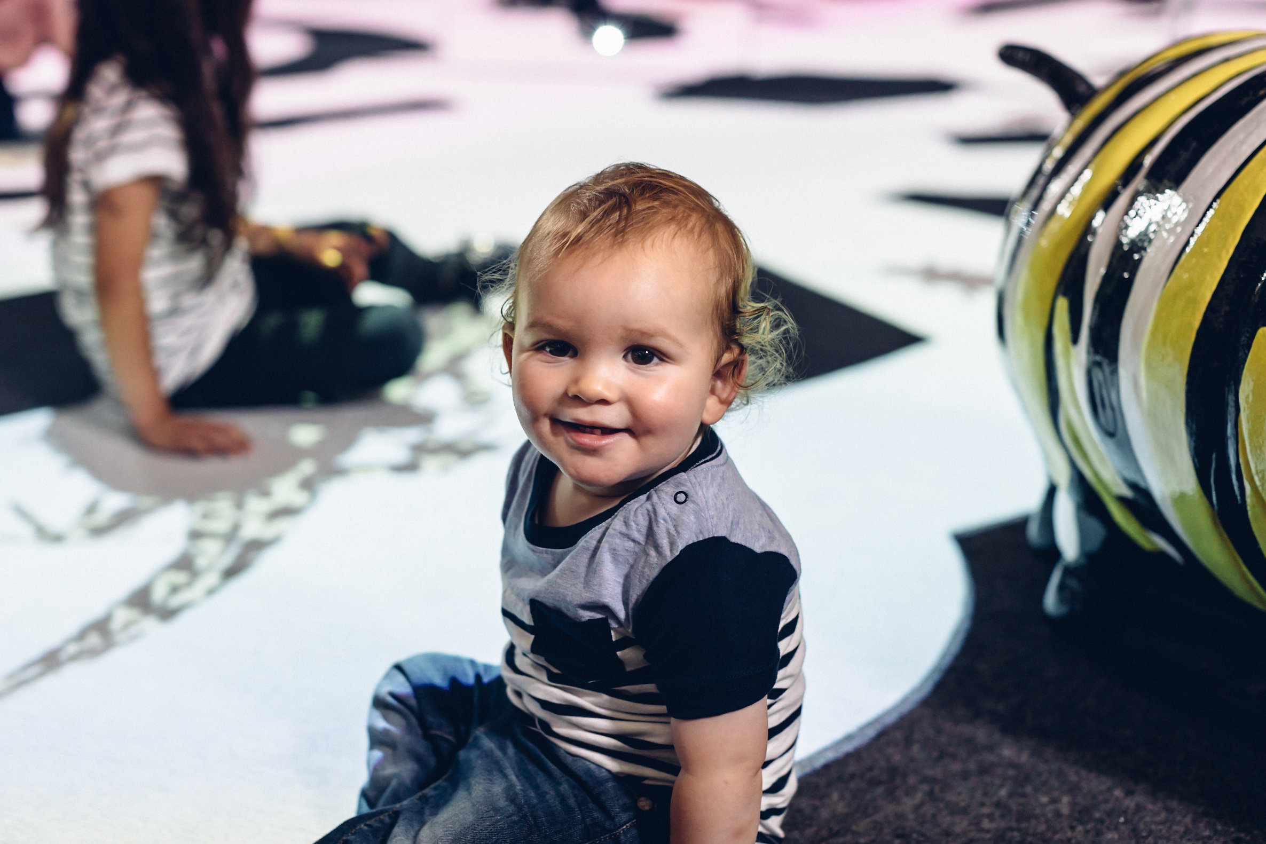
The Museum Generation
To celebrate the brand new Pauline Gandel Children's Gallery at Melbourne Museum and to congratulate a new generation of children to our museums, Museums Victoria will be giving every baby born, fostered or adopted in Victoria in 2017 a free six-month Museums Victoria Membership.

Slide 8
The Museum Generation
Memberships will be distributed at the eight-week visit to the maternal child health nurse beginning in 2017.
We want to provide easy accessibility to the gallery for all new families
To date there have been 625 memberships redeemed
Couldn’t do this without the help of Maternal Child Health nurses
For more information please see our frequently asked questions or call 13 11 02.

Slide 9
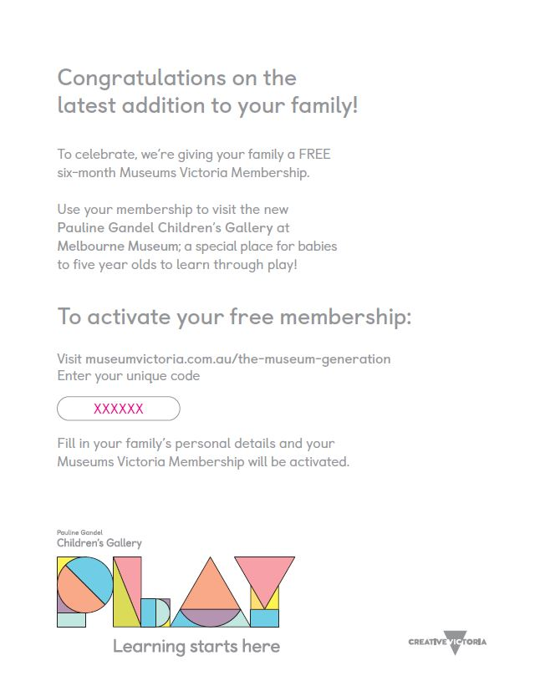

Slide 10
