Slide 1
Respect Victoria
Victoria's first agency dedicated to the prevention of
family violence and all forms of violence against women
September 2018

Slide 2


Introduction to Respect Victoria
  Respect Victoria focusses on the primary prevention of family violence for all Victorians. That means stopping violence before it starts, by changing the culture that allows it to happen
  We are the only Victorian organisation dedicated to the primary prevention of all forms of family violence
  We are being established under the Prevention of Family Violence Bill (2018) to:
      Fulfil Recommendation 188 of the Royal Commission into Family Violence
      Deliver on commitments in Free from Violence (Victoria’s strategy to prevent family violence and all forms of violence against women)

Slide 3
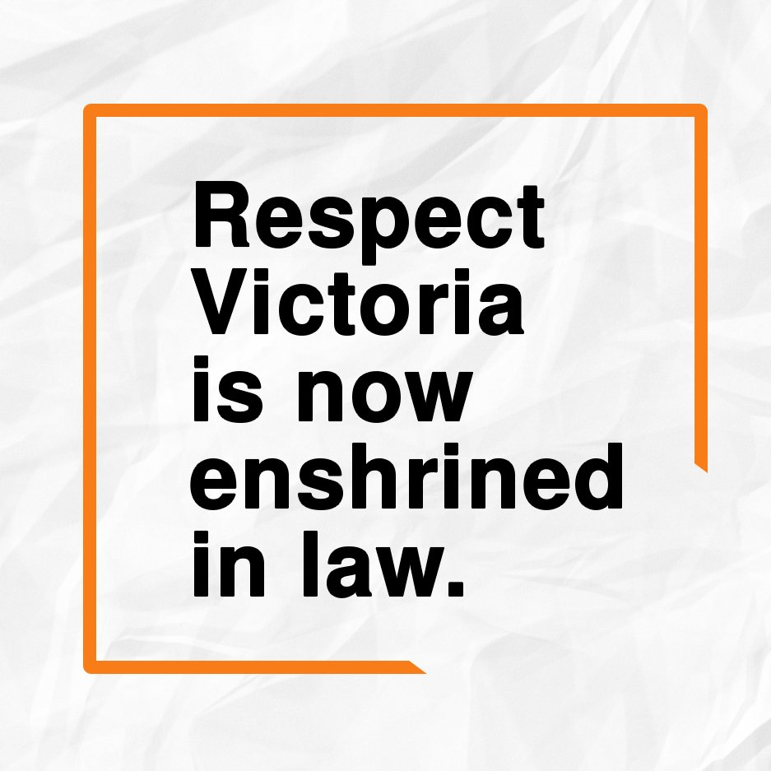
Passage of Legislation
Respect Victoria is now enshrined in law
Doors to Respect Victoria opened on
1 August 2018
Bill passed the Legislative Assembly on
9 August 2018
Bill passed the Legislative Council on
23 August 2018
The Legislative Assembly agreed to amendments made by the Legislative Council on 5 September 2018 effectively enshrining Respect Victoria in law as a Statutory Authority

Slide 4
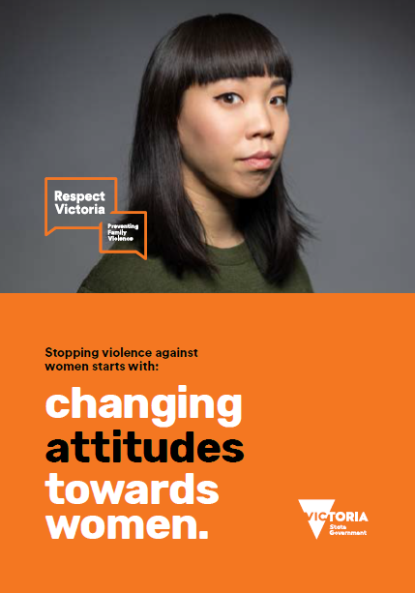
Transition to Statutory Authority
Papers for the Governor in Council are currently being finalised
Board members will be appointed by Governor in Council on the recommendation of the Minister
It is envisaged that Respect Victoria
will be a fully functioning Statutory Authority by 4 October 2018

Slide 5
Respect Victoria’s Mandate
Respect Victoria will address all forms of family violence, working across the whole community and with new strategic partners, in a range of settings in which Victorians live, work, learn play and engage
Legislation outlines the governance and responsibilities of the Statutory Authority
Establishing Respect Victoria as a Statutory Authority will fulfil Recommendation 188 of the Royal Commission into Family Violence
It will also deliver on two of the five pillars outlined in Free From Violence: Victoria’s Strategy To Prevent Family Violence And All Forms Of Violence Against Women:
      Engage and communicate with the community
      Research and evaluate

Slide 6
What Does It Mean To Become a Statutory Authority?
  Responds to Recommendation 188 of the Royal Commission into Family Violence
  As a Statutory Authority, Respect Victoria will:
      be impartial and independent
      advocate and lobby to and with government on behalf of all Victorians
      establish formal and informal alliances and partnerships with government and non-government organisations, working towards a Victoria free from violence
      remain core business of government – its work will be enduring

Slide 7
Who We Are – Advisory Board & Executive
Respect Victoria is led by an Advisory Board of eight Directors, including a Chair, and the CEO
Membership of the Advisory Board is skills-based and drawn from diverse sectors, including prevention of family violence, communications, cultural diversity, law, primary health, financial management, risk management and governance
Membership:
      Melanie Eagle (Chair)
      Andi Diamond, Kate Fitz-Gibbon, Rod Jackson, Emily Maguire,
      Julia Mason, Steve Walsh,
      Victim Survivors Advisory Council member (to be appointed)

Slide 8
Who We Are – Management Team
RESPECT VICTORIA
Chief Executive Officer
TRACEY GAUDRY
Executive Assistant
FELICITY CARROLL
OPERATIONS
Manager
AMY PRENDERGAST
RESEARCH
Manager
STEFANI COOPER
COMMUNICATIONS
Manager
JULIA KNIGHT
Principal Legal Adviser
SARAH MASTERS
Senior Advisor
Operations & HR
KELLY JOHNSON
Senior Adviser
Research & Evaluation
LAURA WOOD
Senior Communications
Advisor
LUKE BUTLER
Senior Advisor
Board Governance
SARAH PISANI
Project Officer
MARIE NEDELKOVA
SHARED SERVICES FROM DHHS

Slide 9
Function and Purpose
Respect Victoria will be a dedicated agency focused on addressing all forms of family violence, rather than focussing specifically on men’s violence against women and their children and/or broader health promotion
The organisation will work to prevent family violence against
women, men, children and young people, people with a disability, Aboriginal peoples, older people, people with diverse gender and sexual identities, and
people from diverse cultural backgrounds, through driving
high-quality evidence and communicating these with
government, community and organisations
It will do this through two of the five pillars outlined in Free From Violence:
      engage and communicate with the community
      research and evaluate

Slide 10
Key Priorities – Communicate
Respect Victoria will transform and lead high quality communications,
to improve the way government, organisations and the community
work to prevent family violence
Immediate awareness and behaviour change campaigns include:
  State-wide mass campaigns:
      Respect Women - Call it Out
      LGBTI
      Aboriginal
      Elder abuse
      Victoria Against Violence (working with Office for Women)

Slide 11
Key Priorities – Engage
Respect Victoria will work with partners across a range of settings including rural and regional Victoria, education and care settings, workplaces, community organisations, faith-based and cultural organisations, sport,
the arts and media
This approach will ensure quality primary prevention programming
becomes part of core business in government, sectors, non-government and the private sectors, and that civil society takes greater responsibility
for the prevention of family violence, including increasing positive
bystander behaviour in the face of sexism and all forms of discrimination

Slide 12

Key Priorities – Research and Evaluation
Respect Victoria will build on Victoria’s
prevention activity into world leading practice, providing high-quality research and evaluation
It will do this by:
      Developing a draft strategic short, medium and long-term research and evaluation agenda based on identified gaps in the evidence base including prevalence, drivers, contributing factors and quality programming evaluation
      Establishing a research alliance and partnerships with primary prevention organisations to inform the development of an evidence and research framework

Slide 13
Respect Victoria
Discussion

