Slide 1
Local Government Public Health and Wellbeing Planning
Briefing for Executive and Councillors
2021
Notes:
This presentation has been developed by the MAV to provide a resource for local government officers with responsibilities including public health planning to engage with Council’s executive and councillors about the legislative and community responsibilities of council for planning for the health and wellbeing of the local community.
As such, the resource can be tailored to suit local data and needs analysis as well as local partnerships and collaborative forums.
Local government has a natural constituency – the residents, businesses, services, and visitors within our municipalities are our focus.
This population focus and councils’ ability to shape services to meet local needs makes local government the natural leader in the endeavour to enhance the health and wellbeing of our communities.
Councils also influence the social determinants of health with activity and engagement in economic development, environment and social development
as well as in infrastructure and town and parks planning and development. Councils are also strong advocates and influencers in tackling health inequalities.
However for maximum impact and effectiveness, council requires partners as many of the levers for change are not within our domain.

Slide 2
Contents
Overview
Legislative context
Requirements
Victorian Public Health & Wellbeing Plan 2019-2023
Focus areas
How councils can influence health and wellbeing
Council strategic planning landscape
Integration with Council Plans
Timelines
Resources

Slide 3
Local Government
Has legislative authority and community responsibility based on an electoral mandate to plan for local areas and ensure community health, wellbeing and development
They do this by addressing the causes of health problems rather than dealing with the symptoms. Helping keeping people well and out of hospitals through immunisation, health inspections and creating healthy environments
Notes:
Councils have legislative authority and community responsibility based on an electoral mandate to plan for local areas and ensure community health, wellbeing and development.
Public Health and Wellbeing Act 2008 (Vic) mandates councils ‘to seek to protect, improve and promote public health and wellbeing within the municipal district’ (s.24)
Local government’s contribution to the promotion, improvement and protection of public health occurs through a myriad of activities including planning processes, environmental monitoring and management, health promotion activities and more traditional public health concerns such as waste management, prevention of infectious diseases, food safety and monitoring drinking water quality. For example last year local government performed
606,800 maternal and child health consultations
306,600 immunisations to preschool and secondary school aged children
50,000 food premises registered

Slide 4
The Act
Authorised Version No. 047
Public Health and Wellbeing Act 2008
No. 46 of 2008
Authorised Version incorporating amendments as at
9 December 2020 Division 3—Councils
Function of Councils
Secretary may require report from Council
Municipal public health and wellbeing plans
Inclusion of public health and wellbeing matters in Council Plan or Strategic Plan
Special powers of Secretary in a state of emergency
Notes:
The function of a Council under this Act is to seek
to protect, improve and promote public health and
wellbeing within the municipal district by—
(a) creating an environment which supports the health of members of the local community and strengthens the capacity of the
community and individuals to achieve better health;
(b) initiating, supporting and managing public health planning processes at the local government level;
(c) developing and implementing public health policies and programs within the municipal district;
(d) developing and enforcing up-to-date public health standards and intervening if the health of people within the municipal district is affected;
(e) facilitating and supporting local agencies whose work has an impact on public health and wellbeing to improve public health and
wellbeing in the local community;
(f) co-ordinating and providing immunisation services to children living or being educated within the municipal district;
(g) ensuring that the municipal district is maintained in a clean and sanitary condition.

Slide 5
Public Health and Wellbeing Act Objectives
protecting public health and preventing disease, illness, injury, disability or premature death
promoting conditions in which persons can be healthy
reducing inequalities in the state of public health and wellbeing

Slide 6
Challenges
Common challenges to our good health:
preventable diseases are on the rise
the population is growing
the population is ageing
our lifestyles are changing
our world is changing
Some population groups have significantly worse health outcomes than others
Notes:
Healthy behaviours and living conditions are especially important to keep us free of chronic diseases such as anxiety, depression, cancer, heart disease and stroke. These diseases are among the leading causes of poor health and premature death in Victoria, as in other western countries.
Local Government’s role is in keeping people well.
25% of children are overweight or obese, a significant increase from 5 per cent in the 1960s (Preventative Health Taskforce 2008).
Almost half of Victorian adults are overweight or obese (VPHS, 2010).
The prevalence of type 2 diabetes increased from 3.3 per cent in 2003 to 4.8 per cent in 2008, a statistically significant increase, consistent with obesity trend
One third of the working population retires prematurely due to ill-health
LOCAL DATA / ISSUES

Slide 7
A municipal public health and wellbeing plan must
Be prepared within 12 months of the council election
Examine data about local health status and health determinants
Identify strategies based on evidence for creating maximum health and wellbeing
Involve local community in the development and evaluation of the plan
Specify how council will work with Department of Health and Human Services and other agencies
Be consistent with council plan and municipal strategic statement
Have regard to the Victorian Health and Wellbeing Plan
Notes:
Unless section 27 applies, a Council must, in consultation with the Secretary, prepare a municipal public health and wellbeing plan within the period of 12 months after each general election of the Council.
(2) A municipal public health and wellbeing plan must—
include an examination of data about health status and health determinants in the municipal district;
(b) identify goals and strategies based on available evidence for creating a local community in which people can achieve maximum health and wellbeing;
(ba) specify measures to prevent family violence and respond to the needs of victims of family violence in the local community;
(c) provide for the involvement of people in the local community in the development, implementation and evaluation of the public health and wellbeing plan;
(d) specify how the Council will work in partnership with the Department and other agencies undertaking public health initiatives, projects and programs to accomplish the goals and strategies identified in the public health and wellbeing plan;
(e) be consistent with— (i) the Council Plan prepared under section 90 of the Local Government Act 2020; and
(ii) the municipal strategic statement prepared under section 12A of the Planning and Environment Act 1987.
(3) In preparing a municipal public health and wellbeing plan, a Council must have regard to the State Public Health and Wellbeing Plan prepared under section 49.
(4) A Council must review its municipal public health and wellbeing plan annually and, if appropriate, amend the municipal public health and wellbeing plan.
(4A) An annual review must include a review of the measures referred to in subsection (2)(ba)
(6) A Council must give a copy of the current municipal public health and wellbeing plan to the Secretary.

Slide 8
Plans must have regard to State Priorities
Notes:
Having regard to State priorities doesn’t mean that councils have to address all of them.

Slide 9
Plans must have regard to State Priorities
Notes:
The 2019-2023 Victorian State Health Plan identified 10 priority areas, all of which are included above. The State Health Plan also highlights four focus areas, these are ‘tackling climate change and its impacts on health’; ‘increasing healthy eating’; ‘increasing active living’, ‘reducing tobacco-related harm’. Councils are encouraged to address each of these in their MPHWPs. The following slides provide an overview of each focus area.

Slide 10
Tackling climate change and its impacts on health
Councils are well placed to take actions to mitigate and adapt to climate change and its impacts on health at the local level
We are already seeing direct and indirect health and wellbeing impacts associated with floods, fires and heatwaves
Under Climate Change Act 2017 local government must consider climate change in MPHWPs
DHHS has developed a resource to assist councils to meet their legislative obligations
Notes:
In Victoria the impacts of climate change are already being felt and are expected to increase.
DELWP’s Victorian Climate Science Report 2019 found by the 2050s in Victoria, we can expect to see:
an average annual temperature increase of up to 2.4C
Double the number of very hot days
Longer fire seasons with up to 60% more very high fire danger days
Sea levels will rise by around 24cm
More intense downpours, decline in cool season rainfall
Decline in alpine snowfall of 35-75%
There are also a multitude of co-benefits that can be gained by addressing climate change and encouraging healthy lifestyles

Slide 11
Increasing healthy eating
Local government has the ability to increase healthy eating through its role as an employer, planner, and the through delivery of key services
Actions to increase healthy eating include:
Embedding healthy food and drink supply and promotion within LG facilities
Implement initiatives supporting healthy eating across the life span
Programs supporting councils to achieve these outcomes:
Healthy Eating Advisory Service (Workplace, services and facilities)
Achievement Program (Workplaces, services, facilities)
INFANT Program (delivered through MCH service)

Slide 12
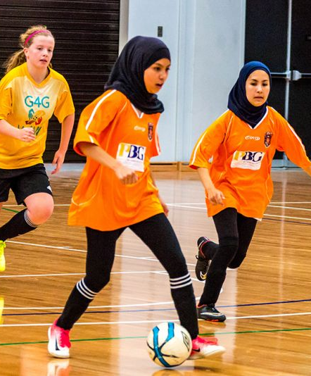
Increasing active living
Local government work to increase levels of physical activity in their communities. Some key actions include:
Plan and develop neighbourhoods to support active lifestyles
Ensuring options for physical activity that are accessible, inclusive and safe
Notes:
The MAV is working with councils to increase the uptake of active transport options such as walking and cycling. You can access the MAV Walking and Bike Riding Hub to view webinars, case studies and more: https://www.mav.asn.au/what-we-do/policy-advocacy/transport-infrastructure/walking-and-bike-riding-resource-hub

Slide 13
Reducing tobacco-related harm
Local government takes several evidence-based actions to reduce tobacco-related harm including:
educating businesses and the community about their obligations under the Tobacco Act 1987
monitoring compliance and taking enforcement action where necessary
respond to complaints in relation to the Tobacco Act 1987
participating in the Cigarette Sales to Minors Program and conduct test purchases with young people to ensure compliance with the Tobacco Act 1987

Slide 14
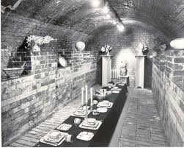
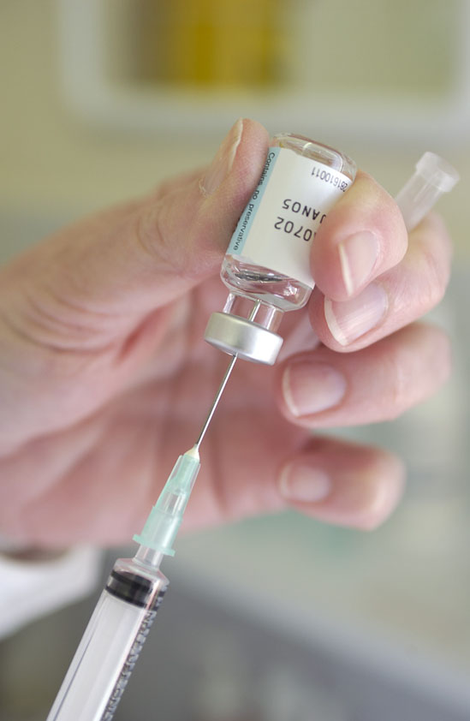
Local Government CAN influence the health and wellbeing of communities
Early 20th Century
Parks and playgrounds
Maternal and Child Health
Immunisation
Food Regulation
Residential Zones
Late 20 Century to now
Healthy Cities
Health Promotion
Preventative focus
Climate change and health
19th Century
Drains
Sewers
Building regulations
Notes:
Local governments’ role in public health progressed from sewers and drains (Melbourne sewers in 1897. From ‘Smell boom’ to dramatic falls in mortality rates, and reduction or elimination of diseases like typhoid and diphtheria)
Through to Building regulations to stop we overcrowding in slums, fresh air and light and
Parks and playgrounds. Zoning to separate residential areas from industrial – reduce noise and noxious fumes
Maternal and Child health –commenced in 1917 in Richmond and
Immunisation – 1920s
Later – WHO Declaration of Alma Alta 1978 –Ottowa Health Promotion Charter 1986, Healthy Cities
Shifting emphasis from protection and prevention to promotion, addressing social determinants
Vic Gov and MAV Environments for Health framework

Slide 15
Council CAN influence the health and wellbeing of communities
Dimensions of Health | Components | Council Action Area Examples
Built/Physical | Provision of infrastructure Amenities: parks, street lighting, roads, footpaths | Land use planning Transport and traffic management Recreation facilities
Social | Sense of community Participation Perceptions of safety | Community support Art and cultural development Library services
Economic | Economic policy Industrial development Employment | Community economic development Access and equity
Natural | Geography Air & water quality Native vegetation | Water quality Waste management Energy consumption
Adapted from Environments for Health – Department of Human Services Victoria
Notes:
From Leading the Way
Identifying areas in which council can influence health and wellbeing will depend on the population make-up of the community and its priorities, but will involve the following
Altering our surroundings – through building, parks and facilities, roads, paths and other infrastructure.
Creating Opportunities for people to participate in the life of the community
Encouraging economic development and distributing our wealth
Looking after our natural environment so that it continues to nurture us.

Slide 16
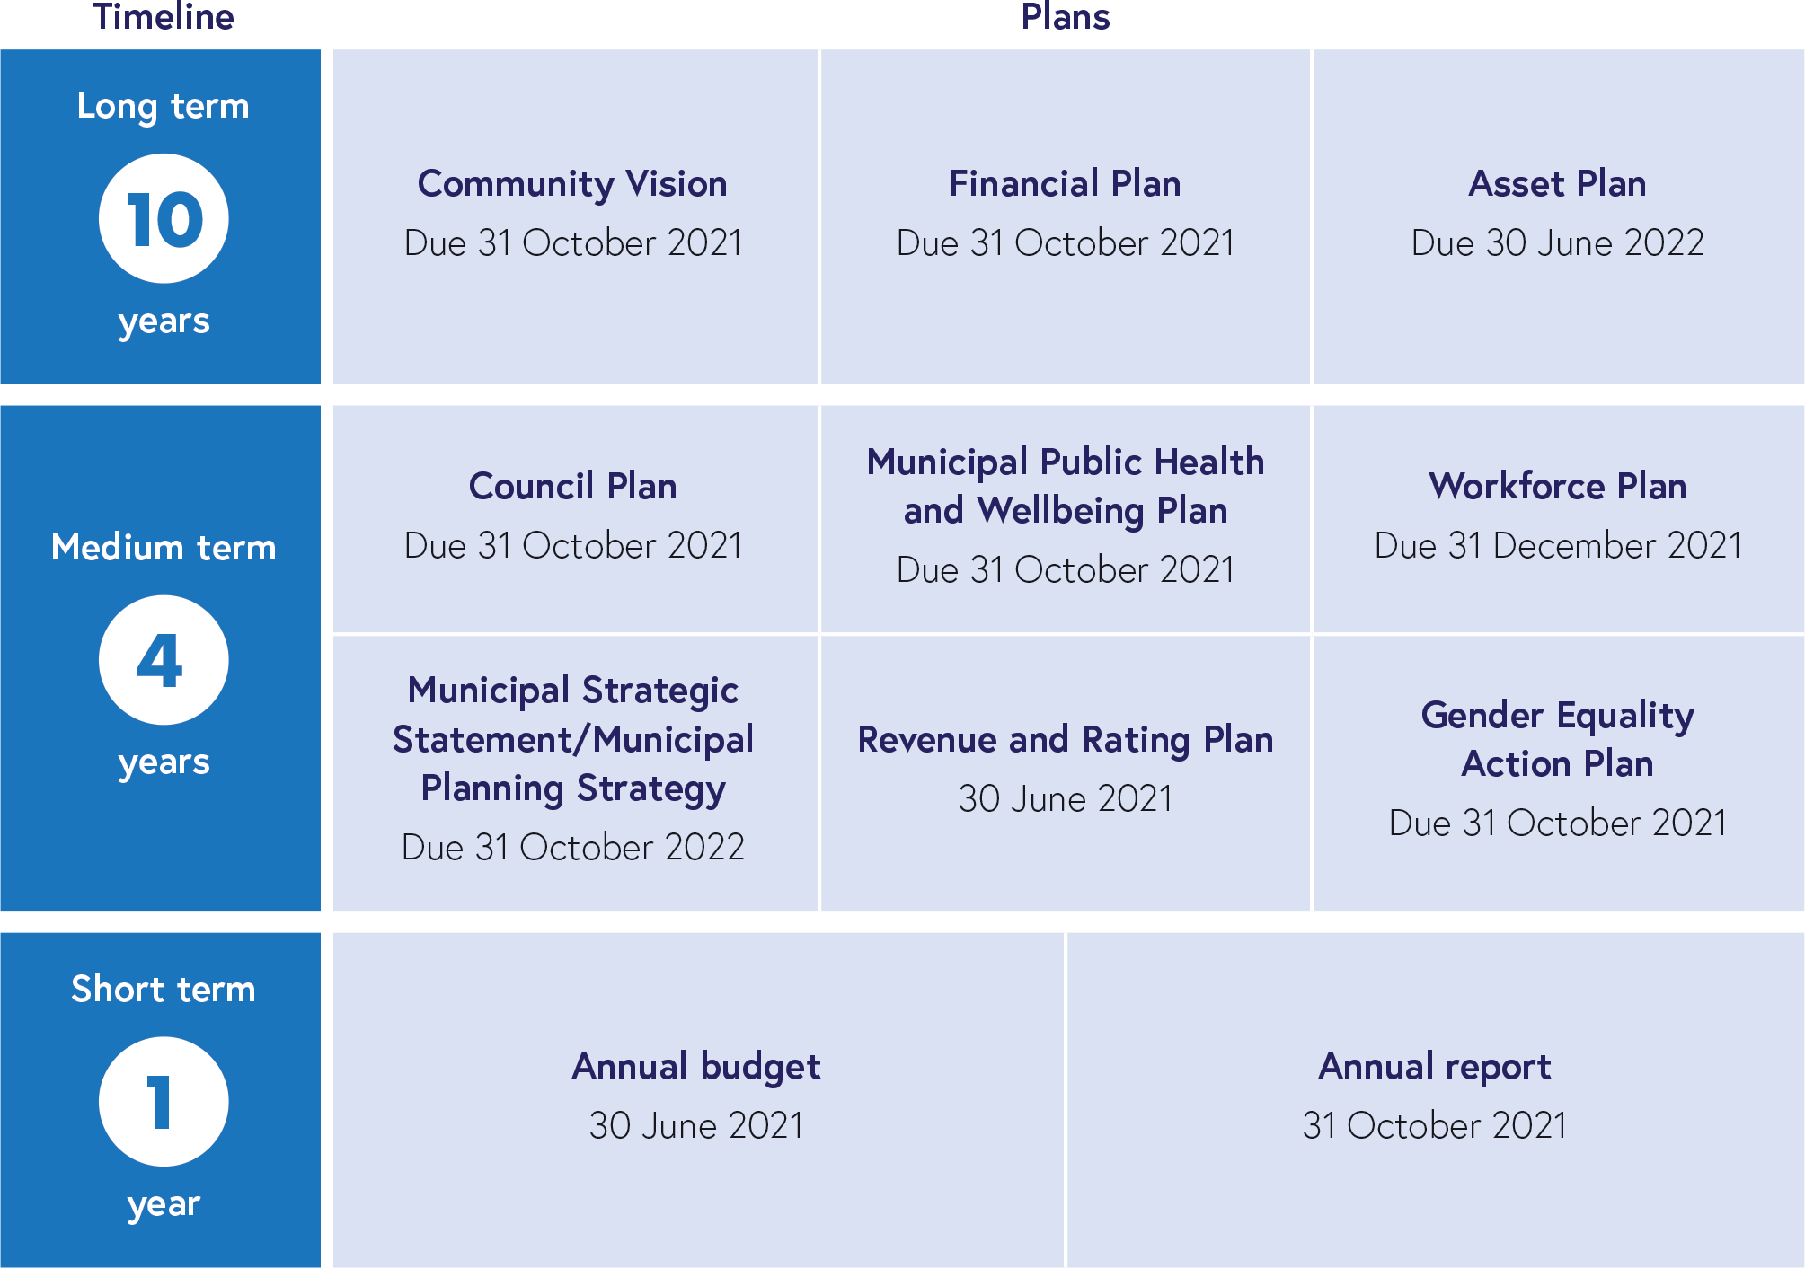
Council planning landscape
Notes:
This typology illustrates the strategic planning landscape that councils are now expected to operate in (as at 2021).
There have been a number of changes to councils’ legislative responsibilities regarding strategic planning in the last two years. A number of these are due to the introduction of the Local Government Act 2020 which outlines five key council strategic documents.
These are the:
Community Vision (10 years)
Council Plan (4 years)
Financial Plan (10 years)
Asset Plan (10 years)
Revenue and Rating Plan (4 years).
While many councils have previously developed plans and documents similar to those outlined in the LG Act, there is now a legislative requirement for all councils to do so. Councils must also undertake an integrated approach to planning and monitoring and reporting on these plans.
In 2022 councils will transition from Municipal Strategic Planning Strategies to developing Municipal Planning Strategies, these documents must be consistent with MPHWP.
In addition to the LG Act, the Gender Equality Act 2020 requires all councils to develop a Gender Equality Action Plan.

Slide 17
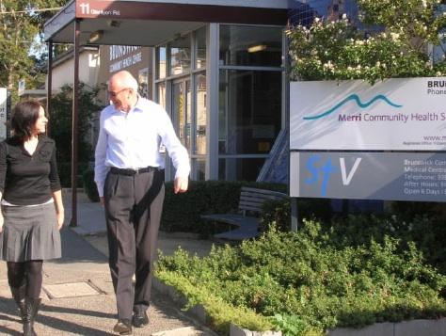
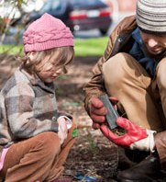
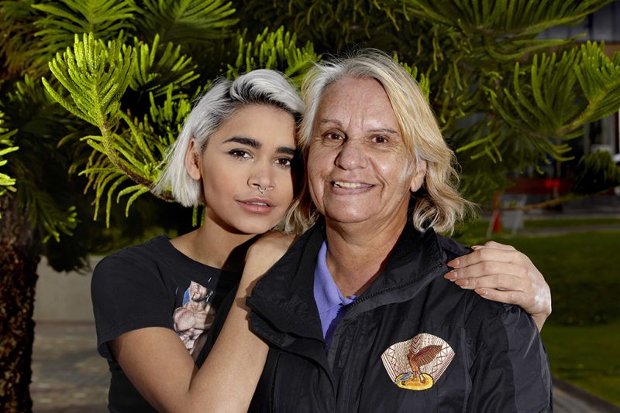
Partnerships & collaboration
Many of the goals of municipal public health plans can only be realised through collaboration between local stakeholders. Councils can play a variety of roles in partnerships, including:
Leaders
Collaborators
Planners
Providers
Advocates
Notes:
Local government has the authority and responsibility for public health leadership, including creating a vision and goals, promoting partnerships and integrated planning, supporting active community participation and community development principles, advocating for local needs, establishing structures for corporate cooperation and facilitating change.
Partnerships and collaboration are central to all local government work.
Partnerships and the role councils can play within them are varied.
They can include:
• Leader – Identify key community issues and mobilise groups and interested parties to work together
• Collaborator – Support and partner with the community, private and government organisations to deliver initiatives for the community
• Planner – Undertake research and consultation and develop strategies to address identified challenges or issues
• Provider – Deliver a range of infrastructure, services, facilities and programs that meet the needs of the community
• Advocate – Advocate on behalf of the community to decision makers to achieve the best possible outcomes for community
(Brimbank Community Vision Collaboration 2018-2021 Document)
Partners can include:
Community Health Services
Local clubs and community groups
State Government
Academic institutions & schools
Other councils
Victoria Police
NGOs

Slide 18
Including family violence measures in municipal public health and wellbeing plans
Following the Royal Commission into Family Violence, the Public Health and Wellbeing Act 2008, was amended to require councils to specify measures to prevent family violence
Councils are required to provide the Secretary of DHHS with information regarding these measures every two years
The MAV and DHHS developed the guidance Family violence and municipal public health and wellbeing planning, and the advice note;
Reporting on family violence measures in municipal public health and wellbeing plans (2019)
Notes:
Councils can demonstrate commitment and lead change by taking action to support the development and coordination of local strategies and initiatives with community partners and within their organisation.
Following the Royal Commission into Family Violence, the Public Health and Wellbeing Act 2008, in accordance with Recommendation 94 of the Royal Commission, was amended to require councils to specify measures to prevent family violence and respond to the needs of victims of family violence in the community in preparing public health and wellbeing plans.
This amendment also requires councils to provide the Secretary to the Department of Health and Human Services with information regarding these measures at key intervals during the four year lifetime of their plans [(Section.26 (6A)].
Councils’ role in preventing family violence spans

Slide 19
Including health and wellbeing matters in Council Plans
Under the Local Government Act 2020, MPHWPs can be incorporated into Council Plans
It is important to note that there is no longer a 4-month period between the due date for the Council Plan and MPHWP
Both are now due in October 2021, in addition to the 10-year Community Vision
Integrated plans must be provided to DHHS who will determine whether the integrated plan meets the requirements of the Public Health and Wellbeing Act 2008
Notes:
There can be pros and cons when it comes to integrating MPHWPs into Council Plans. Integration can lead to MPHWPs having a higher profile within councils and ensure that broader council strategic decisions are made with consideration of the priorities of the MPHWPs. Integration means that plans are subject to greater scrutiny prior to submission to DHHS (as per the Act). Integration can also limit line of sight for partners and key stakeholders.

Slide 20
Alignment of state and municipal public health and wellbeing planning
October 2020
Local government elections
October 2024
Local government elections
October 2021
Council plans
October 2025 Council plans
October 2021
MPHWPs
October 2025
MPHWPs
2018
2019
2020
2021
2022
2023
2024
2025
September 2019
Victorian Public Health and Wellbeing Plan
September 2023
Victorian Public Health and Wellbeing Plan
November 2018
Victorian government election
November 2022
Victorian government election
Notes:
The planning timeline is outlined above.

Slide 21
Previous plans
The MAV website hosts a list of all MPHWPs from the 2017-2021 cycle.
You can access them here.

Slide 22
Resources
DHHS - Guide to municipal public health & wellbeing planning (2013)
DHHS – Health Protection and Municipal Public Health and Wellbeing Plans Guidance (2020)
DHHS - Practical guide to conducting annual reviews of municipal public health & wellbeing plans (2012)
VicHealth Local Government Action Guides

Slide 23
Further resources
Healthy Eating Advisory Service
MAV Walking and Bike Riding Hub
Achievement Program
VicHealth Coronavirus Impact Survey Report

