Slide 1




CDIS User Groups
August 2025
CDIS User Group – August 2025

Slide 2

Agenda
BF changes (slides from DH)
Recording GP on CDIS
Groups FAQ
Birth Notices
Adoption/Surrogacy
Phone numbers
Cancelling Appointments
CDIS Support
Questions
CDIS User Group – Aug 2025

Slide 3
Breastfeeding Data Update – effective Aug 1st, 2025
The following was distributed together with the July 2025 MCH Newsletter:
Infant and Child Feeding Practice Note
Breastfeeding Changes Factsheet
The recording of the BF session is available MCH Clinical Practice Videos | MAV website
Password – mchvideos
The slides from the BF session
As part of the MCH System Replacement Project, the information we collect about infant and child
feeding will be redesigned with input from the MCH workforce. A survey will be circulated too the
sector in the August MCH newsletter.
CDIS User Group – Aug 2025

Slide 4
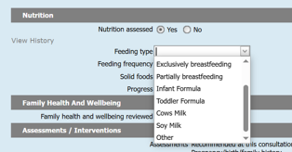
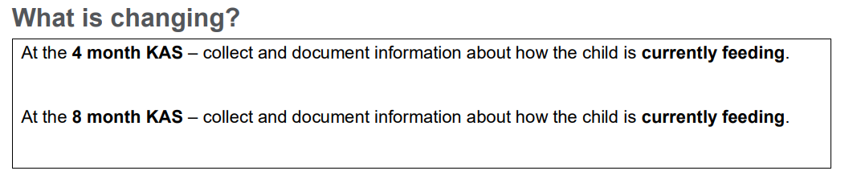
Breast Feeding Data Update
Removal of Predominantly BF option in drop down box
Recording of BF data
CDIS User Group – Aug 2025

Slide 5
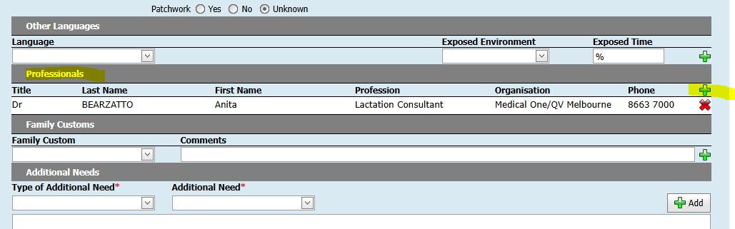
Linking Professionals to CDIS record
Please use the Professionals tab using generic (organisation) or add the GP details to the page (summary screen)
This clarification has been requested in response to the Parent, carer and family active engagement practice note regarding communication with GP
CDIS User Group – Aug 2025
Notes:
use Generic or Service Providers, or GP Professionals, to record information as needed in line with guidelines and how the councils wish to operate. highlighted that the conversation with the caregiver can be challenging, and the information may not be relevant after the next visit. Kylie mentioned their service uses External referrals and Anthea mentioned the advice keeps changing. The issues are the display of info on the front screen (summary screen) and ensuring the conversation is attempted and recorded as per the guidelines.

Slide 6
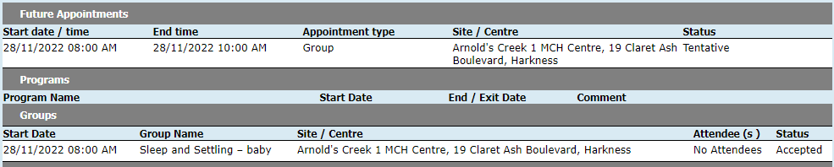
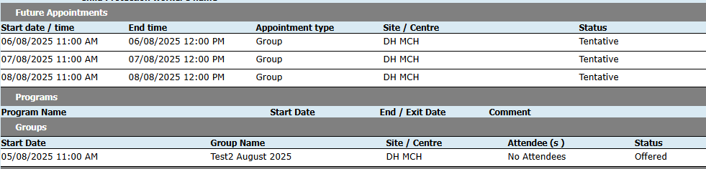
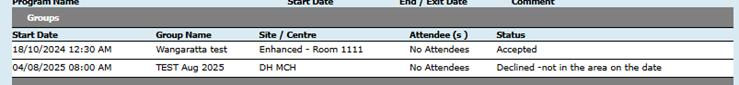
Groups FAQ
Where can I see a clients group details?
Groups appear on the Client Summary page, whether accepted, offered or declined, including any reasons recorded for declining.
Accepted
Offered
Declined
CDIS User Group – Aug 2025

Slide 7
Groups FAQ
Why is my facilitator not able to be booked for a group?
Your facilitator is already booked for another group session or scheduled in the calendar for a client or non-client appointment at the time the group is scheduled.
Why can’t I record outcomes for attendees in the group (no box)?
Attendees need to be added to the group prior to the date the group commences.
CDIS User Group – Aug 2025

Slide 8
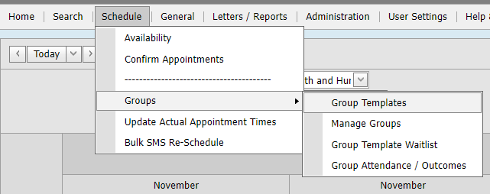
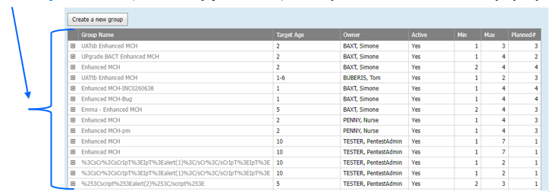
Groups FAQ
Why do I have so many groups listed?
A Group Template can be hidden and/or made inactive via the 'Group Template' screen:
** Only CDIS Role of System Admin – Council can see and adjust this **
Schedule > Groups > Group Templates
Click a Group Name (it’s a hyperlink) to open the Edit Group popup.
CDIS User Group – Aug 2025

Slide 9
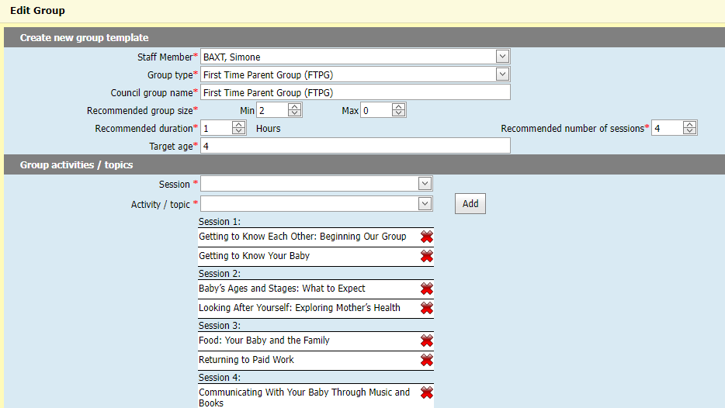
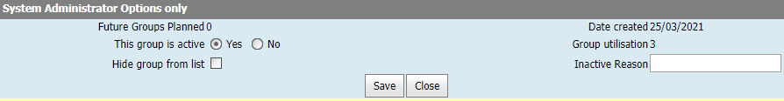
Groups FAQ - Why do I have so many groups listed? Continued.
** Only CDIS Role of System Admin – Council can see and adjust this **
Scroll down to 'System Administrator Options only' section where there are two fields:
- This group is active
- This group is not hidden from the list
***The System Admin – Council role will always see inactive or hidden groups*** The template will be hidden for non-system administrator roles i.e. clinician, clinical coordinator, admin, IT.
CDIS User Group – Aug 2025

Slide 10
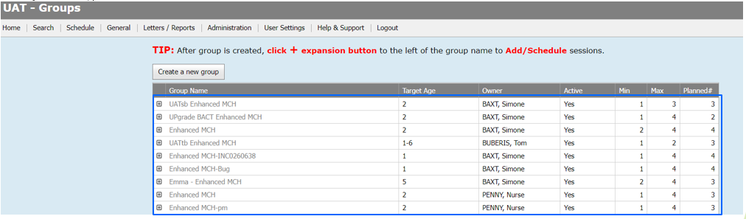
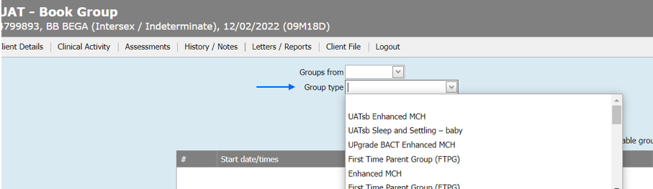
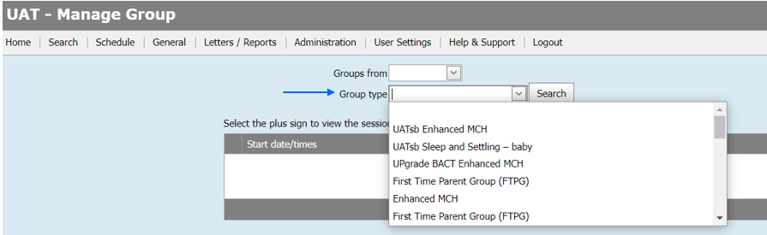
When Groups are hidden, they will not be visible in the following screens*
* for all CDIS roles that are not System Administrator – Council
Group template lists
Client screen group choice
Group management drop down
CDIS User Group – Aug 2025

Slide 11
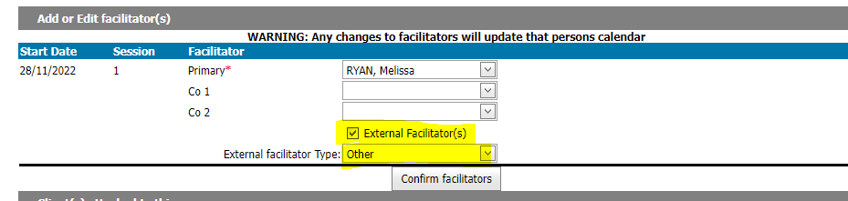
Groups FAQ - Groups offered in partnership with another MCH service, how do I record these?
Create a group as per initial group process set up.
Primary facilitator will need to be filled with your LGA facilitator
You can then tick external facilitator and the appropriate type.
Once you have the data from the external service regarding who has registered and who attends the session, you can add this information to CDIS (Tip – it's easier to only record those who attended the actual session).
You may only be provided with first name, surname and email addresses depending on the booking system used therefore will need to search for client prior to adding.
Add to group from client details. Practice Note
CDIS User Group – Aug 2025

Slide 12
Groups FAQ – How does SMS work for groups?
Group SMS Reminders can be sent from one of 3 ways:
1) From the Bulk SMS Screen. From the Home Page, select menu: General > Bulk SMS
There are 2 templates available for groups, but the recipients are based on the search criteria in this screen which is limited to:
Site
Age range (only in years)
Overdue KAS calculation
Aboriginal and or Torres Strait Islander Status
SMS Templates
Group Waitlist. The SMS message template is:
Hello [RecipientFirstName], your name has been placed on a waiting list for the next Parent Group. We will contact you soon with details. Please call [SitePhoneNumber] if you would like more information. Automated no reply
Manage Group – blank template in PROD by default.
The variables that can be used for both SMS templates are under the SMS Message box:
[RecipientFirstName], [RecipientLastName], [ClientFirstName], [ClientLastName], [AppointmentType], [SitePhoneNumber], [SiteName]
Once send is clicked, the SMS is sent immediately.
CDIS User Group – Aug 2025

Slide 13
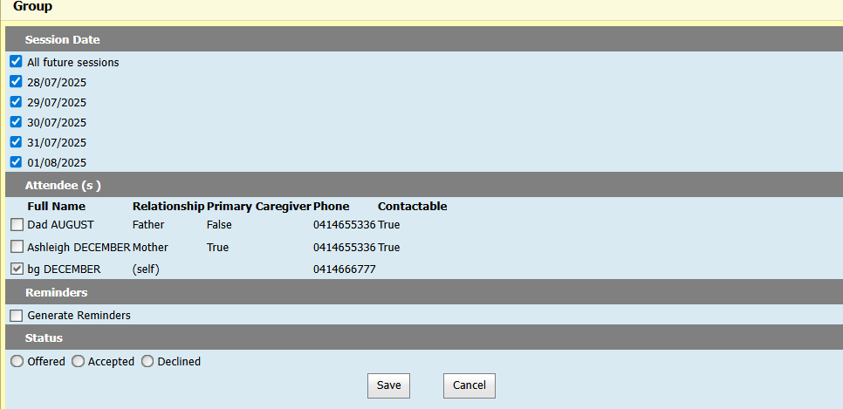
Groups FAQ – How does SMS work for groups?
Group SMS Reminders can be sent from one of 3 ways:
2) When enrolling the client into the group, you can select ‘generate reminders’ which will then list all the contactable caregivers, for you to select, and the override option.
Once you click offered or accepted and save, an SMS is sent immediately.
CDIS User Group – Aug 2025

Slide 14
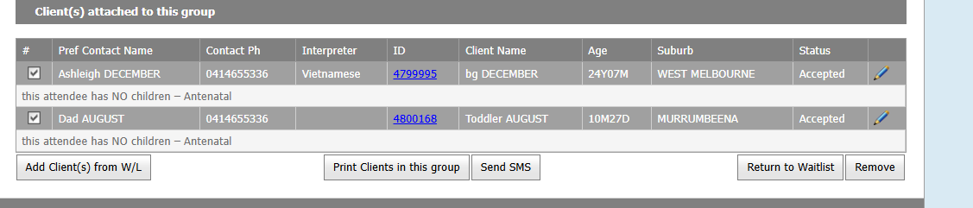
Groups FAQ – How does SMS work for groups?
Group SMS Reminders can be sent from one of 3 ways:
3) From the Manage Group Screen, you can select one or more clients^, then click Send SMS and then choose a template, like in the Bulk SMS screen, however the variables are even more limited:
[RecipientFirstName], [RecipientLastName],
^ If you ticked all the clients, you must select all the caregivers from the one screen.
After you click send, the SMS is sent immediately.
CDIS User Group – Aug 2025

Slide 15
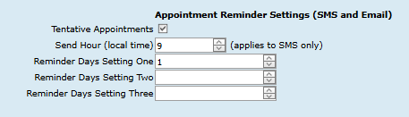
Groups FAQ – How does SMS work for groups?
Group SMS Reminders can be sent from one of 3 ways:
In the three scenarios mentioned on the previous slides, SMS are sent immediately when clicking Send or Save.
A further SMS will be automatically sent each day that there is a group scheduled.
These further SMs reminders are scheduled based the Appointment Reminder Settings of each Service Provider in CDIS:
Send Hour (local time)
Reminder Day Settings
This is because group sessions are also ‘appointments’ and therefore use the same logic and settings for Appointment Reminders.
CDIS User Group – Aug 2025

Slide 16
Groups FAQ
Resources
Please refer to MAV MCH CDIS Education vimeo – CDIS Groups:
https://vimeo.com/706008678
Please refer to Dept Health website MCH/CDIS Practice process:
CDIS Group Processes
CDIS Initial Group Set up Processes
https://www.health.vic.gov.au/maternal-child-health/child-development-information-system?rid=191847
CDIS User Group – Aug 2025

Slide 17
Legislation re Birth Notifications
The Child Wellbeing and Safety Act 2005 sets out requirements regarding the birth notification process. The Act stipulates that the birth notification is to be forwarded by the hospital or, if the birth did not occur in a hospital, the doctor or midwife that cared for the mother at the birth, to the Chief Executive Officer of the council of the district where the mother resides, within 48 hours of the child being born. It is then the responsibility of the Chief Executive Officer to forward the birth notice to the relevant MCH nurse at the MCH centre within that local government, who contacts the mother and invites her and her family to access the MCH Service.
As per MCH Service Guidelines 2021
CDIS User Group – Aug 2025

Slide 18
BN are a legal document that inform MCH services of the birth and birth mother's current address.
MCH services can transfer a CDIS history into their LGA based on the information in BN
Tips when entering a Birth Notice (BN):
If unsure of address and what LGA the street belongs to please use:
https://maps.vec.vic.gov.au/ Know Your Council
This will help you to confirm what address belongs to which LGA.
Please do not enter the birth notice if address not in your LGA.
Contact the hospital and inform them that BN was sent to incorrect LGA.
Contact relevant council and advise of BN to come.
As per Birth Notification Processes located on the MAV Maternal and Child Health Information page. Found via the CDIS Help and Support tab.
CDIS User Group – Aug 2025

Slide 19
We are not receiving Birth Notice (BN) in the time frame required?
Discuss any concerns regarding delays or issues in receiving Birth Notices (BN) with your leadership team and collaborate to develop an appropriate action plan.
It is also recommended to meet or have a conversation with the maternity service to ensure that current processes align with legislative requirements.
CDIS User Group – Aug 2025

Slide 20
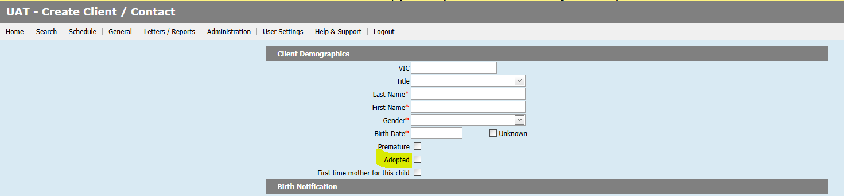
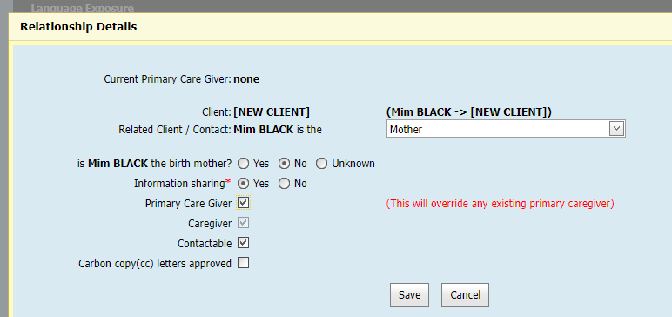
What if the baby is adopted or part of a surrogacy arrangement?
Enter Birth Notice as received. If baby not residing in LGA of birth mother – contact the LGA where baby will live advise and ask them to transfer in the new CDIS record.
Please tick adoption box if relevant in demographic data.
When adding relationships add birth mother, she may already be open if she has other children in the service otherwise open her for service as she may require post natal care and then close when she completes the care.
Then when adding the non biological mother and open for service ensure that you have ticked non birth mother but add as mother:
CDIS User Group – Aug 2025

Slide 21
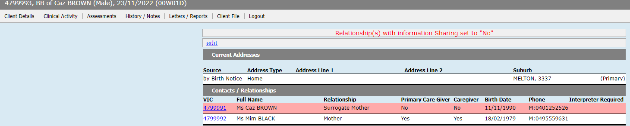
What if the baby is adopted or part of a surrogacy arrangement?
This is how the baby's details will appear:
CDIS User Group – Aug 2025

Slide 22
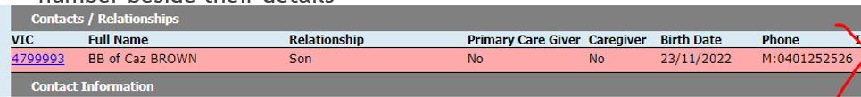
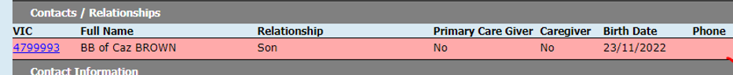

Baby/child should not have a phone number unless migrated data
Please ensure that any baby or child added to CDIS does not have a phone number beside their details
Some children will have contact numbers if the history is migrated.
When you enter a baby's DOB there should be no field to enter phone number.
Please do not enter a phone number as it is unclear which parent or caregiver this number belongs to and is unable to be updated.
CDIS User Group – Aug 2025

Slide 23
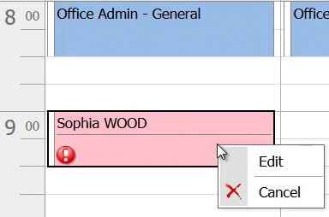
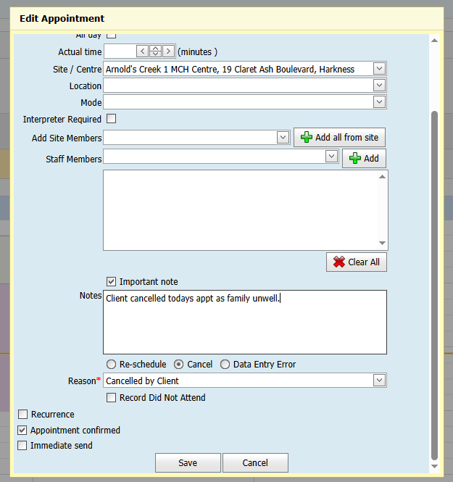
Cancelling appts process
From the calendar screen right click on
the client's appointment and select edit
`
See June 2025 CDIS User Group presentation for best practice of rescheduled, cancelled and DNA appointments
https://www.mav.asn.au/__data/assets/powerpoint_doc/0009/42876/2025-June-CDIS-User-Group-Clinical-and-Admin.pptx
As per CDIS webinar series on Department of Health MCH website:
https://www.health.vic.gov.au/maternal-child-health/child-development-information-system
Webinar 7: https://vimeo.com/432021138 (password cdis)
This note is not recorded in the
Progress notes but remains on the
cancelled appointment notes
and can be viewed in view.
Select Cancel appointment
and select appropriate reason
View on client's summary page
CDIS User Group – Aug 2025

Slide 24
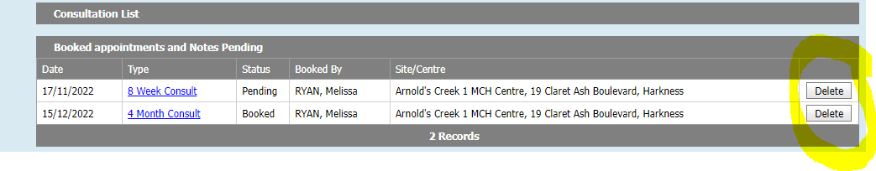
What to do with old appointments in the consult page.
Deleting from the consultation page will not record the missed appointment in the client record or attribute to DNA data.
However, this is a good way to delete appointments from a long time ago or appointments that belong to another MCH service that were not deleted in the transfer.
Add a note if necessary to account for the appointment being cancelled this way.
CDIS User Group – Aug 2025

Slide 25
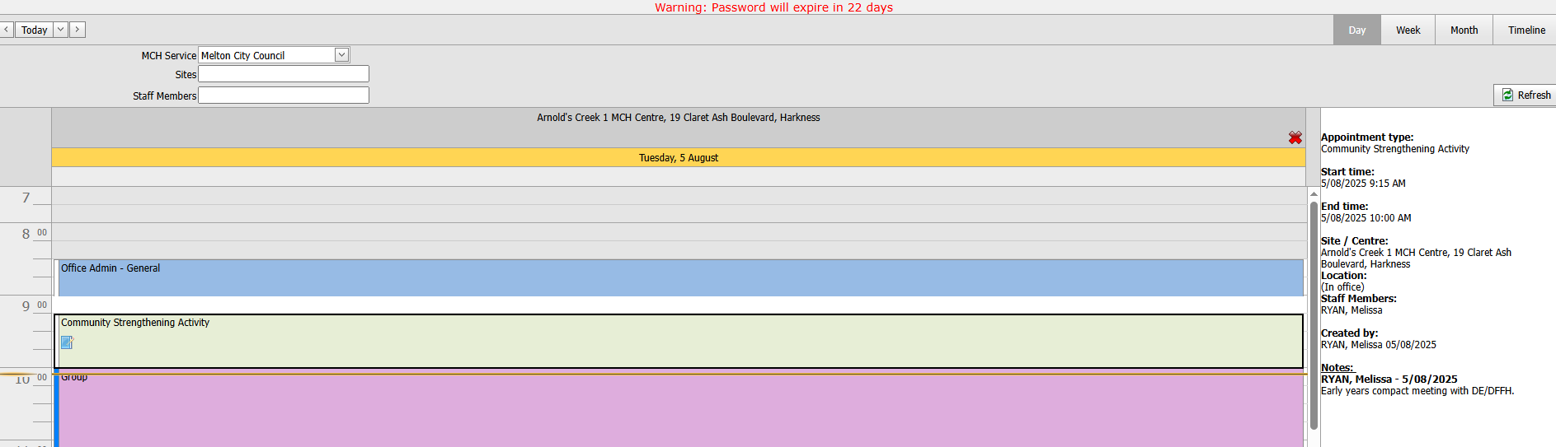
Community Strengthening Activities
Community Strengthening Activities:
From page 16 of the MCH service guidelines 2021.
https://www.health.vic.gov.au/publications/maternal-and-child-health-service-guidelines
A community strengthening activity requires a sustained effort to increase active engagement, collaboration and partnership among community members, groups and organisations. Activities may include health and parenting programs targeting children and families led by other services.
MCH involvement in supported playgroups or engaging families to facilitate place-based and community-led groups are further possibilities within in this area.
Maternal and Child Health Service guidelines
These guidelines inform the maternal and child health framework for Victoria. They identify the relationship between key policy documents that govern the MCH Service.
Please record any community strengthening activities in your calendar for the data to be reflected in MCH annual reports
CDIS User Group – Aug 2025

Slide 26
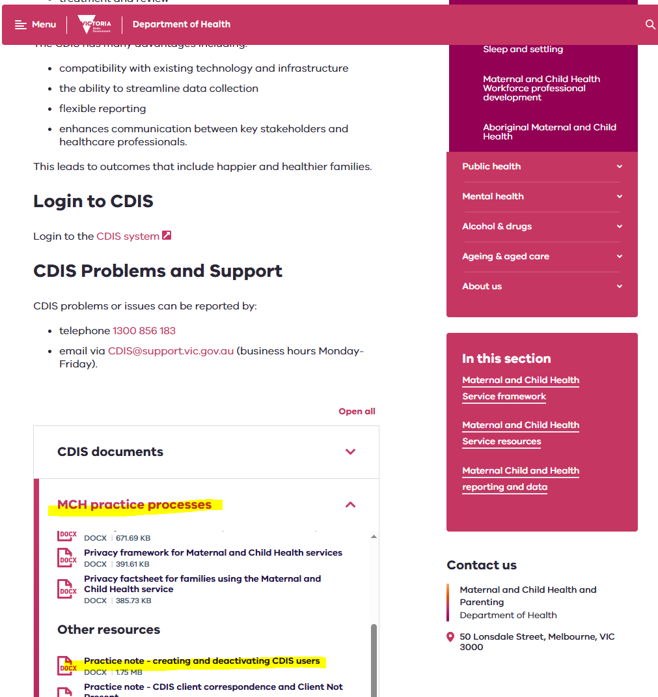
Onboarding and Offboarding team members
It is important for security reasons to periodically review and de-activate staff no longer employed or taking leave. This is done via the Employee Administrations screen.
Menu Administration > Employee Administration.
See Practice Note – Creating & deactivating CDIS Users
https://www.health.vic.gov.au/sites/default/files/2024-11/practice-note-creating-and-deactivating-cdis-users-oct-2024.docx
CDIS User Group – Aug 2025

Slide 27
CDIS Support (continued)
CDIS Support Hours
Monday to Friday between 8:30am to 5:30 pm
Contact
1300 856 183
cdis@support.vic.gov.au
CDIS User Group – Aug 2025

Slide 28




As the CDIS Champion for your MCH service you can access
the PowerPoint presentations on MAV MCH Resource page .
Please use these slide to update and educate your teams.
CDIS User Group – Aug 2025

