Slide 1
Groups FAQ
What do I do if I receive a Birth Notice in Error?
General practice discussion, Q&A
Child Development Information System (CDIS)
CDIS Users Group (Clinical)
Thursday 1st December 2022 8:30 am – 9:30 am

Slide 2
Contents
Tips & Tricks
Groups - FAQ
What to do if I receive a BN in error?
Overdue KAS follow up
2023 CDIS meeting dates (proposed)

Slide 3
Tips and Tricks
When writing a referral letter use the appointment panel on the right of the CDIS screen for the clients details. You can copy and paste demographic details such as Name, Primary carer name, mobile, email and address into the referral letter.
The Orange Door has been added to the Client Not Present Agency options.

Slide 4
Groups FAQ
Resources
Please refer to MAV MCH CDIS Education vimeo – CDIS Groups:
https://vimeo.com/706008678
Please refer to Dept Health website MCH/CDIS Practice process:
CDIS Group Processes
CDIS Initial Group Set up Processes
https://www.health.vic.gov.au/maternal-child-health/child-development-information-system?rid=191847

Slide 5
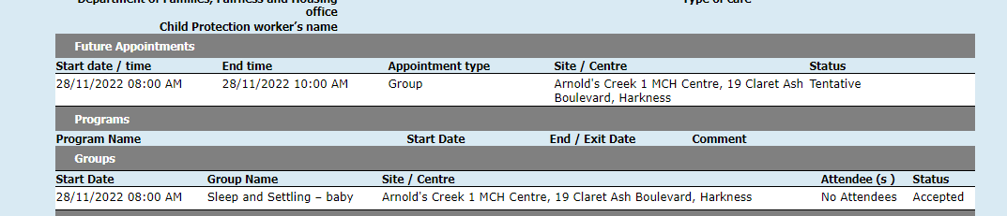
Groups FAQ
Why isn’t my group visible ?
Group must be accepted to appear on the Clients Summary page
Why is my facilitator not able to be booked for the group?
Your facilitator is already booked for another group session or scheduled in the calendar for a client or non-client appointment.
Why can’t I record outcomes for attendees in the group (no box)?
Attendees need to be added to the group prior to commencement of group.

Slide 6
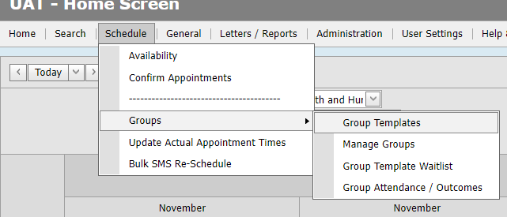
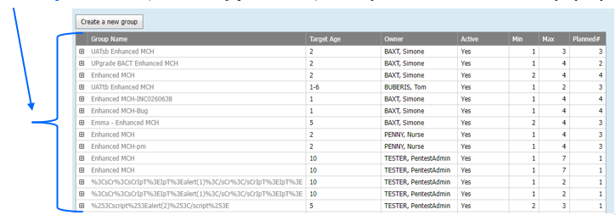
Too Many Groups Listed?
You can mark a Group Template as hidden and/or inactive via the 'Group Template' screen (Schedule > Groups > Group Templates).
Click a Group Name (it’s a hyperlink) to open the Edit Group popup.

Slide 7
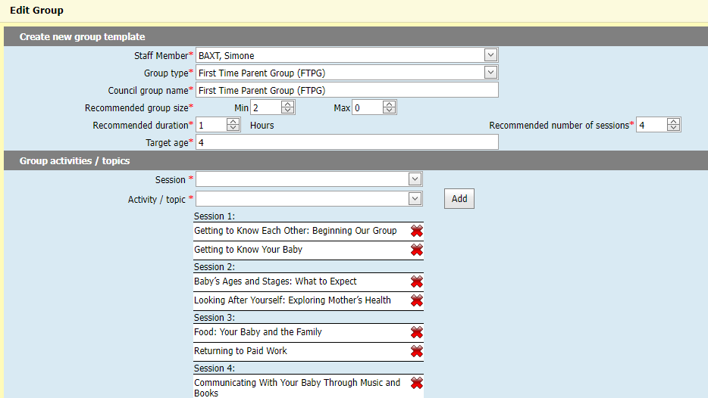
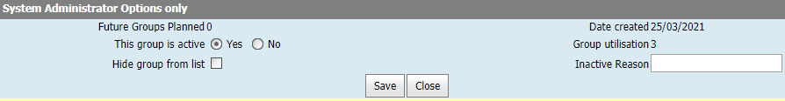
Too Many Groups Listed?
** Only CDIS Role of ‘System Admin – Council’ can see and adjust this **
Scroll down to 'System Administrator Options only' section where there are two fields:
- This group is active
- Hide group from list

Slide 8
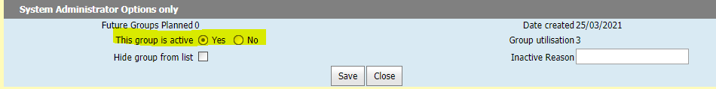
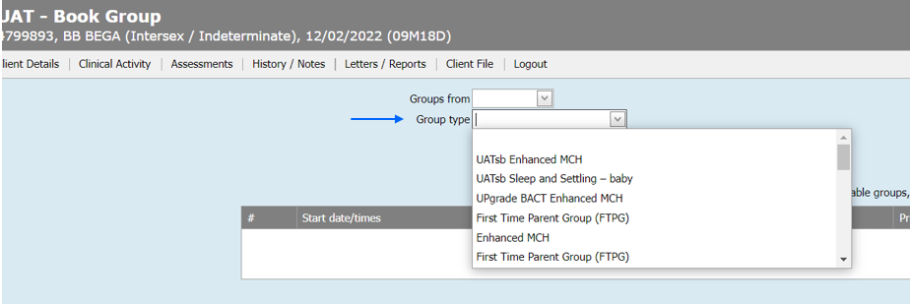
Too Many Groups Listed?
** Only CDIS Role of ‘System Admin – Council’ can see and adjust this **
Change ‘This group is active’ to No
This group is active
Setting this to ‘No’, will hide the group template for all roles in the following location:
- From a client record > Clinical Activity > Book Group 'Group type' drop down list

Slide 9
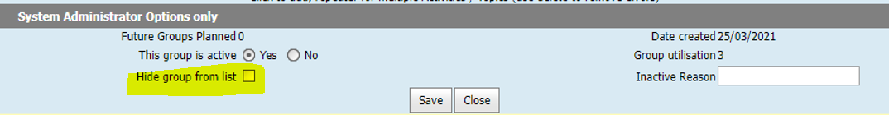
Too Many Groups Listed?
** Only CDIS Role of ‘System Admin – Council’ can see and adjust this **
Tick the checkbox to ‘Hide group from list’
Hide group from list
Ticking this checkbox will hide the group template^ in several locations.
^ The template will be hidden for non-system administrator roles i.e. clinician, clinical coordinator, admin, IT. The role ‘System Administrator – Council’ is a system-admin role.

Slide 10
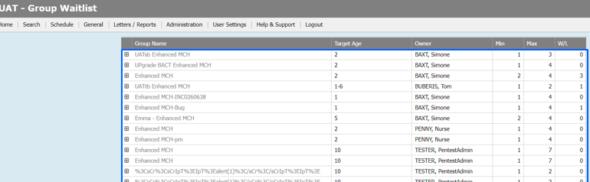
Too Many Groups Listed?
Hide group from list
Ticking the ‘Hide group from list’ checkbox will hide the group template^ in:
- 'Group Waitlist' screen - the table/grid on the screen (Schedule > Groups > Group Template Waitlist)
^ The template will be hidden for non-system administrator roles i.e. clinician, clinical coordinator, admin, IT. The role ‘System Administrator – Council’ is a system-admin role.

Slide 11
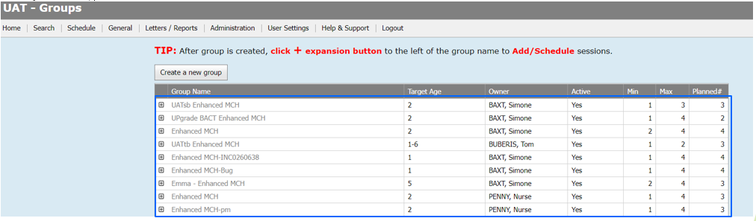
Too Many Groups Listed?
Hide group from list
Ticking the ‘Hide group from list’ checkbox will hide the group template^ in:
- 'Group Template' screen – the table/grid on the screen (Schedule > Groups > Group Templates)
^ The template will be hidden for non-system administrator roles i.e. clinician, clinical coordinator, admin, IT. The role ‘System Administrator – Council’ is a system-admin role.

Slide 12
Too Many Groups Listed?
Hide group from list
Ticking the ‘Hide group from list’ checkbox will hide the group template^ in:
- 'Book Group' screen – the 'Group type' drop down list (From a client record > Clinical Activity > Book Group 'Group type' drop down list)
^ The template will be hidden for non-system administrator roles i.e. clinician, clinical coordinator, admin, IT. The role ‘System Administrator – Council’ is a system-admin role.

Slide 13
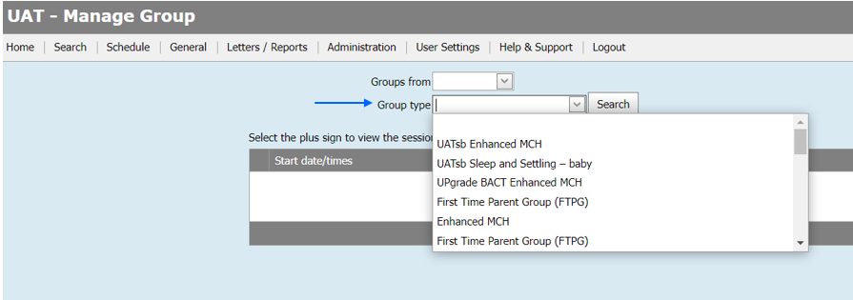
Too Many Groups Listed?
Hide group from list
Ticking the ‘Hide group from list’ checkbox will hide the group template^ in:
- 'Manage Group' screen - 'Group type' drop down list (Schedule > Groups > Manage Group - 'Group type' drop down list)
^ The template will be hidden for non-system administrator roles i.e. clinician, clinical coordinator, admin, IT. The role ‘System Administrator – Council’ is a system-admin role.

Slide 14
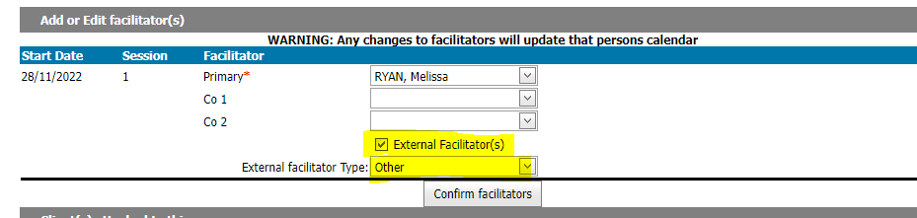
Groups offered in partnership with another MCH service, how do I record these?
Create a group as per initial group process set up.
Primary facilitator will need to be filled with your LGA facilitator
You can then tick external facilitator and the appropriate type.
Once you have the data from the external service regarding who has registered and who attends the session, you can add this information to CDIS (Tip – its easier to only record those who attended the actual session).
You may only be provided with first name, surname and email addresses depending on the booking system used therefore will need to search for client prior to adding. Add to group from client details.

Slide 15
What to do when I receive a Birth Notice (BN) in error?
Scenarios:
1. BN received from Maternity service but family not living in the LGA it was sent to.
2. BN received but baby not residing with birth mother eg OOHC, surrogacy or adoption.
3. BN incorrectly entered into CDIS prior to realising not residing in current LGA.

Slide 16
Legislation regarding Birth Notifications
The Child Wellbeing and Safety Act 2005 sets out requirements regarding the birth notification process. The Act stipulates that the birth notification is to be forwarded by the hospital or, if the birth did not occur in a hospital, the doctor or midwife that cared for the mother at the birth, to the Chief Executive Officer of the council of the district where the mother resides, within 48 hours of the child being born. It is then the responsibility of the Chief Executive Officer to forward the birth notice to the relevant MCH nurse at the MCH centre within that local government, who contacts the mother and invites her and her family to access the MCH Service.
As per MCH Service Guidelines 2021

Slide 17
Tips with entering Birth Notice
If unsure of address and what LGA the street belongs to please use:
https://maps.vec.vic.gov.au/
This will help you to confirm what address belongs to which LGA.
Please do not enter the birth notice if not in your LGA.
Contact the hospital and inform them that BN was sent to incorrect LGA.
Contact relevant council and advise of BN to come.
As per Birth Notification Processes located on the MAV Maternal and Child Health Information page. Found via the CDIS Help and Support tab.

Slide 18
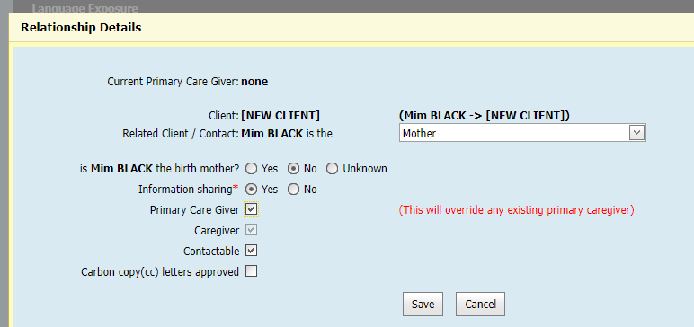
What if the baby is adopted or part of a surrogacy arrangement.
Please tick adoption box if relevant in demographic data.
When adding relationships add birth mother, she may already be open if she has other children in the service otherwise open her for service as she may require post natal care and then close when she completes the care.
Then when adding the non biological mother and open for service ensure that you have ticked non birth mother but add as mother:

Slide 19
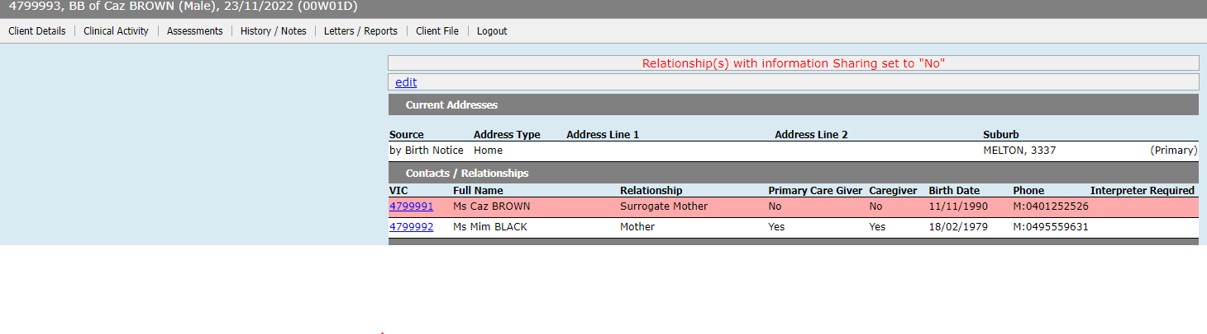
This is how the babies details will look:

Slide 20
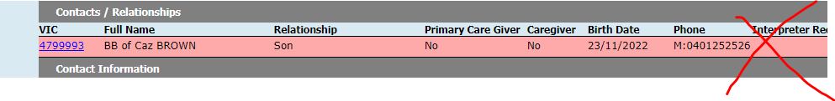
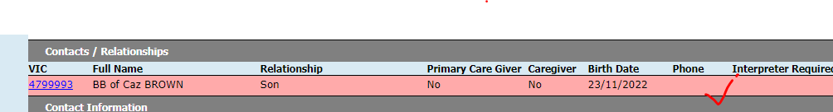
Baby/child should not have a phone number unless migrated data.
Please ensure that any baby or child added to CDIS does not have a phone number beside their details
Some children will have contact numbers if the history is migrated.
When you enter a babies DOB there should be no field to enter phone number.
Please do not enter a phone number as it is unclear which parent or caregiver this number belongs to and is unable to be updated.

Slide 21
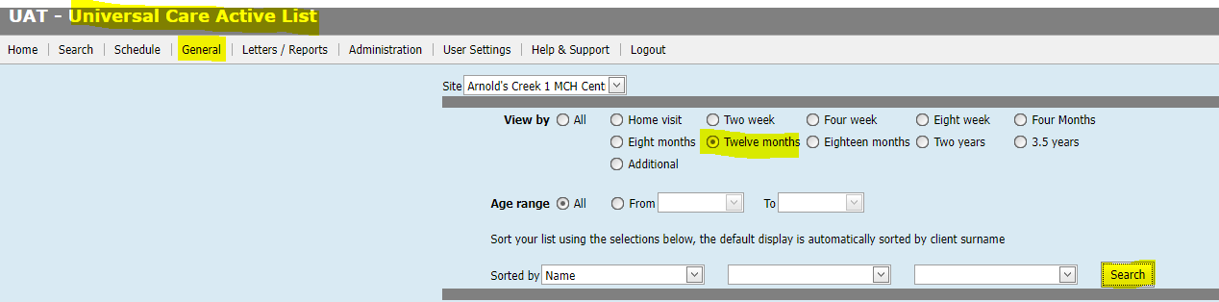
Can I run a report to check overdue KAS?
Yes
General Tab
Universal Active List
Select site
Age selected for overdue KAS or search by DOB and age parameters to reduce the search.
Search
You can then Print Page and an excel document will populate.
This is recommended practice to rebook missed appointments.

Slide 22
Questions & Answers - addressed in the next slides
Pleased ask any questions you have
Please use chat function to add any comments/queries
Questions asked on the day:
Why do I have to cancel appointments from the calendar?
Why can’t I delete from the Consultation page?

Slide 23
Best practice for cancelling appointments.
As per CDIS webinar series on Department of Health MCH website:
https://www.health.vic.gov.au/maternal-child-health/child-development-information-system
Webinar 7: https://vimeo.com/432021138 (password cdis)
Appointments are to be cancelled from the calendar so that a DNA is recorded in the client CDIS history.
DNA recorded this way will also be reflected in the DNA report function of CDIS.

Slide 24
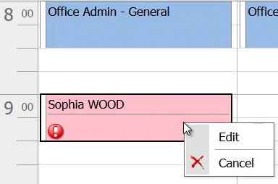
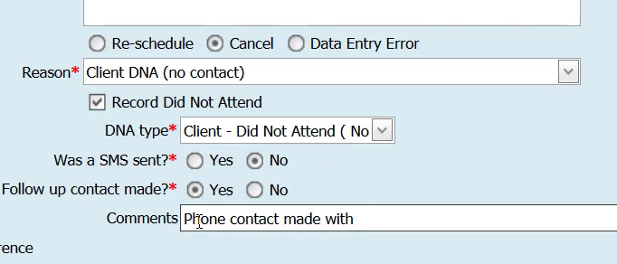
Process:
From the calendar screen right click on the clients appointment and select edit:
Select Cancel appointment and appropriate reason (see snip below)
Complete the fields
Then save.
Appointment will delete from the calendar
Clients history will look like this:

Slide 25
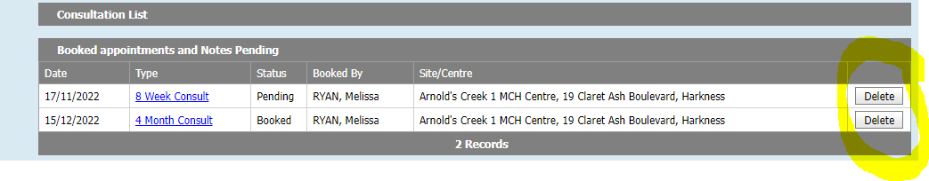
What to do with old appointments in the consult page.
Deleting from the consultation page will not record the missed appointment in the client record or attribute to DNA data.
However, this is a good way to delete appointments from a long time ago or appointments that belong to another MCH service that were not deleted in the transfer.

