Slide 1


Local Government Health and Wellbeing Planning
BRIEFING FOR
Executive & Councillors
2024
Notes:
This powerpoint presentation has been developed as starting point for sharing information with councillors and executives on municipal health and wellbeing planning.
The presentation can be downloaded and additional local information and data included as required.

Slide 2
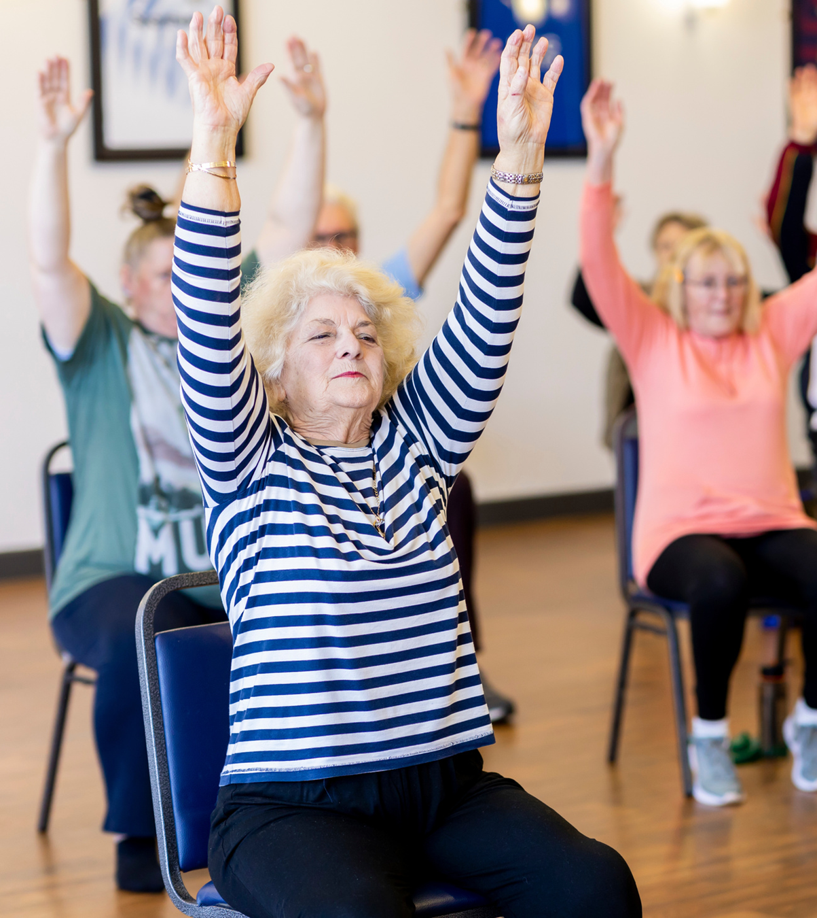



Local Government
Has legislative authority and community responsibility based on an electoral mandate to plan for local areas and ensure community health, wellbeing and development
Do this by addressing the causes of health problems rather than dealing with the symptoms. Helping keep people well and out of hospitals through immunisation, health inspections and creating healthy environments
01
Local Government Public Health and Wellbeing Planning
Notes:
Section 8 of the Local Government Act 2020 states the role of a council is to provide good governance in its municipality for the benefit and wellbeing of the community. Section 9 sets out governance principles for councils, including:
priority being given to achieving the best outcomes for the community, including future generations
promoting the economic, social and environmental sustainability of the municipal district, including mitigating and planning for climate change risks
engaging the municipal community in strategic planning and strategic decision making
innovation and continuous improvement being pursued.
Why Councils Do Health and Wellbeing Planning
Legislative Authority: Under the Local Government Act (LG Act), councils are mandated to plan for the health and wellbeing of their local communities. This authority gives councils the power to develop strategies that improve community health, safety, and development. Councils also have a requirement under the Victorian Public Health and Wellbeing Act 2008 to prepare Municipal Public Health and Wellbeing Plans within 12 months of councils being elected.
Community Responsibility: Councils have a responsibility to serve their communities, based on their electoral mandate. This means they must prioritize the wellbeing of residents by understanding local needs and implementing effective programs and services.
Proactive Approach: Rather than just addressing the symptoms of health problems, councils focus on tackling the root causes. This involves preventive measures such as:
Immunisation programs to prevent illness.
Health inspections to ensure public safety.
Creating healthy environments, like green spaces, that promote physical and mental health.
Keeping People Well: By promoting preventive health measures, essential in maintaining public health and keeping people well.

Slide 3

Victorian Public Health & Wellbeing Act Objectives
protecting public health and preventing disease, illness, injury, disability or premature death
promoting conditions in which persons can be healthy
reducing inequalities in the state of public health and wellbeing
02
Local Government Public Health and Wellbeing Planning
Notes:
The objective of the Victorian Public Health and Wellbeing Act 2008 is to achieve the highest attainable standard of public health and wellbeing by:
protecting public health and preventing disease, illness, injury, disability or premature death
promoting conditions in which persons can be healthy
reducing inequalities in the state of public health and wellbeing.
The Minister for Health must prepare a state Public Health and Wellbeing Plan every four years (section 49).
Council Municipal Public Health and Wellbeing Plans have to have regard for the Victorian Public Health and Wellbeing Plan (section 26(3)).

Slide 4

Challenges
Common challenges to our good health:
  preventable diseases are on the rise
  the population is growing
  the population is ageing
  our lifestyles are changing
  our world is changing
Some population groups have significantly worse health outcomes than others
03
Local Government Public Health and Wellbeing Planning
Notes:
Topics of interest to councils from the Victorian Public Health and Wellbeing Plan 2023 – 2027 include:
Tobacco use is still the leading contributor to burden of disease and premature deaths in Victoria, despite considerable progress in reducing smoking rates. Tobacco use is responsible for 9.3 per cent of disease burden and 13.3 per cent of deaths in Australia.¹ There are concerns this will increase with the uptake of e-cigarette use.
In 2022, we experienced the third year of the COVID-19 pandemic, with high case numbers and rises in the cost of living that were compounded by rising inflation and interest rate increases. The report from a survey conducted in 2022 found Australians’ subjective wellbeing showed a pattern of decline.¹ The average wellbeing score for people aged 18–25 years was the lowest in 21 years.
Good nutrition is essential for health and wellbeing because it helps achieve and maintain a healthy weight, protects against chronic disease (including cardiovascular disease, type 2 diabetes, dementia, and certain cancers), and supports a healthy immune system.
Poor diet, overweight and obesity are leading contributors to chronic disease and premature death in Victoria, accounting for 5.4 per cent and 8.4 per cent of preventable burden of disease respectively.¹
For infants and children, breastfeeding and healthy eating provides the nutrition required for optimal physical and cognitive development, and good oral health. High consumption of sugars is the main cause of tooth decay. Tooth decay can be prevented by reducing free sugar intake to less than 10 per cent of total energy intake, and ideally, reducing this even further minimises the risk of tooth decay throughout life.^{2,3}
Active living supports everyone, at all stages of life, to live healthy, engaged and purposeful lives. Only half of Victorian adults meet the physical activity guidelines for sufficient physical activity (53.0 per cent of women, and 48.7 per cent of men). ¹
Regular physical activity is a well-known protective factor for preventing and managing chronic disease including cardiovascular disease, type 2 diabetes and certain cancers.² Physical activity also plays an important role in improving quality of life, managing and decreasing pain, and promoting mental wellbeing. ^{2,}
Climate is a key determinant of health that affects other determinants and health equity. Climate change affects health in many ways – both directly and indirectly. Direct impacts include morbidity and mortality associated with extreme events such as heatwaves, floods, drought and bushfires. Indirect impacts are associated with ecological and land-use change (including changes in the spread of infectious diseases), along with worsening air, food and water quality.^{1, 2, 3}
Our climate is changing due to greenhouse gas emissions, which are causing a rise in average global temperatures and disruption of ecosystems. In Victoria, climate change is evident through increasing average temperatures, decreasing average rainfall and an increase in fire danger.⁴ Without significant action to reduce emissions locally and globally, the changes to our climate will become more extreme.⁵
Consumption of alcohol and other drugs (AOD) is a significant preventable cause of disease and death in Victoria. It is associated with a wide range of health and wellbeing impacts.
While the impacts of drug use on health and wellbeing can vary, related harms can impact physical health through increased risk of chronic disease, exposure to infectious diseases, and mental health and wellbeing impacts.¹
There were 1031 overdose deaths in Victoria over the period July 2020 – June 2022 and 75 per cent of these deaths were determined to be unintentional. ⁶ Pharmaceutical drugs contributed to three-quarters of all deaths due to overdoses during this period. ⁶
For adult men and women, the risk of dying from alcohol-related disease and injury remains below 1 in 100, if no more than 10 standard drinks are consumed each week, and no more than four standard drinks are consumed on any one day. ⁷ The long-term risk of alcohol-related disease and injury can be lowered by drinking less often and drinking less on each occasion.⁷
Family violence and sexual violence is a significant public health issue. The trauma of family violence and sexual violence can impact a person’s ability to work, their financial security and access to safe, affordable housing. Family violence can affect children’s emotional, behavioural and social wellbeing, including attendance and achievements at school.
Violence also affects sexual and reproductive health outcomes for women, who are at increased risk of violence at particular life stages, including while pregnant or while separating from a relationship.⁴
Family violence and violence against women increases during and after a natural disaster or crisis such as bushfires or floods.
Injury is a complex public health issue that covers a broad range of causes. These include unintentional injury from falls, transport, sport and recreation, drowning, poisoning, burns and consumer product injuries. Injury may also be intentional due to suicide, self-harm and all forms of violence. Injury is a major cause of morbidity and mortality across the world. It is both predictable and preventable.¹ The impact of injury and associated injury harms can be profound for individuals, families and communities, and may result in loss of income and productivity, reduced social participation, physical and psychological impairment. It can also affect daily living and quality of life
Common Challenges to Our Good Health
“We’re facing some real challenges when it comes to maintaining good health in our communities. One of the biggest issues is that preventable diseases—things like diabetes, heart disease, and even some cancers—are on the rise. These are conditions that, with the right lifestyle choices and early intervention, could largely be avoided.
On top of that, we have a growing population, which means more people relying on the same health services. It puts extra pressure on our systems, making it harder to meet everyone’s needs.
We’re also seeing our population ageing, which brings its own set of challenges. As people live longer, there’s more demand for aged care and resources to manage chronic diseases, so the way we plan for health services has to shift.
Lifestyles are changing too. We’re more sedentary, more stressed, and often less connected to activities that keep us healthy, which is contributing to problems like obesity and mental health issues.
And let’s not forget, we live in a rapidly changing world. Climate change, pollution, and pandemics like COVID-19 have added new layers of complexity to public health. These global challenges are affecting our local communities in ways we haven’t had to consider before.
Finally, we have to acknowledge that not everyone is starting from the same place. Some groups in our communities have much worse health outcomes than others. Whether it’s due to socioeconomic factors, limited access to services, or cultural barriers, these disparities need to be addressed if we’re going to improve overall health for everyone.”

Slide 5
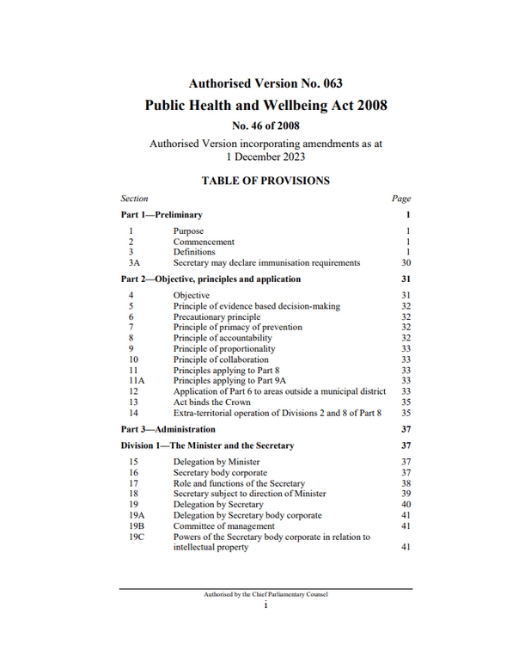

Public Health and Wellbeing Act
Division 3 - Councils
  Function of Councils
  Secretary may require report from Council
  Municipal public health and wellbeing plans
  Inclusion of public health and wellbeing matters in Council Plan or Strategic Plan
  Special powers of Secretary in a state of emergency
04
Local Government Public Health and Wellbeing Planning
Notes:
The Victorian Public Health and Wellbeing Act includes provisions specific to councils. These include:
Section 24 of the Public Health and Wellbeing Act 2008 states that a function of all councils is to “seek to protect, improve and promote public health and wellbeing” within their municipal districts. The Act sets out ways in which councils must do this, including:
(a) creating an environment which supports the health of members of the local community and strengthens the capacity of the community and individuals to achieve better health;
(b) initiating, supporting and managing public health planning processes at the local government level;
(c) developing and implementing public health policies and programs within the municipal district;
(d) developing and enforcing up-to-date public health standards and intervening if the health of people within the municipal district is affected;
(e) facilitating and supporting local agencies whose work has an impact on public health and wellbeing to improve public health and wellbeing in the local community;
(f) co-ordinating and providing immunisation services to children living or being educated within the municipal district;
(g) ensuring that the municipal district is maintained in a clean and sanitary condition.
Councils can choose to include health and wellbeing matters in council plan and Department of Health provides guidance on process.
In addition there is other legislation councils need to have regard for:
Under the Climate Change Act 2017 both the state and municipal public health and wellbeing plans must have regard to climate change.
The Gender Equality Act 2020 requires the public sector, councils, and universities to undertake Gender Impact Assessments when developing or reviewing any policy of, or program or services provided, that has a direct and significant impact on the public

Slide 6



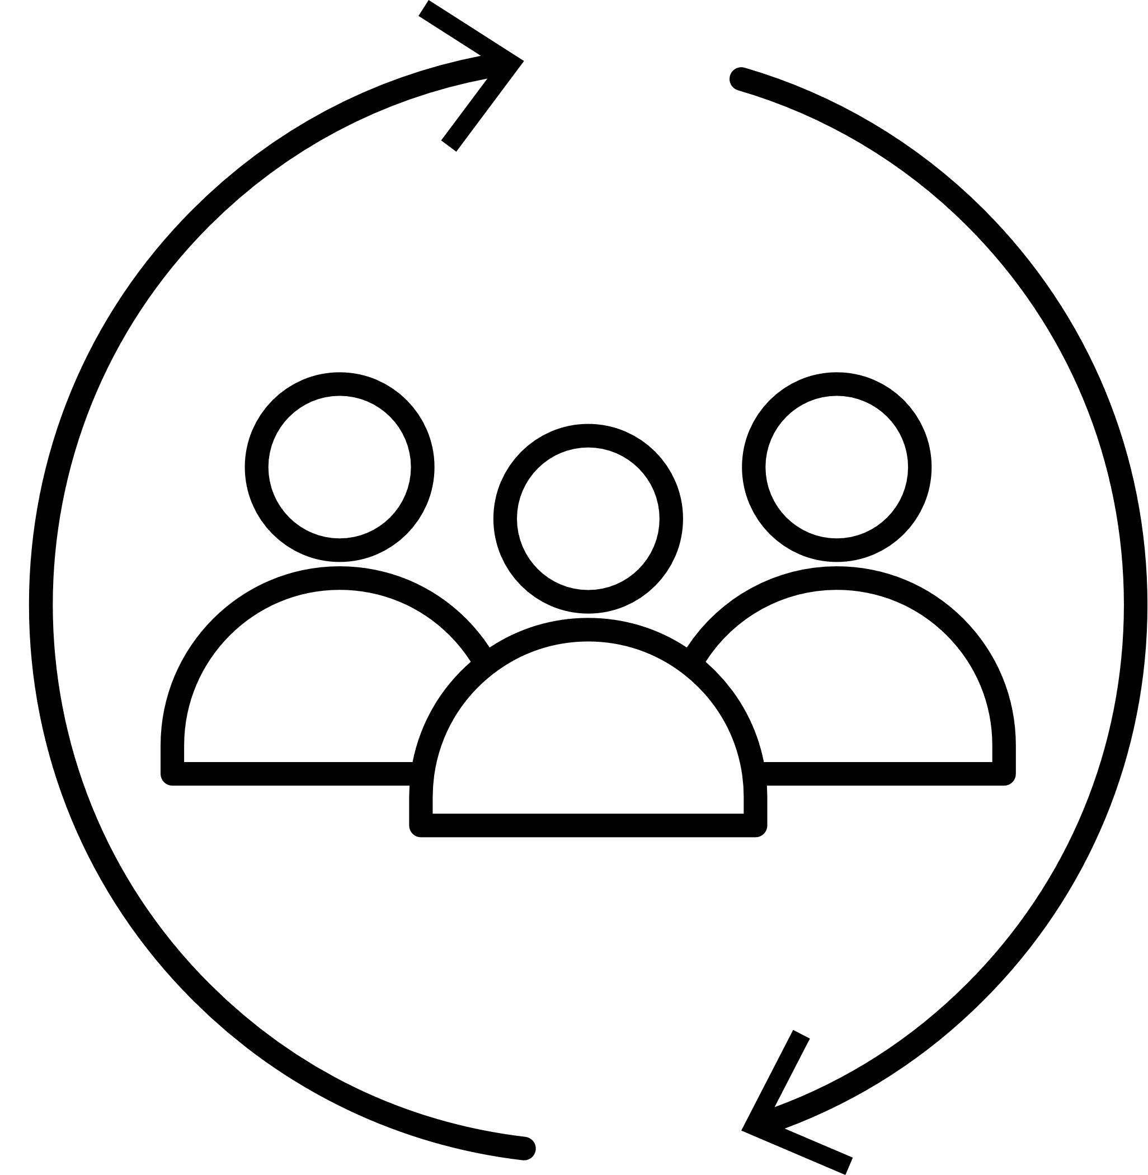



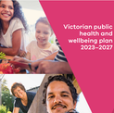
A municipal public health and wellbeing plan must
Be prepared within 12 months of the council election
Examine data about local health status and health definitions
Identify strategies based on evidence for creating maximum health and wellbeing
Involve local community in the development and evaluation of the plan
Specify how council will work with the Department of Health and other agencies
Specify measures to prevent family violence and respond to the needs of victims of family violence in the community
Be consistent with Council Plan and the Municipal Strategic Statement
Have regard to the Victorian Health and Wellbeing Plan
05
Local Government Public Health and Wellbeing Planning

Slide 7
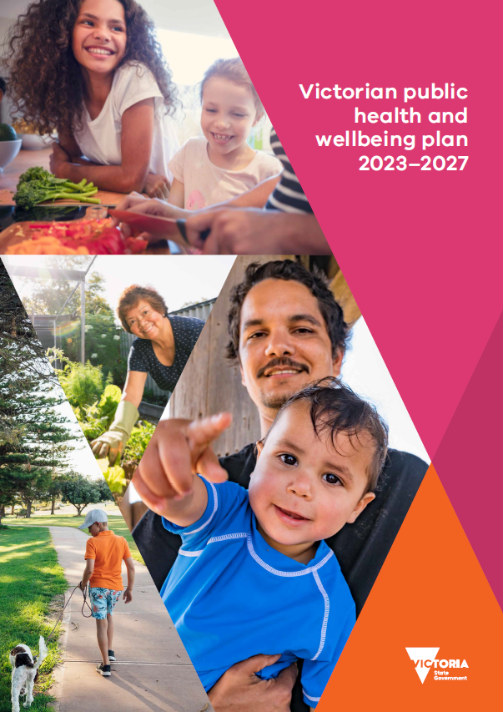
Plans must have regard to State Priorities
06
Local Government Public Health and Wellbeing Planning
Notes:
State Priorities include a focus on addressing health inequities.
The Victorian Public Health and Wellbeing progress report 2023 is the second report against the Victorian public health and wellbeing outcomes framework.
The report includes data for 57 out of 188 measures and provides a point in time summary of health and wellbeing of Victorians in 2023. Some areas are showing improvements in outcomes, and other areas are making no improvements or heading in the wrong direction.
Inequity in health and wellbeing outcomes is highlighted throughout the progress report, focusing on the difference in outcomes experienced by people of different sex and gender, Aboriginal people living in Victoria, Cultural and linguistically diverse people, and people of a low socio-economic status

Slide 8
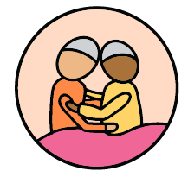

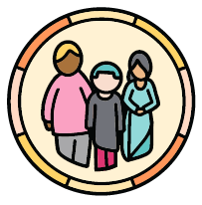


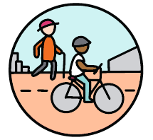
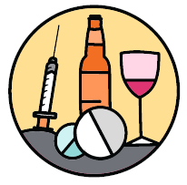


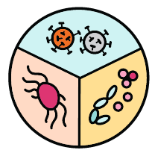
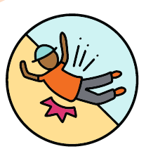
State Priorities
sexual & reproductive health
reducing tobacco &
e-cigarette harms
mental health & wellbeing
healthy eating
active living
reducing harm from alcohol & drug use
tackling climate
change
preventing violence
decreasing
antimicrobial
resistance
reducing injury
Notes:
Not all state priorities can be priorities for a council. Councils can work with community partners based on local need and capacity to address relevant priorities to prevent harm as well as enhancing wellbeing.

Slide 9
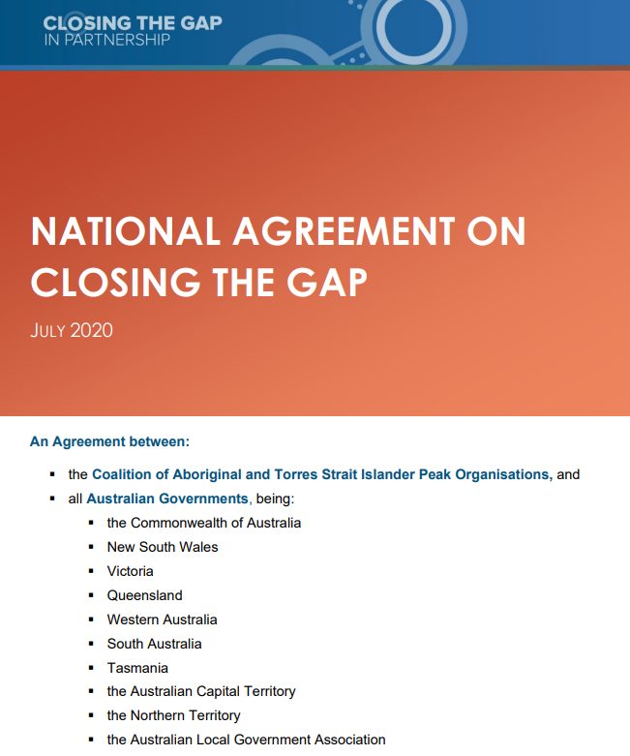

First Nations - Aboriginal and Torres Strait Islander people living in Victoria
Local Government Act 2020
Traditional owners must be engaged in council strategic planning and decision-making
Victorian Aboriginal and Local Government Strategy 2021-2026
Strategic Pillar 6 - Health and Wellbeing – design local Aboriginal health and wellbeing policies and services in partnership with Traditional Owners, Aboriginal Community Controlled sector and the Aboriginal community
Public Health and Wellbeing Act 2008
Includes a Statement of Recognition of Aboriginal people in Victoria as First Nations People of Australia and their enduring connection to Country, kin and culture
Victorian Public Health Wellbeing Plan 2023-2027
Embedding approaches to achieve self-determination in health and wellbeing policies and programs is identified as a key enabler for improved outcomes for Aboriginal and Torres Strait Islander people
National Closing the Gap Agreement
Sharing decision-making with Aboriginal and Torres Strait Islander people represented by their community-controlled peak organisations, and helping achieve improvements in early childhood and development, housing, health, disability, workforce, capital infrastructure, service provision and governance
06
Local Government Public Health and Wellbeing Planning
Notes:
There are a number of imperatives for council Municipal Public Health and Wellbeing Plans to consider actions to support Aboriginal and Torres Strait Islander people in Victoria.
The Local Government Act 2020 expressly cites traditional owners of land in the municipal district as part of the municipal community which is to be engaged in strategic planning and strategic decision-making (Section 9(2)(d)).
The Victorian Aboriginal and Local Government Strategy 2021-2026 is a roadmap for self-determination for Victorian Aboriginal people, councils and the Victorian Government. It was developed by Local Government Victoria in collaboration with the Victorian Aboriginal community, councils and peak local government associations. It comprises 7 Strategic Pillars –(1) Culture, Respect & Trust, (2) Awareness and Engagement, (3) Accountability and Direction, (4) Governance and Participation, (5) Economic Participation, (6) Health and Wellbeing, (7) Resourcing and Funding.
Strategic Pillar 6: Health and Wellbeing provides some suggestions for how councils can Understand, Embrace and Embed health and wellbeing for Victorian Aboriginal people. Recommendations are:
Design local Aboriginal health and wellbeing policies and services in partnership with Traditional Owners, the Aboriginal Community Controlled sector, and Aboriginal community
Prioritise self-determined solutions that promote culture, connection, and community strengthening
Ensure the preservation of Aboriginal culture by supporting Aboriginal Elders, and empowering the next generation of proud, strong, and thriving Aboriginal people to continue their culture
The Public Health and Wellbeing Act 2008 includes a Statement of Recognition that Aboriginal people in Victoria “are First Nations people of Australia” and their enduring connection to Country, kin, land and culture. Aboriginal self-determination is identified as a foundational principle to improve health and wellbeing outcomes of Aboriginal people in Victoria (section 3B(2)(a), along with a number of other acknowledgements. (section 3B(2)( c). Section 3D sets out seven key principles.
The Victorian Public Health and Wellbeing Plan 2023-2027 acknowledges that wellbeing for Aboriginal people is considered a holistic concept, shaped by connections to culture, extended kinship, elders, ancestors, and spirituality, which in turn are influenced by social, historical, political and cultural factors. The Plan also acknowledges that there are priority groups within the Aboriginal Victorian population who particularly experience poor health and wellbeing outcomes, and may need support to access culturally inclusive health services and programs. Embedding approaches to achieve self-determination in health and wellbeing policies and programs will build on the strengths within Aboriginal communities.
Councils are part of the National Closing the Gap Agreement through the Australian Local Government Association being a signatory, alongside the Commonwealth and all state and territory governments.

Slide 10


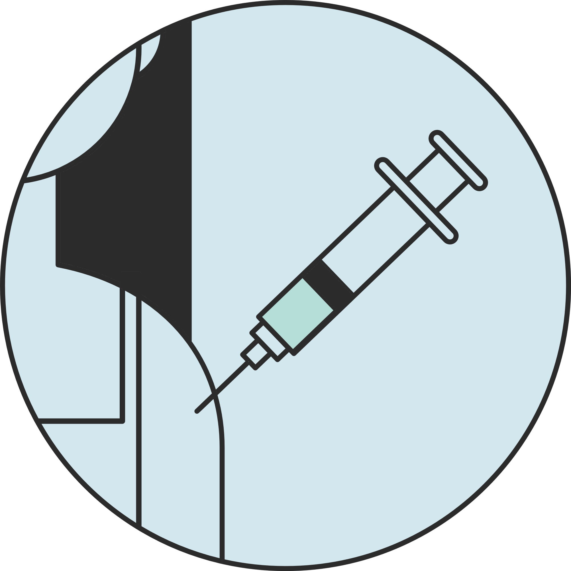
Local Government CAN influence the health and wellbeing of communities
19th Century
Drains
Sewers
Building regulations
Early 20th Century
Parks and playgrounds
Maternal and Child Health
Immunisation
Food Regulation
Residential Zones
Late 20th Century to now
Health Promotion
Preventative focus
Climate change and health
08
Local Government Public Health and Wellbeing Planning
Notes:
How Victorian Councils Influence Community Health and Wellbeing
“Victorian councils have been shaping the health of their communities for well over a century. Back in the 19th century, councils played a huge role in improving public health by building drainage systems. These systems helped manage waste and prevent the spread of diseases like cholera, which were major issues at the time.
By the early 20th century, the focus started shifting towards creating healthier environments for people to live and play. Parks and playgrounds became a priority, giving children and families safe spaces to get outside, be active, and enjoy nature.
Fast forward to the late 20th century and into today, and councils have embraced a broader, more integrated approach to health. We started seeing a stronger emphasis on health promotion and a preventative focus—working to keep people healthy rather than just treating illness.
Now, councils are tackling climate change and health. With rising temperatures, air pollution, and extreme weather events, there’s growing recognition that the environment is critical to public health, and councils are leading the charge on local climate action.
Alongside these big-picture efforts, councils continue to deliver vital everyday services. Maternal and Child Health programs support young families, while immunisation programs keep preventable diseases at bay. Food regulation ensures that the food we eat is safe, and careful management of residential zones helps create healthy, livable communities by ensuring access to green spaces, reducing noise, and controlling pollution.
All of these efforts come together to make sure that councils are not just managing health issues as they arise, but actively working to improve the wellbeing of everyone in the community.”

Slide 11
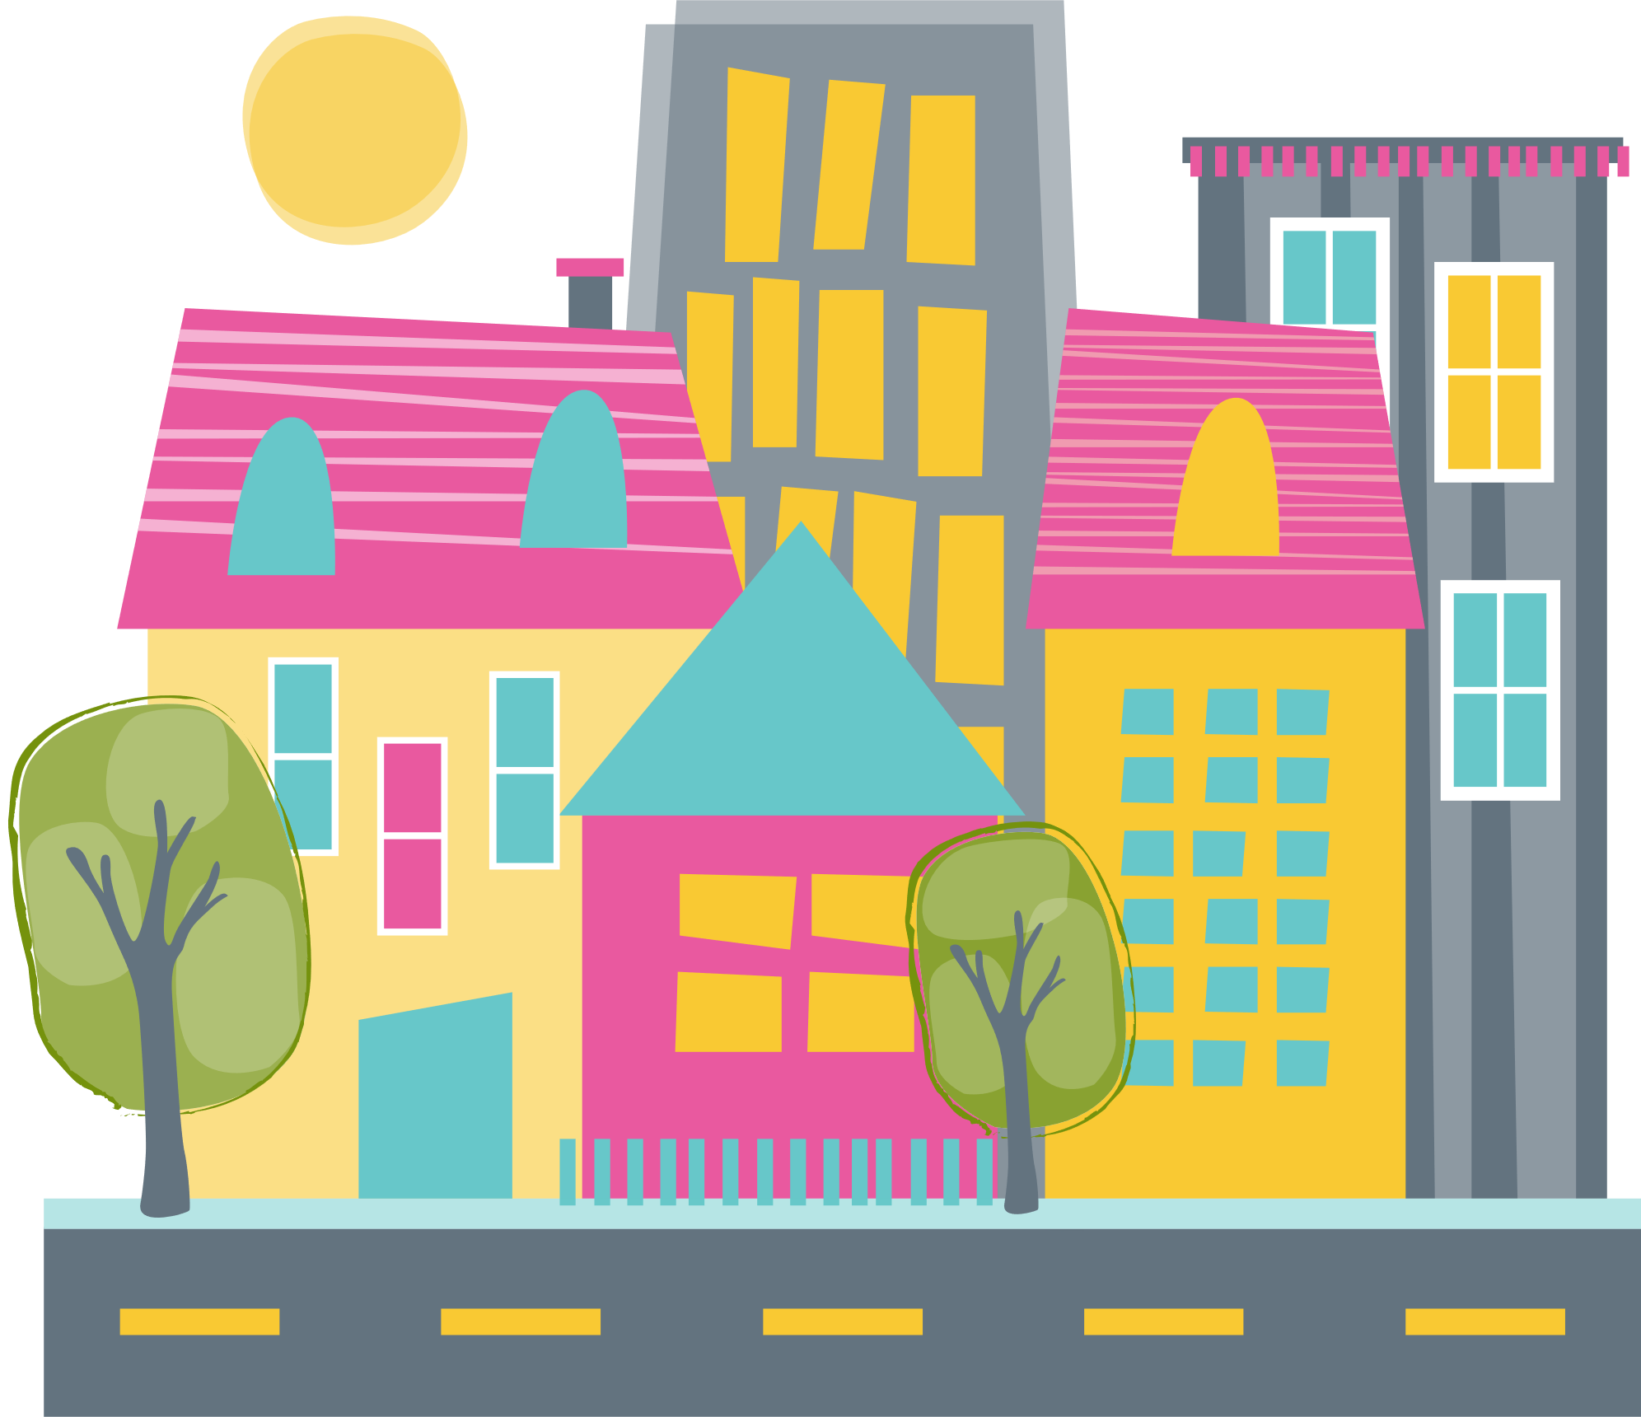
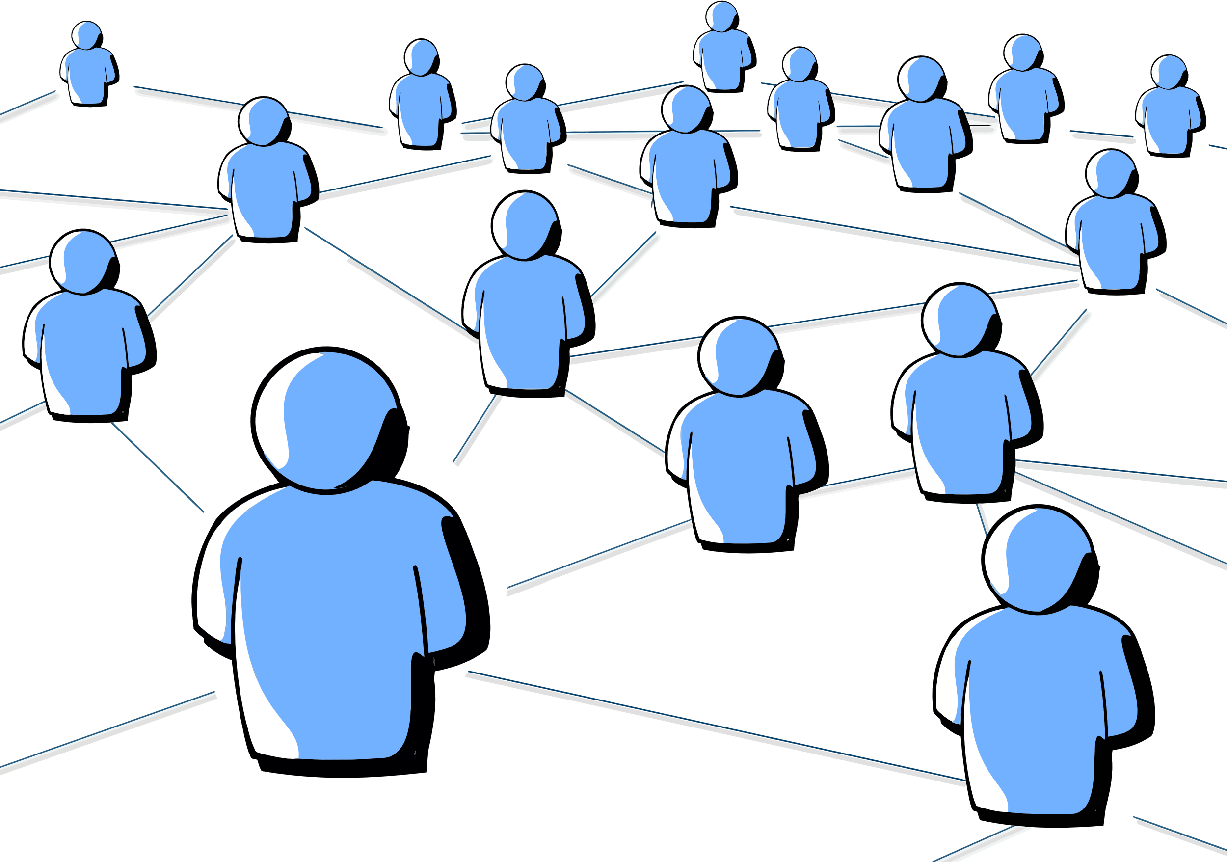


Council CAN influence the health and wellbeing of communities
Environmental Dimensions | Components | Council Action Area - Examples
 | Provision of infrastructure amenities: parks, street lighting, roads, footpaths | Land use planning Transport & traffic management Recreation facilities
 | Sense of community Participation Perceptions of safety | Community support Art & cultural development Library services
 | Economic policy Industrial development Employment | Community economic development Access & equity
 | Geography Air & water quality Native vegetation | Water quality Waste management Energy consumption
Built/Physical
Social
Economic
Natural
Adapted from Environments for Health - Department of Human Services Victoria
Notes:
How Councils Can Influence the Health and Wellbeing of Communities
“Councils have a direct and lasting impact on the health and wellbeing of their communities through a wide range of services and planning initiatives.
One of the key areas is land use planning. By designing communities with green spaces, housing, and business zones in mind, councils ensure people live in areas that support physical activity, reduce pollution, and encourage healthier lifestyles.
Transport and traffic management is another major factor. Councils can promote active transport options like walking and cycling, while managing traffic to reduce accidents and improve air quality, which all contribute to better health outcomes.
Then there’s recreation facilities, such as parks, pools, and sporting grounds. These spaces give people opportunities to stay active and connected, improving both mental and physical wellbeing.
Councils also provide community support services, offering assistance to vulnerable groups, promoting social cohesion, and helping to reduce the impacts of social isolation.
They invest in art and cultural development, which enriches community life, fostering mental health, creativity, and a sense of belonging. Similarly, library services provide learning opportunities, community hubs, and access to information that support lifelong wellbeing.
Through community economic development, councils help build stronger local economies, creating jobs and financial stability, both of which are important for health.
Access and equity are core to council programs, ensuring that all residents, regardless of background or ability, can access services and participate in community life equally.
When it comes to the environment, councils safeguard water quality and manage waste, ensuring clean, safe surroundings that protect public health. They also influence energy consumption, helping communities reduce their environmental footprint, which has direct benefits for health, especially as we face the challenges of climate change.
In all these ways, councils play a vital role in promoting healthier, more resilient communities.”

Slide 12
Council planning landscape
Timeline
Plans
Short term
year
1
Annual Budget
30 June 2025
Annual Report
31 October 2025
Medium term
years
Council Plan
Due 31 October 2025
Municipal Public Health & Wellbeing Plan
Due 31 October 2025
4
Long term
years
Community Vision
Review adopted by
Due 31 October 2025
10
Notes:
Note – many councils adopt council plan with the annual budget in June

Slide 13

Resources
  MAV has guidance links and analysis of past plans on the MAV website.
  Useful resources including guidance on health and wellbeing planning on the Department of Health website DH Prevention
  Vichealth has a range of evidence informed resources which are aimed to assist councils in acting to improve health and wellbeing of communities.
12
Local Government Public Health and Wellbeing Planning

Slide 14


Alignment of state & municipal public health & wellbeing planning
October 2024
LG elections
October 2028
LG elections
October 2025
Council Plans
MPHWPs
October 2029
Council Plans
MPHWPs
October 2031
Community Vision
2024 2025 2026 2027 2028 2029 2030 2031
May 2024
Vic Public Health & Wellbeing Plan
September 2028
Vic Public Health & Wellbeing Plan
November 2026
Vic Government election
November 2030
Vic Government election
13
Local Government Public Health and Wellbeing Planning
Notes:
The alignment of the Victorian plan and council health and wellbeing planning cycles coupled with more and better reporting on key indicators and monitoring of the outcomes through the shared data dashboard, allows for stronger connection between state and local priorities. Councils plans and reporting on data dashboard can help to inform the next Victorian plan.

Slide 15

Questions
Notes:
Contact the MAV for further information – Inquiries@mav.asn.au

