Slide 1




CDIS User Group - Admin
Thursday 13/02/2025
CDIS User Group – Admin Feb 2025

Slide 2

Agenda
Role of CDIS Champion
Open/Change/Close
When to close a record
Relationships
Addresses
Calander/Legend/Icons
Appointment Unconfirmed
Childhood records
Recording of a stillborn babe and deceased parent/carer
Transfers
BN list
Updating Home site
CDIS Support
CDIS User Group – Admin Feb 2025

Slide 3
Role of the CDIS Champion
Representing your team.
Resource in your team for CDIS education, questions and troubleshooting.
Note any common themes or questions from your team to report to the group.
Gather information from your team to be addressed in the User Group meetings or followed up by the CDIS Reference group and highlight education needs.
Attend User Group meetings every 6-8 weeks.
Contribute to User Group meetings conversations re your teams CDIS practice, questions and ideas.
Sharing information learned at the CDIS user group meetings with your team ie regular CDIS update presentation at team meetings
Prompting your team use of CDIS resources such as the vimeo’s and CDIS education through the Help & Support tab on CDIS.
CDIS User Group – Clinical Feb 2025

Slide 4
Open/Change/Close
Client records should be OPEN for Universal service, which means they are active or receiving maternal and child health service (previously referred to as enrolled)
Who should be open:
• All children eligible for MCH service (up to school age)
• All Primary Caregivers
MCH activity is recorded at the service it occurs for reporting. Data is not affected by transfers of clients.
Funding is based on number of open records/enrolments as reported in the annual report at the end of financial year (2E). Based on population not activity.
CDIS User Group – Clinical Feb 2025

Slide 5
When to Close Records
When a child dies/stillborn
When a child moves permanently overseas
When a child moves permanently interstate.
As funding is based on OPEN records only, records that are closed are not counted in service funding.
Even though we are a voluntary service, MCH services should be proactive and offer “assertive outreach”, example if a client says declines MCH support, we encourage a response such as “Are you happy if we contact you periodically to check in and see if you would like a key age and stage visit at a later stage”.
If a client adamantly declines service, add an edit note “Client declining service”, untick the consent for contact in the client details screen but leave them “Open”. There are examples of clients who have declined service in past, making contact for review when child is older, the KAS consults have then been conducted in closed records and have not been counted in reporting or included in numbers for funding.
Closed clients will also not appear on Missed visit reports. But older children open to service who have not had a KAS visit will be appear on reports.
CDIS User Group – Admin Feb 2025

Slide 6
Relationships
Under client details
Client relationships – important that these are always kept up to date
Family relationships must be added from this screen
Perform a statewide search and use the correct record if found, do not create a new record if not needed.
Every child should have at least one contact that is a primary care giver
https://vimeo.com/432021489 - CDIS education video that will step you through the process.
Only Primary Care givers or Caregivers of children should be ticked as information sharing in a child record.
Ensure “contactable” is ticked if you want to be able to send SMS to the PCG or care giver.
CDIS User Group – Clinical Feb 2025

Slide 7
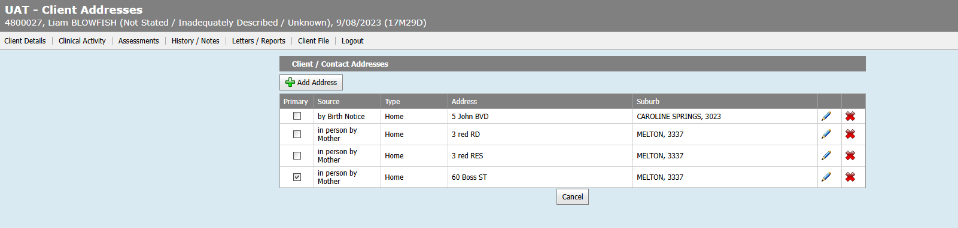
Addresses
Current address is important to maintain the integrity of a medical record.
A medical record must contain all previous addresses to help identify the client.
Tip – ask caregivers if they received the sms reminder to check current contact details.
CDIS User Group – Clinical Feb 2025
Notes:
A history of addresses can help to identify the right CDIS record

Slide 8
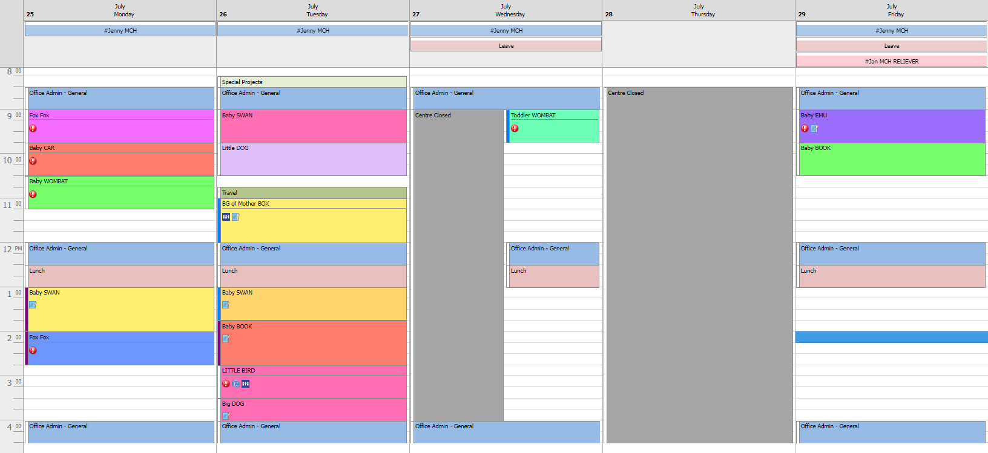
CDIS User Group – Admin Feb 2025
Notes:
This is a snip of a possible CDIS calendar
Staff names have been added at the top of the calendar as a work around as the calendar is assigned to a site, not a person. To achieve this, the staff member is created as a closed MCH client, with a hashtag before the staff member name to make it easy to find the staff member on a search. The booking is made as an all day appointment so that it appears at the top of the calendar.

Slide 9
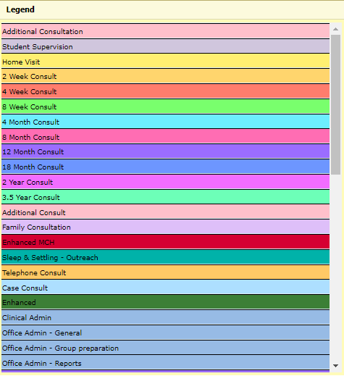
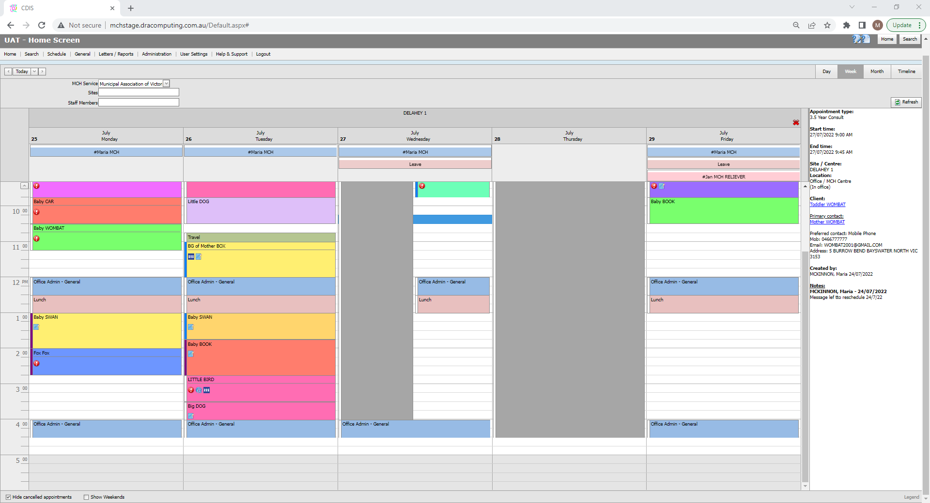
Legend
CDIS User Group – Admin Feb 2025
Notes:
Appointments are colour coded in accordance with the legend that can be located on the bottom right corner of the screen

Slide 10
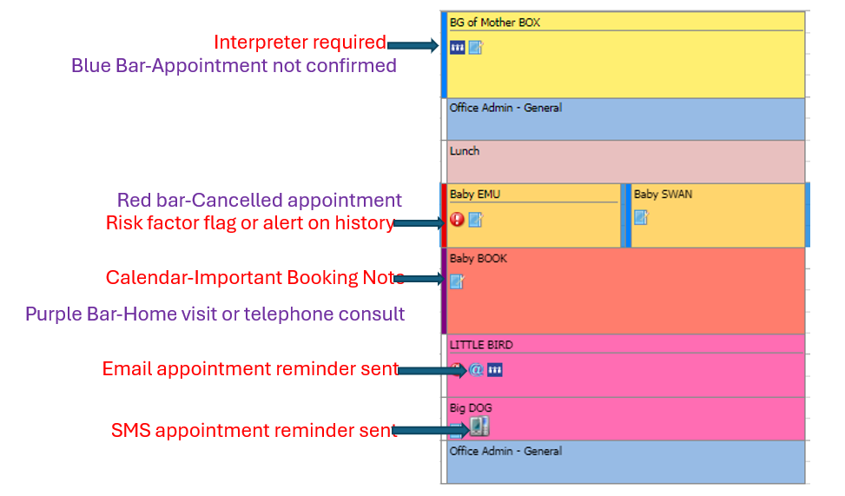
Legends & Icons
CDIS User Group – Admin Feb 2025
Notes:
Some appointments will have code icons that serve as an administration tool reminder.
The exclamation mark denotes a red flag alert on the history
The universal interpreter sign flags that an interpreter booking is required.
The @ sign indicates that a appointment reminder has been sent as an email
The phone icon indicates that an appointment was sent as SMS
The note book signifies that there is an appointment note on the right hand side of the calendar. This is a useful tool when leaving messages such as “voice message left to confirm HV” or “additional weight check required”.
The blue coloured bar on the left of an appointment means that the appointment is not confirmed,
White bar means confirmed
Purple means Consultation is at home or a telephone consult
And the red bar means the appointment was cancelled and is only visible when unticking the “hide cancelled appointments box” at the very bottom left of the calendar.

Slide 11
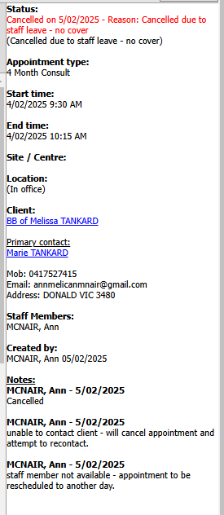
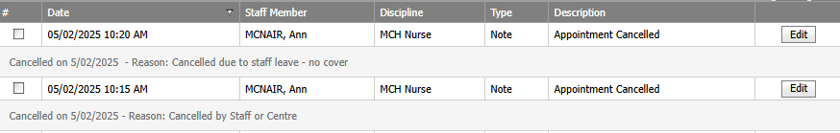
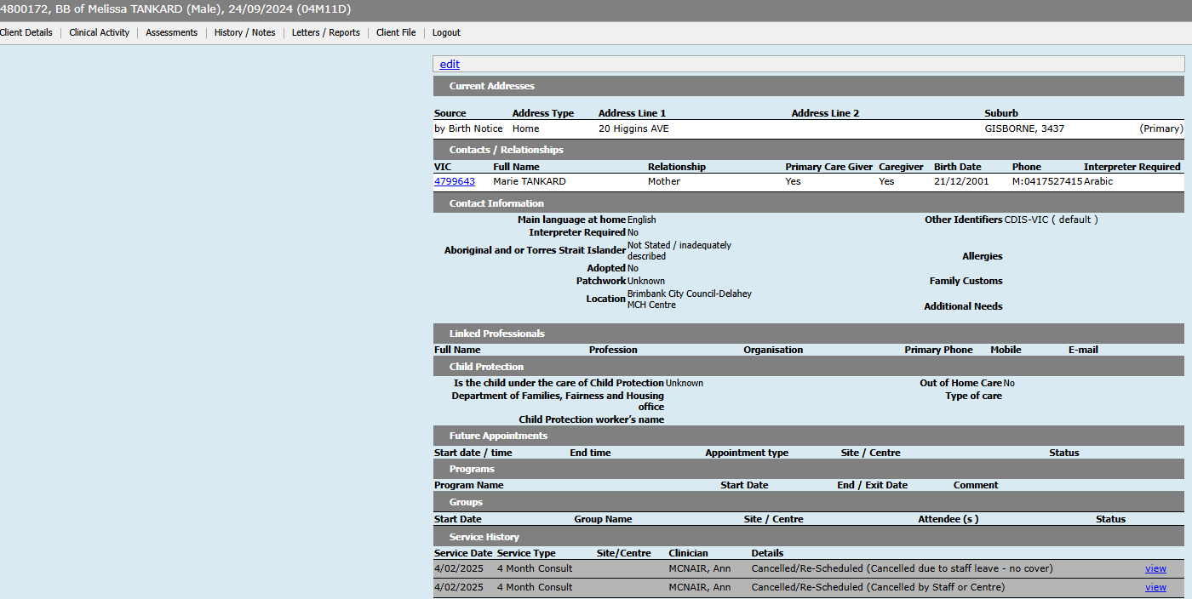
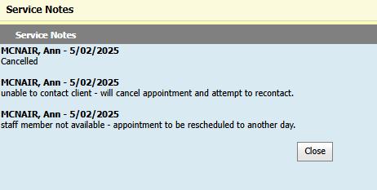
Recording a reason for cancelled appointments
CDIS User Group – Admin Feb 2025
Notes:
If CPS or others ring us for Information sharing that the client record often appears to show a history of appointments cancelled and although it may say by Staff or Centre that sometimes people do not put this as the reason or other services may perceive the client is not engaged because of the cancellations.
If the appointment cancelled out of the calendar the important notes do not appear in the History/Notes> Notes for the client and the only way that the important notes from the Calander can be seen is if staff click on the blue hyperlink where it appears. I know it is extra work but could the important note be copied and pasted into the client notes as part of the process?

Slide 12
Child Records
Clients may have 2 separate records; one for when they are a child & another for when they are an adult/caregiver
*Hint: if the record is closed it may be an old child record; if the CDIS number begins with a 1/2 then it may be an old child record
Best Practice is to close the child’s record when they become a parent and open a new CDIS record. When closing a parents childhood record - add a note to edit field “Date DO NOT USE CHILDHOOD RECORD Staff Member initials”
* Relationships need to be current so review and disconnect any relationships that are no longer relevant/active.
CDIS User Group – Admin Feb 2025
Notes:
We need to ensure that we are not using a child record for a client that is now an adult.
Clients should have 2 separate records; one for when they are a child & another for when they are an adult/caregiver
If your client search reveals a child history, best practice is to close the history and add a comment in the edit bar on the client summary page to state “Date DO NOT USE CHILDHOOD RECORD Staff Member initials”
An old child record should not be utilised upon that client becoming a caregiver (ie parent).
If this has occurred, notify the team leader to create a new history and copy the current notes into the new file.
The old file should be closed with a note added to edit field stating. “Date DO NOT USE CHILDHOOD RECORD Staff Member initials”
An adult’s relationships should be kept current in CDIS, and old relationships that are no longer relevant/active, should be disconnected.

Slide 13
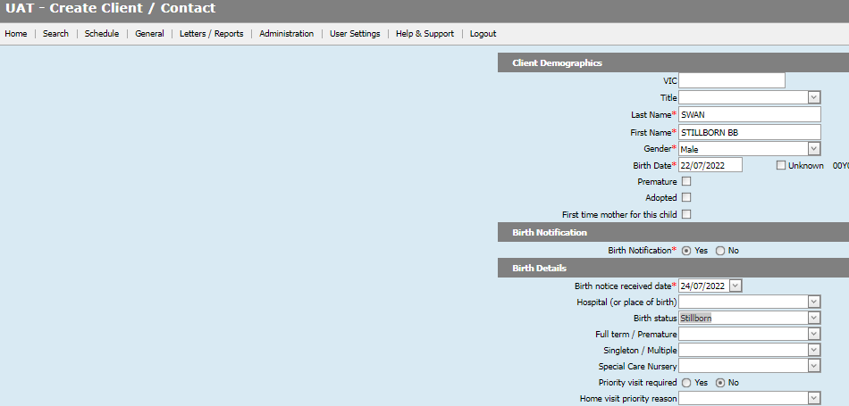

Recording a stillborn baby – create & open
1
This ensures that Birth is counted in the
Birth Notification List
CDIS User Group – Admin Feb 2025
Notes:
. As stillborn births count in the annual Birth Notification tally, the following steps are required to ensure correct recording.
1. A key step that is required when entering a stillborn BN in CDIS is making sure that the client is opened to service.

Slide 14
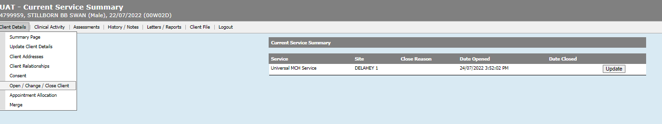
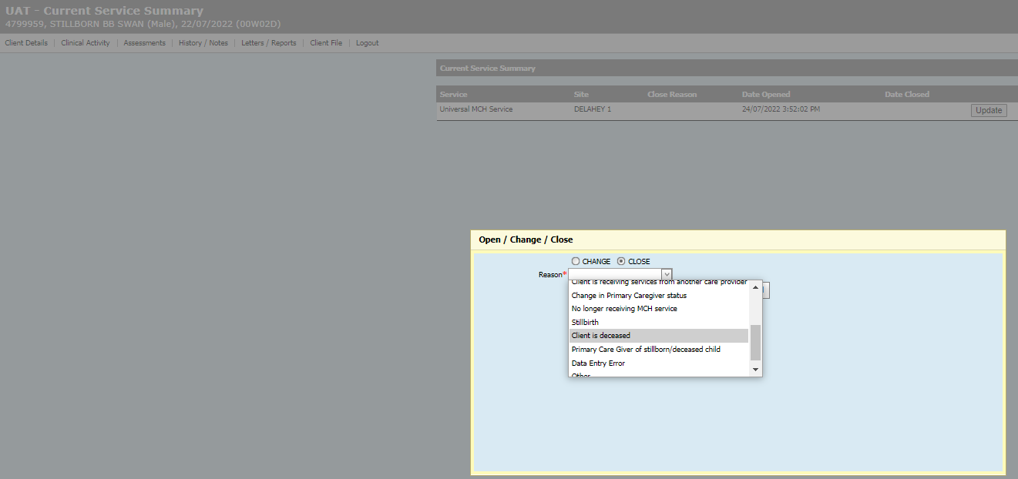
Recording a stillborn baby – close client
2
CDIS User Group – Admin Feb 2025
Notes:
Step 2 is that we now close the client file via the client details - open/change/close client tab.
Select stillbirth as the reason.

Slide 15
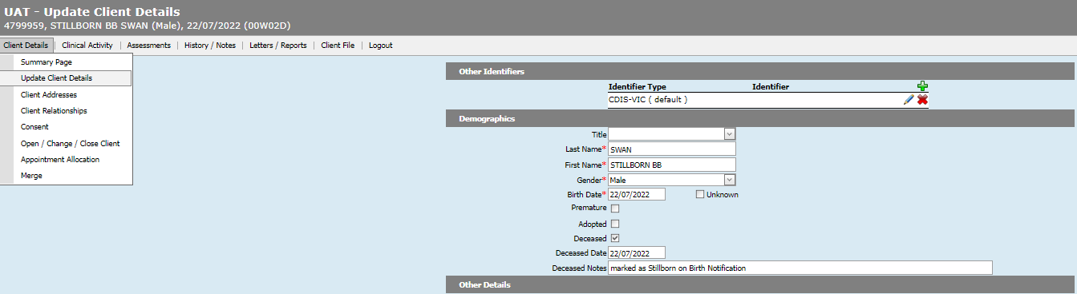
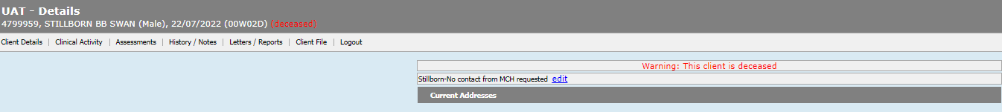
Recording a stillborn baby – update client details
3
CDIS User Group – Admin Feb 2025
Notes:
Third step is to go back into the update client details screen and mark the infant as deceased.
This will cause the babies name to be in yellow italics in the client home screen.

Slide 16
Recording a deceased parent/caregiver
1. Client details > close record >select reason as deceased
2. Update client details > close > select reason as deceased > save
3. Change relationship status/contactable/Information sharing status
4. Select new Primary Care Giver and check that they are open
5. Open new primary Caregiver to service
CDIS User Group – Admin Feb 2025
Notes:
Similarly, a deceased adult should be closed with the reason marked as deceased.
Enter the Update client details page to mark them as deceased there as well.
Remember to update relationships, selecting a new Primary care giver if required and ensuring they are open to service.

Slide 17
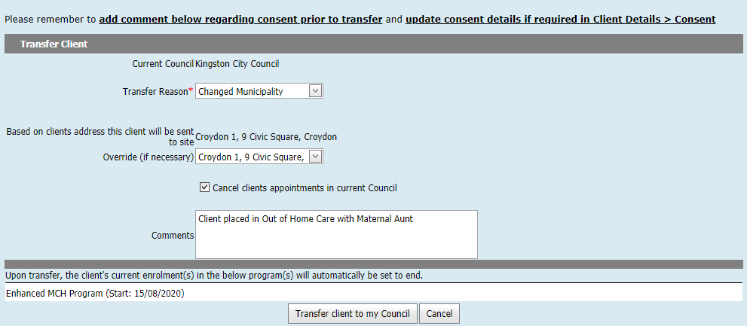
Transfer of EMCH / S&S client
CDIS User Group – Admin Feb 2025
Notes:
Careful note should be taken when transferring adults that have a current enrolment in an Enhanced or S&S program as these programs will be closed and information can get lost when transferred.
Cut and Paste the Program information into the comments before transfer of the record.
Best practice would be to have the MCH team leader contact the relevant council prior to transfer.
Best Practice is to always pull histories, never “push” or transfer a file away from your council.

Slide 18
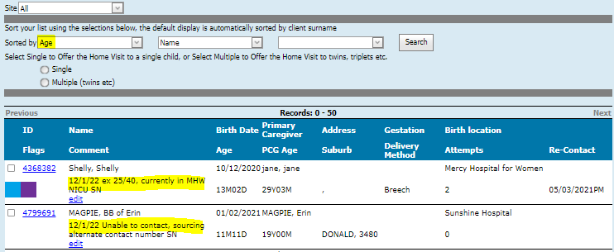
Birth Notification List
*Hint: if data is present in the delivery method column, family likely to have already had the Home visit as data entered by MCHN
CDIS User Group – Admin Feb 2025
Notes:
The BN list will contain new birth notifications who have yet to have their HV confirmed.
The edit bar is a useful tool for tracking HV plans, particularly if there is a delay in the HV.
The edit bar note is for administration purposes only and does not get recorded in the clients notes as a permanent record.

Slide 19
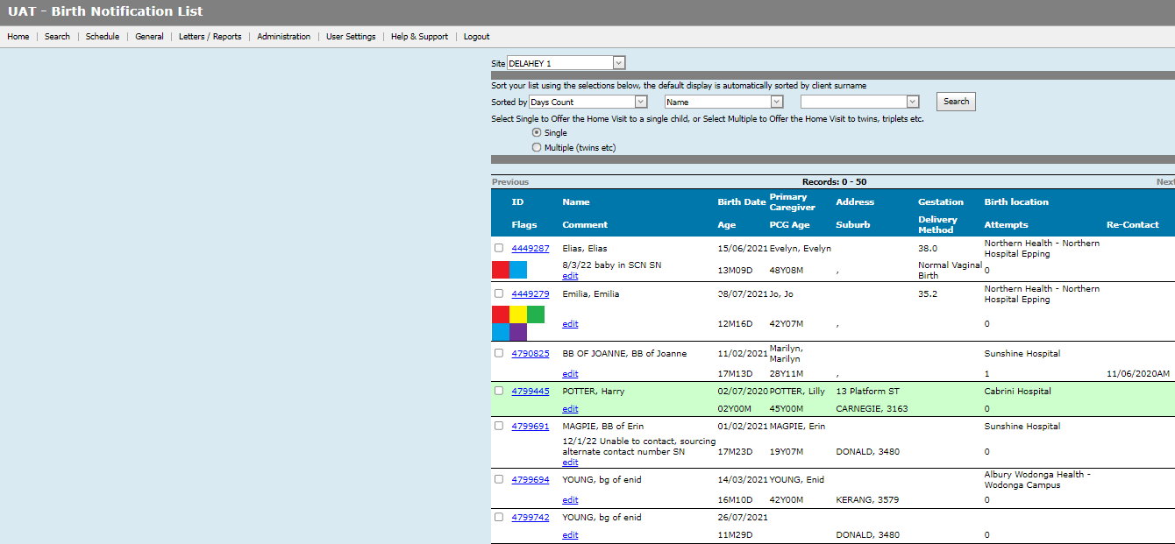
Caregivers added to the Birth Notifications List
CDIS User Group – Admin Feb 2025
Notes:
On the occasion that a previously closed client is re-opened for service, they may appear on the birth notification list.
Sometimes an older child is put onto the system they can also sometimes appear or if a previous Council has not removed them in the past from the BN list on transfer they can also appear.

Slide 20
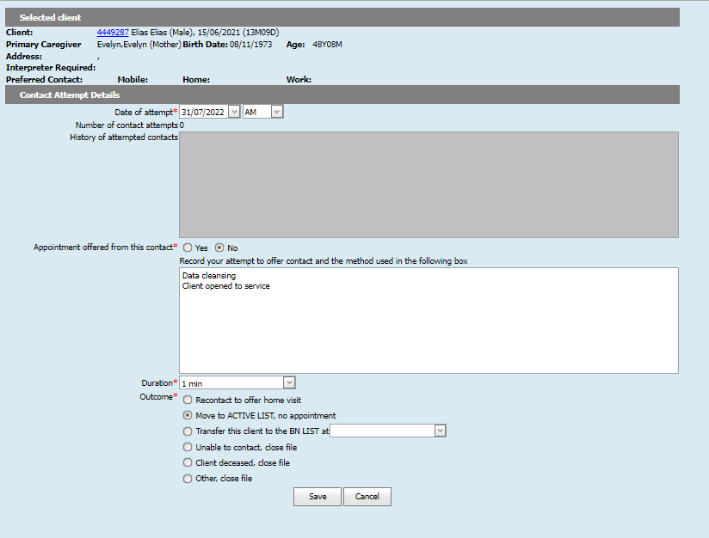
Data Cleansing the BN list
CDIS User Group – Admin Feb 2025
Notes:
To remove them off the list, proceed tick the fields to offer an appointment but state “data cleansing-client receiving MCH service” and apply a time period of 1min.

Slide 21

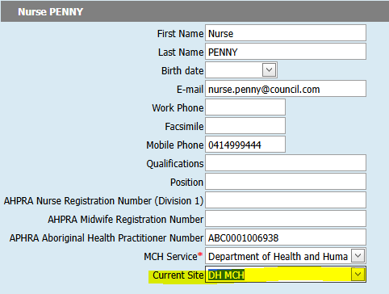
Update Current (Home) Site
If working from a different diary or site in CDIS, you can change your current site.
On the Home page, select menu User Settings > Update Details
Click Current Site drop-down list and select the correct site.
Click Save at the bottom of the screen.
The default site on the Calendar screen will now be updated.
CDIS User Group – Clinical Feb 2025

Slide 22

CDIS Support
Before contacting CDIS Support with issues or questions:
Discuss with a Clinical Coordinator, Team Leader or CDIS Champion. Many issues can be solved swiftly by your team.
Are you the only one with the issue or are others experiencing this too? When was this problem first noticed?
Any technical issues e.g. printing, connecting to CDIS, do others have an issue? Check with your IT team if there is a network issue, or an issue affecting your device.
Check the online resources available from the CDIS Home page > Help & Support menu.
CDIS User Group – Clinical Feb 2025

Slide 23
CDIS Support (continued)
If your local resources cannot assist, and your issue or question remains, contact CDIS Support on 1300 856 183 or cdis@support.vic.gov.au and include:
  Confirmation you have first asked a Clinical Coordinator, Team Leader or CDIS Champion and / or local IT.
  A summary of the question or issue, and if it is affecting others also.
    What screen are you using? Provide a screen capture of the error and copy and paste the screen URL (web address).
    What actions / steps are you doing in CDIS? (this helps to reproduce an issue)
    What is the outcome you’re expecting vs what is actually happening?
    Client ID (this is essential to investigate client related issues)
  For reports, also include the name of the report, include the data range, and any other data selections. If you can , supply a copy of the report . Leave CDIS ID’s but you can remove personal information such as DOB, name etc, and list what you have removed along with the report and the issues you’re experiencing.
CDIS User Group – Clinical Feb 2025

Slide 24
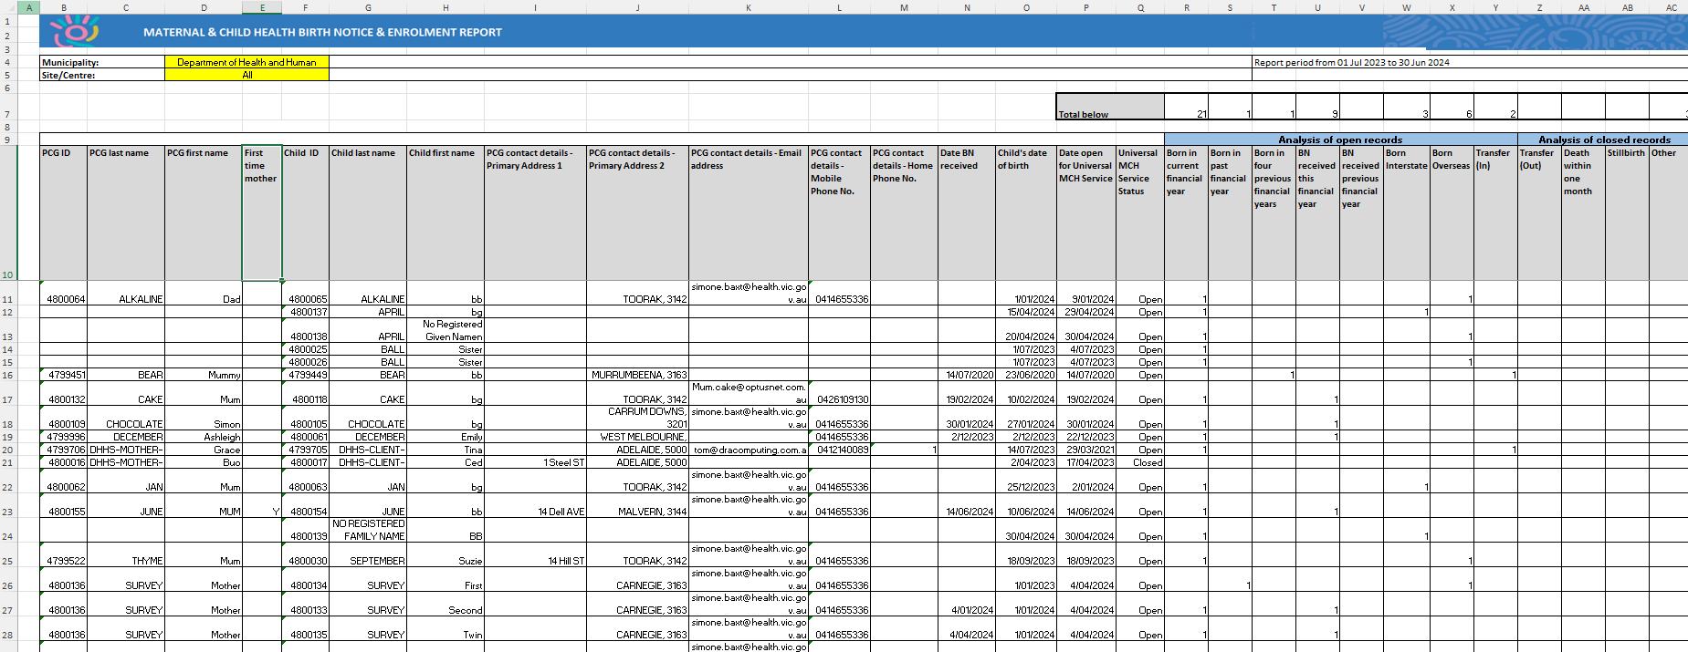
CDIS Support (continued)
This is an example Birth Notice and Enrolment Report.
CDIS User Group – Clinical Feb 2025
Notes:
Example Birth Notice and Enrolment Report

Slide 25
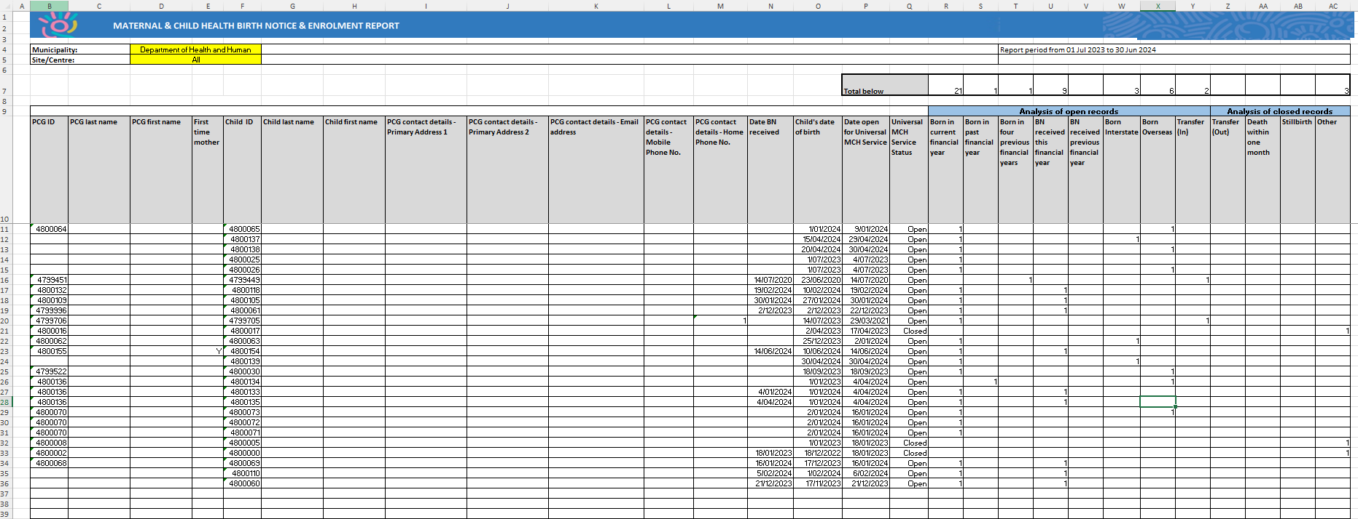
CDIS Support (continued)
You can highlight and remove the data in columns C and D, and G through and including L.
CDIS User Group – Clinical Feb 2025
Notes:
Example Birth Notice and Enrolment Report

Slide 26
CDIS Support (continued)
CDIS Support Hours
Monday to Friday between 8:30am to 5:30 pm
Contact
1300 856 183
cdis@support.vic.gov.au
CDIS User Group – Admin Feb 2025

