Slide 1








Building respectful communities
Embedding prevention strategies in the Northern Metropolitan Region

Slide 2
The Northern Metropolitan Region of Melbourne

Slide 3
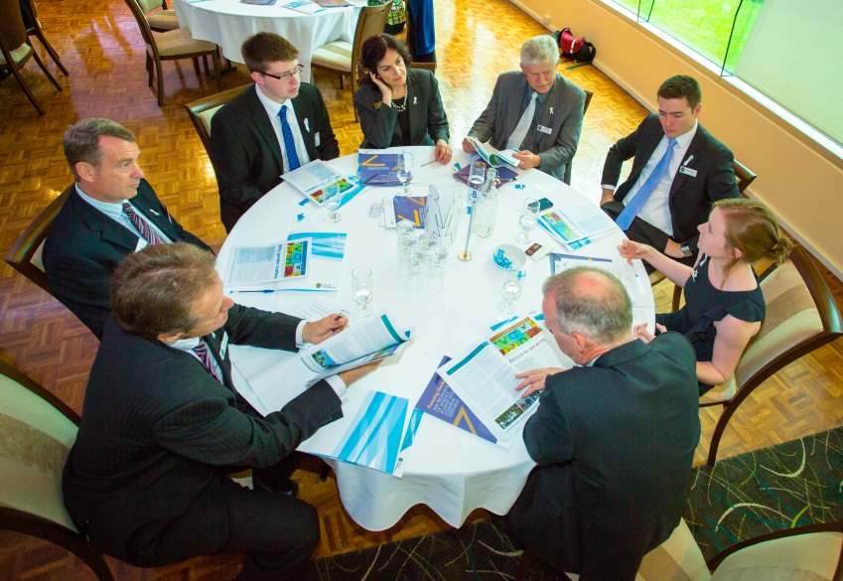
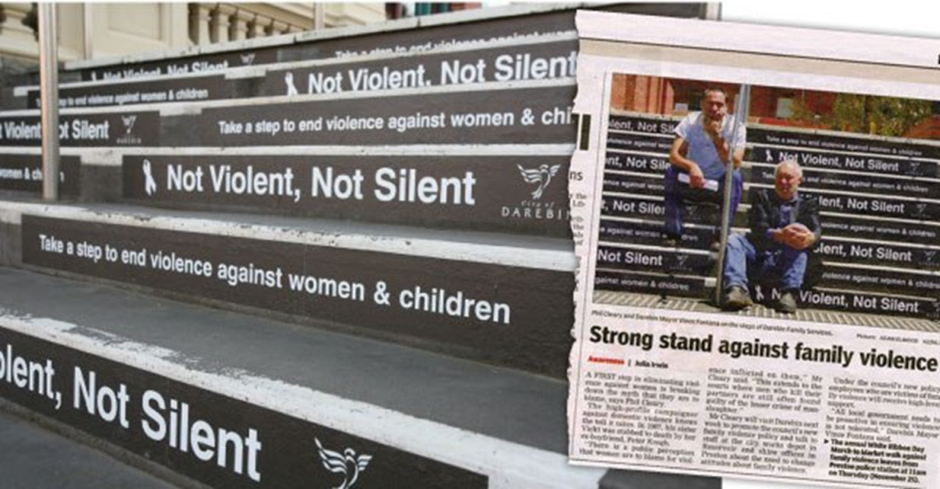
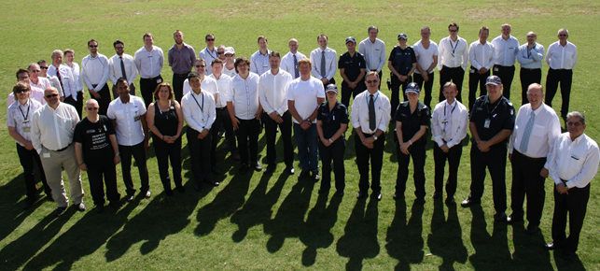
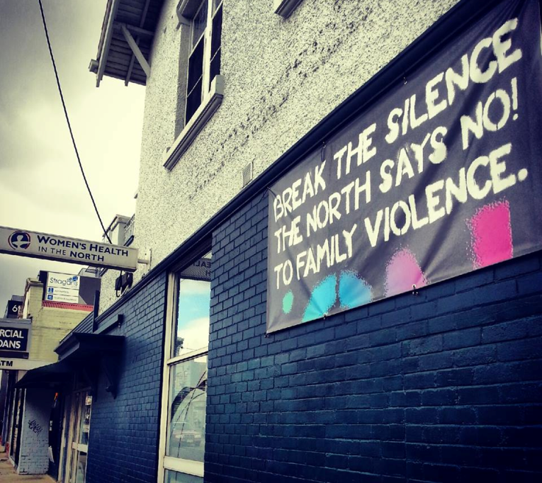
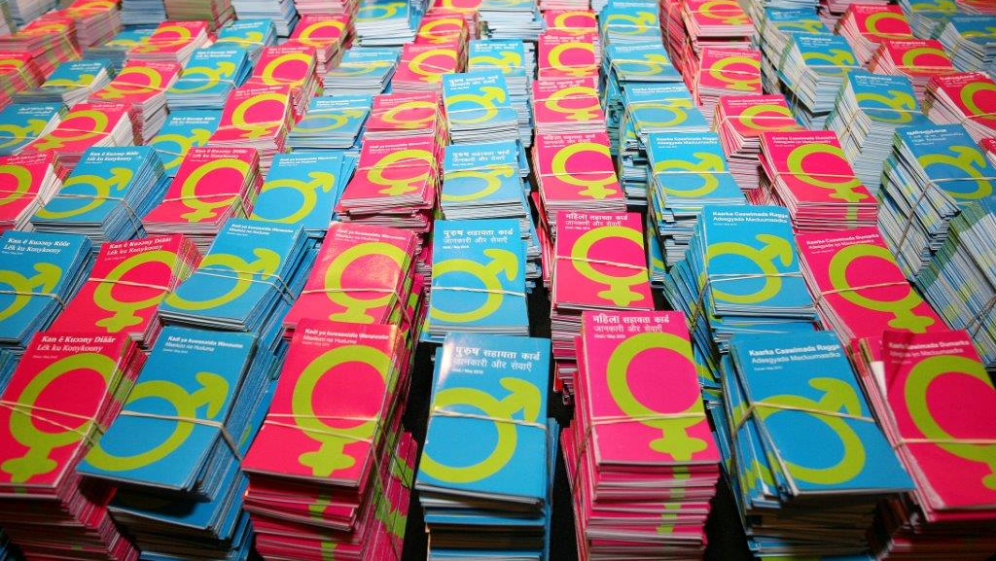
Awareness raising

Slide 4


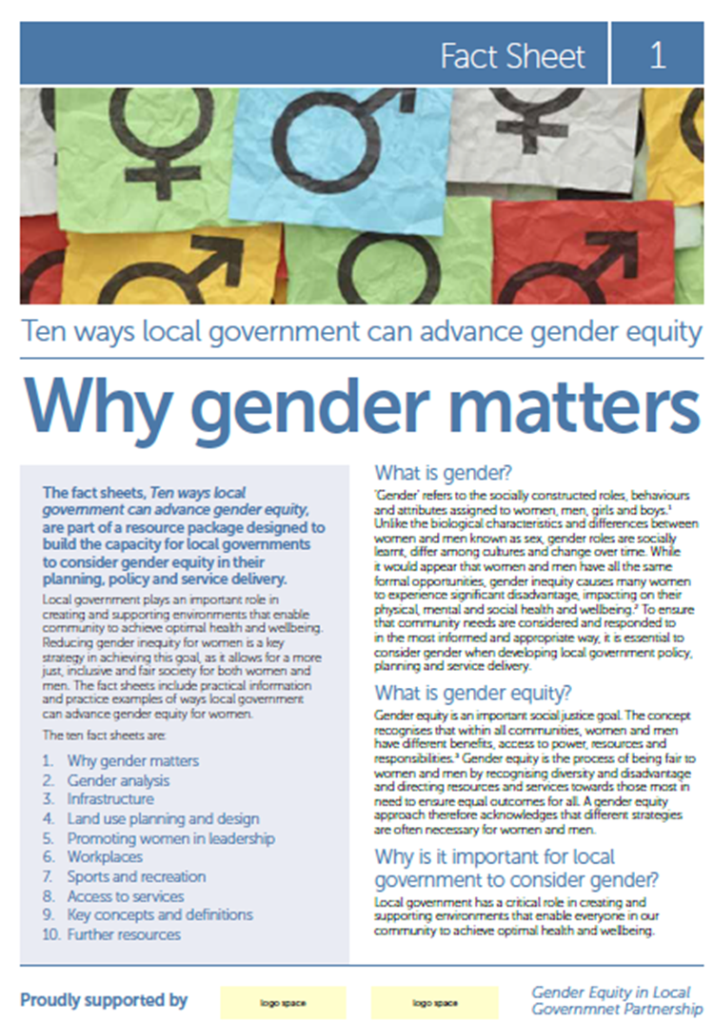
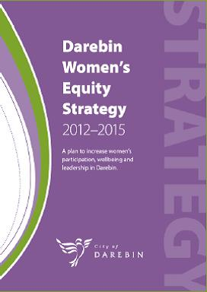
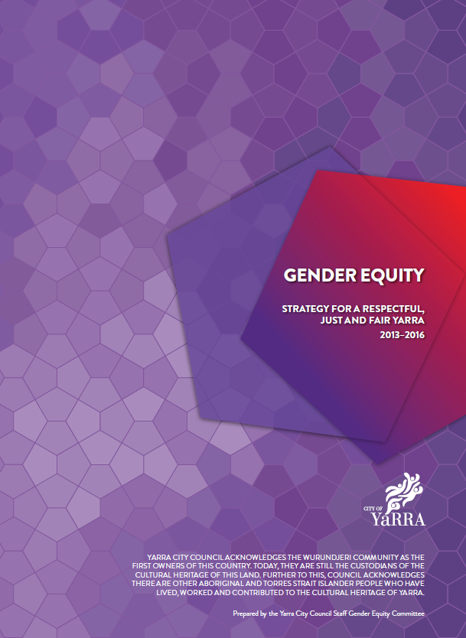
Embedding

Slide 5


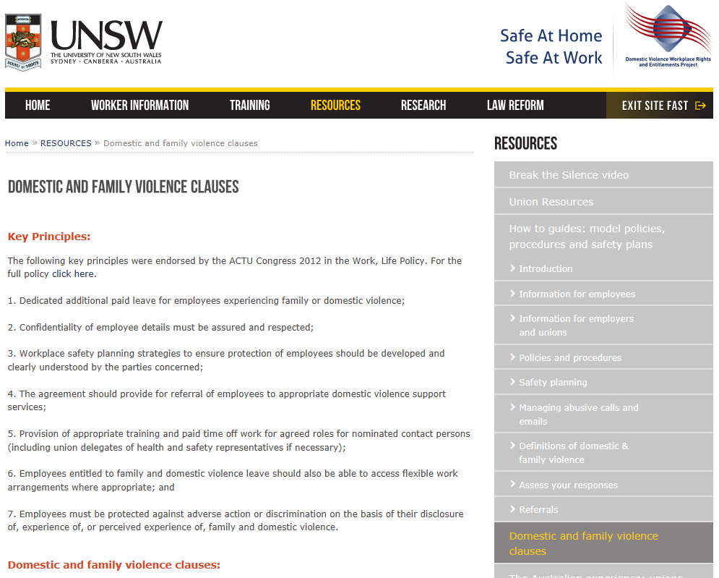
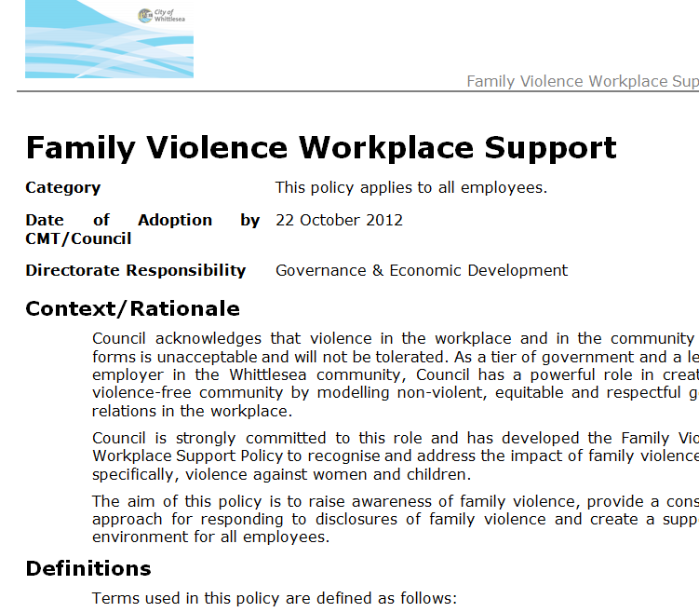
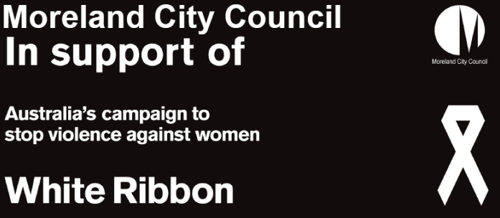
Workforce
Whittlesea Family Violence Workplace Support Policy
Banyule Enterprise Agreement clause
Moreland White Ribbon
Workplace Accreditation Pilot

Slide 6

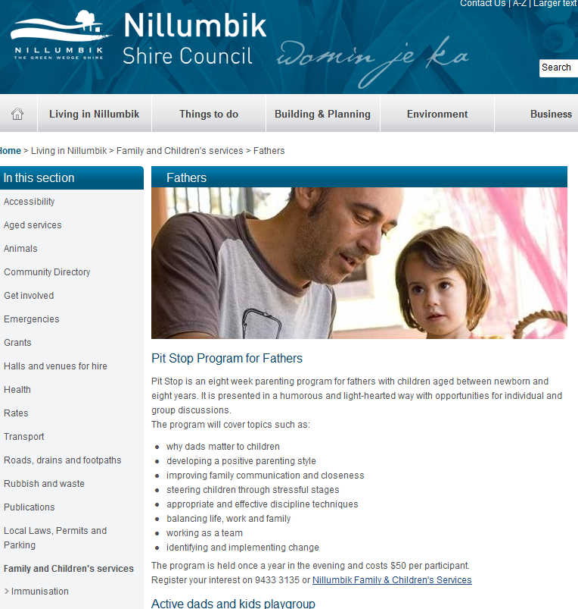
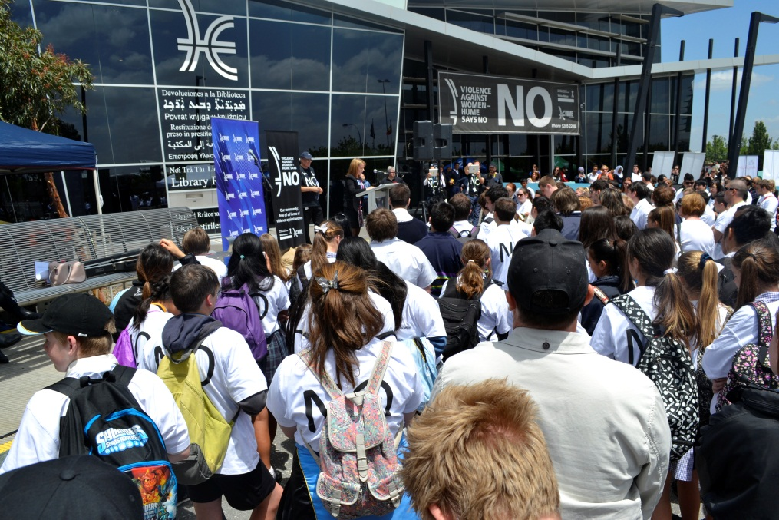
Children, young people and families
Hume Young Leaders Program & Respectful Relationships Program
Nillumbik “I’m a parent” parenting program

Slide 7

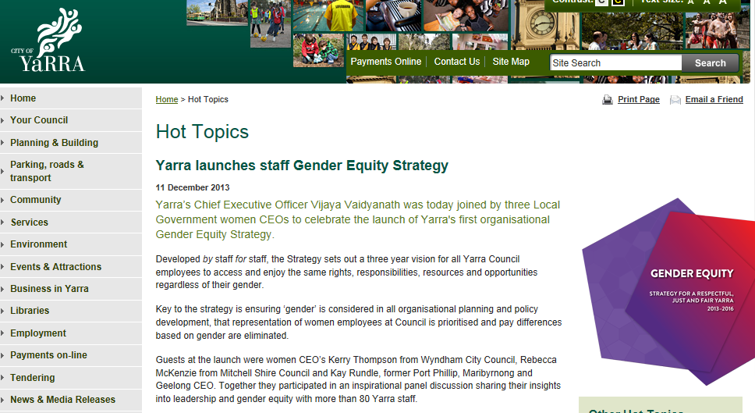
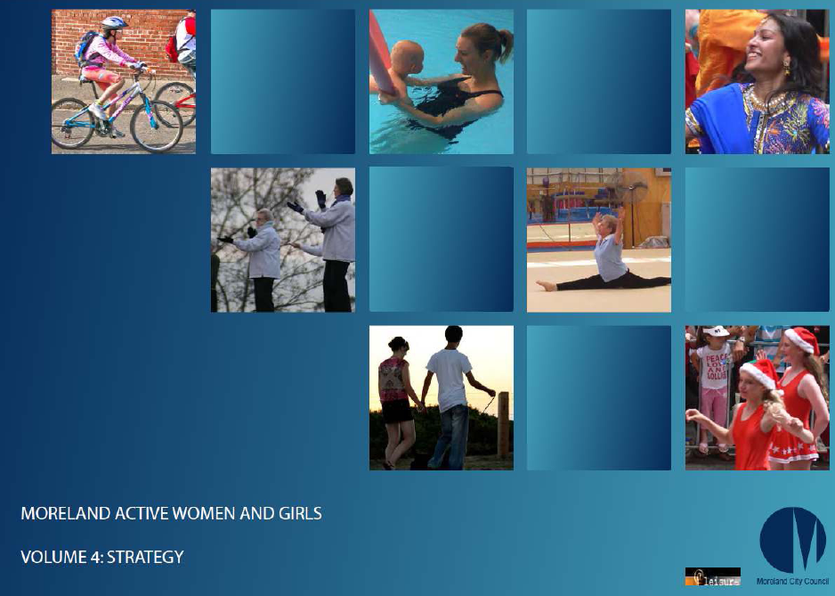


Sport and leisure

Slide 8


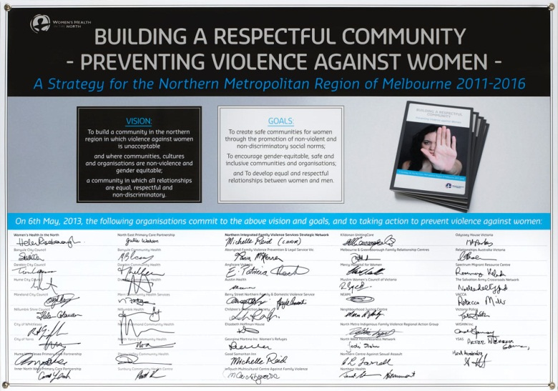
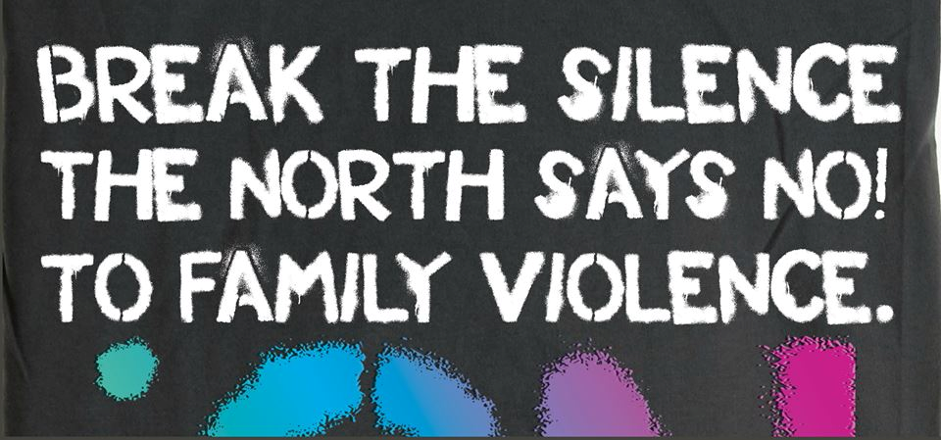
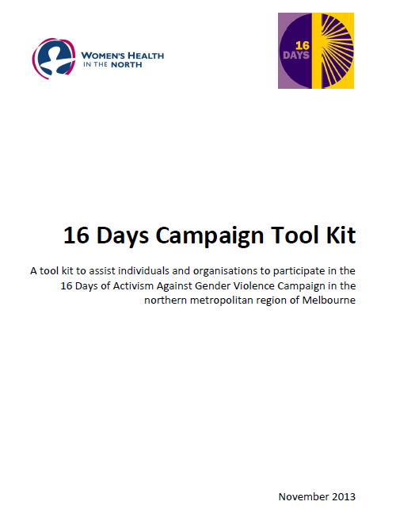
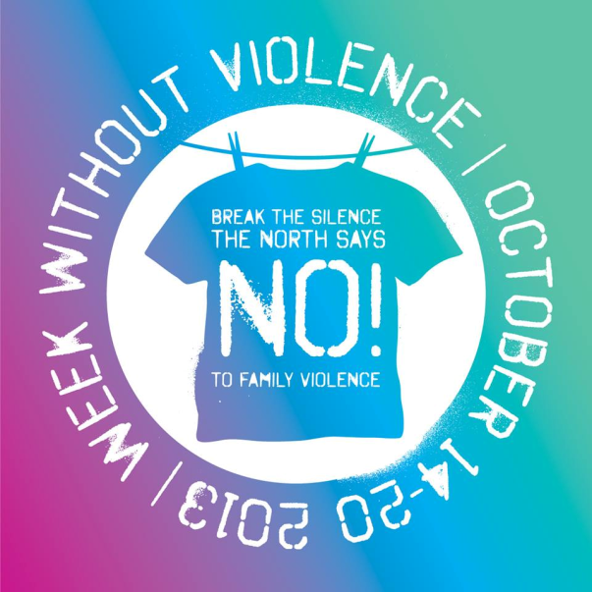
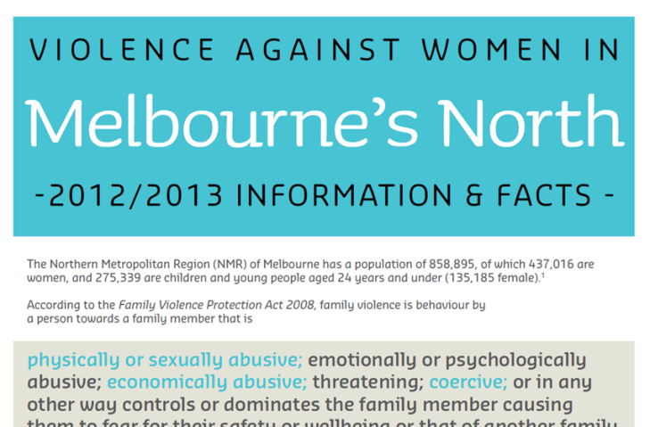
Partnerships

Slide 9

Where to now?

Slide 10
Contact details
Banyule City Council
Sarah Mulholland 9457 9992
Darebin City Council
Teneille Summers 8470 8522
Moreland City Council
May Haeder 9240 2313
Nillumbik Shire Council
Narelle Hart 9433 3135
Hume City Council
Cara Rose 9205 2869
City of Whittlesea
Liz Meade 9217 2192
City of Yarra
Maryanne Clarke 9426 1506
Women’s Health In the North
Sandra Morris 9484 1666

