Slide 1
What do I do if I receive a Birth Notice in error?
General practice discussion, Q&A
Child Development Information System (CDIS)
CDIS Users Group (Admin)
Tuesday 29/11/2022 11:00 am – 12:00 pm

Slide 2
Contents
What to do if I receive a BN in error?
Overdue KAS follow up
General Discussions
Q & A

Slide 3
What to do when I receive a Birth Notice (BN) in error?
Scenarios:
1. BN received from Maternity service but family not living in the LGA it was sent to.
2. BN received but baby not residing with birth mother eg OOHC, surrogacy or adoption.
3. BN incorrectly entered into CDIS prior to realising not residing in current LGA.

Slide 4
Legislation regarding Birth Notifications
The Child Wellbeing and Safety Act 2005 sets out requirements regarding the birth notification process. The Act stipulates that the birth notification is to be forwarded by the hospital or, if the birth did not occur in a hospital, the doctor or midwife that cared for the mother at the birth, to the Chief Executive Officer of the council of the district where the mother resides, within 48 hours of the child being born. It is then the responsibility of the Chief Executive Officer to forward the birth notice to the relevant MCH nurse at the MCH centre within that local government, who contacts the mother and invites her and her family to access the MCH Service.
As per MCH Service Guidelines 2021

Slide 5
Tips with entering Birth Notice
If unsure of address and what LGA the street belongs to please use:
https://maps.vec.vic.gov.au/
This will help you to confirm what address belongs to which LGA before making any entries into CDIS.
Please do not enter the birth notice if not your LGA.
Contact the hospital and inform them that BN was sent to incorrect LGA.
Contact relevant council and advise of BN to come.
As per Birth Notification Processes located on the MAV Maternal and Child Health Information page. Found via the CDIS Help and Support tab.

Slide 6
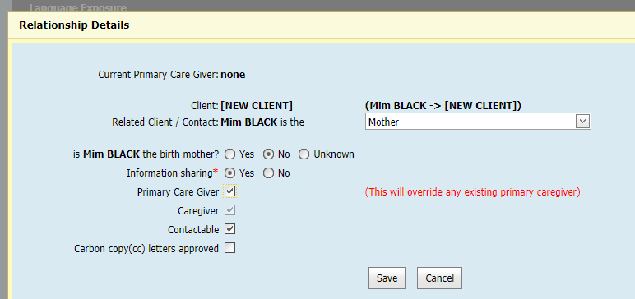
What if the baby is adopted or part of a surrogacy arrangement.
Please tick adoption box if relevant in demographic data.
When adding relationships add birth mother, she may already be open if she has other children in the service otherwise open her for service as she may require post natal care and then close when she completes the care.
Then when adding the non biological mother and open for service ensure that you have ticked non birth mother but add as mother:

Slide 7
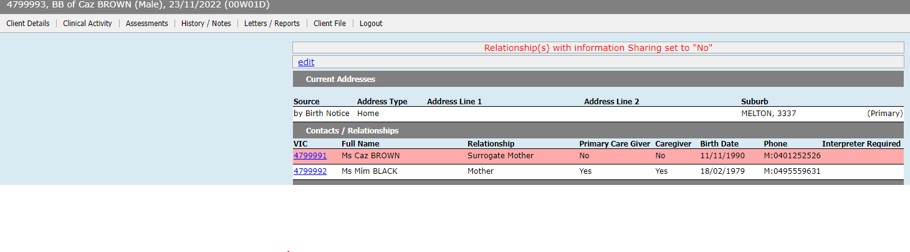
This is how the babies details will look, birth mother should always be attached to the child's history.

Slide 8
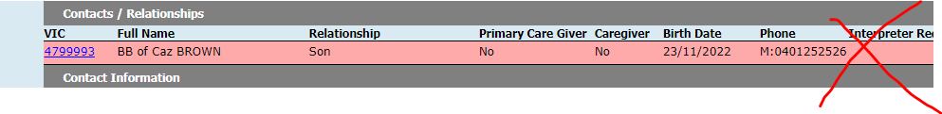
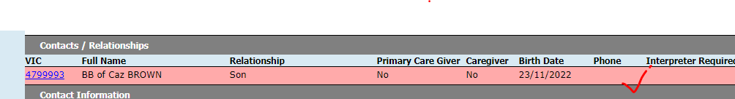
Baby/child should not have a phone number unless migrated data.
Please ensure that any baby or child added to CDIS does not have a phone number beside their details, we do not call the baby/child.
Some children will have contact numbers if the history is migrated.
When you enter a babies DOB there should be no field to enter phone number.
Please do not enter a phone number as it is unclear which parent or caregiver this number belongs to and is unable to be updated.

Slide 9
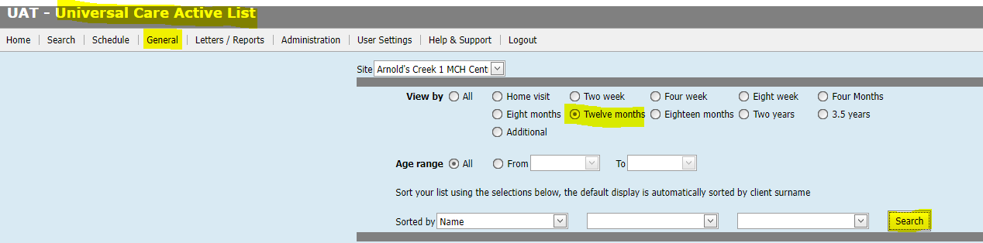
Can I run a report to check overdue KAS?
Yes
General Tab
Universal Active List
Select site
Age selected for overdue KAS
Search
You can then Print Page and an excel document will populate.
This is recommended practice to rebook missed appointments.

Slide 10
Questions and Answers – addressed in the next slides
Pleased ask any questions you have
Please use chat function to add any comments/queries.
Questions asked on the day:
Why do I have to cancel appointments from the calendar?
Why can't I delete from the Consultation page?
This meeting is for you and your MCH team and their practice so please provide feedback for future meetings

Slide 11
Best practice for cancelling appointments.
As per CDIS webinar series on Department of Health MCH website:
https://www.health.vic.gov.au/maternal-child-health/child-development-information-system
Webinar 7: https://vimeo.com/432021138 (password cdis)
Appointments are to be cancelled from the calendar so that a DNA is recorded in the client CDIS history.
DNA recorded this way will also be reflected in the DNA report function of CDIS.

Slide 12
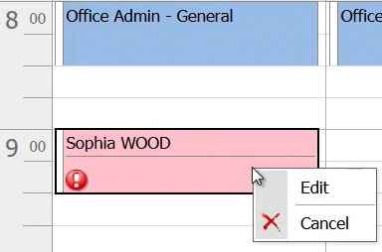
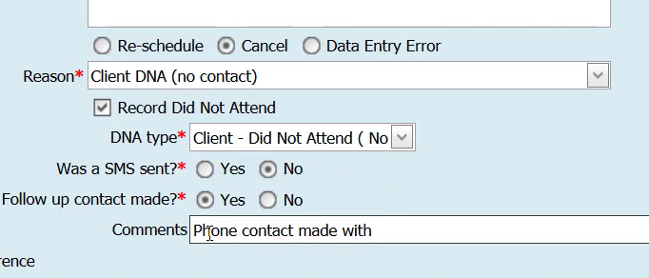
Process:
From the calendar screen right click on the clients appointment and select edit:
Select Cancel appointment and appropriate reason (see snip below)
Complete the fields
Then save.
Appointment will delete from the calendar
Clients history will look like this:

Slide 13
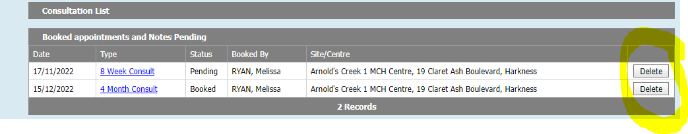
What to do with old appointments in the consult page.
Deleting from the consultation page will not record the missed appointment in the client record or attribute to DNA data.
However, this is a good way to delete appointments from a long time ago or appointments that belong to another MCH service that were not deleted in the transfer.

