Slide 1


Harmful Workplace Experiences and Women’s Occupational Wellbeing
Victor Sojo, Robert Wood & Anna Genat
June, 2015
Melbourne School of Psychological Sciences

Slide 2
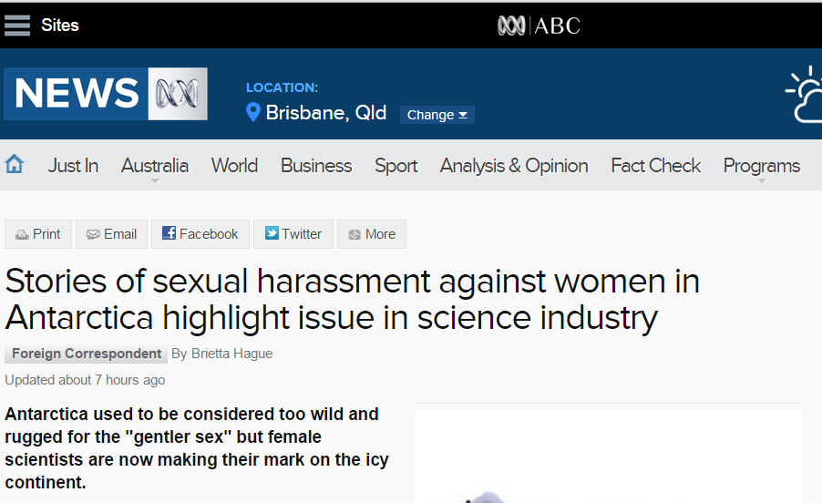

Harmful Workplace Experiences and Gender

Slide 3
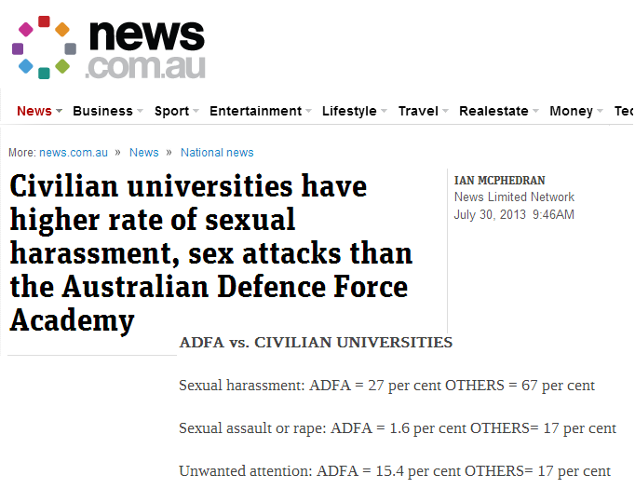
Harmful Workplace Experiences and Gender

Slide 4
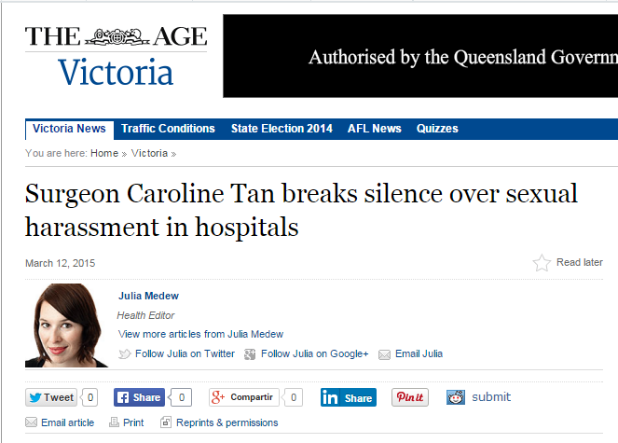
Harmful Workplace Experiences and Gender

Slide 5
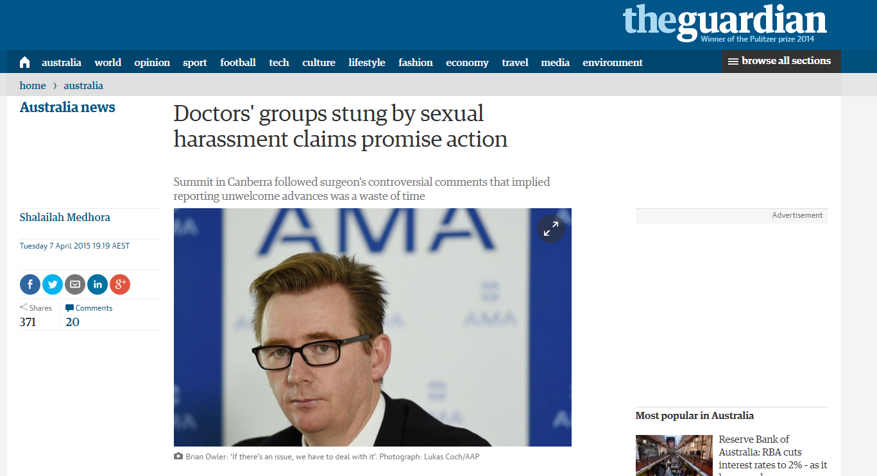
Harmful Workplace Experiences and Gender

Slide 6
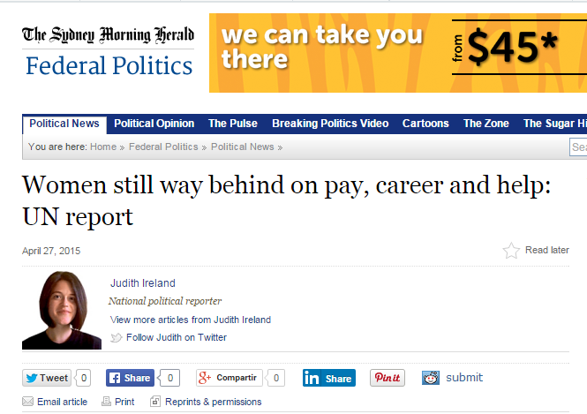
Harmful Workplace Experiences and Gender

Slide 7
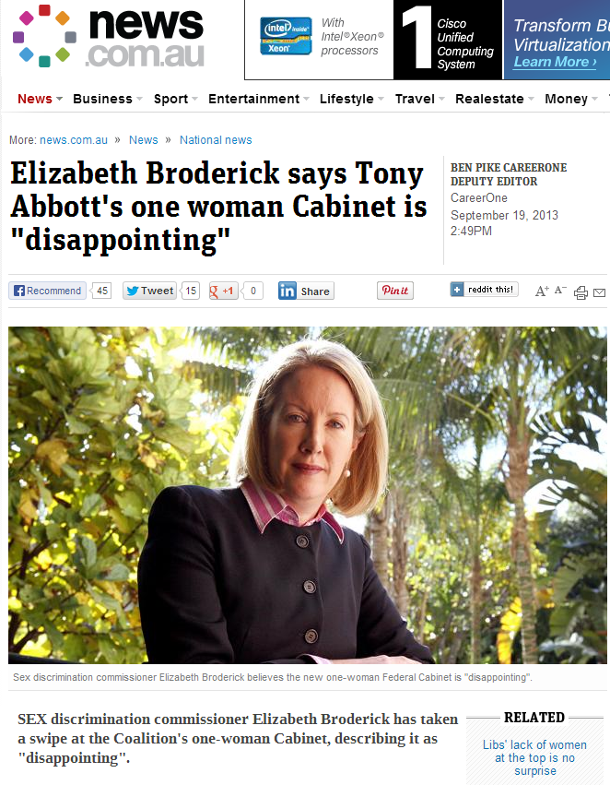
Harmful Workplace Experiences and Gender

Slide 8
Harmful Workplace Experiences and Gender
At work, women are more likely to experience:
  Negative Attitudes towards their Gender
  Gender-based Discrimination
  General Workplace Harassment (Bullying)
  Sexual Harassment
  Sexual Assault
  Other general stressors such as Inter-role conflict.
  (Cortina, Magley, Williams, & Langhout, 2001; Eagly, & Karau, 2002; Elliot, Mok, & Briere, 2004; Schmitt, Branscombe, Kobrynowica, & Owen, 2002; Rospenda, Richman, & Shannon, 2009)

Slide 9
Harmful Workplace Experiences: Definition
Interpersonal abuse against employees
  Happens in the workplace
  Might harm or injure them
  Contribute to a hostile work environment.
  Harmful Workplace Experiences might be…
  Momentary or ongoing
  Psychological, physical or both
  Generalised or based on attributes (gender, race)
  Individual experiences or Organisational actions.
  (Bowling & Beehr, 2006; Rospenda et al., 2009)

Slide 10
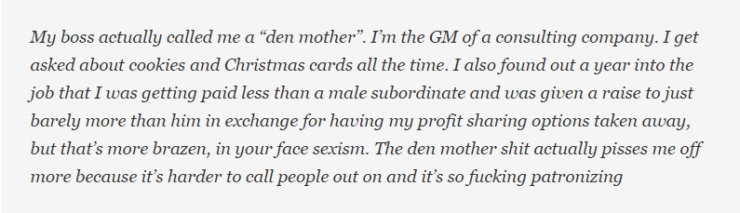
Harmful Workplace Experiences: An Example
Taken from comments section of “Cleaning Nail Clippings, Cutting the Cake: Your 'Soft Sexism' Stories”
http://jezebel.com/cleaning-nail-clippings-cutting-the-cake-your-soft-se-1696010639
  How would you feel and what would you do if you were in her situation?
  What kind of beliefs and attitudes underpin the actions of her boss and colleagues?
  What are the short and long term consequences of being in her situation?

Slide 11
Harmful Workplace Experiences: Classification
Harmful workplace experiences
Non-gender-based Work Harassment
Gender-based
Non-Sexual
Sexual
Organizational climate
Individual experiences
Individual experiences
Organizational climate
Sexist Organizational Climate
Sexist Discrimination
Sexual
Coercion
Unwanted Sexual Attention
Org. Tolerance for Sexual Harassment
Gender Harassment
Sexual Harassment

Slide 12
Harmful Workplace Experiences: Expected Impact
Moderators:
Male Dominated Context
Low Intensity / High Frequency
Gender harassment
Org Tolerance for SH.
Sexist discrimination
Sexist organizational climate
≠?
Proximal Outcomes
Organisational commitment
Job satisfaction
Work satisfaction
Co-worker satisfaction
Supervision satisfaction
High Intensity / Low Frequency
Sexual coercion
Unwanted sexual attention
Distal Outcomes
General health
Mental health
General Stressors
Work harassment
Job stress
Family stress
(Hershcovis & Barling, 2010; VicHealth, 2012)

Slide 13
Meta-analytic Method
Data collection strategy
  Empirical papers published from 1985 to 2013
  Peer-reviewed journals
  Samples of Working Women
  Evaluating relevant constructs
  Data that could be transformed into Effect Size r
Final data set
  106 Journal articles
  109 Ind. Samples
  40 MDWE / 69 General
Data analysis
  Random effects MA
  Reliability correction
  Moderation analysis

Slide 14
Harmful Workplace Experiences and Health
Low | High | General
Low | High | General
r
r

Slide 15
Harmful Workplace Experiences and General Work Attitudes
Low | High | General
Low | High | General
r
r

Slide 16
Harmful Workplace Experiences and Specific Work Attitudes
Low | High | General
Low | High | General
Low | High | General
r
r
r

Slide 17
Harmful Workplace Experiences and Specific Work Attitudes
Low | High | General
Low | High | General
Low | High | General
r
r
r

Slide 18
Moderation Analysis: Work context Impact on the Sexual Harassment - Mental Health Association
r

Slide 19
Harmful Workplace Experiences: Impact
  The distinction between high and low severity of the HWE is not supported by their association with health and work attitudes.
  Sexist Org Climate and Sexist Discrimination have stronger links with General Work Attitudes than other HWE.
  Sexual harassment has a stronger impact in MDE.
HWE are as harmful as other work and family stressors in their impact on work attitudes and health.
Associations of the HWE with work attitudes were the strongest for Satisfaction with Supervision.

Slide 20
Harmful Workplace Experiences: What to do in research?
Longitudinal research
  Better reporting of relevant variables that could moderate these effects (e.g., managerial status of sample).
  Studies of
    Power differential between target and perpetrators
    Other dimensions of gender harassment (e.g., challenging women’s capacity to manage work-family issues)
    Relationship between work-family conflict constructs and HWB constructs.

Slide 21
Harmful Workplace Experiences: What to do in practice?
Evaluation of “low level” sexism, harassment & discrimination.
  Analysis and change of current policy & practices to manage harassment & discrimination.
Promotion of civil work environments.
  Supervisors of each unit/team/department as drivers of strategies.

Slide 22
Harmful Workplace Experiences
  Thank you…
  For more information: www.cel.edu.au

