Slide 1
Gender Equity Advocates
Free From Violence Grant project
Jodie Leahy Family Support & Gender Equity Officer
December 2021

Slide 2
GENDER EQUITY AT NILLUMBIK SHIRE COUNCIL
2016
Gender Equity Internal Working Group
Local Government PVAW grant
2018
Nillumbik’s Gender Equity Policy Statement is endorsed by Council
2021
Gender Equality Act 2020 implementation commences
Pre-2015
Community focused events & activities
2017
Health & Wellbeing Plan includes
gender equity & PVAW as a priority
2018 - 2021
Gender Equity Advocates program established & expanded
Organisational-wide gender & intersectionality presentations

Slide 3

Applying for the Free From Violence Grant
Gender Equity Internal Working Group
Leadership support
Whole-of-organisation engagement
Build capacity and change organisational culture
- Conversation starter
- Focus on service delivery
Partners – Women’s Health in the North & OH&S trainers

Slide 4
Gender Equity Advocates
Risk, leadership support & whole of organisation engagement
15 staff from across the organisation
  Infrastructure
  Finance
  Human Resources
  Policy & Strategy
  Operations Centre
  Environment
  Communications
  Customer Experience
  Planning
  Governance
  Community Services
Plus an additional 11 staff including the CEO, two EMT members, Managers and staff across the organisation

Slide 5
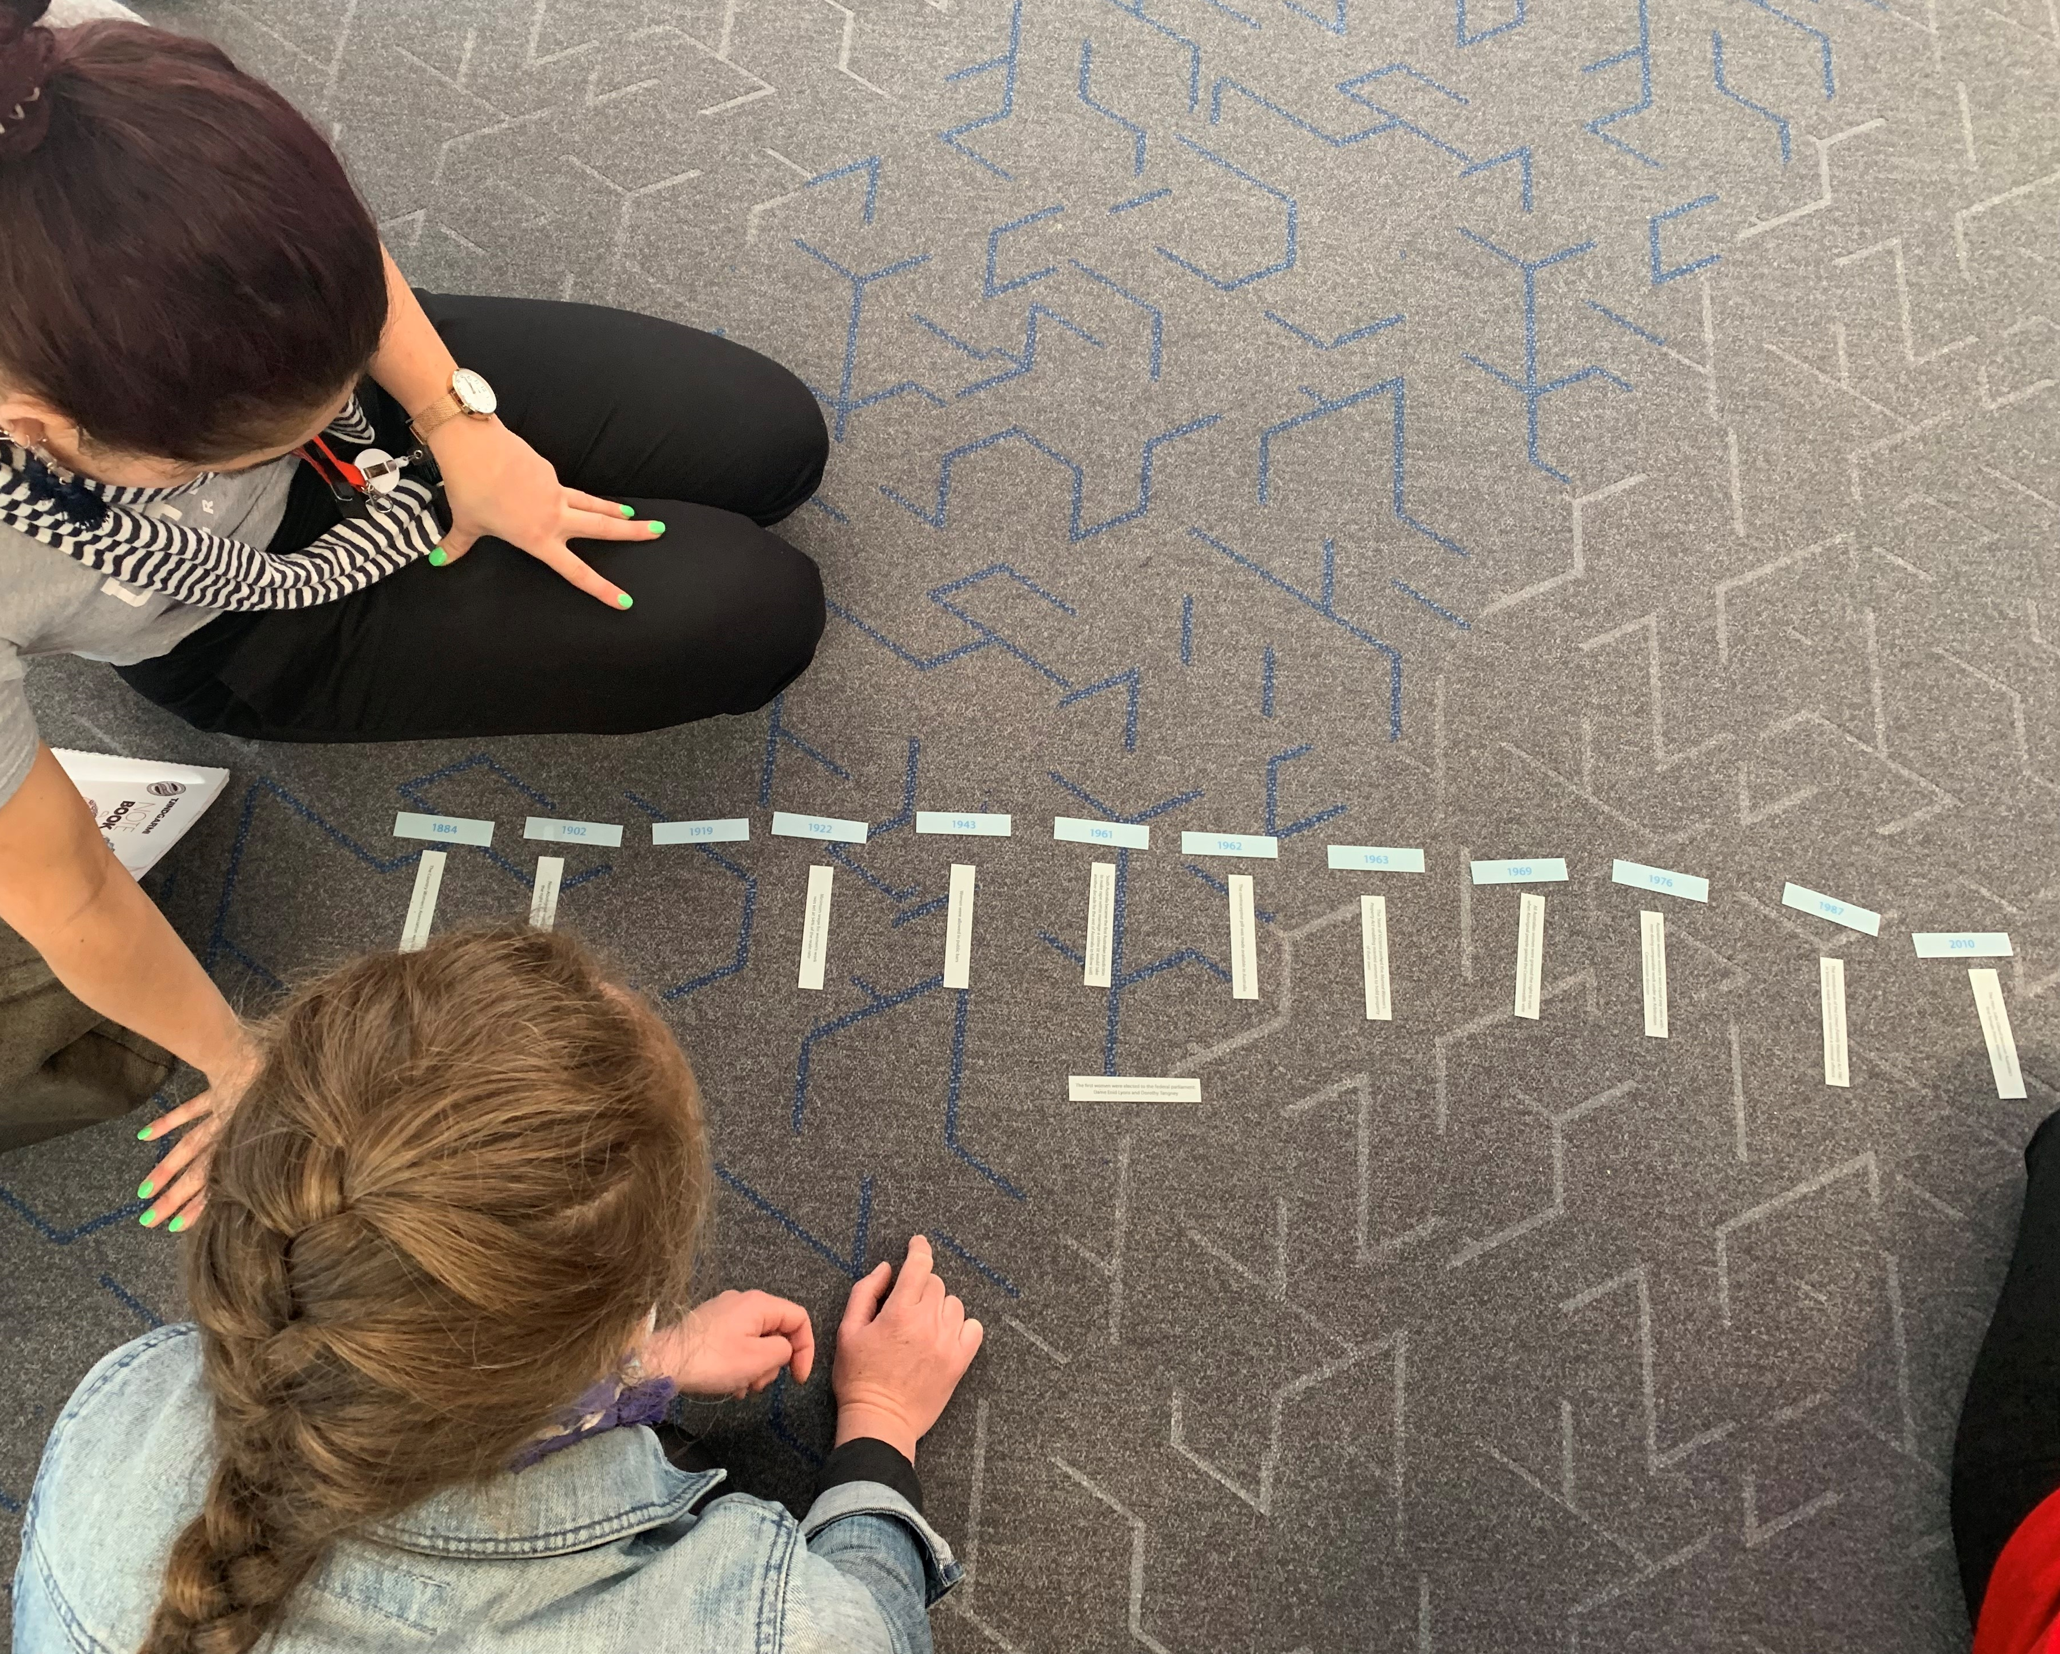
A tailored training program was designed by the Gender Equity Officer with external OH&S trainers and Women’s Health In the North
Two half day sessions – Gender Equity and PVAW
Two Community of Practice sessions
  Resistance and backlash
  Intersectionality
Paired up and visited teams to start the conversation
Presentations focussed on:
  Definitions and data
  Alignment to best practice, strategies & plans
  Gendered drivers
  Family Violence Leave Policy & where to get support

Slide 6
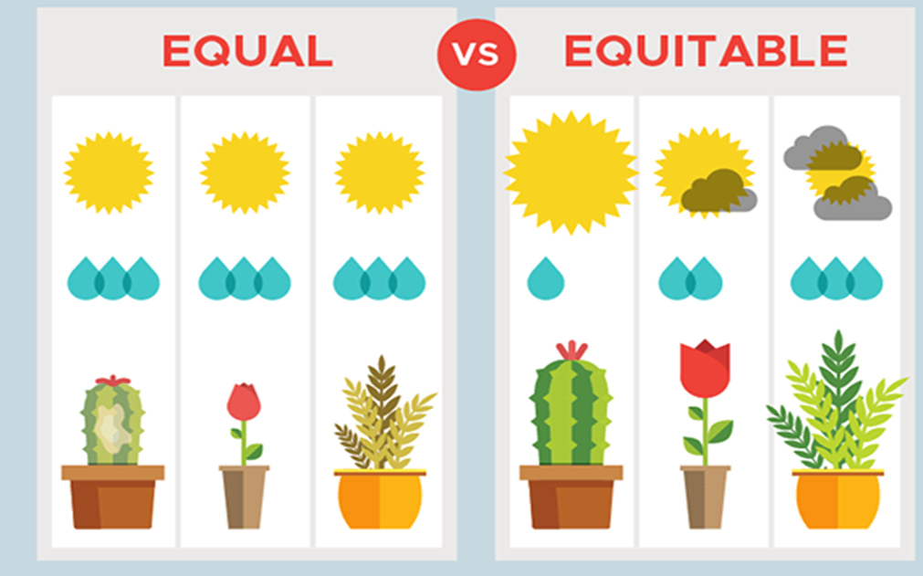
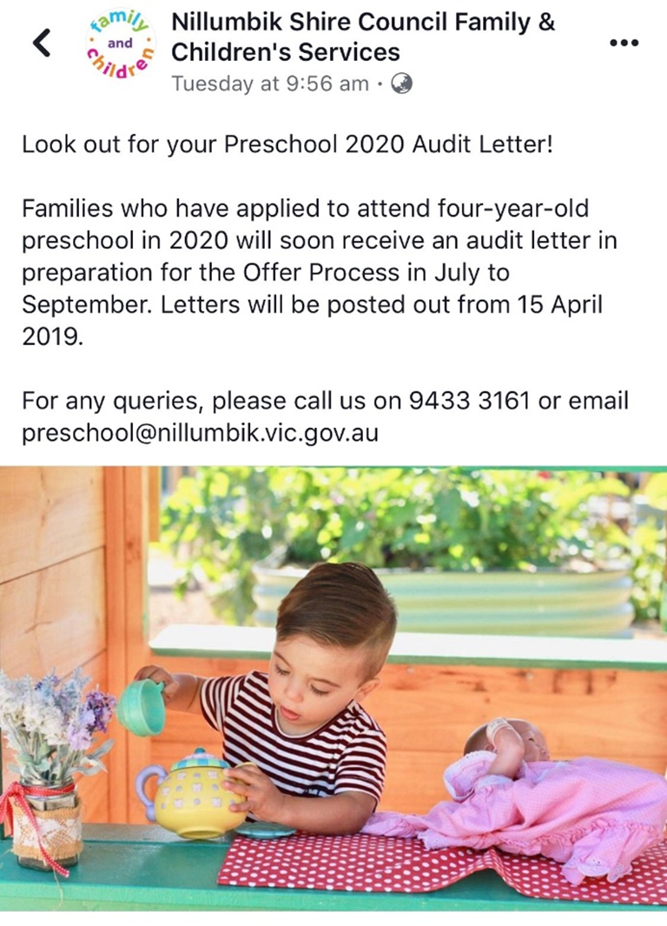

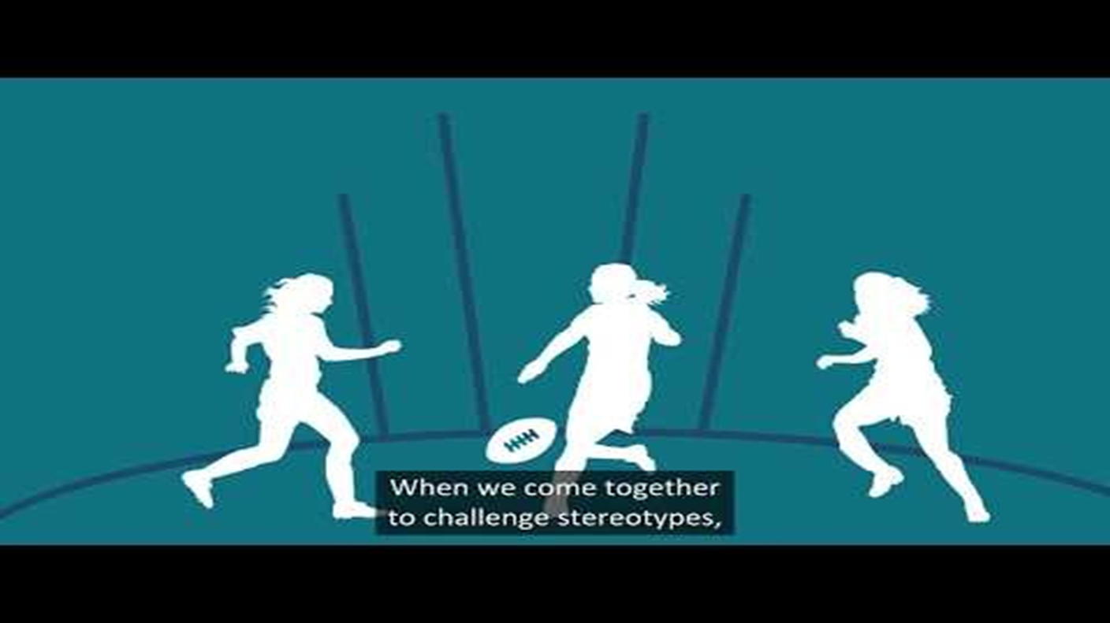
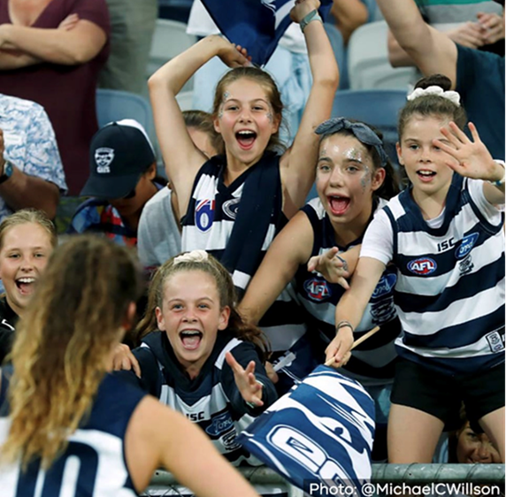
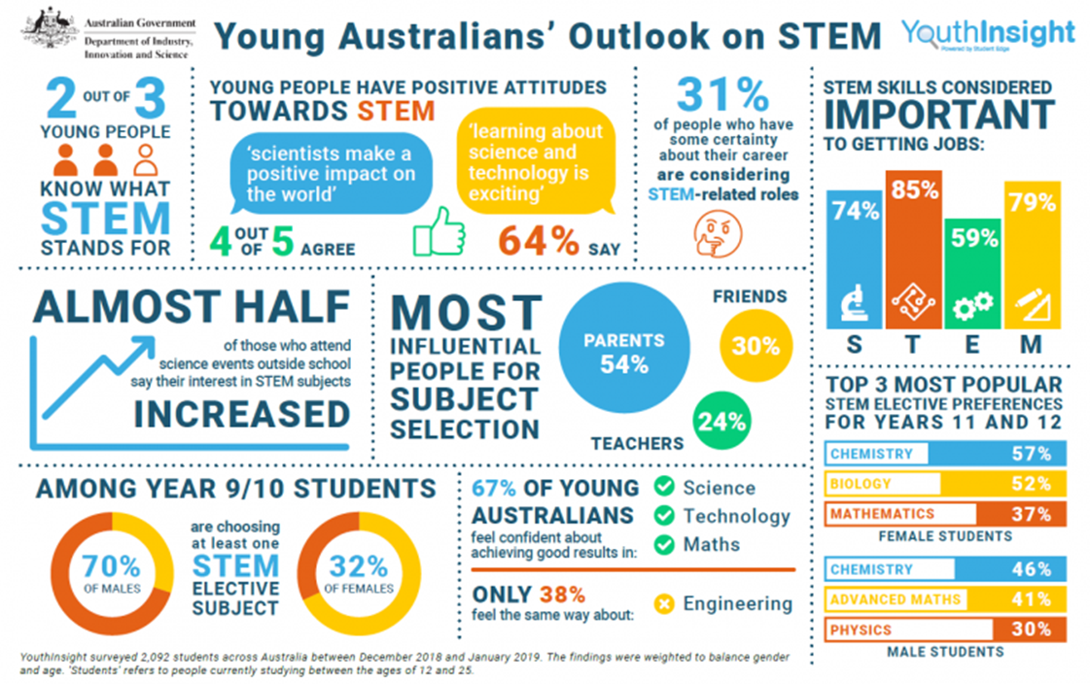
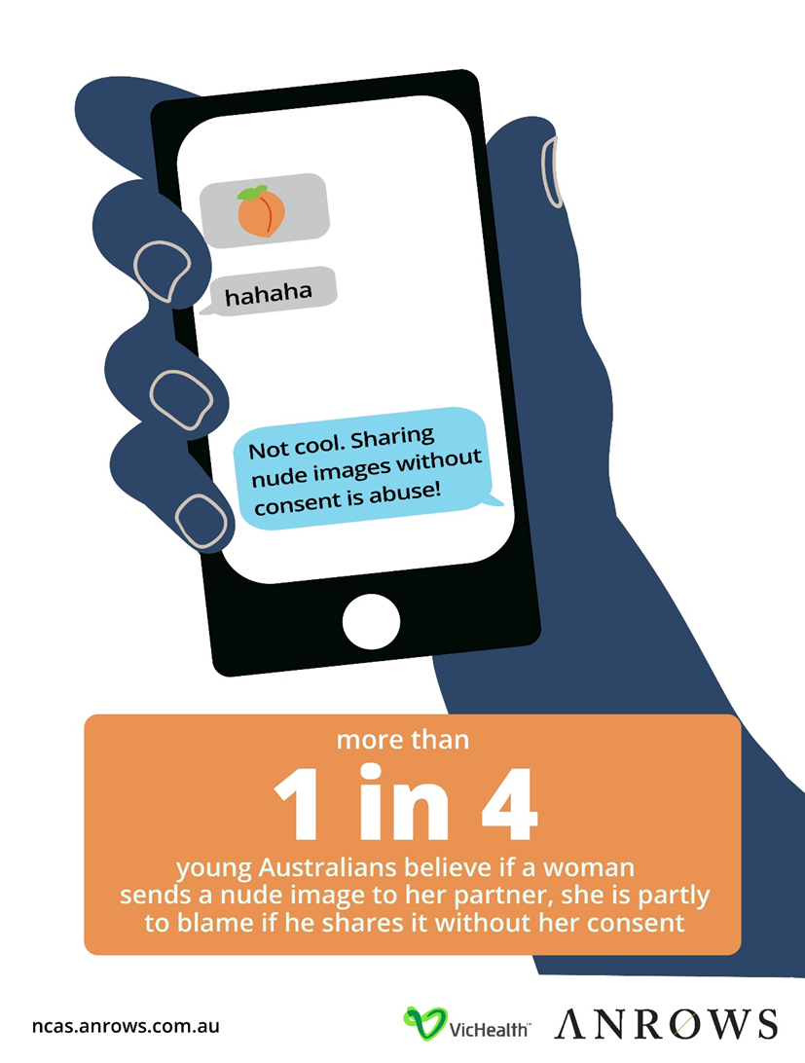
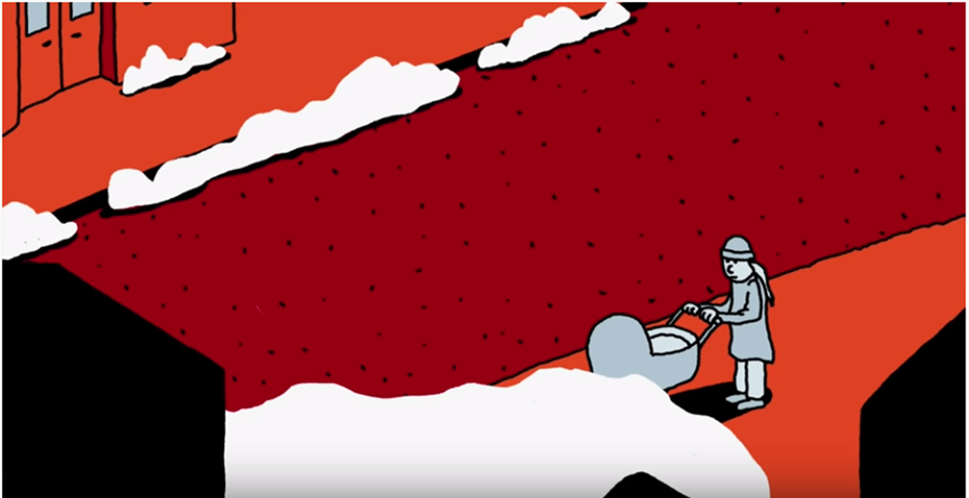
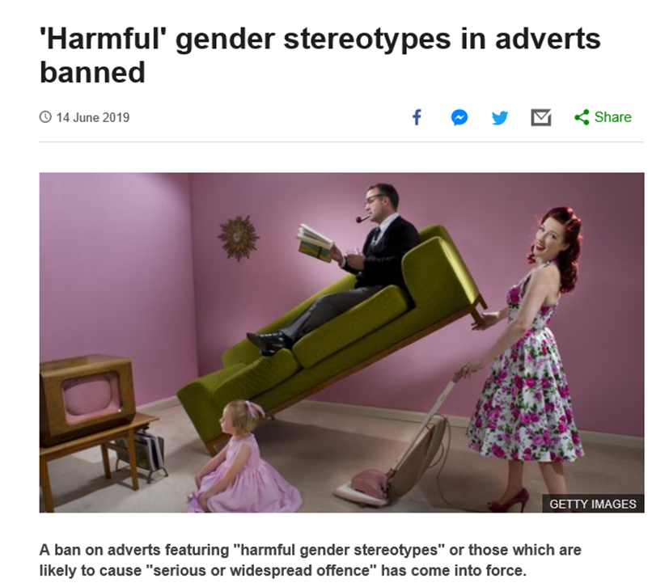
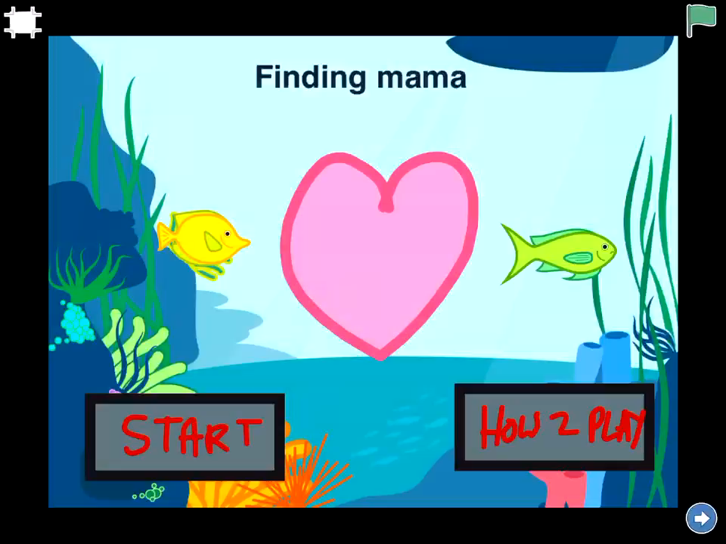
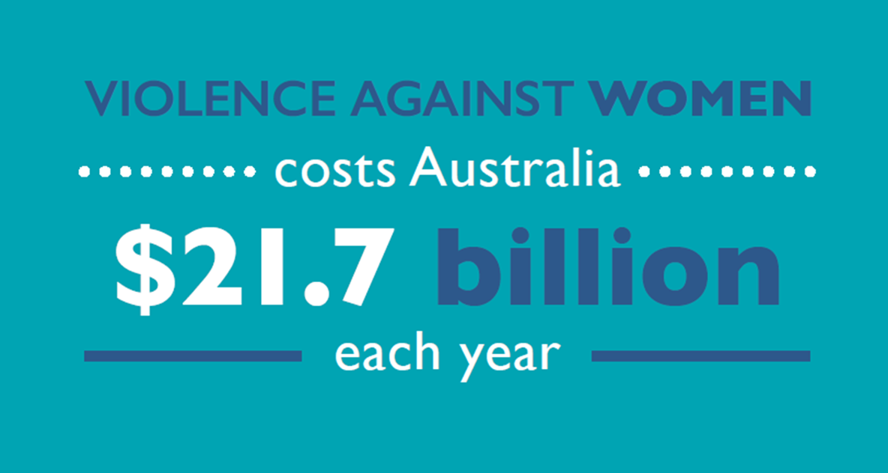
Team Presentations

Slide 7
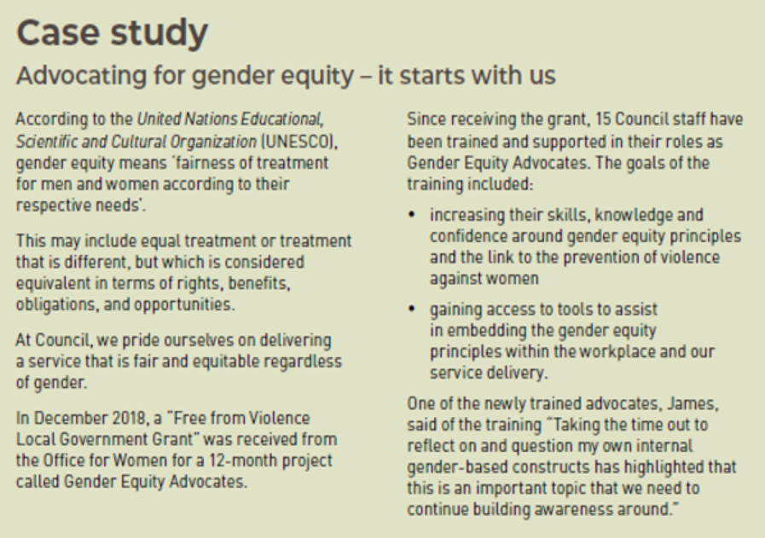
Project Outcomes
Women’s Health in the North facilitated a gender analysis workshop with the Community Safety team
A social work student completed a gender analysis
and audit of the Maternal and Child Health centres
Gender equity considered in procurement
Included in early years services service level
agreements
Communications Writing Style Guide
Staff inductions – GE and Family Violence Leave
Annual Report articles
GE a team agenda item & GE intranet page
Increase of 70% in staff disclosures in FV – reviewed and updated policy & procedures reviewed with HR
Enterprise Agreement negotiations

Slide 8
The 15 Gender Equity Advocates represented all areas of Council and different levels of banding and positions.
Feedback from the GEAs
“Get to know someone from an area of Council I don't have anything to do with in my day to day work"
“Break down the silos"
“Learned about the Executive members and was interesting to see them out of their role and being on the same level as [all GEAs]"
“More of a sense how gender equity principles forms a golden thread throughout the organisation”
“It was a great opportunity to learn as well as to teach”
“I have grown more passionate about the project after every session and presentation I was part of”
“Staff are generally responsive to the GEA project and the organisation has been
supportive”
“My kids have had discussions at home about the project and we continue to talk about it”
“There is so much work being done which is positive, but still a lot more to be done.
We can’t stop the momentum.”

Slide 9
2020 and beyond!
Recruited 10 new GEAs – Gender & Intersectionality team presentations
Gender Equity in Early Years Services Policy Sample – SLAs, working group, community of practice
Passionate engagement and collaboration in 16 Days of Activism and International Women’s Day events and activities
Women in Business, Women’s Community Leadership Program, Young Women Leader Awards
Gender equity at the Operations Centre
Quarterly survey about Gender, Access, Equity and Inclusion
Gender Equality Act 2020 requirements – Gender Impact Assessments, GEAP engagement

Slide 10
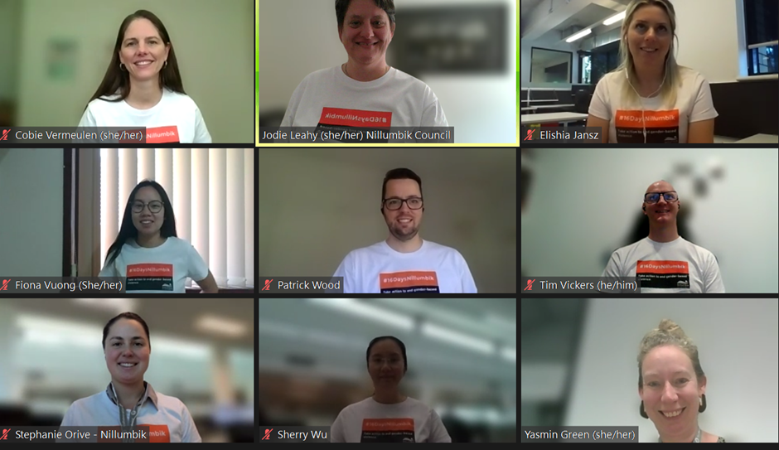
Some of our current GEAs

