Slide 1

MCH Referral Resource

Slide 2
Referral Resource
The Referral Resource is a “go to” tool for MCH staff to access referral information that assists them in their clinical practice;
Most MCH services may have a data base, word document, excel spreadsheet or something similar with all the referral information that staff need to refer families to either agencies or services locally or beyond
We found that this type of information was not updated, difficult to source, each nurse or centre had a collection of “their own resources”
Our nurse Bec came up with the concept to have this information placed in one easy accessible area for all MCH staff to access;
Bec approached myself and asked could she develop the Referral Resource portal for the service and we approved this to be done

Slide 3
Referral Resource
What is it?
The Referral Resource is a Power Point document, that for allows easy navigation of available referral pathway options;
It is has two sections; Child and Adult
Information provided for each organization is;
      Contact details
      Services
      Eligibility
      Referral template/link
      Fees
      Waitlist timeframe

Slide 4


The Set Up
Dedicated person to lead, collate, categorize and publish the information
Collaboration with the MCH and Allied Health staff to formulate a list of organizations to be included in the resource
Template to provide to organizations of the information you require
Council record date base (eg. TRIM) to store Powerpoint file and associated attachments
TIME
  Approximately 38hours to publish the information into Powerpoint from the Excel spreadsheet
COST
  The time to pay a staff member to set it up and collate the information
  No ongoing costs, aside from time to maintain
MAINTNANCE
  Someone to manage the resource – add to & update
  At Brimbank we ask staff to email the Team Leaders with any updates and our Administration staff will update the portal as required

Slide 5
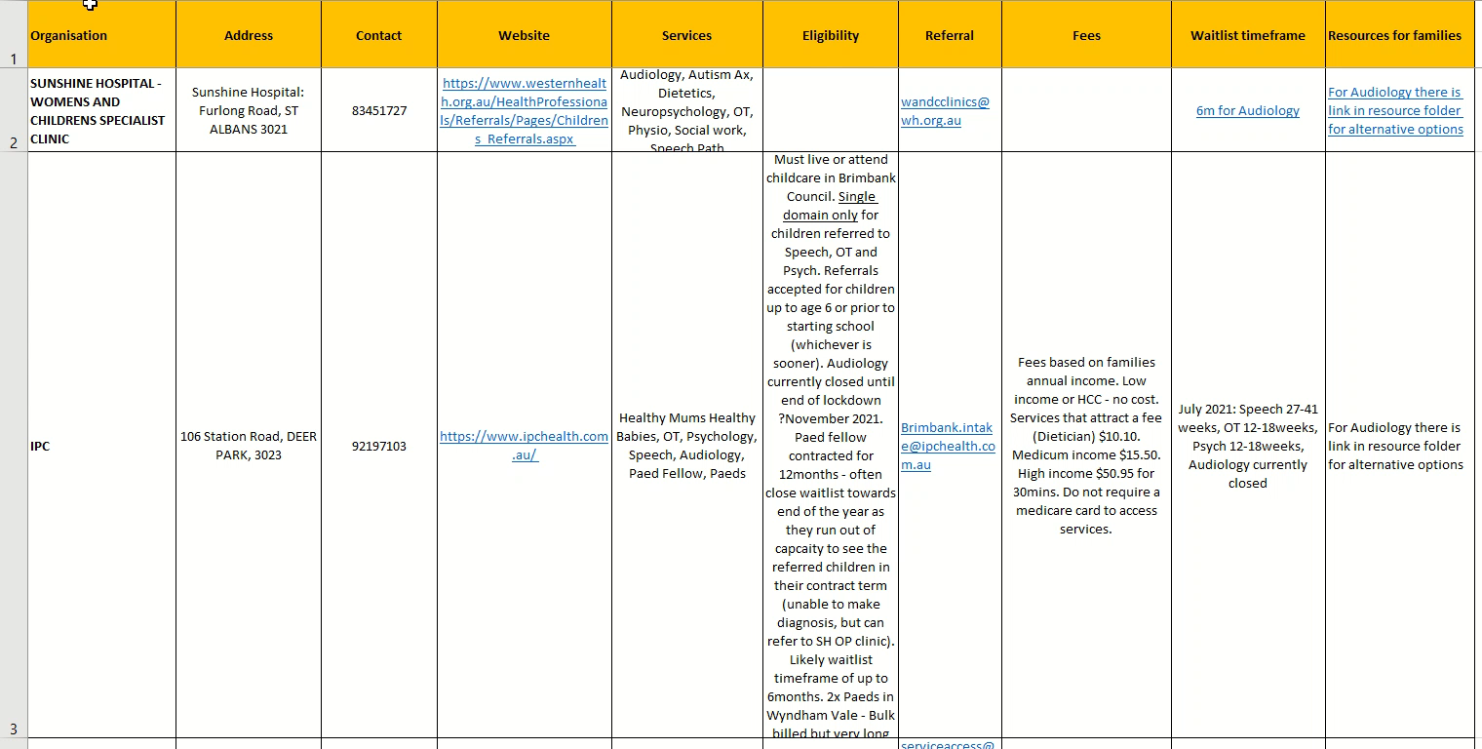
Spreadsheet

Slide 6

Demonstration

Slide 7
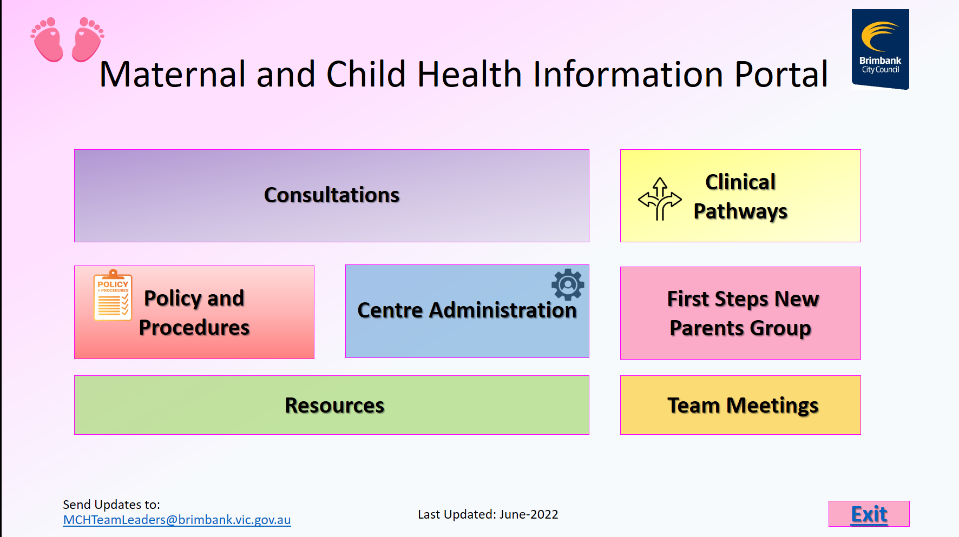
Policies and Procedures Portal
We have also recently developed another portal that contains information on MCH policies and procedures and other information that staff require

Slide 8

Questions
Any questions?

