Slide 1
CDIS Data Cleansing and Reporting for MCH Leadership
Tuesday 6th February 2024
11-12 pm

Slide 2
Agenda
Recording of session for future resource
Data cleansing and Housekeeping
Summary of Recommended Data Cleansing
What data can I get from CDIS?
Reporting Recommendations
Scenarios

Slide 3
Disclaimer
Please be patient and mindful of the content in these slides.
This is the second presentation in what we hope to be a series of presentations for MCH Leadership to discuss data cleansing, data reporting and interpreting reports.
There are many levels of experience in the session today from new and emerging MCH leaders to very experienced leaders.
We can learn so much from each other so please share any current practices or tips & tricks that you have found to benefit your data collection and reporting
Notes:
We have added slides following the last session and the questions that where asked.

Slide 4
MCH Funding
As per MCH Service Guidelines (2019) Universal MCH funding is population based and calculated on the total number of children aged 0-6yrs in the MCH service.
See MCH Guidelines for further information re flexible service funding, Family Consult funding, EMCH and S&S https://www.health.vic.gov.au/maternal-child-health/maternal-and-child-health-service-framework
See MAV MCH Resource page for Funding calculator and other funding resources https://www.mav.asn.au/what-we-do/policy-advocacy/social-community/children-youth-family/maternal-and-child-health-children-0-6-years/maternal-and-child-health-resources
Notes:
Total number of infant records 2E on the annual report

Slide 5
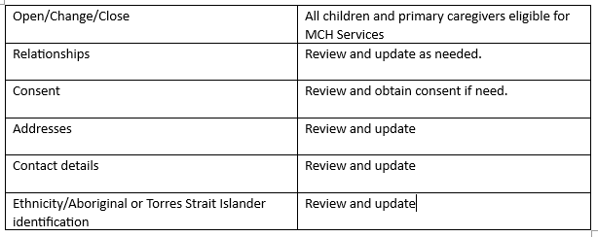
Data Cleansing
Data cleansing ensures accurate data .
Data cleansing is reviewing the CDIS data for your MCH service, identify discrepancies and cleaning up client records for reports.
Data cleansing is everyone's responsibility
Housekeeping with every client history
Notes:
At each primary caregiver contact by phone or F2F personal details should be confirmed eg address, mobile numbers, open status, consent.
Universal Active List report is a good way to compare PCG and child's details such as center, open for service, Aboriginal and Torres Strait Islander.
Review IS of caregivers

Slide 6
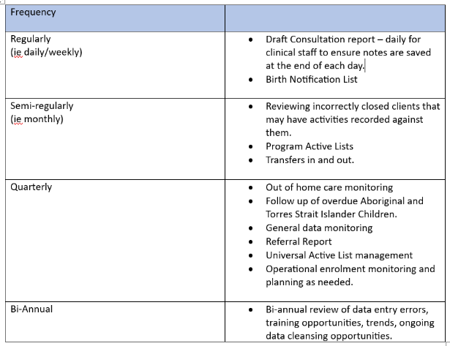
Summary of recommended data cleansing
The recommended frequency of the below data checks is a guide only.
This is dependent on MCH service size, resources available and current data entry accuracy.
Every 3 months review the CDIS access.
Check all current staff are active and any staff that have left are inactive.
Ensure council and health service provider emails are used when activating staff.
Notes:
This is a guide only and is dependent on the size of your MCH services, resources available and current data entry accuracy.
Initially may be frequent but then time frames reduce
Transfer in – ensure that there are no transfer in error – that records are transferred in not pushed out.
Really important to check email linked with clinicians - Gmail, Hotmail and other email accounts are not safe to use, could enable hacking – must be a LGA/health service email address

Slide 7
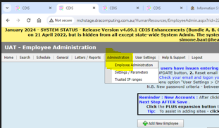
How to make staff inactive in CDIS
Home Screen – Administration – Employee Administration
Untick both the Clinician and Application User checkboxes
Update the End date to be the day after their last working day
Important: Change of name or change of position requires inactivating the old account and
commencing a new account for that User with the changed details
Hint: Use the show inactive employees box to reactivate staff returning
from extended leave
Notes:
Request from Dec session

Slide 8
Reporting Recommendations
CDIS data is accurate at the time the report is generated
CDIS updates overnight therefore most accurate in the morning after the reporting period.
It is recommended to create all reports prior to the commencement of work eg before consults or any work such as making appointments etc. begin on the first workday of each month.
Store reports that contain identifying information in a dedicated secure file as per the Health Records Act.
Consider deidentifying reports prior to saving

Slide 9
What Data can I get from CDIS?
Notes:
Note: The LGPRF is a completely different report with different parameters. It is used as part of a bigger report from LGAs and not used by the MCH service for reporting other than for this purpose.
This is why the LGPRF data is often different to the MCH annual report data.
Note the difference between the Universal Active List and the Universal Active List report. List in general – report under reports.

Slide 10
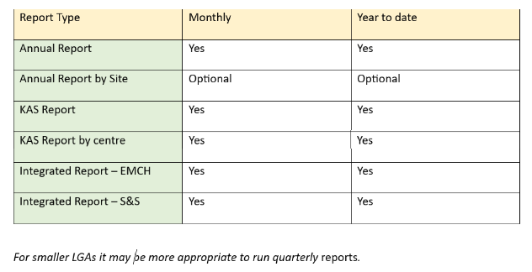
Reporting Recommendations
Notes:
Annual Report by site – Ann to discuss if report goes higher than column Z – and what to do?
KAS report can be by calendar/room – add the rooms together to get the site data.

Slide 11
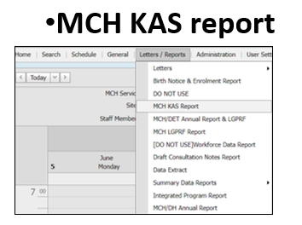
Various CDIS reports
Notes:
Important note: Data updates overnight
?Transfers In and Out

Slide 12
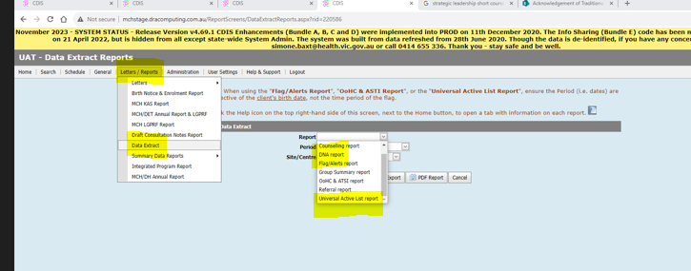
Scenario 1: What is the most efficient way to check DNAs and missed KAS appointments?
There are two reports that you can use to rebook families who have missed appointments:
Data Extract Reports:
DNA report
Universal Active List Reports
Notes:
DNA need to be recorded correctly for this information to appear on the reports.
This process has recently been rigorously tested by Ann and we will update the recommended process in the next CDIS user groups.

Slide 13
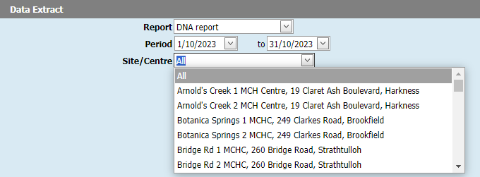
DNA Report
Select time period – eg a month review
Can select all or search by site
Select Excel Report
Notes:
Good practice for MCHN to check DNAs at their center/office/room either by report or in DNA history of client record

Slide 14
DNA Report – Pros and Cons
PROs | Cons
Quick way to look at DNA data | DNA report does not identify if a client has been rebooked only that a DNA was recorded.
Shows attempts to rebook
Shows DNA reason/comments
Shows risks
Notes:
May have clients listed multiple times so also good to filter by client name.

Slide 15
Universal Active List Report
Select time period – eg a month review
Can select all or search by site
Select Excel Report

Slide 16
Universal Active List – pros & cons
PROs | Cons
Shows last appointment status | Doesn’t show DNA
Shows next appointment status | Filter for appropriate data
Shows risks
Shows First Nations status
Notes:
Can search Aboriginal and Torres Strait Islander

Slide 17
Best Practice re following up DNAs
Ensure your team are completing DNA appointments correctly in CDIS. This is important for the DNA to appear in the DNA history, notes on the client file and recorded in the reports.
Having a DNA procedure for your service.
Comparing the DNA and Universal Active List Reports
Checking on client record re rebooking of missed appointments.
MCH clinician to follow up own centre DNAs
Notes:
Recommended DNA process…
Important re recording of DNA in practice.

Slide 18
How to filter reports- excel reports eg Universal Active Report
Notes:
This spreadsheet has been filtered via referral type internal, program EMCH.
You can filter any excel spreadsheet for whatever is in the heading box – eg closed clients, additional needs, Aboriginal and Torres Strait Islander status, sites.
Child is always in blue and PCG highlighted in pink as above.

Slide 19
Scenario 2: How can I find how many young parents are in my LGA to invite to a young parent group?
Universal Active List Report and filter primary care giver by age
Notes:
This can also be used to filter for Aboriginal and Torres Strait Islander status, flags, Programs, internal and external referrals.

Slide 20
How can I find children eligible for ESK?
Not easy request on CDIS.
You can try by running a Data Extract report – Universal Active List report and filter for factors such as age, flags (Child Protection), Aboriginal Status, Language, Additional need.
Tip: Encourage clinicians to record ESK eligibility as a Additional Need.
Tip: Can use ESK program but it must be monitored by Leadership as internal referral
Notes:
Not inclusive of all children this method. Trick is for clinicians to identify early and flag as per LGA process.

Slide 21
Scenario 3: How do I get data on groups?
There are two places that record data regarding groups:
MCH/DH annual report which records the hours within a period spent on groups – see below
Data Extract – Group Summary report can give you more details you would need to filter for groups (eg sleep & settling) as this gives more information re the clients that attended the groups.
This will show group information including:
Group sessions that started within a date range
Name of groups
Client booking status – offered, accepted, declined
The number of sessions attended by the client.
Notes:
Group demographics can also be filtered in this report such as childs age, any flags, additional needs, language etc.

Slide 22
Scenario 4: Where do I find the data for the family consults and MARAM?
Data for these consults and assessments can be found in multiple ways – in the MCH/DH Annual Report and the KAS Report
MCH/DH Annual Report MCH KAS Report
Notes:
KAS report records data of assessments included within a KAS and any assessment conducted within 7 days of the KAS consult

Slide 23
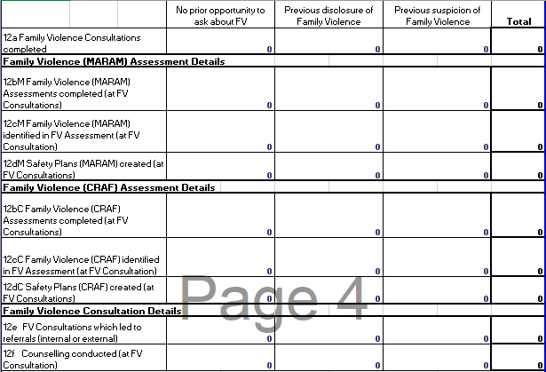
MCH/DH Annual Report
.
CRAF was superseded by MARAM in CDIS in Oct 2020 and is no longer in use but data is available for historical reporting purposes.
when
a MARAM Family Violence Assessment was completed, AND
Referral contains one or more internal or external referrals, of any referral type
12e (row 102, column D)
Counts Total of Column B, C and D
12f (row 103, column D)
Counts Total of Column B, C and D
For a completed consultation with any Counselling type on the Consultation

Slide 24
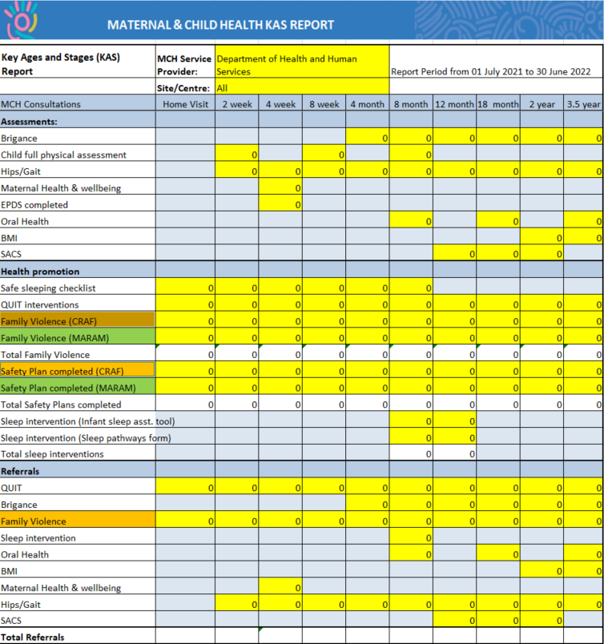
MCH KAS Report
Health Promotion
Family Violence (MARAM)
The report will count Family Violence tools with a date on or within +7 days of the consultation date.
The report will count this irrespective of whether the consultation is correctly completed for the child or incorrectly against the CG.
Safety Plan (MARAM)
The report will count Safety Plan tools with a date on or within +7 days of the consultation date.
The report will count this irrespective of whether the consultation is correctly completed for the child or incorrectly against the CG.
Notes:
This shows the KAS Report recording of MARAM and Safe plan completed
CRAF was replaced by MARAM in Oct 2020

Slide 25
Scenario 5: Why is our Breastfeeding data not current?
The MCH/DH Annual Report provides data on:
Number of babies fully BF
Number of babies partially BF
CDIS produces BF data for the previous year to ensure we gather the 6-month BF rates.
This data is subjective to misinterpretation because the clinician at the 4mth KAS should be recording BF status at 3mths(if the parents can remember☺)

Slide 26
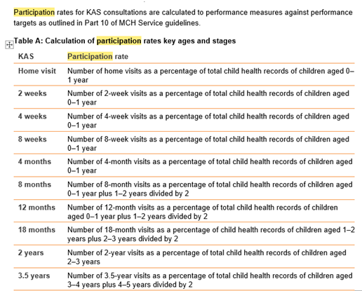
Scenario 6: How do I work out our participation rates for KAS consults?
There is no report that you can run from CDIS that gives you the participation rates.
However, you can manually work out the participation rates from the annual report (ie annual data)
Recommended not to complete these via sites as data inaccurate. Due to movement of clients between centres.
Following this guide found in the MCH Service Guidelines 2019
Notes:
Performance measures and target from the MCH guidelines
All draft consults must be completed.

Slide 27
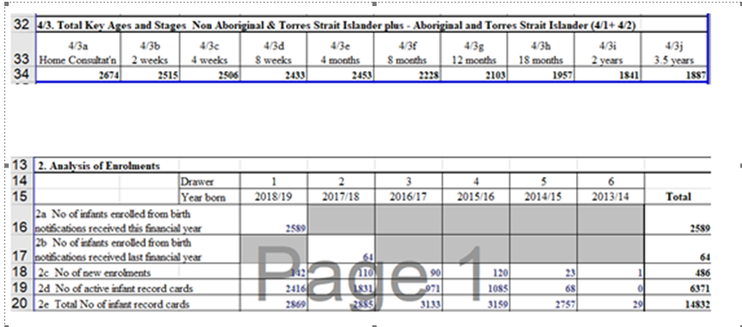
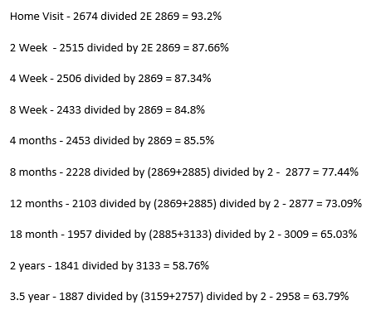
Scenario 6: How do I work out our participation rates for KAS consults?
An example:
Annual report for 2018/19 in UAT
MCH Participation Rates Calculator now available on MAV MCH Resources page under Other

Slide 28
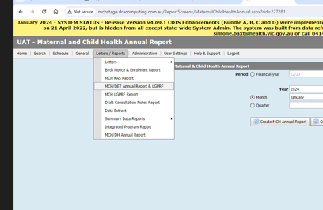
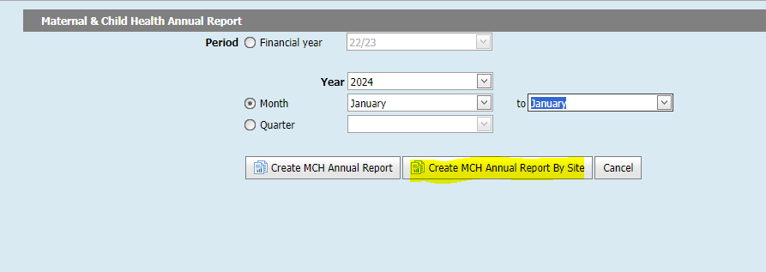
Can I check MCH site data regarding KAS attended?
Selecting MCH/DET Annual Report & LGPRF will provide you with MCH site data.
A valuable report but does not include data for family consults and other items.
Data is accurate for those items recorded.
Excel spreadsheet with Annual Report data by Centre.
For larger LGAs those that have more than 16MCH center/offices the data is available, and you will need adapt the excel spreadsheet to incorporate all data.
Notes:
If you have more than 16 Centres/Offices than the data for the remaining Centres/offices will appear in Columns AA,AB,AC etc. In Row 7, 9, 13, 20, 27, 34, 43, 89, 111, 137, 144 there are grand totals such as the 2d Total - Total number of active infant records. Once you have more centres/offices than Column Z no totals will appear. To add the formula to these columns, copy that formula from the Row across the Excel spreadsheet. If you want assistance please contact us.

Slide 29
Workaround for more than 24 centre/offices
For LGAs that have more than 24 MCH centre/offices the formula in the spreadsheet is missing after Column Z.
In the example above the row after Column Z Row 7 is blank with no data and you need to copy the formula from Column Z in line 7

Slide 30
Workaround for more than 24 centre/offices cont.
There will be totals in the SP Total column but the data is only for those sites up to Column Z in Row 7, 9, 13, 20, 27, 34, 43, 89, 111, 137, 144.
You need to copy the formula across these rows to get the correct totals.
Click in Column Z and holding down the left mouse button drag the mouse across to the last column BEFORE the SP Total. In the above example finish in Column AK

Slide 31
Workaround for more than 24 centre/offices cont.
Previous SP Total in Column AL Row 7 was 3680 but after correcting the formulas across all Columns from AA to AK the SP Total is 5030

Slide 32
Does the EMCH report provide hours per client?
EMCH Integrated Program reports cumulative Total Hours delivered by the EMCH program not hours delivered per client.
Program Active list – Print List provides an excel spreadsheet that records, total hours, direct and indirect hours and travel. Only active cases will be on this list.
Some councils do run this list at the end of each month to see how families are tracking. Then save this each month.
Good practice for EMCH clinicians to run this and review client load.
Some councils maintain a deidentified excel data base recording all closed EMCH cases and hours per family.
Referral report can also report referrals to Integrated Programs this can help to double check clients referred to EMCH and outcomes. Rember if referred via the bypass process – the referral will not be in this report. Best practice refer only via internal process not bypass.

Slide 33
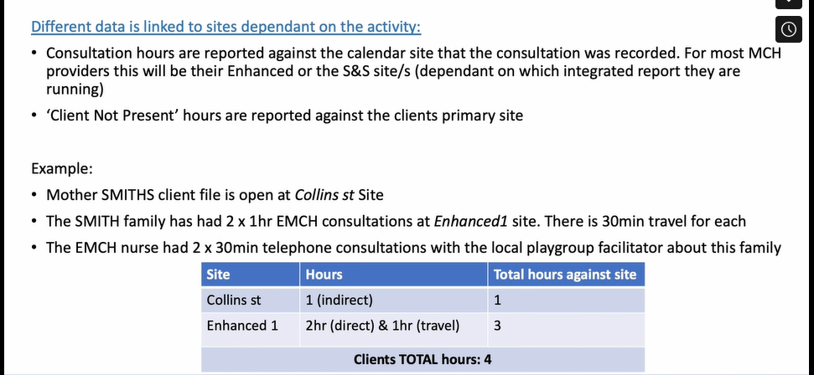
Are Client not Present (CNP) hours included in EMCH Integrated Report?
Please see MCH CDIS Education – New Reports on MAV MCH Resource page.
Client not present hours are recorded and reported against the client's primary site.
The Enhanced Program must be selected when recording CNP for the hours to be recorded.
When viewing the report review hours in EMCH site and primary site.

Slide 34
Resources
EMCH CDIS Education – Data Cleansing training vimeo
MCH CDIS Education – New reports vimeo
MCH Leadership Pack – reporting (to be published)
Notes:
On the MAV resources page - Passwords – lower case cdis

