Slide 1
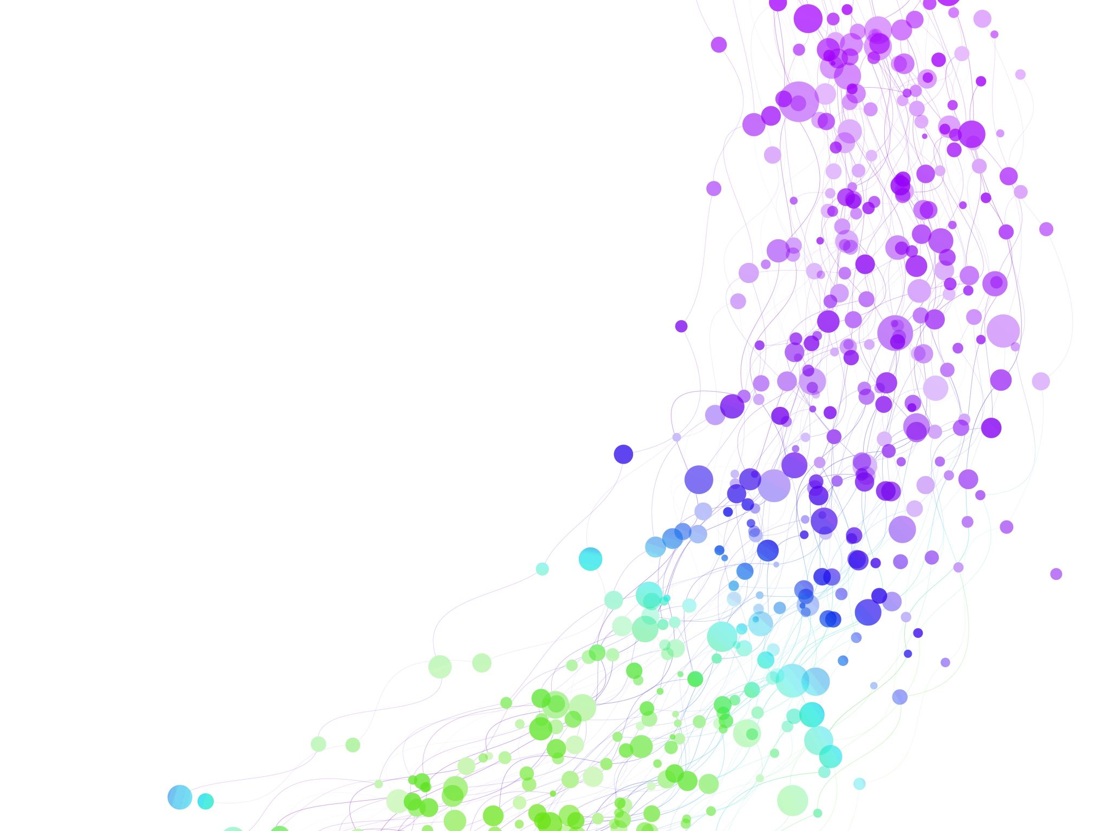
Child Development Information System (CDIS)
CDIS User Group – Admin
August 2024

Slide 2

Agenda
Tips & Tricks
  Edit Bar
  Bulk Rescheduling SMS
CDIS: Discharge Summary Process
Practice Note - Client Correspondence & CNP
Attachments: Naming Conventions

Slide 3

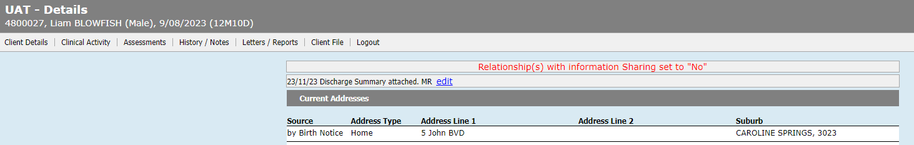
Tips & Tricks
Using Edit bar to alert MCHN that discharge summary has been attached.
Always remember to date and initial.
Always remember to delete once not required.

Slide 4
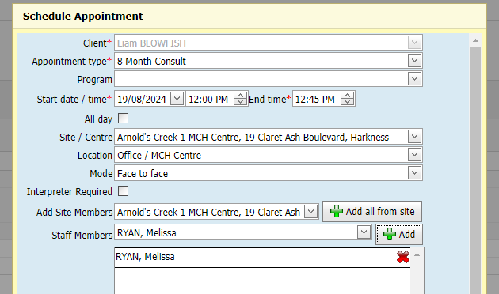
Tips & Tricks
Bulk Rescheduling Feature:
Helpful when you need to send a message to multiple clients eg:
  Cancelled appointments due to sick leave
  Road works/closures to center
Important to note:
To use this feature, you must add the clinician's mane against the booking.

Slide 5
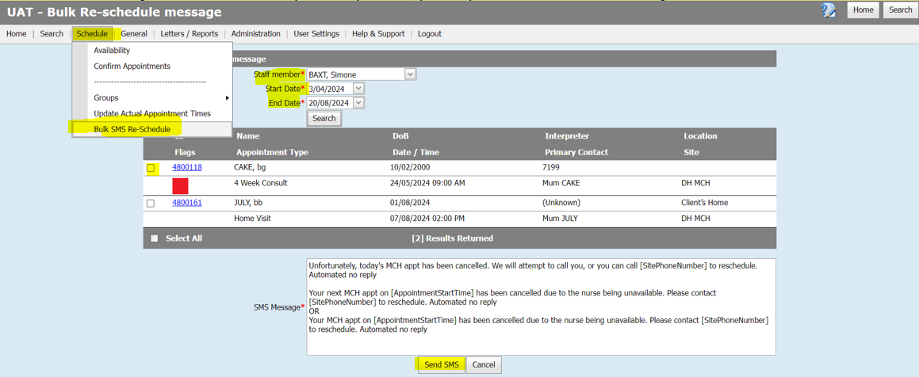
Tips & tricks
Bulk SMS Reschedule Process:
Select Bulk SMS reschedule
Add clinicians name and date
Select the clients using all to receive SMS.
Cross check against calendar to ensure you are sending the SMS to the correct clients.
Any clients that are not on the list may have no clinician or the wrong clinician allocated to the appointment.
Important to remember to change clinician is there is a change.

Slide 6
CDIS: Discharge Summary Process
Reference group have reviewed and updated the CDIS: Discharge summary Process to now include guidance regarding recording of discharge weight.
Link: https://www.health.vic.gov.au/maternal-child-health/child-development-information-system
Key message:
MCHN to read prior to HV
Attach to CDIS record (can be attached by admin team)
Record discharge weight and date into CDIS following the last weight recorded from maternity service eg Dom, PACU, HITH
Notes:
Reminder that the Discharge Summary is always attached to the infant’s record as the birth details etc. relate to the baby.

Slide 7
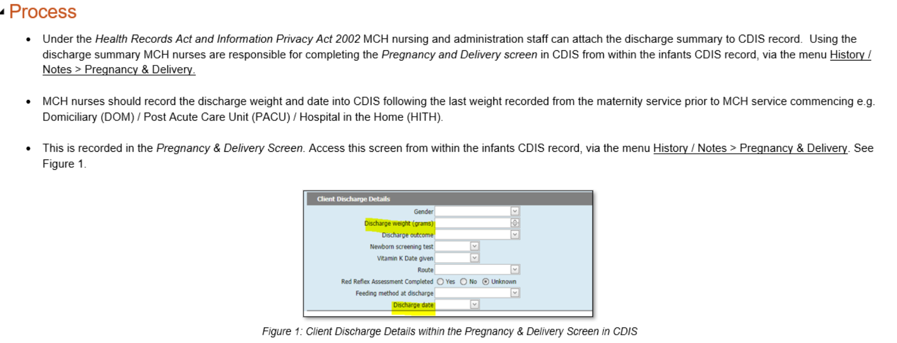
CDIS: Discharge Summary Process

Slide 8
Client Not Present – Administration Staff
Reference group have created this practice note to guide how to document client correspondence in CDIS and how to use the CNP screens.
Client correspondence includes SMS, phone calls, emails, and reports and must be recorded in CDIS to maintain an accurate and complete health record.
Administration staff recording in CNP will be the exception rather than the rule e.g. further detail regarding disclosures made in communication with parent/carer.
MCH Administration teams can attach documents to CDIS records and then forward correspondence to MCH Leadership or clinician.
All Cancelled/rescheduled appointments should be recorded in the appointment.
Communication from administration teams to clinicians is essential to ensure appropriate client service. E.g. emailing/calling clinician regarding EMCH client contact.
https://www.health.vic.gov.au/maternal-child-health/child-development-information-system

Slide 9
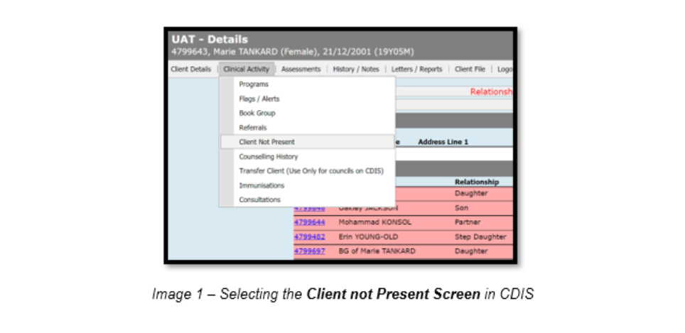
Client Not Present – preferred method of recording client correspondence
This ensures notes are recorded in the client history where the CNP is recorded.

Slide 10
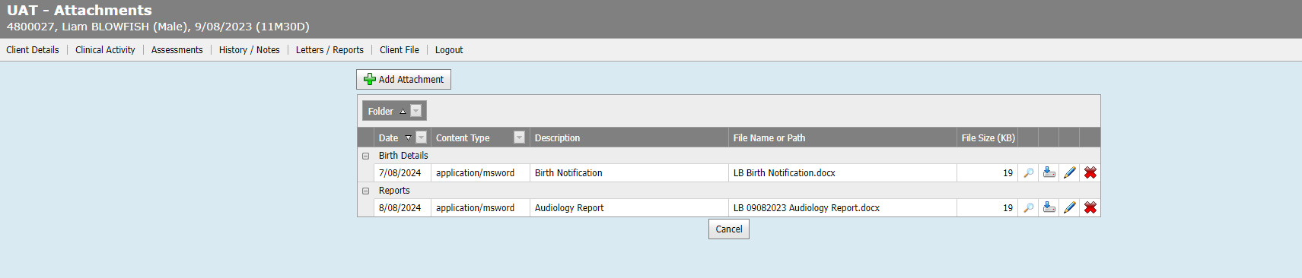
Attachments: Naming Conventions
Do any services have standardized naming conventions for attachments?
See next slide for suggestions

Slide 11
Examples of Naming Conventions
Yarra city uses - DD-MM-YYYY - DOCUMENT TYPE - (NAME)
At Cardinia we save the birth notice under mother's name and the date she birthed.
Darebin uses: Baby followed by surname, Birth Notice. Eg: Baby Greene Birth Notice
Melton use Baby Boy/Baby Girl and Surname when creating the CDIS profile, this will be updated when the child's details are confirmed with the parent. We name birth notice DOB + Surname, we don't stipulate the sex of the child
Important to check with your internal policies and procedures regarding naming conventions

