Slide 1
Model of Care (MoC) - EMCH Program
22 April 2021
Marcia Armstrong – Principal MCH Advisor

Slide 2
MoC
Recognises the EMCH program is a tier of support offered to families whose needs cannot be adequality accommodated by the MCH program
EMCH is a continuum of the UMCH program and will transition back to the UMCH program when they no longer require additional support

Slide 3
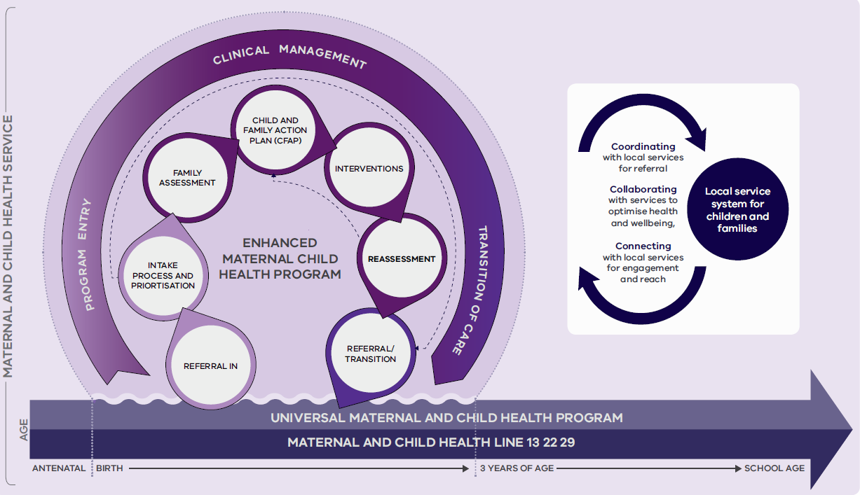

Slide 4
Program Entry
program eligibility
referral pathways
Intake process and prioritisation
Clinical management
family assessment
CFAP
interventions
reassessment
Transition of care
transition
referral out
outcomes monitoring

Slide 5
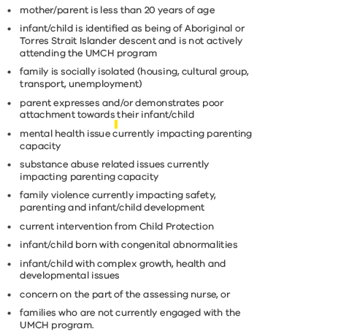
Issues

Slide 6
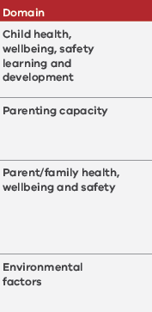
Goals

Slide 7
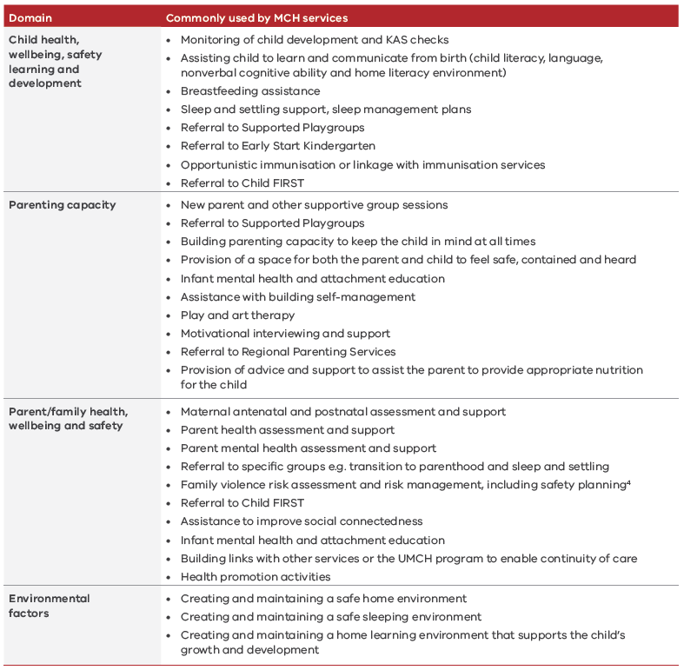
Actions and Interventions

Slide 8
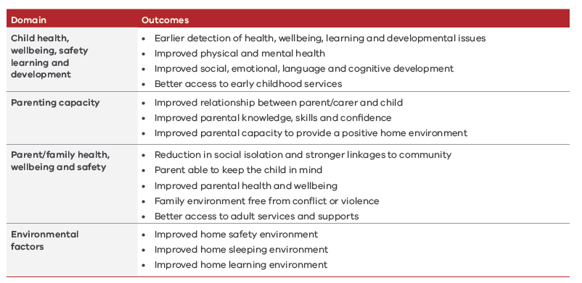
Indicative Outcomes

Slide 9
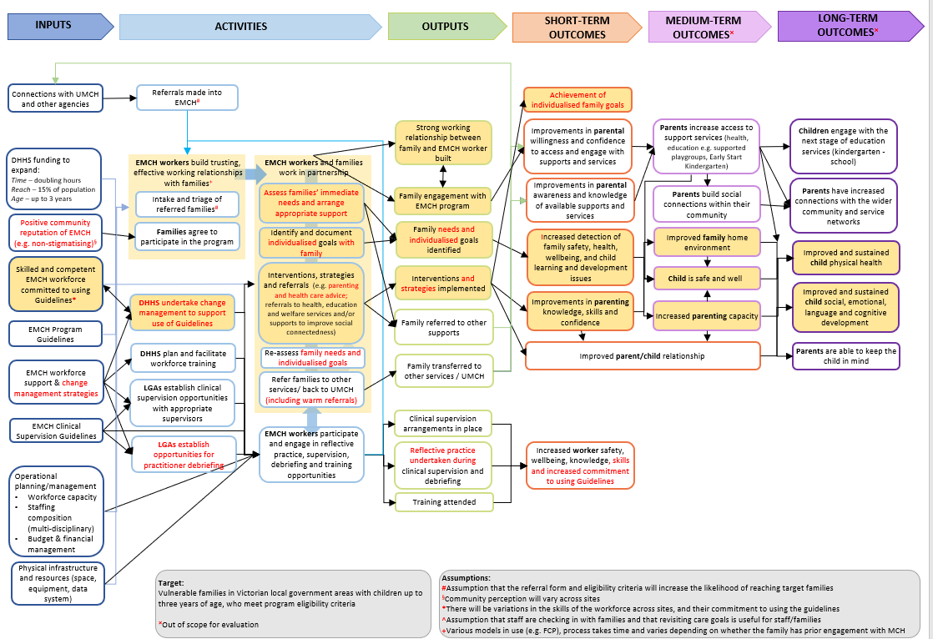

Slide 10

Questions?

Slide 11
Accessibility statement and publisher information
To receive this presentation in another format phone 0407 218 294, using the National Relay Service 13 36 77 if required, or email Safer Care Victoria <info@safercarevictoria.vic.gov.au>.
Authorised and published by the Victorian Government, 1 Treasury Place, Melbourne.
© State of Victoria, Australia, Safer Care Victoria, April, 2021
Available at the Safer Care Victoria website <https://www.bettersafercare.vic.gov.au>

