Slide 1
Striving for gender equality in Wodonga
Anthea Maher
Team Leader Population Health and Community Wellbeing
Wodonga City Council
Notes:
Hi/Name
I would like to start with acknowledging the traditional owners of this land on which we stand and pay our respects to their Elders past, present and future, for they hold the memories, the tradition and the culture of all Aboriginal and Torres Strait Islander People.
Today I will be speaking about councils project- striving funded by Communities Free from violence grant program

Slide 2
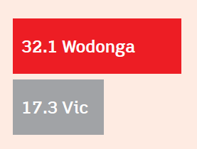
In 2018-2019, Wodonga had a rate of 32.1 incidents of alcohol fueled family violence per 10,000 population, close to double that of Victoria’s state average.

Slide 3
Striving for gender equality in Wodonga
Implementation of settings based, community action plan;
Workplace Program: Balance for Better Business
Community Workshops
Community wide social marketing campaign (phase 2- TV Radio/TV)

Slide 4


Slide 5


Slide 6
https://reflectrespect.com.au/

Slide 7
Achievements & Challenges
Attracted additional funding for youth campaign
VicHealth Award finalist
Wagga Wagga Council replicated campaign
Campaign extension: Growing Respectful Relationships
Maintaining stakeholder engagement
Backlash/ Resistance
Sustainability

