Slide 1
Child Development Information System (CDIS)
CDIS Clinical Users Group
Thursday 11th May 2023 8:30 am – 9:30 am

Slide 2
Contents
Tips and Tricks Saving Consults Clients only box Saving SMS to CDIS
VIHSP Update
ESK added to CDIS programs
When a ‘child’ becomes a ‘parent’ Practice Note
Family Consult
Q&A – Family Consult and MARAM reporting

Slide 3
Tips and Tricks
Can I save my consult/notes in draft and complete at my next shift?
Health records are to be contemporaneous; the patient or clinical record should be completed at the time that the service was rendered or initiated or as soon as practicable afterwards. Best practice is for practitioners to save their notes at the end of each day
Only in extenuating circumstances should a Coordinator or Team Leader save the consult/notes e.g. if practitioner went home suddenly unwell and did not return to work the following day. Then you would also document in the notes “incomplete consultation notes saved by (name)”
If you were working in the hospital, you would not leave until your notes were completed due to your legal responsibilities
Please refer to MCH Documentation Standards 2016

Slide 4
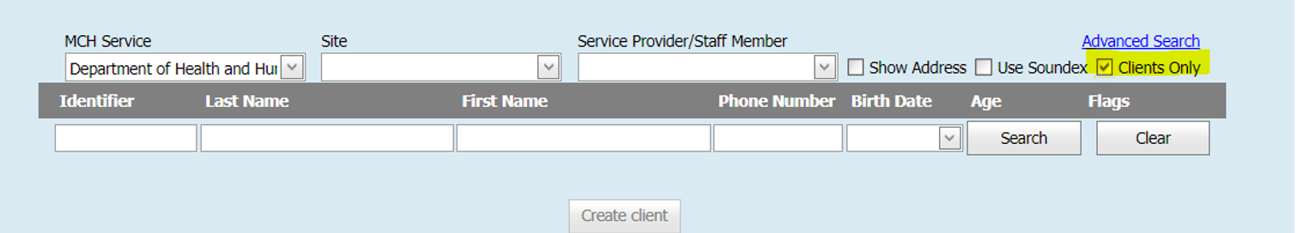
Tips and Tricks
Use the clients only check-box to search for active clients
This box will enable the search to only include clients ‘open for service’ If you do not tick this you will get open and closed clients in the search
This is one way to distinguish between child and adult records
RISK – There is a chance here to create a duplicate file so please don’t use when adding a birth notice. Best practice is to complete a state-wide search with the clients only box not ticked.

Slide 5
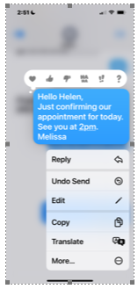
Saving SMS messages from clients into CDIS
Did you know you can save your SMS messages from clients and forward to your email address then paste into “client not present”?
Hold on the message (this is for Android/Samsung and iPhone) , select More…
Tick the messages to be sent to your email. You can tick multiple messages.
Copy and paste from email into Client not present notes. Identify client and yourself with initials.
Delete the email from your inbox.

Slide 6
VIHSP Risk Factor Update
In 2020, following consultations with paediatricians, neonatologists, and other newborn hearing screening programs nationally, there was an update to one of the risk factors for hearing loss. This new risk factor was a change to the duration of the use of Ototoxic medication from 3 days or more to three or more consecutive doses.
The Green Book documents the new risk factor in the 2-week VIHSP Newborn hearing screen and the 8-month VIHSP Hearing Follow-up as:
“Ototoxic medication (e.g., vancomycin, gentamicin or other aminoglycoside antibiotics) for three or more consecutive doses”, shown in Image 1 and Image 2.
The new risk factor is still in the process of being reflected in the CDIS Assessments and on the VIHSP Community Audiology Referral form located on the RCH web site.
NEW PROCESS
The new risk factor is still in the process of being reflected in the CDIS Assessments and on the VIHSP Community Audiology Referral form located on the RCH web site.

Slide 7
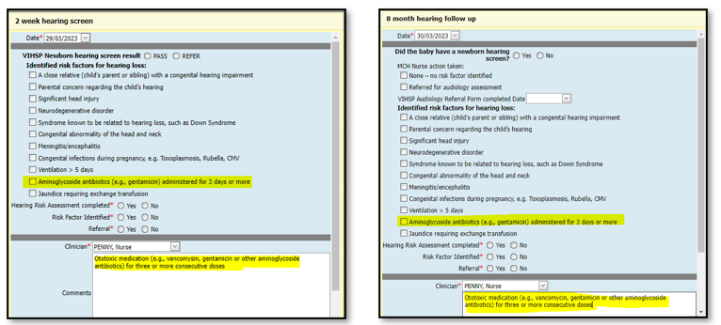
VIHSP Risk Factor Update continued
If the risk factor “Ototoxic medication (e.g., vancomycin, gentamicin or other aminoglycoside antibiotics) for three or more consecutive doses”, is identified, do not tick the description risk factor “Aminoglycoside antibiotics (e.g., gentamicin) administered for 3 days or more’, instead:
Make an appropriate note (as pictured here) in CDIS ‘Comments’ by typing in/cut & paste the new risk factor “Ototoxic medication (e.g., vancomycin, gentamicin or other aminoglycoside antibiotics) for three or more consecutive doses”.

Slide 8
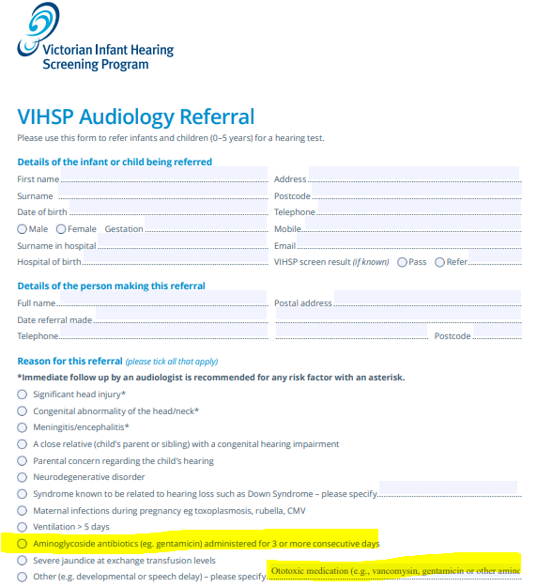
VIHSP Risk Factor Update continued
Tick ‘Other’ (as pictured here) in the VIHSP Audiology Referral form and type in/cut and paste the new risk factor “Ototoxic medication (e.g., vancomycin, gentamicin or other aminoglycoside antibiotics) for three or more consecutive doses”.
Please see Practice Note on the MAV MCH Resource page:
https://www.mav.asn.au/what-we-do/policy-advocacy/social-community/children-youth-family/maternal-and-child-health-children-0-6-years/maternal-and-child-health-resources
Or on The Department of Health web site
https://www.health.vic.gov.au/maternal-child-health/child-development-information-system

Slide 9
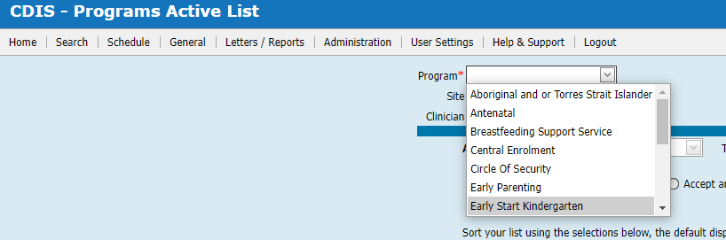
Early Start Kinder (ESK) added to CDIS Program.
A new program is available in the Programs Active List
Named Early Start Kindergarten
Clients can be added or removed from this program the same way they are added or removed from other non-integrated Programs in CDIS.

Slide 10
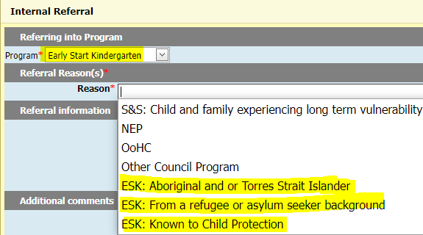
Early Start Kinder (ESK) added to CDIS Programs List
Early Start Kindergarten (ESK – Early Start Kinder) provide 15 hours of free or low-cost kindergarten per week to all eligible children in all areas across Victoria. To be eligible, your child must be 3 by 30 April in the year they start kindergarten, and:
• from a refugee or asylum seeker background, or
• identify as Aboriginal and or Torres Strait Islander, or
• the family has had contact with child protection.
This option and the three reasons have been added to the CDIS programs for individual services to use as they wish to track ESK eligible children.
Central Enrolment - Central Registration and Enrolment Scheme (CRES) - previously known as 'Central Enrolment' - is a best practice model for local councils and other organisations to support families and carers to secure a kindergarten place for their child. CRES provides a single point for families to apply for multiple kindergarten services within a local government area, helping them secure a place that meets their needs. This option is still available in the Programs List within CDIS.

Slide 11
When a ‘child’ becomes a ‘parent’ Practice Note
New Practice note on the MAV website.
In complying with record-keeping legislation clients should have 2 separate CDIS health records.
CDIS ‘Child’ Clients - Children should ideally only have one child CDIS record, which transfers across MCH services with the child if they move location.
CDIS ‘Caregiver’ Clients - Caregivers should ideally only have one adult CDIS record, that can be maintained across their time within the MCH service. e.g., where an adult has a record as a parent, and then subsequently has involvement as a grandparent, this should all be recorded in the same adult CDIS record.
Given these guidelines, this practice note will explain how to maintain this consistently in CDIS to ensure.
When a child becomes a caregiver a new caregiver CDIS record is created
When a caregiver becomes a grandparent or other, maintaining an existing caregiver CDIS record and updating the relationships rather than creating a new record
NB: This also includes merging

Slide 12
Family Consult
Due to its universal nature, the Maternal and Child Health (MCH) Service is well placed to identify and offer initial support to a family at risk of or experiencing family violence. The additional family violence consultation aims to increase capacity within the MCH Service to provide greater outreach support to these families in a location that best suits their needs at any point in the family’s engagement with the MCH Service.
The additional family violence consultation does not replace the need to ask family violence questions at any of the existing Key Ages and Stages (KAS) or additional consultations or contacts but increases capacity within the MCH Service to provide greater outreach support to families.
Funding is based on providing a sixty-minute consultation for all MCH service providers and is targeted to 10 per cent of enrolled 0–1-year-old children. There is funding for an additional eight minutes in rural areas, plus additional weighting for disadvantage. This funding is targeted to 0–1-year-old children due to the heightened risk of family violence for this age group however, it is recognised that family violence can occur at any point through a family’s engagement with the MCH Service. As such, any family identified as experiencing or at risk of family violence may be supported with a number of family violence consultation visits as required.

Slide 13
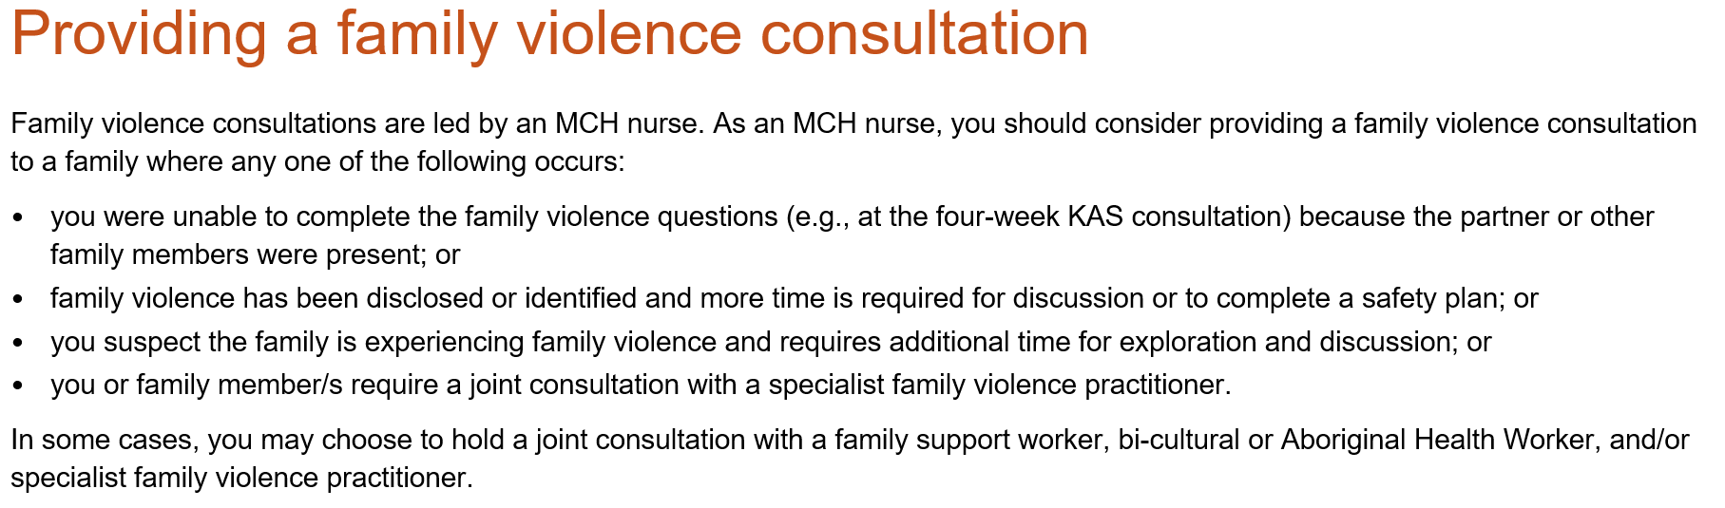

Slide 14
Points of discussion within a Family Consult
Can be completed on children of any age from 0 to school age who are clients of MCH even though funding is calculated on the numbers of children 0-1 years of age. See slide 12.
Can be completed in either a child or parents' history. Data is recorded from either history. FV data is not recorded from an additional consult with the reason Family Violence.
Record MARAM completed in relevant family members history eg MARAM attended see maternal notes.
Best practice is to include the family consult in the calendar as a true reflection of workload.
Time is flexible and should reflect the time spent with a client to complete a MARAM and a safety plan.
Reporting is currently on the number of Family Consults attended not the time spent on the consult even though funding is based on time. The number of consults are captured in the MCH Annual Report.
Family Consult is funded under Universal funding. Can be used with EMCH program but will not contribute to EMCH time. Follow up appointments can be recorded as EMCH appointment for EMCH funding.
NB: Please discuss any LGA initiatives in regards to managing this consult.

Slide 15
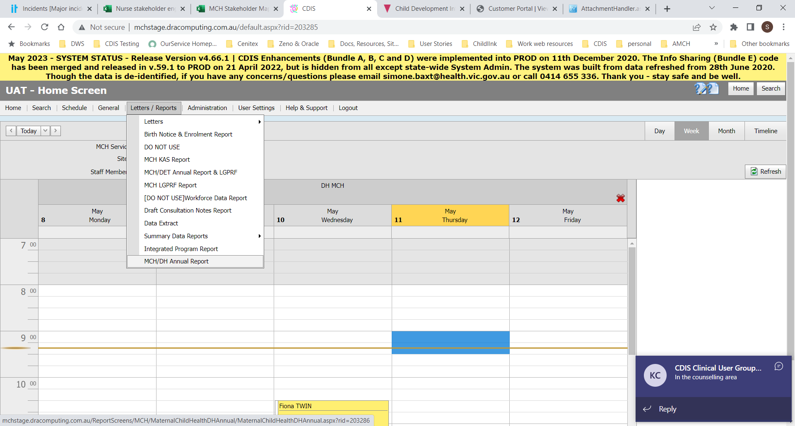
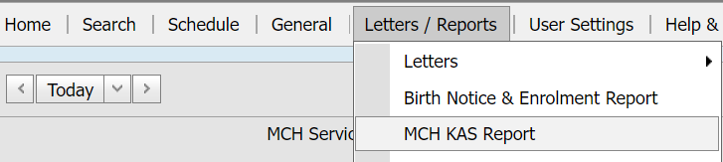
Questions and Answers
Where do I find the data for the family consults and MARAM?
Data for these consults and assessments can be found in multiple ways – in the MCH/DH Annual Report and the KAS Report
MCH/DH Annual Report MCH KAS Report
Please note we will cover the next slides re reporting in more detail at the next
CDIS Clinical User Group

Slide 16
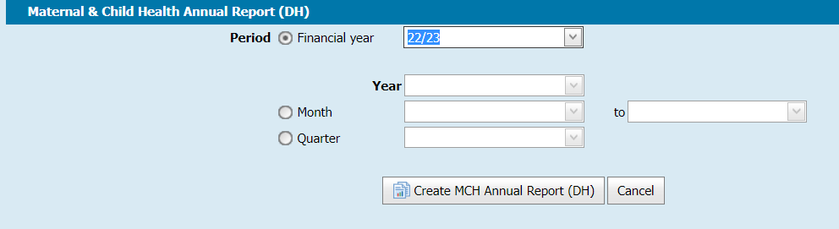
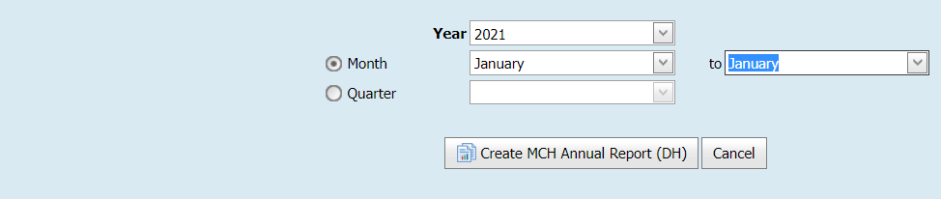
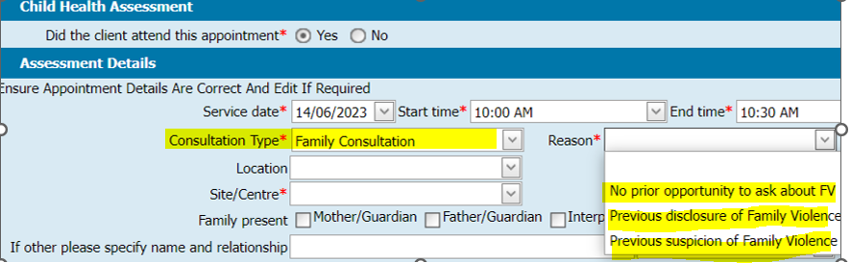
MCH/DH Annual Report
Data is up to date and retrievable the next business day from when it is entered.
Data reported, is what was recorded, during the reporting period selected, when running the report.
Either select the Financial Year
Or leave financial year blank and select another reporting period

Slide 17
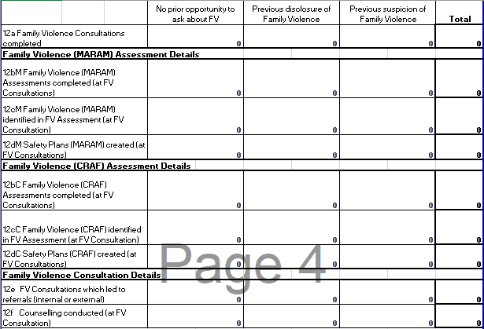
MCH/DH Annual Report
.
CRAF was superseded by MARAM in CDIS in Oct 2020 and is no longer in use but data is available for historical reporting purposes.
when
a MARAM Family Violence Assessment was completed, AND
Referral contains one or more internal or external referrals, of any referral type
12e (row 102, column D)
Counts Total of Column B, C and D
12f (row 103, column D)
Counts Total of Column B, C and D
For a completed consultation with any Counselling type on the Consultation

Slide 18
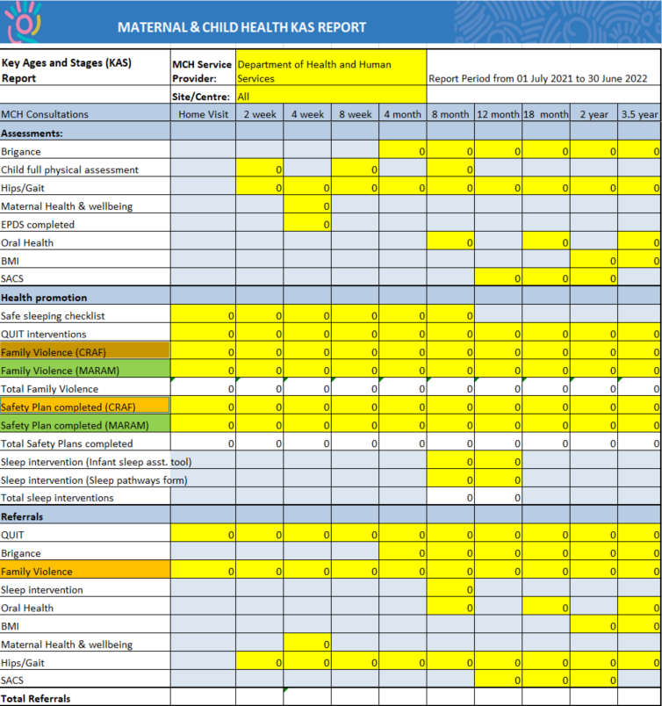
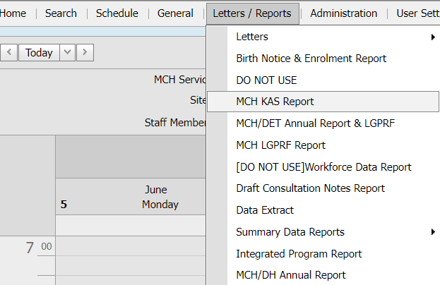
Questions and Answers
Health Promotion
CRAF was superseded in CDIS in Oct 2020 and replaced with MARAM
Family Violence (CRAF)
The report will count Family Violence tools with a date on or within +7 days of the consultation date.
The report will count this irrespective of whether the consultation is correctly completed for the child or incorrectly against the CG.
Safety Plan (CRAF)
The report will count Safety Plan tools with a date on or within +7 days of the consultation date.
The report will count this irrespective of whether the consultation is correctly completed for the child or incorrectly against the CG.
Referrals
Family violence
The report counts the 'Family Violence Assessment (CRAF)' assessment tool where the 'Referral required' field is 'Yes’.
MCH KAS report
Health Promotion
Family Violence (MARAM)
The report will count Family Violence tools with a date on or within +7 days of the consultation date.
The report will count this irrespective of whether the consultation is correctly completed for the child or incorrectly against the CG.
Safety Plan (MARAM)
The report will count Safety Plan tools with a date on or within +7 days of the consultation date.
The report will count this irrespective of whether the consultation is correctly completed for the child or incorrectly against the CG.

