Slide 1
Child Development Information System (CDIS) CDIS Admin Users Group
Thursday 20th July 2023
11 am – 12 pm

Slide 2
Contents
Tips and Tricks
Birth Notices
Incorrect attachment of documents.
Online MCH Admin group on MS teams.
Adding an Address to a Site Name for Client Appointment Correspondence
MCH Resources
CDIS Support Processes
CDIS Support – Simplifying Help Requests
Q&A

Slide 3
Tips and Tricks
Birth Notices:
Electronically recieved– upload to CDIS and delete electronic copy from email.
Hard copy recieved– upload to CDIS and store for 12mths on secure system as per legislation.
Be mindful of creating a second document eg excel that it is safely secured as client details are held in this document.
Incorrect Attachment of documents:
Contact your clinical coordinator as in CDIS they have access to edit/delete the attachments.

Slide 4
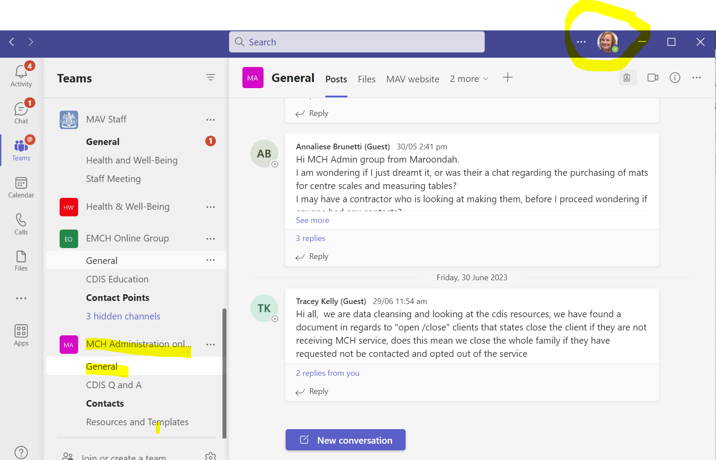
MS MCH Admin Online Teams
Ensure MAV MS Teams account
Contact mryan@mav.asn.au if you have not been added.
Please use to communicate, benchmark and share ideas

Slide 5
Adding an Address to a Site Name for Client Appointment Correspondence
Sites, Centres and Calendars, have the ability to include and display their current address
This is done by adding the current address to the “Name” of the site
Requests can be submitted to CDIS helpdesk using the CDIS Site request form v2, with authority clearly displayed from a clinical Co-ordinator*
*If an admin requests this, ensure a forwarded approval from the Coordinator is included the email chain, or it will be passed back and require re-submission
NOTE: We are still unable to rename sites/centres/calendars/or change addresses in CDIS, when sites physically move or close.
Pros
Addresses are visible in Home screen (Calendars)
Message character count would increase (no increased costs for email correspondence)
Clients receive addresses in their appointment correspondence
Cons
The character limit is 100 (impacts some sites)
Message character count would increase (increasing SMS Costs)
‘Group’ link Site name and address, so addresses would appear twice
Letters include Site name and address so may require editing as address would appear twice
Can only be updated via CDIS Helpdesk by MCH Support at Health

Slide 6
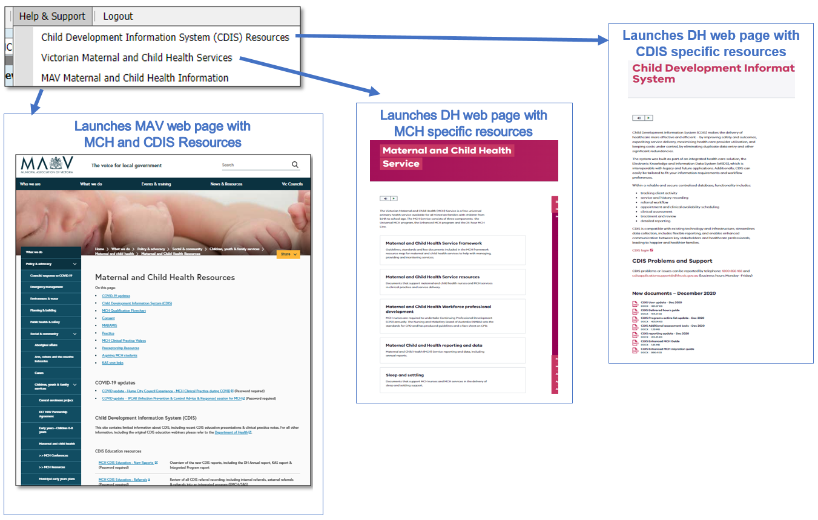
MCH Resources
Vimeo Password – cdis
MCH Clinical Practice videos password – mchvideos
Notes:
Password for vimeos = cdis

Slide 7
CDIS Support – CDIS User Responsibilities
When you are experiencing a CDIS issue / problem / question:
Check internally with your team leader / coordinator / CDIS Champions to validate what’s happening in CDIS. Include this in your request for support.
If your issue is connecting to CDIS, please check with your local IT professional if there is a network issue.
Are you the only one with the issue or are others experiencing this too? When was this problem first noticed? Include this in your request for support.
Check the online resources available to you, and if you're not closer to resolution, escalate to Contact CDIS Helpdesk on 1300 856 183 or cdis@support.vic.gov.au with the following important detail
In summary what is question or problem?
What screen are you using / what actions are you doing in CDIS,
What is the outcome you’re expecting?
What is actually happening instead?
NB: Client ID
Take a screen capture of the error or copy and paste the URL (web address),the name of the screen you’re using. For reports, detail the year or data range you’re using, and any other data selections, and capture the error message.

Slide 8
CDIS Support – Health Responsibilities
Record issue / question /problem and assign Incident #
Triage > Fix on first contact if possible >
If Technical the helpdesk will review and resolve
If Clinical the helpdesk will assign it to the clinical team to review and resolve
If either team requires the issue to be escalated to supplier this is done
The MCH Clinical team in The Department of Health reviews and responds, and if required, consults with Clinical experts in DH, MAV, Safer Care Victoria and the CDIS reference group
CDIS Support Hours
Monday to Friday between 8:30am to 5:30 pm
Contact
1300 856 183
cdis@support.vic.gov.au

Slide 9
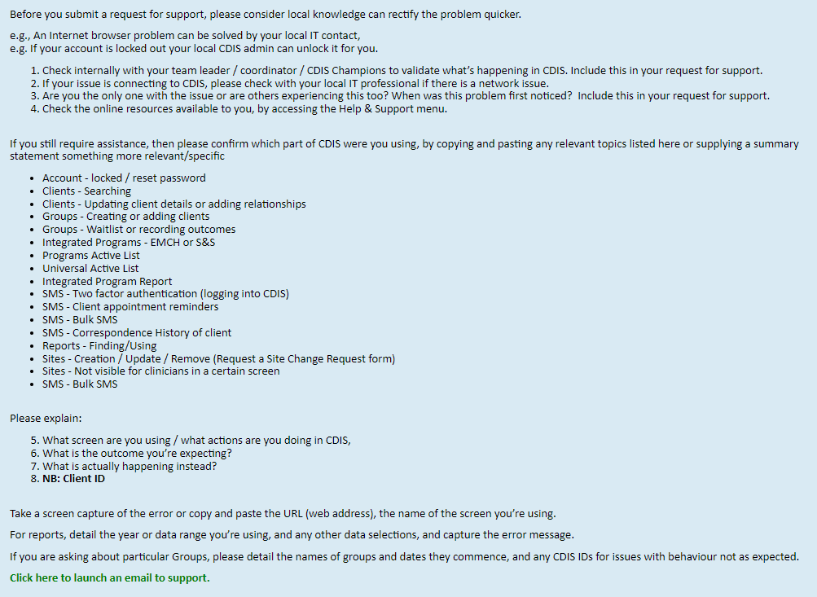
CDIS Support – Simplifying support requests
The CDIS Home screen has been updated to direct users to the Help icon, where there are some tips for quicker troubleshooting and requesting support to CDIS Support.
Both pages have links to launch an email addressed to CDIS Support.

Slide 10
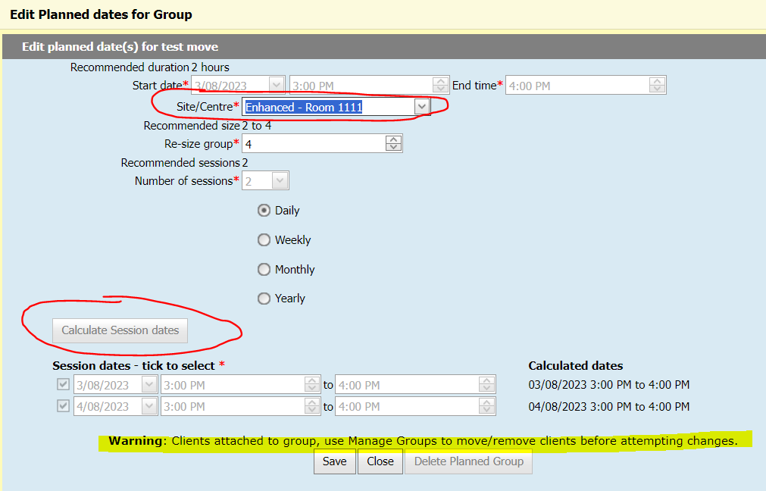
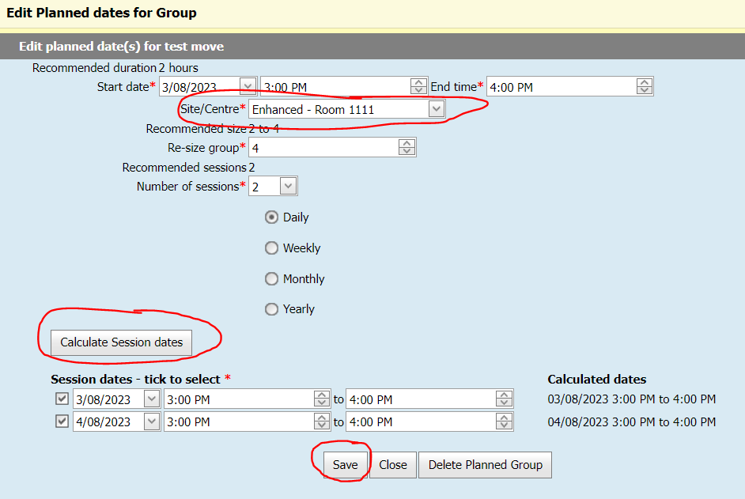
Questions asked during the session
Q. Can you move a group (e.g., FTPG) to another diary (site) and the groups participants stay enrolled or added to the group?
Groups/sessions cannot be edited once the sessions commence
Groups/sessions can only be edited after all participants are removed
Groups/sessions can be moved to a different site/centre before commencement, with no one enrolled, with or without a facilitator booked. However, you must also click “Calculate Session Dates” to confirm the location change is acceptable and then click Save. If this button is greyed out it is because people are already enrolled. There will be a corresponding warning on the screen. If you need to change the site/centre the steps are listed in the box below:
1. Remove all the clients from the group 2. On the 'Group Templates' screen, edit the group 3. Ensure the correct site is selected for 'Site/Centre' 4. Click the 'Calculate Session dates' button 5. Save 6. Add the clients back to the group

Slide 11
Questions asked during the session
Q. Keeping hard copies of documents eg discharge summaries once saved to CDIS?
As the discharge summary has been generated by another service ie the Hospital and the original document is on their system, once uploaded to CDIS the document can be shredded.
When in doubt check with your records department.

