Slide 1
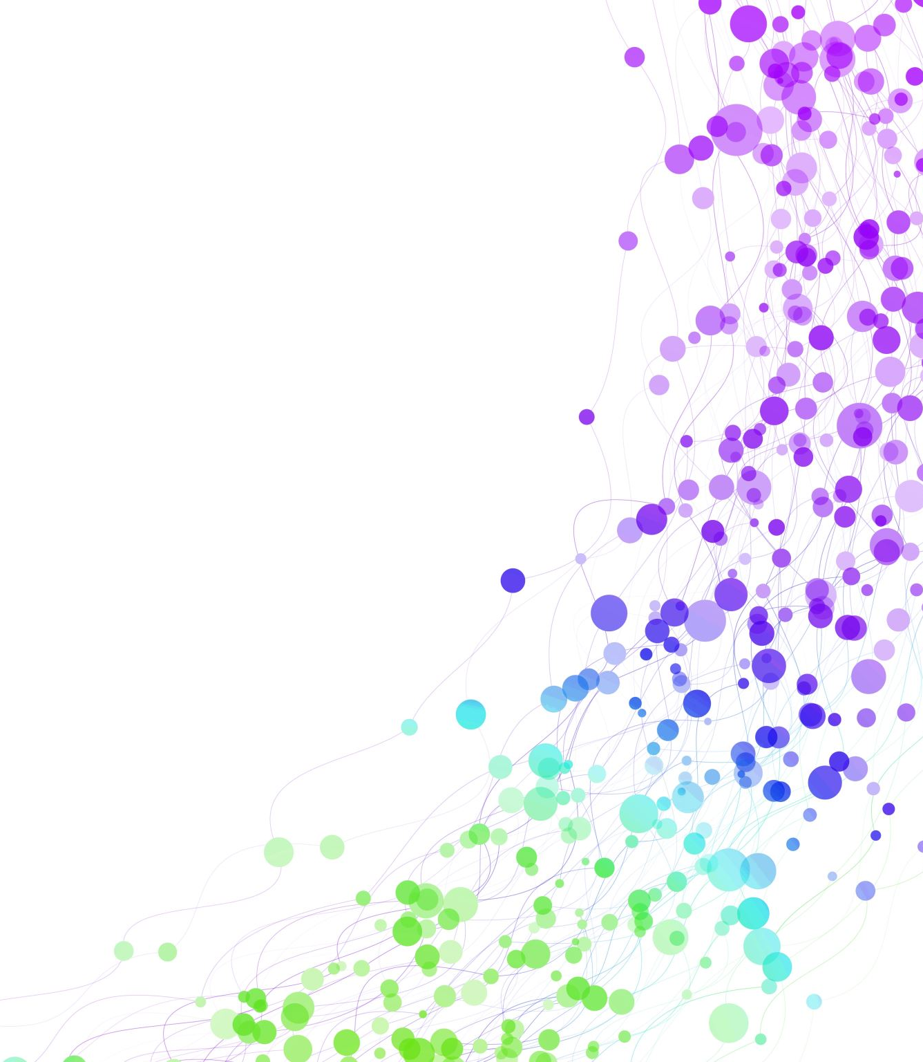
Child Development Information System (CDIS)
CDIS Clinical Users Group
Thursday 7th December 2023
8:30 am – 9:30am

Slide 2
Contents
Tips & Tricks Housekeeping of CDIS Logins. Filtering notes for EMCH history
Best practice opening consults Cancelling consults that are accidently opened
Viewing pop-ups within a consult
CDIS Update – Changes to EMCH Risk Factors (Referral Reasons)
MCH Resources
Q&A

Slide 3
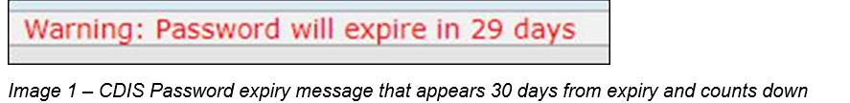
Changing CDIS passwords
Passwords should be changed regularly in CDIS to maintain security.
Updating passwords as required also reduces user accounts being locked out.
If your password remains the same for too long (80-90 days), illness or leave can impact your access.
If your password expires then your account is locked out, and you will require a local support person or a state administrator to reset and unlock before you gain access to CDIS.
Change your password as soon as you see the Warning Message in CDIS that your password will expire. This appears on the Home Screen, above the calendar (image 1).

Slide 4
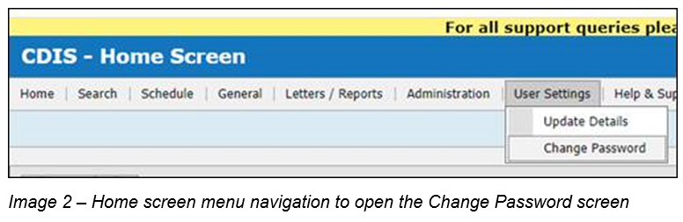
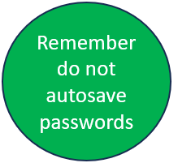
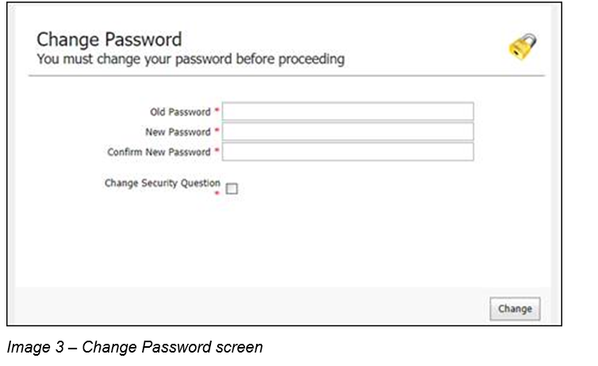
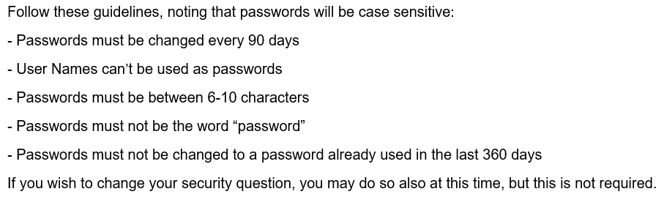
Changing CDIS passwords
To change your password, click on menu User Settings > Change Password (image 2).
Enter information in the fields on the Change Password screen (image 3).
Notes:
Do not autosave when prompted – offer to save password – in the log in

Slide 5
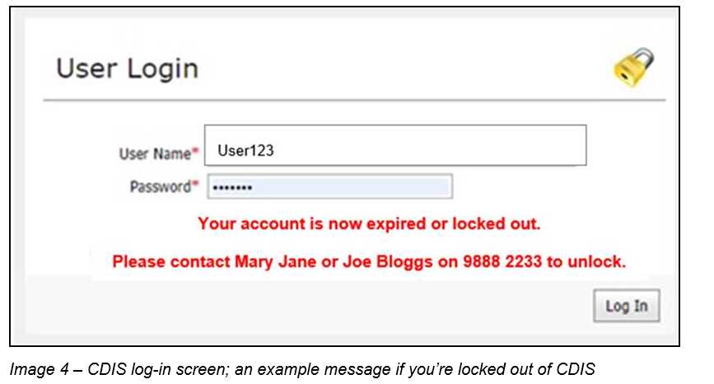
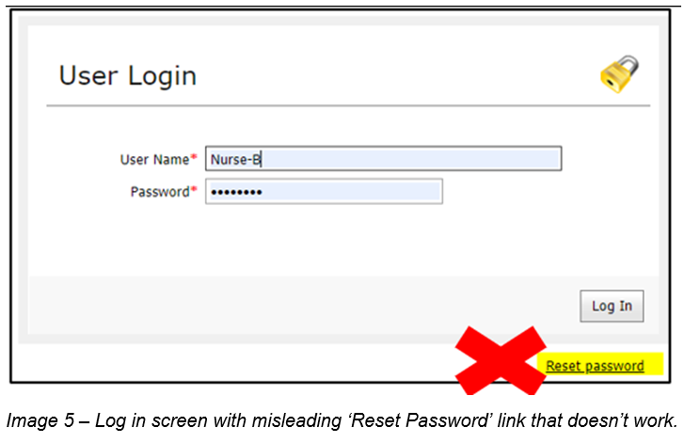
Changing CDIS passwords
If you are locked out of your account, please follow your local process, and contact your local support persons. Some MCH Services have messages on the CDIS log in screen, about who to contact once your account is locked out (image 4).
Do not click on Reset password from the log in page (image 5). Clicking this link does not work.

Slide 6
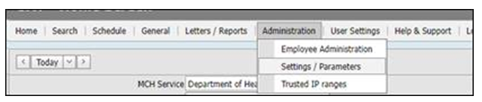
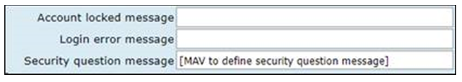
CDIS - Locked Accounts: Setting a Local Message
A bespoke message can be set, to direct CDIS users who are locked out, to local support people. This message can be set up either by:
Emailing CDIS Support, with the message, ensuring it is less than 100 characters;
A CDIS user in your MCH service with the role ‘System Admin – Council’, can set this message following these steps;
A CDIS ‘System Admin – Council’ logs into CDIS and accepts the log-in agreement
Navigate to Administration > Settings Parameters
Scroll to the section under the ;Agreement Message;, and insert desired message into the text box for Account locked message
Prepare a message 100 characters or less (use Word count or Notepad to confirm message length).
Message Examples:
Council CDIS Office Administrators are now able to unlock accounts and reset passwords (87 characters)
For account lockouts or password resets contact Joe Bloggs on xxxxxxxx or Jen Smith on xxxxxxxx (96 characters)
6. Scroll down and Click Save, then Exit the screen by navigating to another screen.
NB: Leave the other two fields blank, so as not to overwrite state-wide or local system messages.
NB: Do not update other fields on this screen, even if you see MAV email addresses. These are all managed at a state-wide level by The Department and have been changed as required. Changing these may cause local issues.

Slide 7
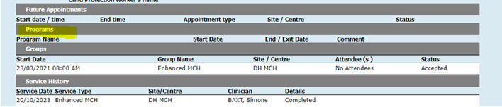
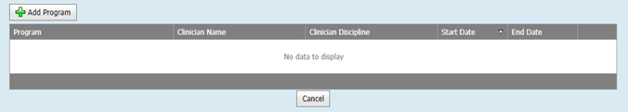
Filtering notes for EMCH history
When transferring a client in from another council the EMCH summary is removed from the Programs section on the Summary Page.
Note: This shows importance of Purple Flag to highlight previous EMCH support
And no record in the program's history

Slide 8
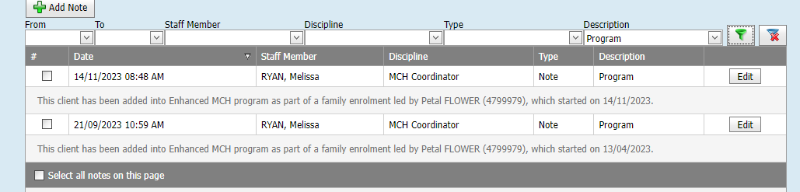
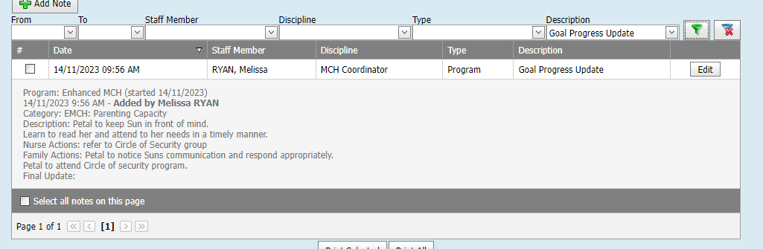
Filtering notes for EMCH history
The best way to find information about the EMCH program attended at another service is to use the filter function in the notes

Slide 9
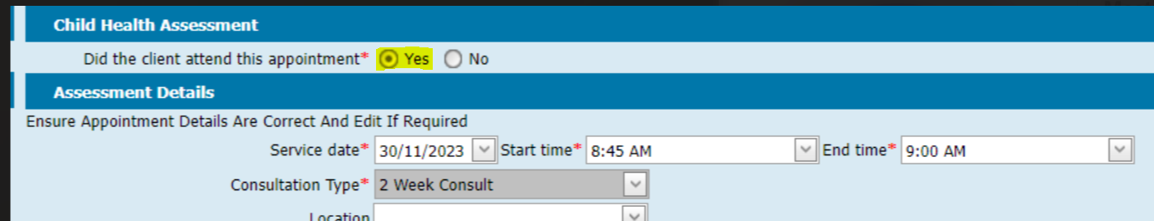
Opening Consults
Best Practice is to open consults when family are in the room attending the appointment.
We have heard of practices where practitioners are opening clients at the beginning of the day.
This results in the automatic selection that the client attended the appointment.
Practitioners may then be prepopulating consultations with templates into notes or completing assessments.
This is breaching the Health Records Act.
This also may cause problems when saving consults later.
Notes:
Add some photos from Sim

Slide 10
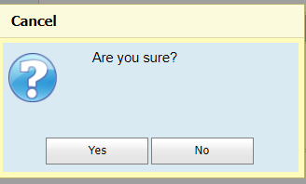
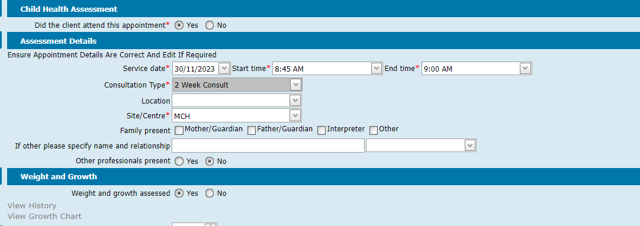
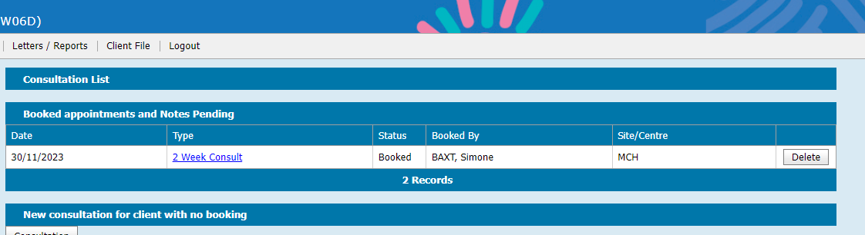
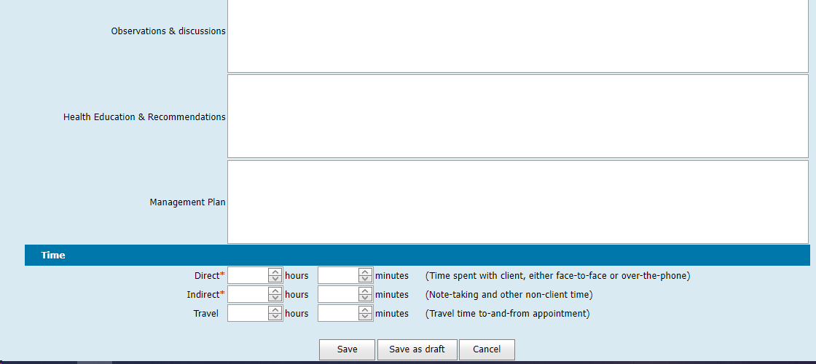
Cancelling Consults Accidentally Opened
Only open consults when family are in the room attending the appointment.
1. To cancel an open consult, that shouldn’t
be commenced, scroll down to the bottom
and select Cancel.
2. On the Cancel pop-up “Are you sure”, click “Yes”.
3. You will return to the Client’s Consultations Screen
2
1
3
Notes:
Add photos from chat

Slide 11
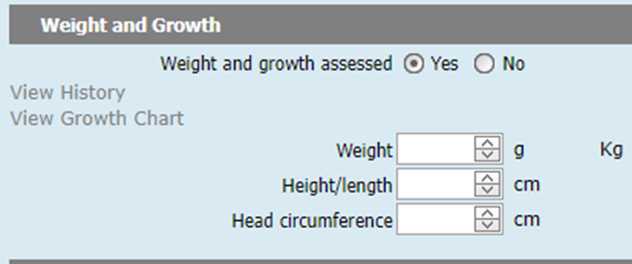
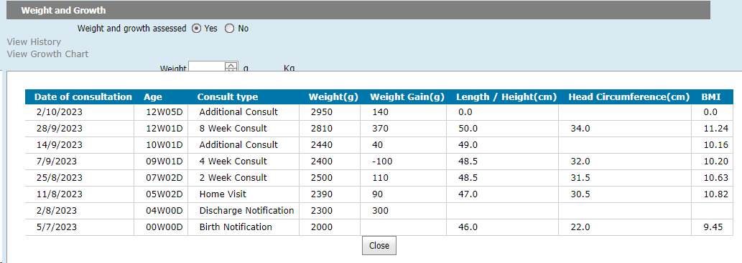
Viewing pop-us from within a consult
Be mindful of accidentally opening a second consult screen
When you're working on a consultation, several links are embedded on the page.
E.g. Within Weight and Growth: You can click on ‘View History” to access pop-up information, then click close to return to the consultation you’re recording/delivering.

Slide 12
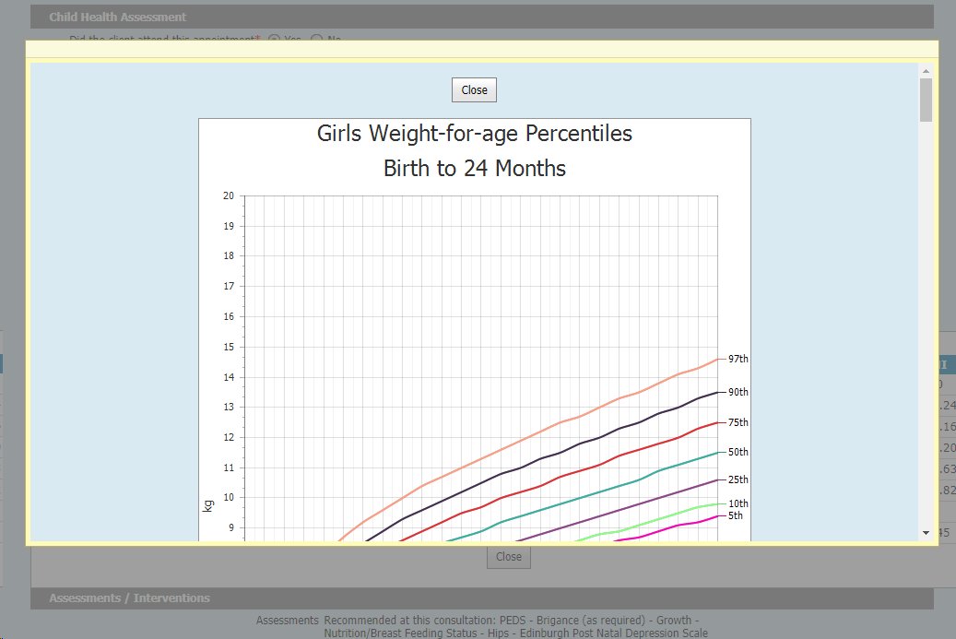
Viewing pop-us from within a consult
Be mindful of accidentally opening a second consult screen
When you're working on a consultation, several links are embedded on the page.
E.g. Within Weight and Growth: You can click on “View Growth Chart” to access pop-up information, then scroll down and click close to return to the consultation you’re recording/delivering.

Slide 13
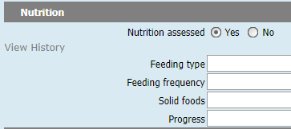
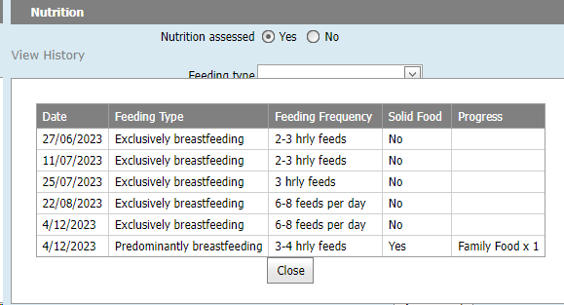
Viewing pop-us from within a consult
Be mindful of accidentally opening a second consult screen
When you're working on a consultation, several links are embedded on the page.
E.g. Within Nutrition: You can click on “View History” to access pop-up information, then scroll down and click close to return to the consultation you’re recording/delivering.

Slide 14
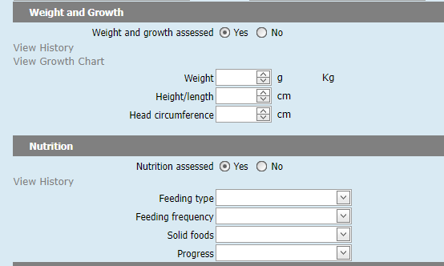
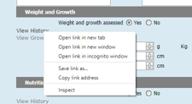
Do not right click on hyperlink
Right clicking on a hyperlink in CDIS will give you the option to open a new tab/window (see below).
If you select open a new tab/window you are opening the same consult in a new tab/window
This may result in issues saving the consult.
Please DO NOT do this.
Notes:
Right cross on the right menu. This is a contributing issue to complications when saving consultations as two consults are inadvertently open.

Slide 15
Update to EMCH Risk Factors (referral reasons)
The Commission for Children and Young People requested an update to the risk factors noted in the Enhanced Maternal and Child Health Guidelines.
The MCH Enhanced Maternal and Child Health Program Guidelines (P14) have been updated to reflect this update.
In CDIS, the following changes have been made to the list of Enhanced MCH Risk Factors, also referred to in CDIS as ‘Referral Reasons’, and ‘Issues’ when used within the Case Summary screen.

Slide 16
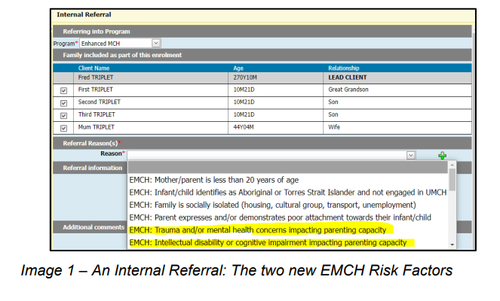
Updated Risk Factors for EMCH:
1. Two new Risk Factors have been added to CDIS:
a) EMCH: Trauma and/or mental health concerns impacting parenting capacity
b) EMCH: Intellectual disability or cognitive impairment impacting parenting capacity
2. The Risk Factor EMCH: Mental health issue currently impacting parenting capacity has been removed from the list.
Closed and Active cases in CDIS will not be affected by the removal of the risk factor in 1a) above, as it will still be listed on the Hx. However, you can choose to add the new Risk Factors (i.e., also called Issues), as part of Clinical Case Management.

Slide 17
Q&A
Best practice for cancelling appointments.
As per CDIS webinar series on Department of Health MCH website:
https://www.health.vic.gov.au/maternal-child-health/child-development-information-system
Webinar 7: https://vimeo.com/432021138 (password cdis)
Appointments are to be cancelled from the calendar so that a DNA is recorded in the client CDIS history.
DNA recorded this way will also be reflected in the DNA report function of CDIS.

Slide 18
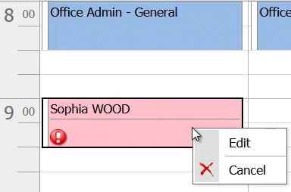
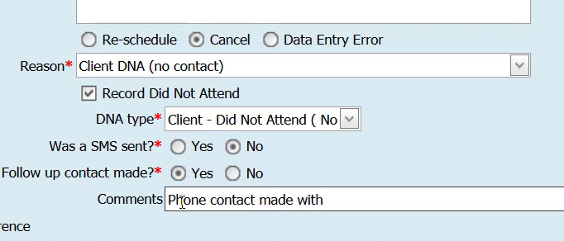
Process:
1. From the calendar screen right click on the client's appointment and select edit:
2. Select Cancel appointment and appropriate reason (see snip below)
3. Complete the fields
4. Then save.
Appointment will delete from the calendar
Clients' history will look like this:

Slide 19

How do I save password protected documents into CDIS without the password?
Ensure you are aware of the type of document you are saving to CDIS eg MS word, PDF.
Multiple ways of removing the password depending on the document.
Open document
File Tab
Select Info
Select Protect Document – Encrypted document, delete password
Save the document as a new document with a new name.
How can I add a password to a document?
Discuss options with your IT department on how to enable this function.

Slide 20
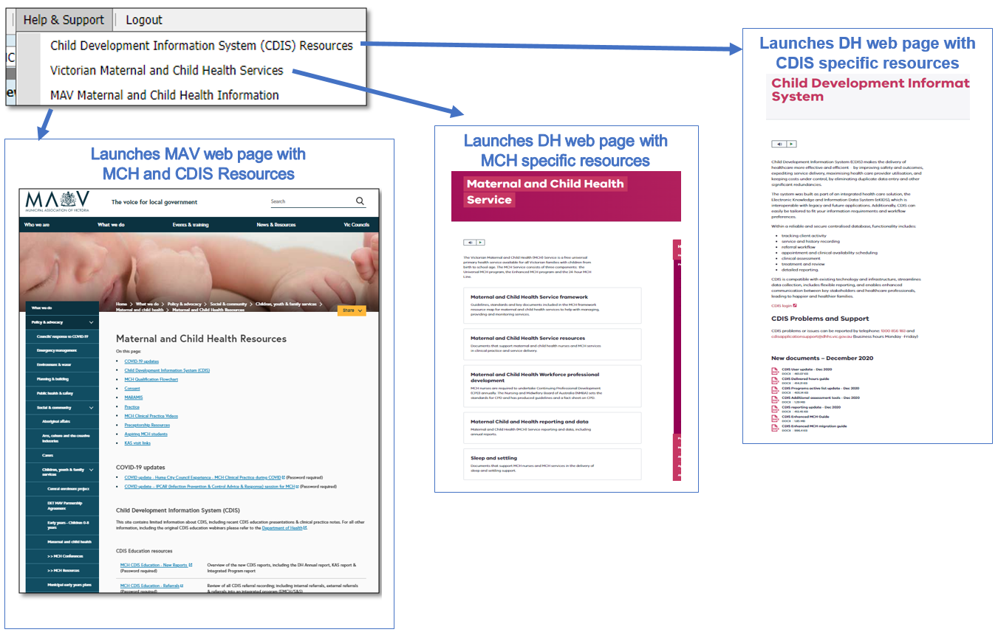
MCH Resources
Vimeo Password – cdis
MCH Clinical Practice videos password – mchvideos
Notes:
Password for vimeos = cdis

Slide 21
CDIS Support – CDIS User Responsibilities
When you are experiencing a CDIS issue / problem / question:
Firstly, check internally with your team leader / coordinator / CDIS Champions to validate what’s happening in CDIS. Include this in your request for support.
If your issue is connecting to CDIS, please check with your local IT professional if there is a network issue.
Are you the only one with the issue or are others experiencing this too? When was this problem first noticed? Include this in your request for support.
Check the online resources available to you, and if you're not closer to resolution, escalate to Contact CDIS Helpdesk on 1300 856 183 or cdis@support.vic.gov.au with the following important detail
In summary what is question or problem?
  What screen are you using / what actions are you doing in CDIS,
  What is the outcome you’re expecting?
  What is actually happening instead?
  NB: Client ID
  cc your MCH Leadership
Take a screen capture of the error or copy and paste the URL (web address),the name of the screen you’re using. For reports, detail the year or data range you’re using, and any other data selections, and capture the error message.

