Slide 1
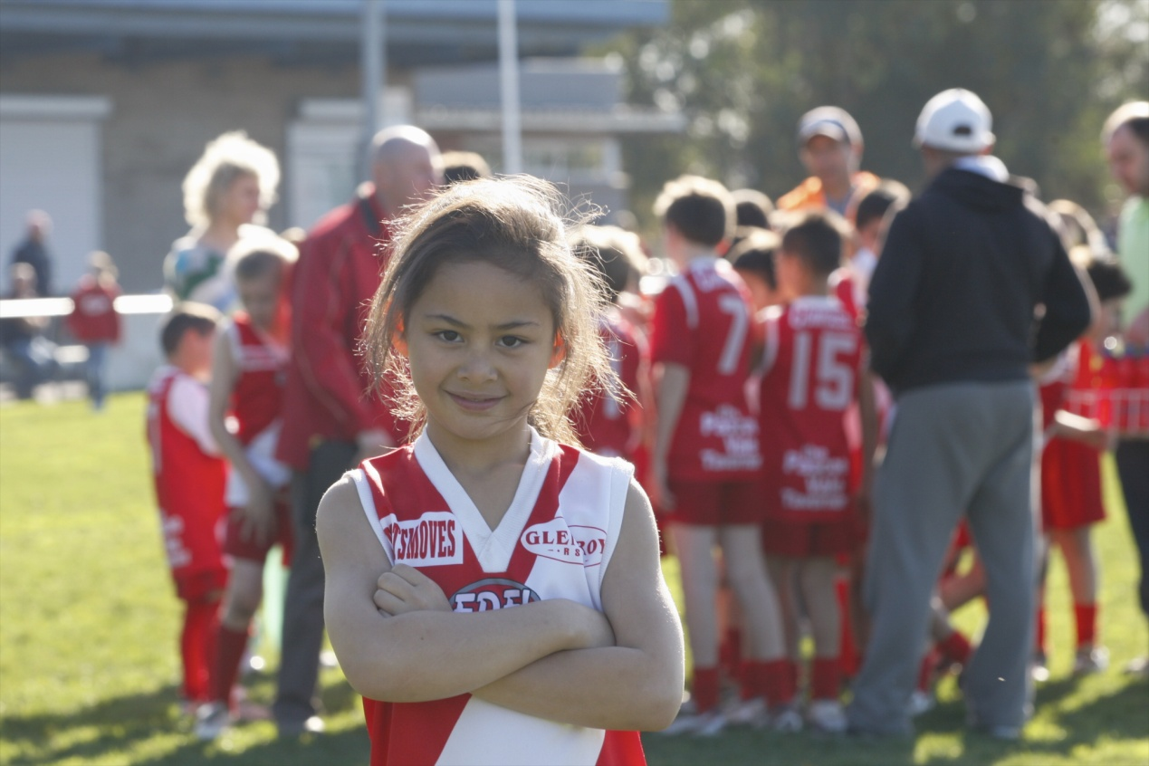
Gender equity in Moreland
A year on from the sports ground allocation policy

Slide 2
October 2010 saw the introduction of Moreland City Council’s ground breaking “Sports ground and pavilion allocation policy”.
This policy requests clubs to be inclusive of women, juniors, people with a disability and people from culturally diverse communities, or risk losing allocation of a ground to a club who is being inclusive.

Slide 3
Origins of the policy
The Active Women and Girl’s in Moreland Strategy (2009) identified that only 8% of participants that access Council’s sports grounds were female.
When looking at all sports, the figure only increased to 20% of participants being female.
This was well below state figures, and reason enough to proactively seek greater participation by females in sport.
Notes:
As the owner of Moreland’s community sports infrastructure, Council is well placed to request clubs and groups accessing our facilities to better reflect our community. Whilst there are many opportunities to educate and support clubs to be more inclusive, the implementation of the policy has ensured that all clubs seek to redress the inequity by proactively attempting to include women and juniors in their club activities or face the loss of a ground and pavilion allocation.

Slide 4
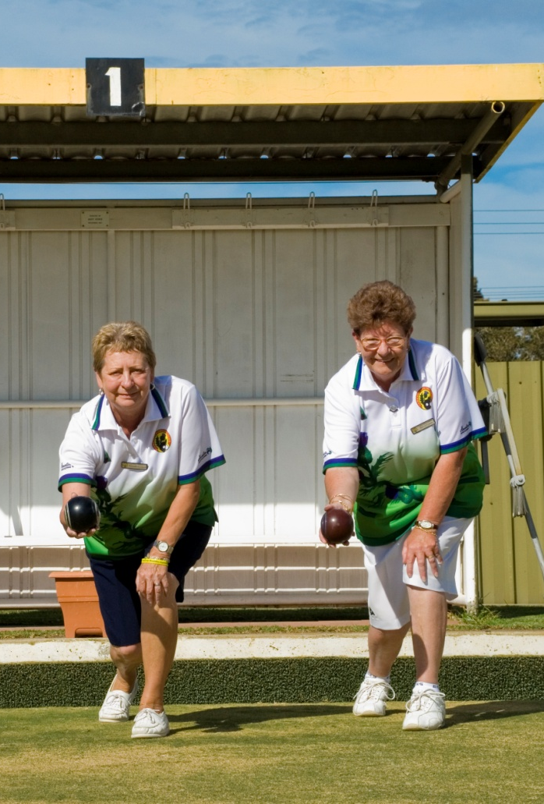
How success was achieved
Timing for the development of the policy was great
Councillors were keen to see a focus on females in sport
The statistics showed a dramatic inequity and a need for intervention.
Councils as facility owners are well positioned to ask clubs to achieve certain tasks and standards
Notes:
– It was the year of women in local government and there were a range of media about men behaving badly in the football and rugby worlds.
Work had been undertaken around the women’s charter and Council had recently endorsed the ‘Commitment to Women’.
– ‘carrot and stick’ method

Slide 5
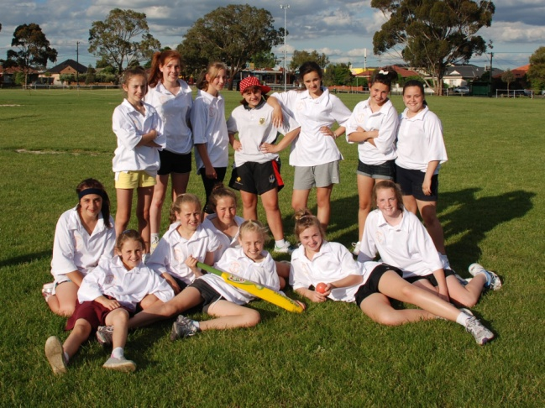
How success was achieved…cont
Council offered support to clubs to be inclusive through workshops
Officers dedicated time to support clubs individually
Moreland prides itself on having great rapport with our facility users
Balancing the threat of losing a ground and reassuring clubs
Notes:
– we did not force clubs to be completely compliant in the early stages, we encouraged them to do their best. We will continue to raise the bar of expectation with clubs each year.

Slide 6
The benefits
more creativity from clubs, ensuring they are attractive to both males and females.
stronger relationships developed between Council and the clubs via the support provided throughout the transition period
a gradual increase in female participation in what are non traditional female sports.
a significant shift in the way clubs are attempting to embrace family and female friendly environments
The profile of sport increasing within Council
Notes:
having a greater understand
. Links to projects such as Preventing Family Violence, alcohol reduction strategies, improving the prevalence of chronic health conditions and increasing participation in physical activity have all enabled sport to be seen in a more positive light. Sport is now seen to be an effective community development tool which has the power to affect social change.
ing of what they stand for and aiming for a greater reflection of the community.

Slide 7
The policy and participation
 |  | Baseball | AFL | Lacrosse | Soccer | Cricket | Total | %
2009/10 | Males | 28 | 3151 | 98 | 1209 | 2124 | 6484
 | Females | 0 | 175 | 10 | 293 | 169 | 637 | 9%
2010/11 | Males | 40 | 3268 | 51 | 1804 | 2266 | 7429
 | Females | 0 | 285 | 12 | 568 | 189 | 1054 | 12%
2011/12 | Males | 40 | 3004 | 51 | 1804 | 2108 | 6916
 | Females | 0 | 283 | 12 | 568 | 329 | 1180 | 15%
Notes:
Winter sport for 2012 yet to be included

Slide 8
Where to from here?
Inclusive and welcoming clubs – the Active Moreland standard
Continued support of clubs to develop new initiatives
Facility improvements to be more conducive to female and junior participation through easy to implement strategies and capital works priorities
Implementing a similar inclusion request of ‘lease clubs’ via lease agreements
Continuing to share good news stories to show how well our clubs are doing
A dedicated program to increase the number of females in sport leadership roles
Notes:
The standard asks clubs to have the following:
Sound Governance practices
Complies with Council requirements for ground/facility allocation
Affiliation with their State Sporting Association
Provide access support arrangements (financial, equipment, transport)
Accredited coaches, officials and volunteers
Inclusive participation opportunities and pathways
Responsible service of alcohol and smoke free environments
Healthy food options (where applicable)
State sport program accreditation (where applicable)

Slide 9
Further strategies under the “Active Moreland” banner will be implemented in 2012 which will also enhance opportunities for women, and other non traditional participants to get more active, more often.
Watch this space…

