Slide 1


Introducing the……..
Victorian Councils: Supporting Communities Around End of Life Project

Slide 2
End of life – let’s clarify what we mean
Terminology around end of life can be confusing
‘End of life’ takes on different meanings dependent on the setting - for example, it can be associated with Assisted Dying or the days before death, or advanced care planning
For this project it has been important to define and clarify what we mean by end of life – particularly as a new area for local government

Slide 3
End of life – our project definition
For this project
‘End of life’ refers to the period of time around dying and death and the impacts this has on the dying person, their family, and their wider community networks.
The MAV and La Trobe University Palliative Care Unit are undertaking this project with funding from DHHS for 3 years (2017-2019).

Slide 4
The bigger picture context
The bigger context for this project includes:
Dying at home used to be common. Today 60-70% of Australians prefer to die at home yet only 14% do so
An ageing population = an increasing number of deaths, challenging the sustainability of the hospital system for ‘normal’ deaths
The Victorian Palliative Care Framework promotes greater choice for people around end of life

Slide 5
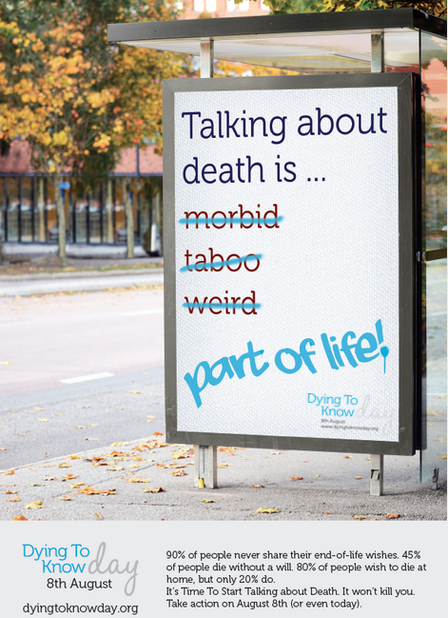
The bigger picture context in the community
The ‘Compassionate Communities’ movement has been gaining momentum and promotes greater community capacity to support those dying, carers and families
Baby boomers are demanding different choices around dying and death
Death is generally a taboo topic. Initiatives are springing up in communities to promote conversations on death and dying
New Zealand Coffin Club video
https://www.youtube.com/watch?v=YKxkLKggTlo

Slide 6
Why would local government be involved in end of life?
Councils have close connections with older people in their communities providing an opportunity to start new conversations
Councils are involved in facilitating heath and wellbeing in the community – healthy end of life is an extension of this
Councils have experience in community strengthening and facilitating change in communities e.g. prevention of violence against women

Slide 7
What the project is about
Exploring how local government can take a lead role in building stronger and more informed communities around end of life
Building partnerships, confidence and skills within council and the wider community around end of life
Facilitating a change in how community view, talk about and experience dying, death and bereavement

Slide 8
What has happened so far?
MAV is leading the project and developing resources and supports for councils
The concept has been embraced by many councils particularly in the Positive Ageing Area
Three councils have been funded to undertake demonstration projects
La Trobe University is undertaking an evaluation of the project

Slide 9
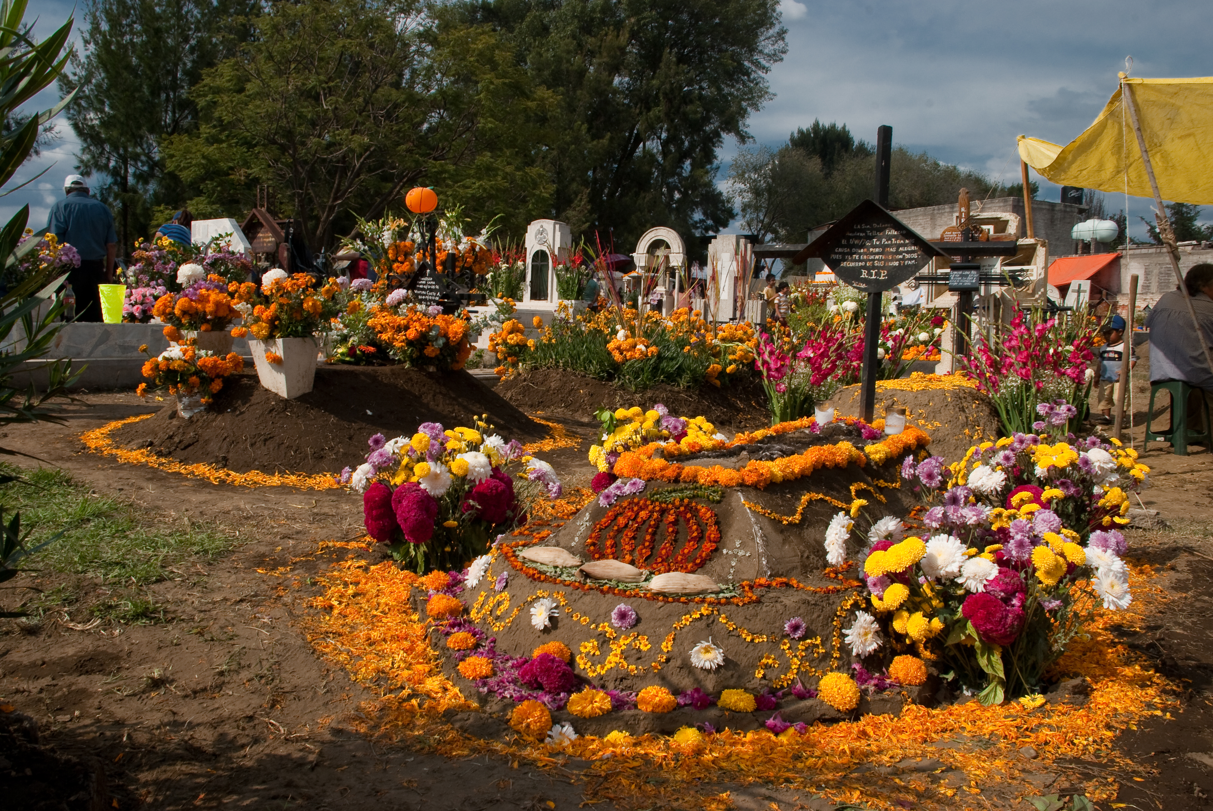
An explosion of activities – what some Councils are doing
Conversations Campaign – conversations about death, dying and end of life, Stonnington Council and Cabrini Hospital
City of Ballarat in partnership with Ballarat Gallery community event El Día de los Muertos (Day of the Dead) as a celebration of Spanish/Latin culture on honoring ancestors

Slide 10
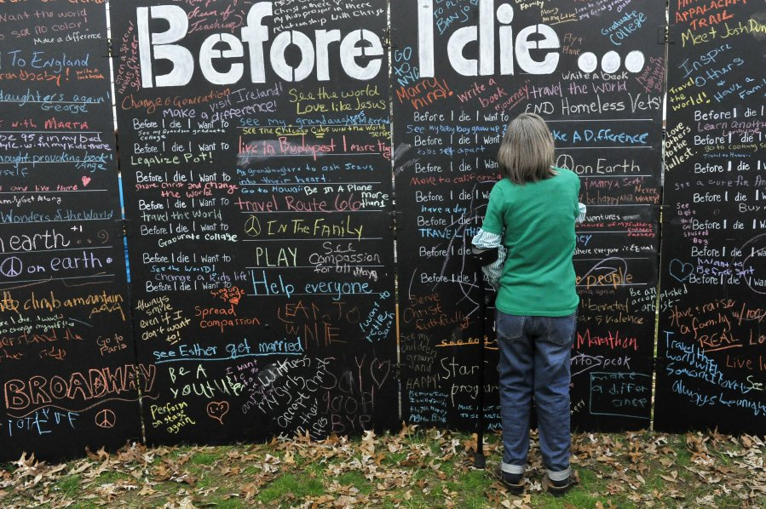
An explosion of activities – what some Councils are doing
‘End of life – Let’s start the conversation’ City of Banyule community think tank
Before I die board Shire of Yarra Ranges Seniors week activity

Slide 11
Many ways for council to be involved………
Participate in or create a community event/activity eg. set up a ‘before I die’ board at a community event
Include end of life into Seniors Week program
Be the conduit of information to community groups and residents
Include end of life in health and wellbeing planning
Create opportunities to build community capacity around end of life

Slide 12
For further information
MAV website
Jan Bruce jbruce@mav.asn.au

