Slide 1
Child Development Information System (CDIS) CDIS Admin Users Group
Thursday 18th May 2023
11 am – 12 pm

Slide 2
Content
Tips and Tricks
Clients only box
MS Teams Admin online group reminder
Reminders
Using Avatars for calendar communications
Managing Staff Availability
When a ‘child’ becomes a ‘parent’ Practice Note
Questions, Suggestions and Answers
Team App for relievers
What is best practice to manage the Birth Notification List

Slide 3
Tips and Tricks
Use the clients only check-box to search for active clients
This box will enable the search to only include clients ‘open for service’ If you do not tick this you will get open and closed clients in the search
This is one way to distinguish between child and adult records
RISK – There is a chance here to create a duplicate file so please don’t use when adding a birth notice. Best practice is to complete a state-wide search with the clients only box not ticked.

Slide 4
MCH Administration MS Teams online – are you connected?

Slide 5
Reminder Requests
Always complete a state-wide search when receiving a birth notice for PCG and baby – just in case BN has been received elsewhere as well.
Some reports that hospitals are sending to multiple LGAs.
Will reduce the number of duplicate histories
Transfer in only PLEASE do not push histories over. If you are wanting an LGA to know of a family moved into their area, please contact the LGA so they can transfer the history in.

Slide 6
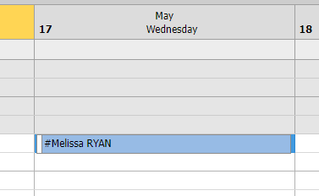
Using Avatars for Calendar communications
MCHN and Team members added to CDIS as a closed client for purposes of displaying their names at the top of calendars and observing workdays eg:
From this the MCHN /practitioner can look up their profile and see the days they are rostered on to work and location, particularly helpful for casual staff:

Slide 7
Using Avatars for Calendar communications
Other suggestions:
A vacant shift is created with an avatar called #Leave Not Covered. (client is not opened to service)
Block out an appointment #LeaveNotCovered as a ‘Telephone Consultation’ from 8:30am-4:30pm
Add an ‘All day’ appointment as ‘Leave’ (This isn’t necessary, but we like it as it makes it clear that the permanent staff is on leave without taking their name off the calendar)
Contact Reliever/s who may be able to cover the shifts available
When reliever accepts a shift:
Delete #LeaveNotCovered appointment
Make ‘All day’ appointment with #StaffName-Reliever as an ‘Additional Consultation’
If unable to replace with staff:
Delete #LeaveNotCovered appointment and replace with ‘Close’ calendar
To search for unfilled shifts, search for client #Leave Not Covered
This will highlight uncovered shifts

Slide 8
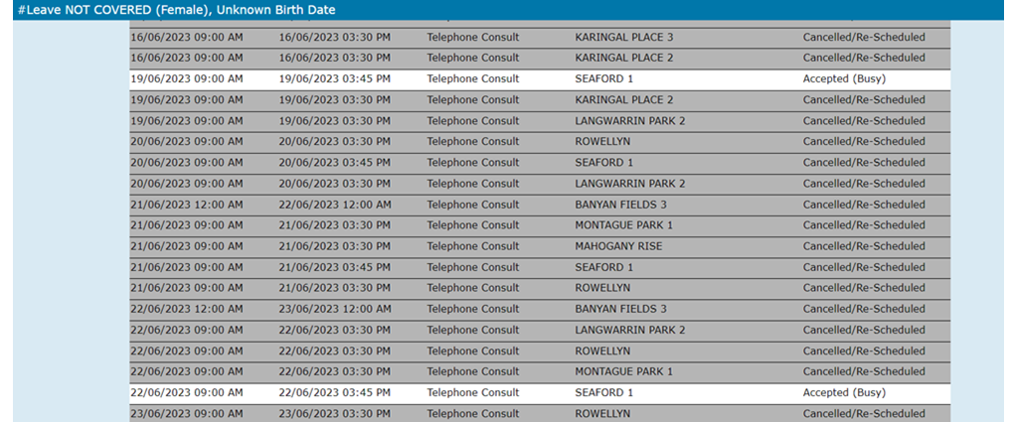
Using Avatars for Calendar communications
To search for unfilled shifts, search for client #Leave Not Covered
This will highlight uncovered shifts
Courtesy of Frankston MCH service

Slide 9
Using Avatars for Calendar communications
Another way to communicate with relievers or staff that want work is to send out a SMS from CDIS with the available shifts. This is done by adding the staff avatars to a group that we have created on CDIS called “relievers text group” and sending a free text SMS with the available shifts.
Important remember they cannot sms back and will need to confirm shift as per LGA process.

Slide 10
Managing Staff Availability
Set up a calendar as a reliever site, call it something appropriate. EG staff availability
Reliever staff or permanent staff wanting additional shifts are asked to add their #Name at the top of the day as an all day appointment to reflect that they are available for a shift
When a shift is allocated to them, the name is rescheduled to the relevant calendar site for that day.
Courtesy of Mornington Peninsula MCH service

Slide 11
When a ‘child’ becomes a ‘parent’ Practice Note
New Practice note on the MAV website.
In complying with record-keeping legislation clients should have 2 separate CDIS health records.
CDIS ‘Child’ Clients - Children should ideally only have one child CDIS record, which transfers across MCH services with the child if they move location.
CDIS ‘Caregiver’ Clients - Caregivers should ideally only have one adult CDIS record, that can be maintained across their time within the MCH service. e.g., where an adult has a record as a parent, and then subsequently is involved as a grandparent, this should all be recorded in the same adult CDIS record.
Given these guidelines, this practice note will explain how to maintain this consistently in CDIS to ensure.
When a child becomes a caregiver a new caregiver CDIS record is created
When a caregiver becomes a grandparent or other, maintaining an existing caregiver CDIS record and updating the relationships rather than creating a new record
NB: This also includes merging

Slide 12
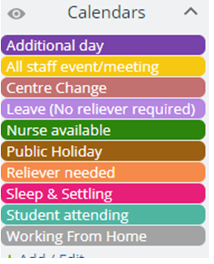
Questions, Suggestions and Answers
TeamUp App for Relievers
https://www.teamup.com/
This key is how to set the program up.
The subscription allows 12 different colours etc to be used and allocated.
Cost $150/year
The relievers have only one option and that is Nurse available.
Relievers can add/delete their availability on the app.
Only admin can allocate shifts and add the centres that need to be backfilled.
Once a shift has been allocated, Admin will then go into CDIS and add the staff member to the calendar.
Courtesy of Darebin MCH Admin Team – for more information please reach out.

Slide 13
Questions, Suggestions and Answers
What is best practice to manage the Birth Notification List?
The guidelines around removing a baby from the birth notification list is LGA specific.
There are two options:
MCHN to complete post HV
Admin Team to complete after HV confirmed
Best Practice is to ensure that you do not miss a child if the HV is not attended once booked ie family not at home. Some councils have measures in place to ensure this is prevented. Once a baby is removed from the BN list you cannot identify if a HV is needed.

