Slide 1
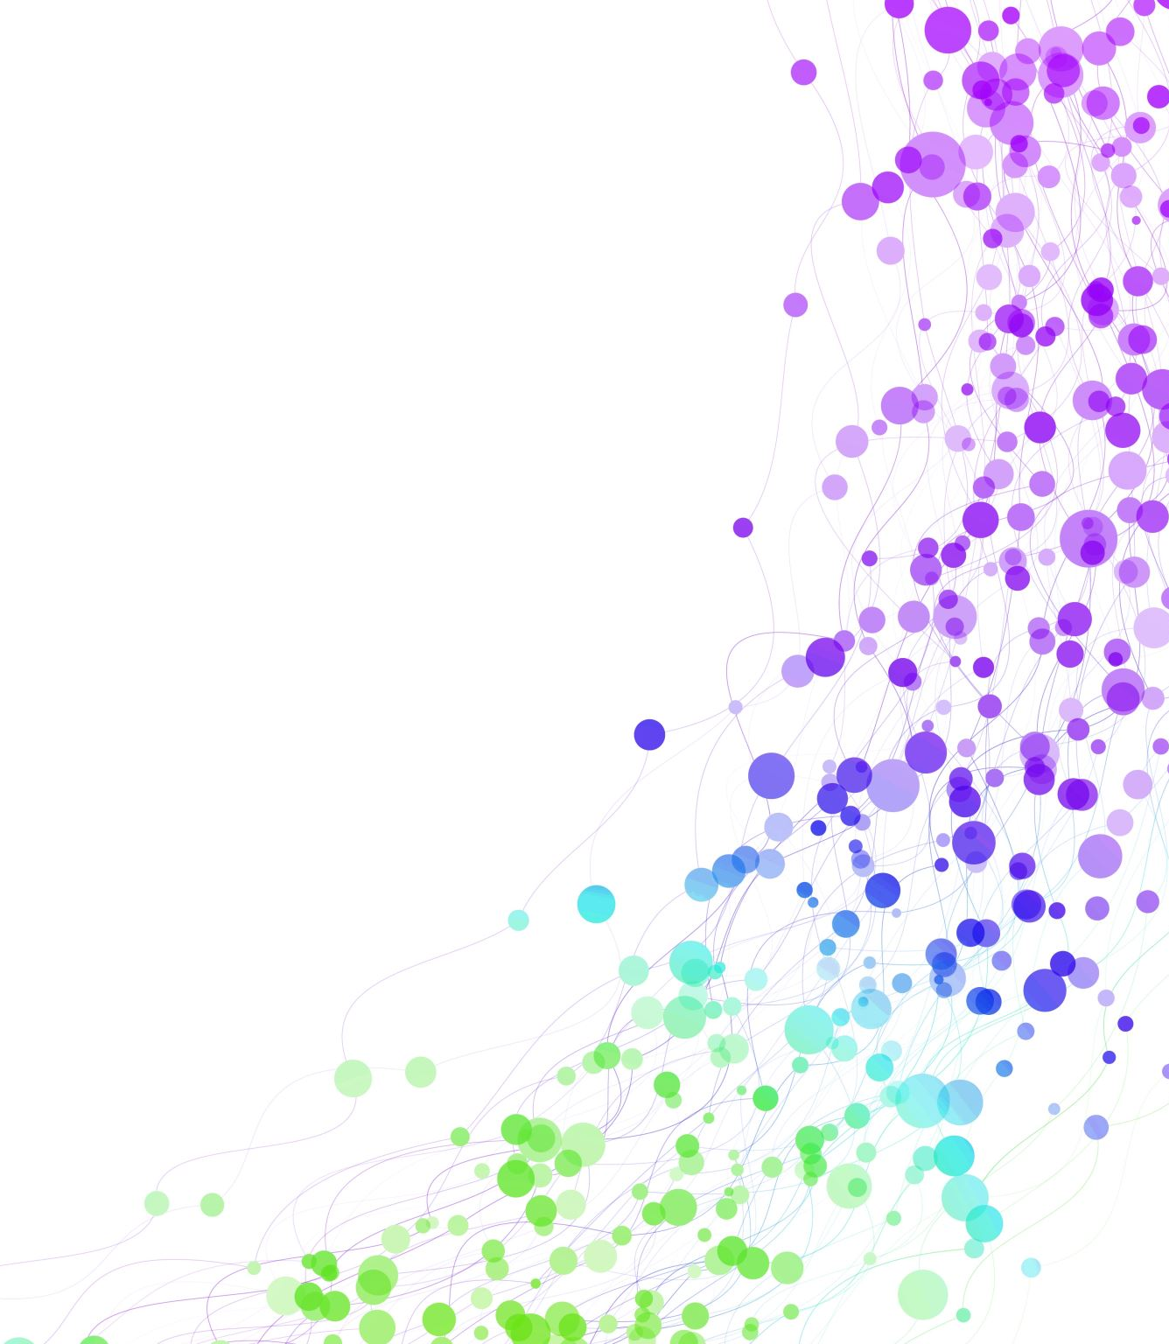
Child Development Information System (CDIS)
CDIS Clinical Users Group
Thursday 13th July 2023 8:30 am – 9:30 am

Slide 2
Contents
Tips and Tricks Recording and Saving Client Consultations Correctly
Flags Update
Adding an Address to a Site Name for Client Appointment Correspondence
MCH Resources
CDIS Support Processes CDIS Support – Simplifying Help Requests
Q&A –

Slide 3
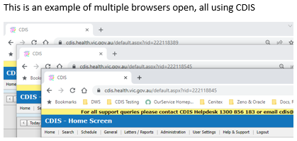

Recording and Saving Client Consultations Correctly
To prevent duplicate or incorrect data entry when recording consultation notes for a client’s consultation, it is recommended to only have one-CDIS Internet browser window or tab open.
It has been reported that clinicians are using CDIS with two-Internet browser tabs or two-Internet windows open, for the same KAS consultation. When recording KAS consultation notes, this presents an issue for the CDIS system, and notes can be inadvertently recorded twice, or saved as draft whilst other notes are simultaneously saved into the client’s health record.
When recording consultation notes for any client consultation, it is recommended to only have one-CDIS Internet browser window or tab open to prevent incorrect or duplicate data entry.

Slide 4
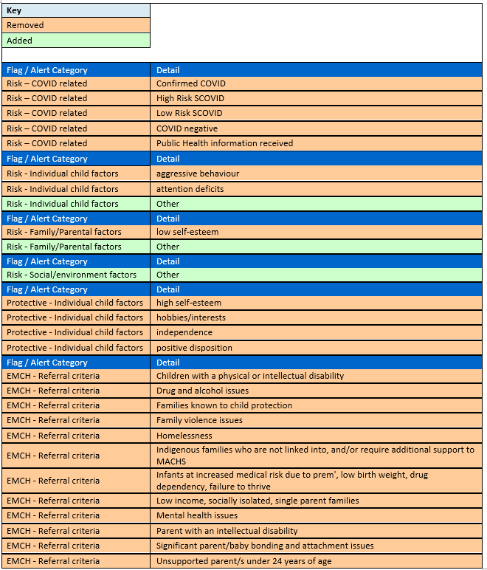
Flags Update
Two Risk / Flag Categories, and their details have been removed from CDIS:
  EMCH – Referral Criteria
  Risk – COVID related
Though these Categories still appear in the “Add Flag / Alert” drop-down list, they cannot be selected/added.
Clients with these Risks/ Flags on their Hx, can have these edited or end-dated.
For several categories, some details have been removed.
These details will no longer be available for selection, however clients with these Risks/ Flags on their Hx, can have these edited or end-dated.
For three categories, the option of ‘Other’ has been added:
  Risk - Individual child factors
  Risk - Family/Parental factors
  Risk - Social/environment factors

Slide 5
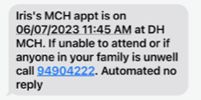
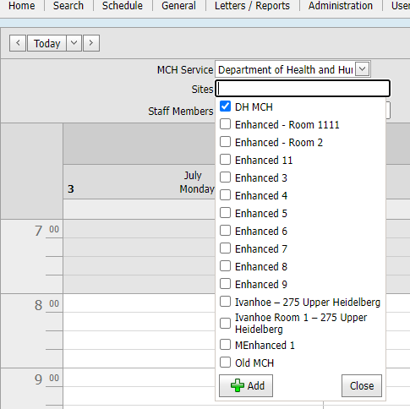
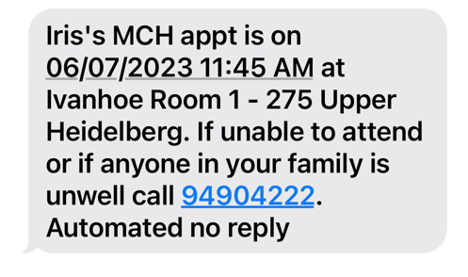
Adding an Address to a Site Name for Client Appointment Correspondence
Sites, Centres and Calendars, have the ability to include and display their current address
This is done by adding the current address to the “Name” of the site
Requests can be submitted to CDIS helpdesk using the CDIS Site request form v2, with authority clearly displayed from a clinical Co-ordinator*
*If an admin requests this, ensure a forwarded approval from the Coordinator is included the email chain, or it will be passed back and require re-submission
We are still unable to rename sites/centres/calendars/or change addresses in CDIS, when sites physically move or close.
Pros
Addresses are visible in Home screen (Calendars)
Message character count would increase (no increased costs for email correspondence)
Clients receive addresses in their appointment correspondence
Cons
The character limit is 100 (impacts some sites)
Message character count would increase (increasing SMS Costs)
‘Group’ links Site name and address, so addresses would appear twice
Letters include Site name and address so may require editing as address would appear twice
Can only be updated via CDIS Helpdesk by MCH Support at Health

Slide 6
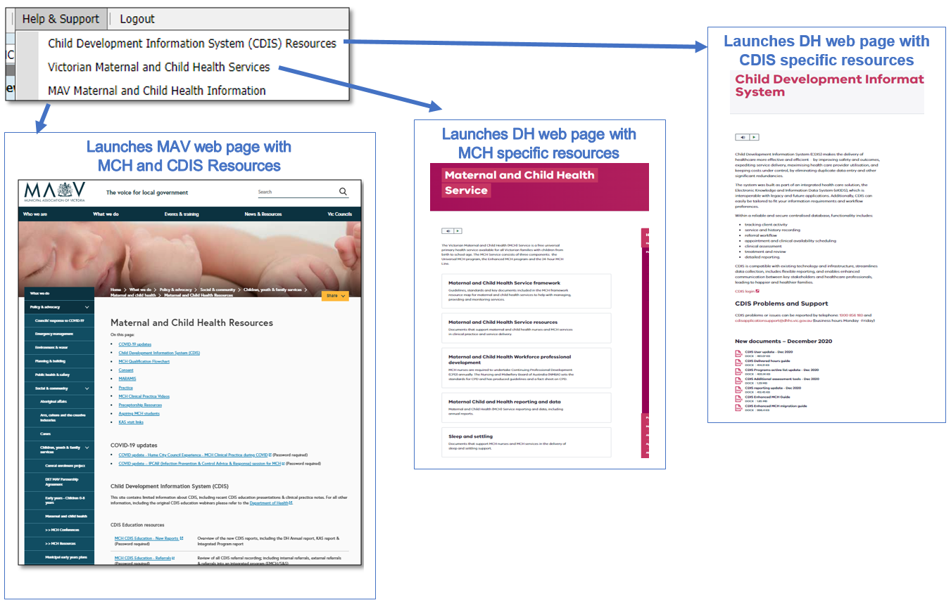
MCH Resources
Vimeo Password – cdis
MCH Clinical Practice videos password – mchvideos
Notes:
Password for vimeos = cdis

Slide 7
CDIS Support – CDIS User Responsibilities
When you are experiencing a CDIS issue / problem / question:
Check internally with your team leader / coordinator / CDIS Champions to validate what’s happening in CDIS. Include this in your request for support.
If your issue is connecting to CDIS, please check with your local IT professional if there is a network issue.
Are you the only one with the issue or are others experiencing this too? When was this problem first noticed? Include this in your request for support.
Check the online resources available to you, and if you're not closer to resolution, escalate to Contact CDIS Helpdesk on 1300 856 183 or cdis@support.vic.gov.au with the following important detail
In summary what is question or problem?
  What screen are you using / what actions are you doing in CDIS,
  What is the outcome you’re expecting?
  What is actually happening instead?
  NB: Client ID
Take a screen capture of the error or copy and paste the URL (web address),the name of the screen you’re using. For reports, detail the year or data range you’re using, and any other data selections, and capture the error message.

Slide 8
CDIS Support – Health Responsibilities
Record issue / question /problem and assign Incident #
Triage > Fix on first contact if possible >
If Technical the helpdesk will review and resolve
If Clinical the helpdesk will assign it to the clinical team to review and resolve
  If either team requires the issue to be escalated to supplier this is done
The MCH Clinical team in The Department of Health reviews and responds, and if required, consults with Clinical experts in DH, MAV, Safer Care Victoria and the CDIS reference group
CDIS Support Hours
Monday to Friday between 8:30am to 5:30 pm
Contact
1300 856 183
cdis@support.vic.gov.au

Slide 9
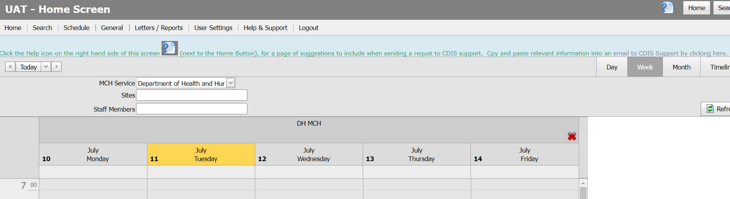
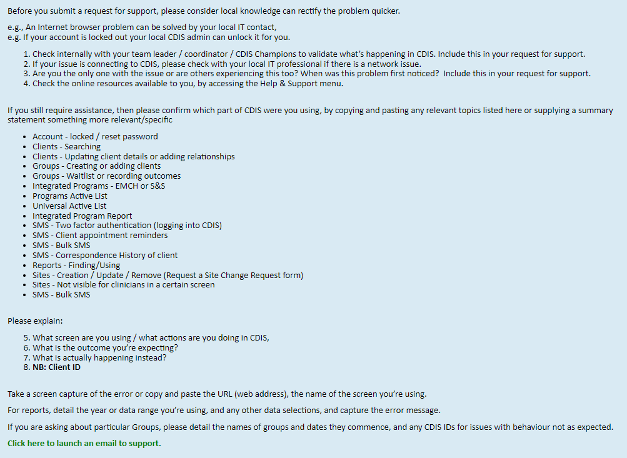
CDIS Support – Simplifying support requests
The CDIS Home screen has been updated to direct users to the Help icon, where there are some tips for quicker troubleshooting and requesting support to CDIS Support.
Both pages have links to launch an email addressed to CDIS Support.

Slide 10
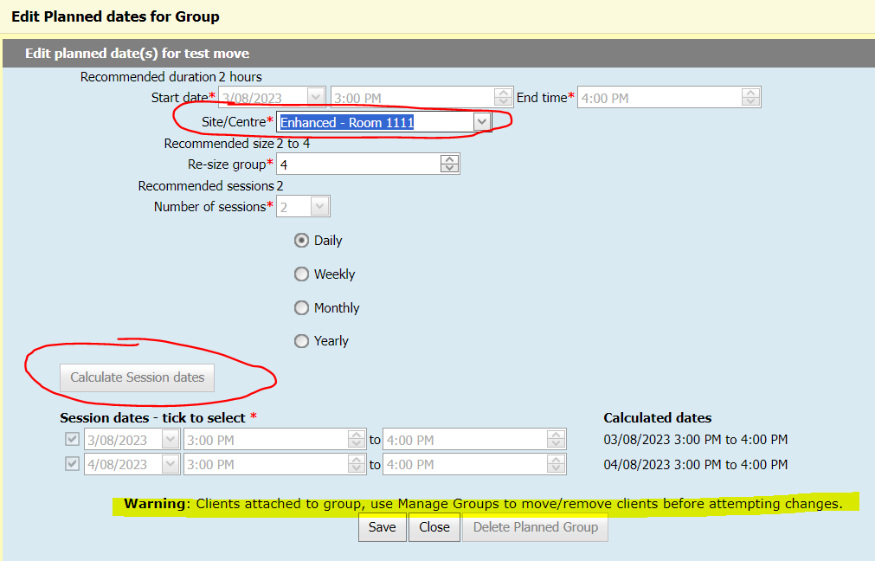
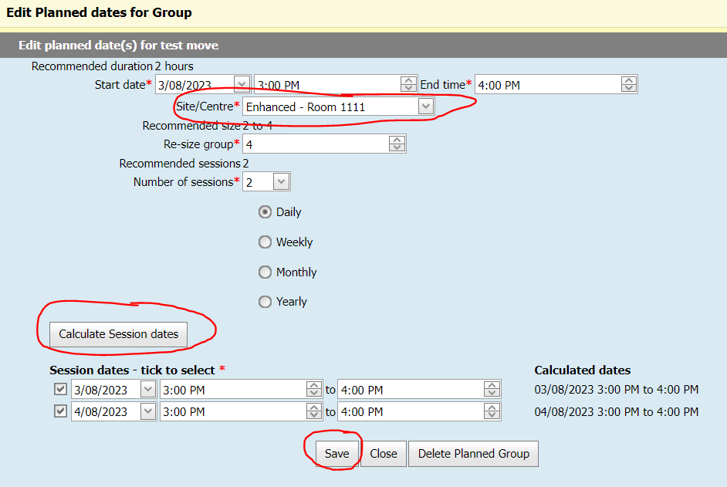
Questions asked during the session
Q. Can you move a group (e.g., FTPG) to another diary (site) and the groups participants stay enrolled or added to the group?
Groups/sessions cannot be edited once the sessions commence
Groups/sessions can only be edited after all participants are removed
Groups/sessions can be moved to a different site/centre before commencement, with no one enrolled, with or without a facilitator booked. However, you must also click “Calculate Session Dates” to confirm the location change is acceptable and then click Save. If this button is greyed out it is because people are already enrolled. There will be a corresponding warning on the screen. If you need to change the site/centre the steps are listed in the box below:
1. Remove all the clients from the group
2. On the 'Group Templates' screen, edit the group
3. Ensure the correct site is selected for 'Site/Centre'
4. Click the 'Calculate Session dates' button
5. Save
6. Add the clients back to the group

Slide 11
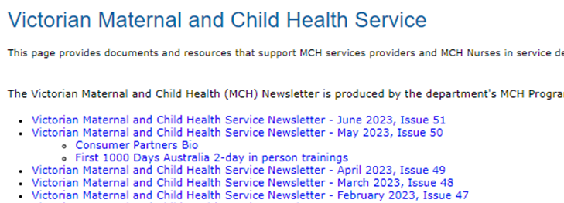
Questions asked during the session
Q. Where are the MCH Newsletters stored?
Currently stored on the Funding Agency Channel. Will need MCH Coordinator to access.
MCH Coordinator can also access on the MAV – MS Teams site
Planning currently in process for an MCH Collaborative platform where these will be stored on this in the future for easy access for all MCH staff.
Q. How can I search for young/teenage parents?
Data Extract Report
Universal Active List Report
Filter for age in PCG section
Q. Sleep and settling referral pathways for groups and outreach.
S&S outreach through PCG.
S&S groups – add child/baby

