Slide 1
Local Laws -
Preventing Violence Against Women
Rod Bezanovic Team Leader Local Laws

Slide 2
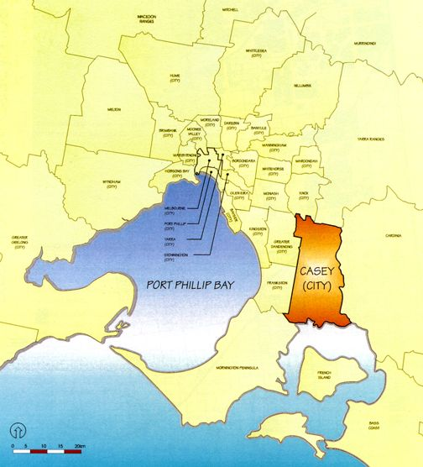
City of Casey Profile
Situated 40km south east of Melbourne
One of Victoria’s fastest growing municipalities
Current population 260,000 growing at 120 per week, 6000 per year
Future population projected at 450,000 by 2036

Slide 3
Casey Demographic
Over 88,000 residents were born overseas
Top 4 countries: United Kingdom, Sri Lanka, India and New Zealand
Top 4 languages other than English: Sinhalese, Dari, Arabic and Hindi
29% of Casey’s population is aged under 18 19,962 children are aged 0-4 years
44% of Casey’s population is couples with children
126,931 women live in the municipality

Slide 4
Family Violence in Casey
The City of Casey has the highest incidences of family violence reports to Police in the state with 3172 callouts in 2011-2012.
It is estimated that 70% of cases are not reported
The Number 1 priority issue for Victoria police (40+% of work)
There is a dedicated Victoria Police Family Violence Unit based in Cranbourne
More than 40,000 women in Casey are estimated to have experienced violence from a male in their lifetime, and even more children
Family Violence is a significant public health issue for the City of Casey

Slide 5
Family Violence Prevention at the City of Casey
Extensive work with faith communities: “Promoting Peace in Families Project”
Input to State policy, planning and member MAV network
Recently received Dept of Justice Grant $600,000 Primary prevention in partnership with Cardinia, Greater Dandenong & Southern Health “Challenge Project”

Slide 6
Continued
Casey Men’s Action Team - preventing violence against women: Team Leader Local Laws is a foundation member and ambassador
Consists of senior staff in Council from various departments
Purpose is to increase the capacity across Council to prevent violence against women by men taking responsibility and action within their spheres of influence
Through involvement in the group, local laws decided to look at ways to prevent violence against women

Slide 7
Local Laws in Family Violence Prevention
Local Laws officers interact with perpetrators and victims
Local laws officers are exposed to violent behaviour or the signs
Identified a correlation between family violence and violence toward pets

Slide 8
What local laws staff saw
Looking back over Local Laws cases it became clear that on several occasions women disclosed fear of harm by their partner, at the time of intervention with an officer, and that they were assaulted by a male partners after an animal was impounded, seized or search warrant executed.
Local laws realised that they could take responsibility to ensure that their actions resulted in women being safe, by preventing violence occurring.

Slide 9
Local Laws – How Practise Changed
Partnership formed with Councils Health Promotion Team and Victoria Police
2 hour training session for all Local Laws officers in family violence prevention
Standard Operation Procedures updated with specific sections dedicated to Family Violence being included within the Animal Management, OH & S and Traffic sections. Debriefing occurs following an incident
Team Leader Local Laws accepted as a White Ribbon Ambassador

Slide 10
Model continued
Male Officers wearing white ribbons in the community
Officers have Family Violence information to give to community members when required
Officers are acting as active bystanders challenging inappropriate views against women and being role models of appropriate behaviour
Safety of women is always a paramount consideration when actions are undertaken

Slide 11
What has changed?
Awareness has been raised so more incidences are noticed, responded to
Staff are better resourced when faced with this issue, that they can make a difference, adds value to work, increased professionalism
Better community profile
Broadened role from enforcement to include public health
Improved partnerships: Collaboration with Police in field to support Local Laws
Model for other Councils/Local Laws
Easily applied to other Council service areas

Slide 12
Examples of changed practice
traffic infringement notice; dealing with the male
Using white ribbon to calm a situation

Slide 13
Next Stages
Evaluation
Continuing to improve the model
Further training and support
Sharing the model with other Councils

Slide 14
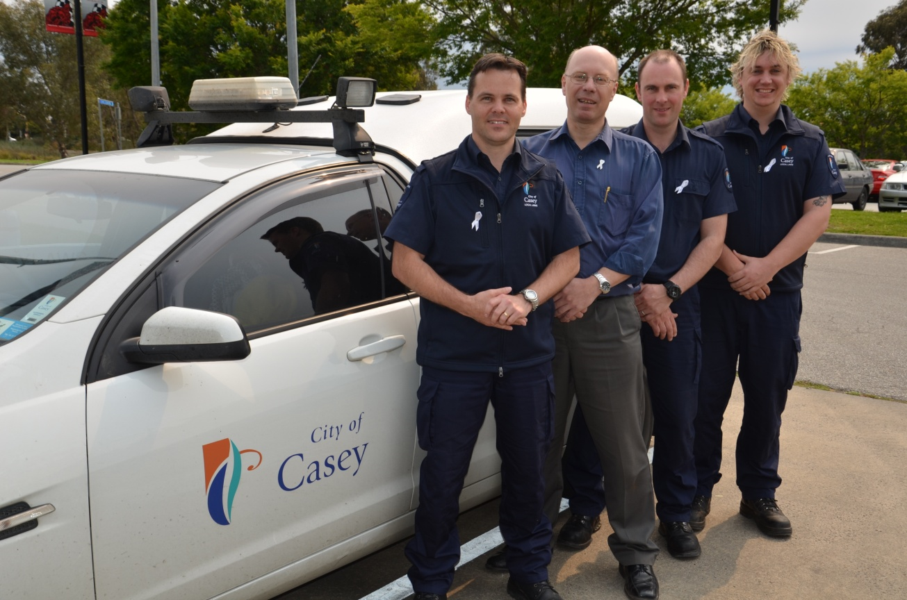
Any questions?
Contact Rod Bezanovic 97055200 rbezanovic@casey.vic.gov.au

