Slide 1
Gender on the Agenda in Local Government – a Partnership Approach
Local Government Promising Practice Forum
Preventing Violence Against Women
14 December 2011

Slide 2


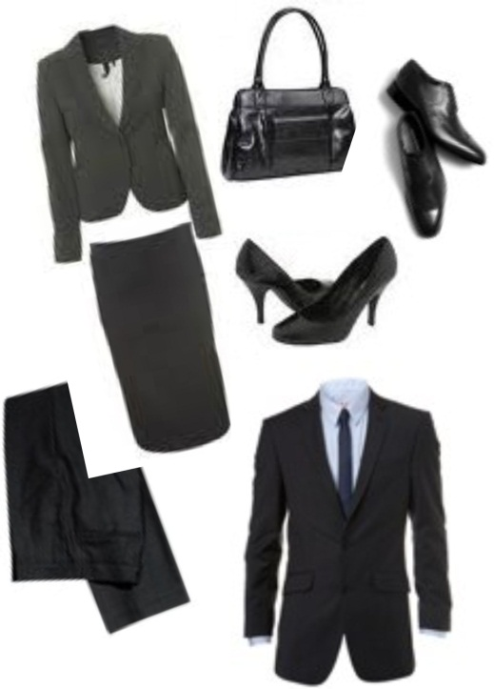
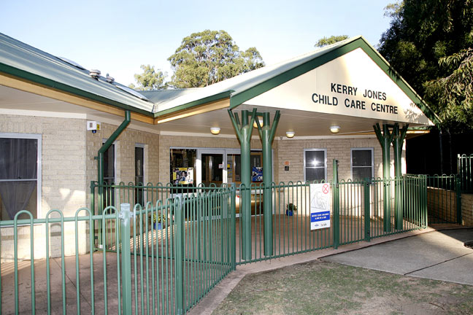
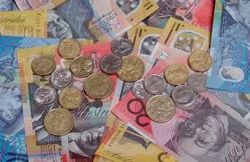
Gender
Notes:
Before we get into the Gender Equity in Local Government working group and what the group has been doing – thought it important to briefly clarify what we mean by gender, gender equity, and why we are talking about gender equity when we’re at a forum to discuss preventing violence against women.
Gender refers to the socially constructed roles, identities and expectations that are assigned to women and men – that is, the masculine and feminine qualities, behaviours and roles that shape who we are.
Gender influences many of the experiences we have on a daily basis.
For example – gender would have played a role in:
The set of clothes you pulled on this morning,
Whether you fit in any housework before heading out the door,
If you were responsible for getting the children ready,
Whether you used public transport or your own car,
And how much you are paid for the work you do.
These things are all influenced not only by your personality, but also by your gender. As a society we give have popularly held beliefs and norms about the roles women and men have, how they should behave and what their interests are. These things are not determined by ‘sex’, that is, by being born ‘male’ or ‘female’ – but are learned through social interaction.

Slide 3
Gender Equity
…is not about the equal delivery of services, or distribution of resources, it is about recognising diversity and disadvantage, and directing resources and services towards those most in need, to ensure equal outcomes for all.
Sue Dyson, 2001
Notes:
Gender not only influences us at a personal level, it helps to shape and organise us as a society – our systems, structures and who has access to power and resources.
For example, on average, there is a pay gap between women and men full-time workers in Australia that is 17%. This is for a range of gender-related reasons including the different roles women and men have in society how they are valued.
A gender equity approach highlights these disparities to encourage a focus on those groups of women and men who are most marginalised – and most often, this means a focus on women.
READ QUOTE – Gender Equity…

Slide 4
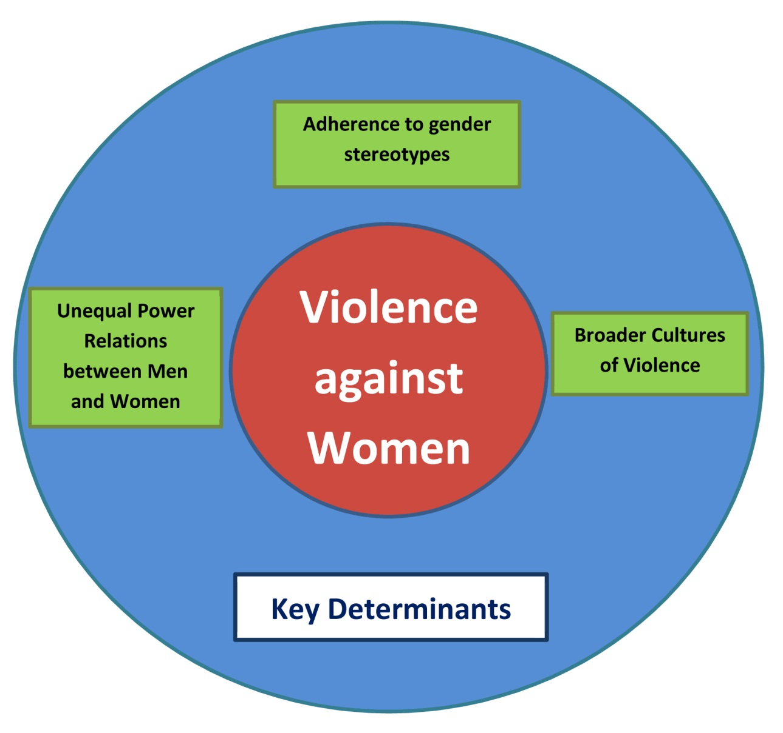
Gender Equity and PVAW
Notes:
So how does ‘gender equity’ relate to preventing violence against women?
Gender inequities – so more specifically, gender stereotypes and unequal power relations between women and men, are one of the key determinants identified by VicHealth in their Framework for Action, Preventing Violence Before It Occurs.
This means that in aiming to prevent violence against women we must look at our cultural values and expectations about how women and men should behave – and address the systems and structures which reinforce and perpetuate these stereotypes.
So when stereotypical views are supported about women as passive, weak, an object or possession and when women don’t have viable incomes or an opportunity to participate in public decision-making this translates into and legitimates unequal relationships between women and men.
This is how gender inequity creates conditions in which violence against women occurs.
Essential to address this unequal dynamic within personal relationships, community attitudes, and also through structural means.
.

Slide 5
Gender Equity and Local Government
Key state and federal legislation:
  Vic Health Act
  Vic Equal Opportunity Act
  Sex Discrimination Act
  Vic Charter of Human Rights
3 local government legislated strategies and other key strategies
Notes:
Local government plays an important role in creating and supporting environments that enable communities to achieve optimal health and wellbeing. Reducing gender inequity is a key strategy in achieving this goal. It helps create a more just, inclusive and fair society for both women and men.
There are a number of legislations which reinforce local government’s role in working toward and upholding gender equity:
Victorian Health Act (Section 6) and the Local Government Act 1999
Councils need to “Act as representative, informed and responsible decision makers in the interests of their communities.” Consider needs of both women and men.
Victoria Equal Opportunity Act 1995
Sex Discrimination Act 1984
Both legislations aim to eliminate discrimination and sexual harassment and promote gender equality in all aspects of the Australian community.
Victorian Charter of Human Rights and Responsibilities Act 2006
Gender equity is not only an important goal in its own right, as I have explained, working towards gender equality is also essential to shifting the conditions that perpetuate and legitimate violence against women.
This is why having Municipal Public Health plans and other key Council strategies that include specific ways to improve women’s health and wellbeing contributes toward preventing violence against women. This is why increasing the number of women in management positions across Council is actually a preventing violence against women initiative.
While these activities do not immediately jump out as a ‘PVAW’ actions, they are (because they are aiming to improve the lives of those groups of women and men most marginalised & gender inequity is a determinant/cause of VAW).
So the role of the Gender Equity in Local Government group that Anna and I belong to is to really look at how local governments can take a practical approach to shifting gender inequity.

Slide 6
Gender Equity in Local Government Working Group
Development and background
Membership
Role
Development of resources
Notes:
Development and background:
The idea for this group was first prompted among local government officers who attended the 2010 National Women’s Health Conference and heard Helen Kelleher’s presentation on a policy scorecard for gender mainstreaming across government policy. This interest was also supported by growing the fact that a number of Councils were beginning to make commitments to progress gender equity, such as Yarra City Council’s formal recommendation that a gender reporting resource be developed for the organisation.
Membership:
The group comprises representatives from local government and women’s health services, in partnership with VicHealth, Monash University, the Municipal Association of Victoria and Office of Women’s Policy.
Role:
The purpose of the Gender Equity in Local Government group is to lead and oversee the development of tools, resources and capacity to assist in embedding gender equity into the core business of local government.
The group would like to see a comprehensive suite of resources for local governments that provide a variety of mechanisms to analyse, research, evaluate and therefore understand how a consideration of gender is relevant across the organisation.
Development of resources:
Have been looking at the need to draw on/develop Gender Equity factsheets, training, lenses, audit tools for local government.
And there are a number of existing tools, such as the WHIN’s audit tool and Gender Analysis Training which has recently been piloted at Darebin Council very successfully.
Plus there are a range of other models out there which can be utilised, but there are the first that are specifically tailored for the local government sector.

Slide 7
Gender Equity in Local Government factsheets :
Why gender matters
Gender Analysis
Infrastructure
Land use planning and design
Promoting women in leadership
Workplaces
Sports and recreation
Access to services
Key concepts and definitions
10. Further resources
Notes:
A key initiative of the GE in LG group has been the development of a series of factsheets: Ten ways local government can advance gender equity. The fact sheets include practical information and practice examples of ways local government can advance gender equity for women.
The purpose of the factsheets is to guide individual council officers how to think about gender equity within their everyday work. By addressing gender equity across a range of local government areas of responsibility i.e. infrastructure and sports and recreation – the factsheets aim to make a consideration of gender practical and familiar to any council officer.
The factsheets also move the progression of gender equity work from the role of a women’s/equity/social planning officer to a whole of organisation responsibility.

Slide 8
Feedback on Factsheets
Draft factsheets in delegates pack
Feedback form – we’d appreciate your input!
Next Steps
Meeting in February 2012
Planning for 2012 activities
Notes:
Feedback on Factsheets
Would appreciate your input and feedback to me by 1st of March 2012.
It would be particularly useful if you could make the relevant factsheet available to relevant staff members for their input i.e. Infrastructure
Next Steps
Open meeting in February 2012 – contact Maryanne if interested in attending for further details.
2012 Work Plan for group =
Completion of draft fact sheets
Finalising consultation on factsheets
Looking at future activities of group i.e. implementation of fact sheets and/or development of further resources.

Slide 9
For more information
Maryanne Clarke
Community Planner, Women’s Health
Yarra City Council
t 9205 5056
e maryanne.clarke@yarracity.vic.gov.au
Anna Stewart
Women’s Health Promotion Worker
Women’s Health in the North (WHIN)
t 9484 1666
e annas@whin.org.au
Notes:
Happy to chat afterwards about the group and next steps etc. – please come and speak with us!

Slide 10
GE Working Group members
Darebin Council
Hume Council
Women’s Health West
Women’s Health in the North
Women’s Health Grampians
City of Casey
Knox City Council
Maribyrnong City Council
VicHealth
Monash University
Office of Women’s Policy
Notes:
Many thanks to the members of the working group – their commitment to this work has been fantastic!!

