Slide 1
MARAM – Levels of Risk
+ Training poll & Q / A
Nic Watson
MAV - MARAM Information Sharing Project Lead
E: nwatson@mav.asn.au

Slide 2
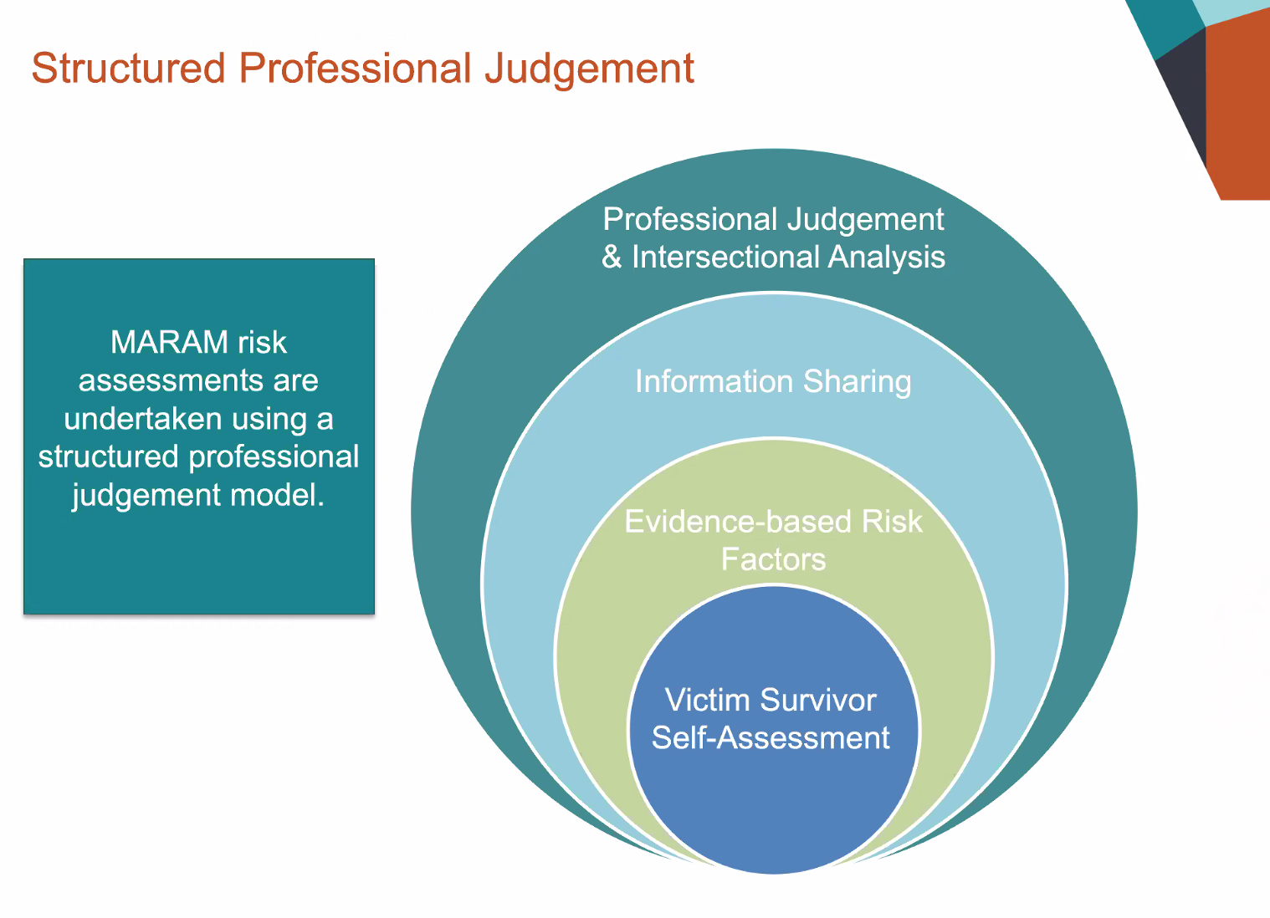

Slide 3
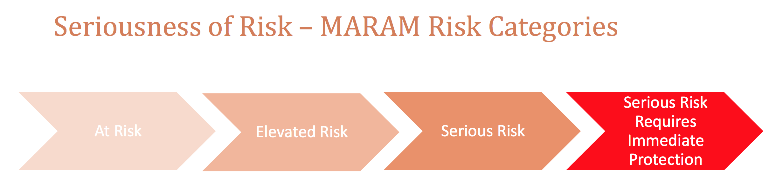
At Risk Elevated Risk Serious Risk Serious Risk
Requires
Immediate
Protection

Slide 4
MARAM - At Risk
High risk factors are not present.
Some other recognised family violence risk factors are present, but protective factors and risk management strategies, such as advocacy, information and victim survivor support and referral are in place to manage (lessen or remove) the risk from the perpetrator.
Victim survivor self-assessed level of fear and risk is low and safety is medium to high.

Slide 5
Elevated Risk
A number of risk factors are present, including some high-risk factors that are likely to continue if risk management is not initiated.
The likelihood of a serious outcome is not high. However, the impact of risk from the perpetrator is affecting the victim survivor’s day-to-day functioning.
Victim survivor self-assessed level of fear and risk is elevated and safety is medium.

Slide 6
Serious Risk
A number of high-risk factors are present related to likelihood of lethality or serious injury. Risk factors may have changed/escalated in frequency.
Serious outcomes from current violence has occurred and it is indicated further serious outcomes from the use of violence by the perpetrator is likely, and may be imminent.
Immediate risk management is required to lessen risk or prevent a serious outcome from the identified threat posed by the perpetrator.
Coordinated and collaborative risk management and action planning by statutory and non-statutory services response is required.
Victim survivor self-assessed level of fear and risk is high-extremely high and safety is low.

Slide 7
Serious Risk and Requires Immediate Protection
Additional category within serious risk where the victim survivor requires immediate protection.
Previous strategies for risk management have been unsuccessful. Escalation of frequency of violence has occurred/likely to occur.
Formally structured coordination and collaboration of service responses is required with involvement from statutory and non-statutory crisis response services.
May include referral for a RAMP (Risk Assessment & Management Panel) to lessen or remove serious risk that is likely to result in lethality or serious physical or sexual violence.
Victim survivor self-assessed level of fear and risk is high-extremely high and safety is extremely low.

Slide 8
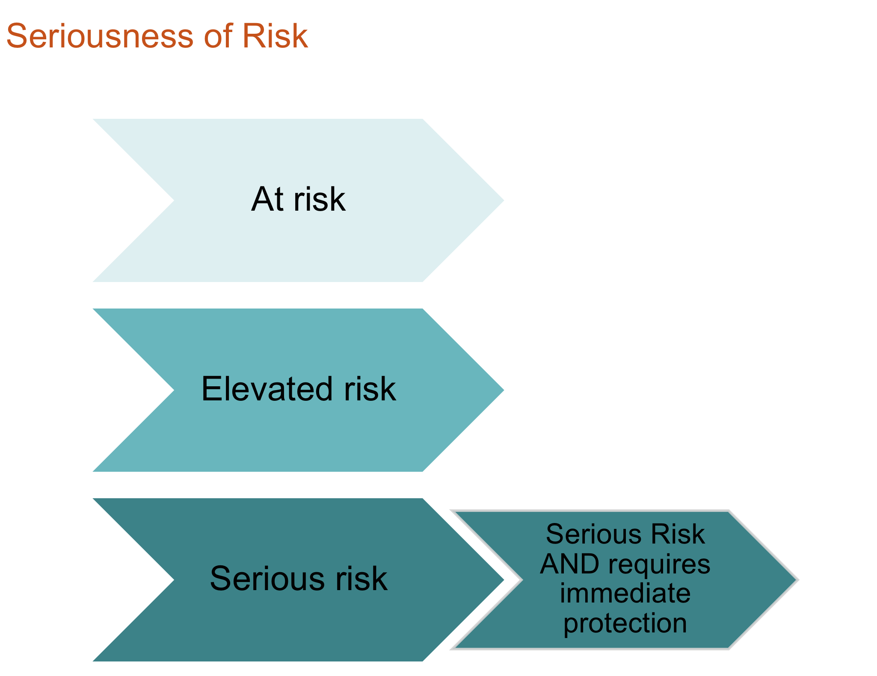
Continue to refer onto Family Violence Specialist
and / or Police

Slide 9
Zoom Poll
– MARAM Modules Training participation
For the two CFECFW MARAM modules:
Have you completed Module 1?
Have you completed Module 2?
Options for those requiring further training to be explored

Slide 10
Questions and Follow Up
Thank you MCH
Nic Watson
MAV MARAM Information Sharing Project Lead
e: nwatson@mav.asn.au

