Slide 1
The CDIS champion role Data Cleansing Merging Q&A
Child Development Information System (CDIS)
CDIS Clinical User Group
Monday 17/10/2022 8:30 am – 9:30 am
CDIS Admin User Group
Tuesday 18/10/2022 2-3pm

Slide 2
Contents
Role of CDIS champion
Use of Medical record: CDIS
Open/Change/Close Client
Further clarification regarding closing clients and age of MCH children
Reasons to close CDIS hx records
Data Entry
Merging of Duplicate Histories
Data Cleanse
Slide from MCH CDIS Education – Data Cleansing
Questions & Answers

Slide 3
Role of CDIS champion – Administration and Clinical
Representing your team.
Resource in your team for CDIS education, questions and troubleshooting.
Note any common themes or questions from your team to report to the group.
Gather information from your team to be addressed in the User Group meetings or followed up by the CDIS Reference group and highlight education needs.
Attend User Group meetings every 6-8 weeks.
Contribute to User Group meetings conversations re your teams CDIS practice, questions and ideas.
Sharing information learned at the CDIS user group meetings with your team ie sharing slides or presenting at team meetings (eg CDIS tips and tricks)
Prompting your team use of CDIS resources such as the vimeo’s and CDIS education through the Help & Support tab on CDIS.

Slide 4
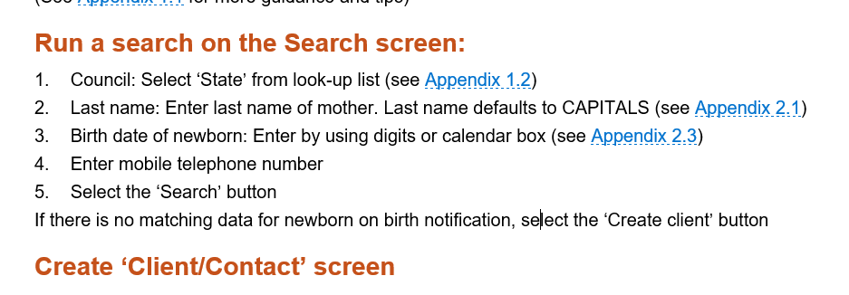
Use of Medical Record: CDIS
Always complete a State search for parents when adding a birth notice to reduce and prevent duplicate histories

Slide 5
Open/Change/Close Client
Always check this field in Client Details tab is updated
This should be checked with every consult with a new client.
Clients need to be open for data collection and referral to any Integrated Programs.
See https://www.health.vic.gov.au/maternal-child-health/child-development-information-system?rid=156286797
CDIS Open, change and close process

Slide 6
Further clarification regarding closing clients and age of MCH children
As per the 2019 MCH Service guidelines:
“The MCH Service is a free universal primary health service for all Victorian families with children from birth to school age.”
There is no requirement to close the history once a child is outside the service age range. They will not be included in any CDIS reporting.
Remember your funding is population based and all children eligible for MCH should be open to ensure full funding is provided for the service.
As per the CDIS Open/Close/Change Process 2020:
All children under six years old should be open to service
All Primary Caregivers
Any other caregiver who is actively receiving an MCH service – then close the record when the ‘episode of care or service’ is finished. For example, a caregiver’s record would be open if they have been referred by MCH (which is recorded from the child’s record then notes entered in the caregiver’s record) until the referral has been followed-up and no further service is required. Then the caregiver’s record would be closed.
Note: primary caregivers’ records always remain open.

Slide 7
Reasons to close Hx records include:
childhood record
client has moved interstate
client has moved overseas
client has declined service
client is receiving service from another care provider
change in primary care giver status
no longer receiving MCH service
still birth, client is deceased
primary caregiver of stillborn or deceased child
data entry error
https://www.health.vic.gov.au/maternal-child-health/child-development-information-system

Slide 8
Data Entry from HV
Important Points:
Recording Aboriginal or Torres Strait Islander identification
Recording First Time mother in the Pregnancy and Delivery (after the APGARS)
Recording of consent
Using the Edit tab on the details page for information prompts/reminders

Slide 9
Merging of Duplicate Histories
Merging of duplicate histories is recommended to be completed by two MCH Clinicians one a Coordinator or Team Leader to ensure correct information of clients details when merging
What is the process at your council when duplicate histories are found?
See Merging Duplicate Records in the CDIS Birth Notification process
https://www.health.vic.gov.au/maternal-child-health/child-development-information-system?rid=159900253
New Merging CDIS histories Practice Note coming soon

Slide 10
Data Cleanse
Every time a CDIS record is open practitioners should review and clean up data as needed.
See MCH CDIS Education – Data Cleansing Training
https://www.mav.asn.au/what-we-do/policy-advocacy/social-community/children-youth-family/maternal-and-child-health-children-0-6-years/maternal-and-child-health-resources
Note: password cdis
See next slide regarding recommended data cleansing

Slide 11
Slide from MCH CDIS Education – Data Cleansing

Slide 12
Questions & Answers
Pleased ask any questions you have
Please use chat function to add any comments/queries
This meeting is for you and your MCH team and their practice so please provide feedback for future meetings
The following slide are in response to questions and comments raised in the meetings

Slide 13
Can I transfer and use an older child’s CDIS history for assessing the families history in regards to genetic conditions or family violence?
Maternal and Child Health services can only access the history of children and their caregivers who are currently eligible for the service.
Children who are over the age of 6 or attending school are not eligible for MCH service.
Accessing older children's information is a potential breach of the Health Record Act.
As per the Health Records Act as described in the next slide
Best Practice – a thorough family assessment is essential to obtain the information required. Documenting in the primary caregivers history will ensure this information is available for future family assessments.

Slide 14
MCH Guidelines 2021 pg 12
The Health Records Act 2001 is a framework to protect the privacy of individuals’ health information, which includes any personal information that is collected in providing a health service. It regulates the collection and handling of health information in Victoria. The Act’s purpose is to promote fair and responsible handling of health information by protecting the privacy of a person’s health information that is held in the public and private sectors, providing individuals with a right of access to their health information and providing an accessible framework for the resolution of complaints regarding the handling of information. Complaints about interferences with privacy are handled by the Health Services Commissioner.
MCH Service providers are subject to the Health Records Act 2001 and it is the responsibility of each individual organisation to ensure it has clearly expressed policies in line with the Health Records Act. Disclosure of information in accordance with the Child or Family Violence Information Sharing Schemes will not constitute a breach of the Health Records Act 2001. A member of the MCH workforce who has to resolve an information privacy problem should do so with the assistance of their line manager(s) and in accordance with their organisation’s information privacy policy.

Slide 15
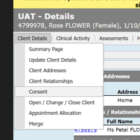
Consent and recording on CDIS
As per MCH Service Guidelines (2021):
MCH services obtain and record informed consent from families, including ensuring that families understand how their information will be collected, stored, used or disclosed in accordance with law.
Consent in CDIS client details page is for consent to MCH service and how their information will be collected, stored, used or disclosed in accordance with law.
Consent on the birth details page is for the home visit.
https://www.health.vic.gov.au/publications/privacy-factsheet-for-families-using-the-maternal-and-child-health-service

Slide 16
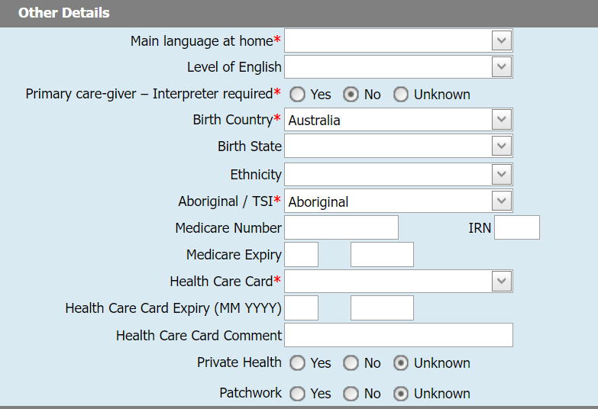
Defining Ethnicity
Not a mandatory field.
Mandatory fields are asterixis in red

Slide 17
CDIS Help and Support pathway

Slide 18
CDIS User group slides added to MAV website

Slide 19
Next User Group Meetings
CDIS Admin Clinical User Group:
Tuesday 29/11/2022 11am
CDIS Clinical User Group:
Thursday 1/12/2022 8:30am
Plan to set meetings for 2023 very soon and send out for future planning

