Slide 1
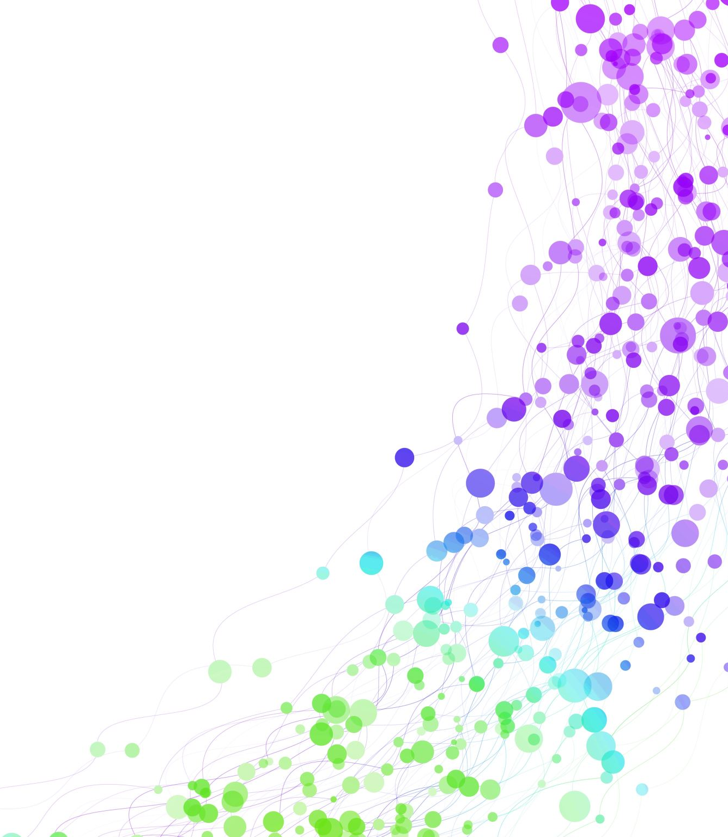
CDIS Clinical & Administration Users Group
April 2024

Slide 2
Contents
Tips & Tricks What is the preferred web browser to use for CDIS? Transfer in of CDIS history Best Practice of using Edit notes (clinical)
Discharge weights (clinical)
Privacy and Consent
Setting appointment reminders
Demo the sites / centre functionality of adding multiple sites/centres to an CDIS user CDIS User Group Evaluations Presentation
Q&A

Slide 3
What is the preferred web browser to use for CDIS?
Best practice use Google Chrome

Slide 4
Transfer in of CDIS Records
Before transferring in a CDIS record into your LGA please check
Right surname
Right name
Correct DOB
Check mobile number
Use advance search
If you transfer in the incorrect record, please notify the LGA for them to transfer the record back.
Never push CDIS records

Slide 5
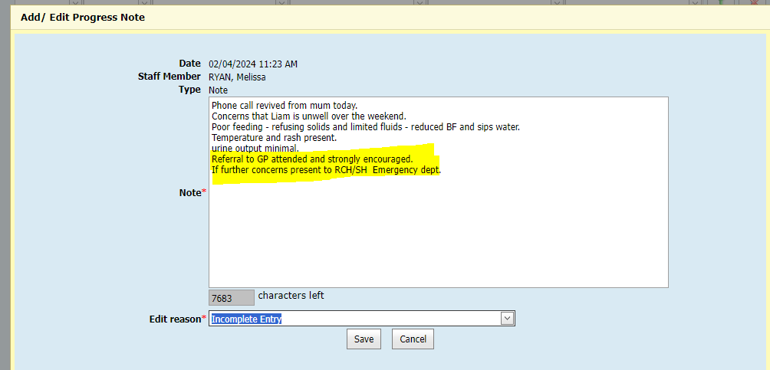
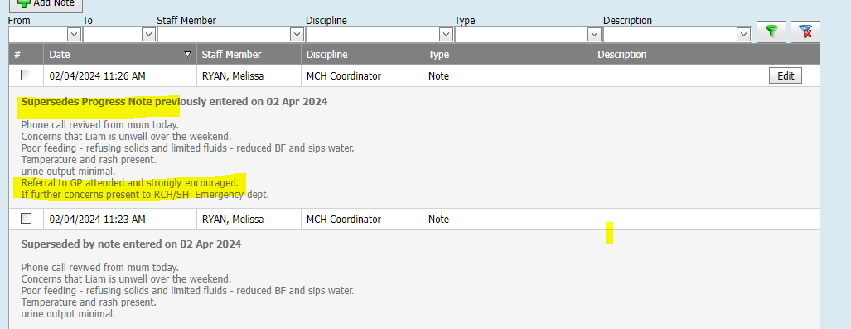
Best Practice when using Edit Notes
Clinical Only
Notes:
First snip is an note added – to edit right top corner
Add extra to notes as highlighted in snip 2
Presentation in CDIS notes as highlighted in snip 3
Edit can only be used by the author of the note.
Notes can be audited and notes with error needs to be retained. Like crossing out an initialing incorrect in a medical record.

Slide 6
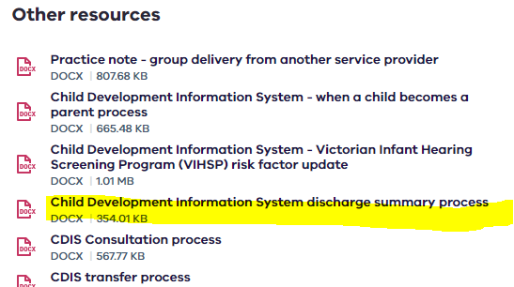
Discharge Weights
Current CDIS Practice Recommended
Record the last date and weight from maternity service DOM/PAC/HITH
Updated in the https://www.health.vic.gov.au/maternal-child-health/child-development-information-system?rid=234730
Clinical Only
Notes:
We know this is not ideal and has been requested many times of how this can be altered on CDIS eg adding multiple weight records once physically discharged from hospital – this is not currently possible on CDIS – has been identified as a requirement for the new system
Remember Dom/PACU/HITH weight may be in the Green book

Slide 7
Privacy Framework for MCH services
The privacy framework for maternal and child health (MCH) services includes:
Health Records Act 2001 (Vic) – in particular, the Health Privacy Principles contained in Schedule 1 of the Act
Privacy and Data Protection Act 2014 (Vic) – in particular, the Information Privacy Principles contained in Schedule 1 of the Act
Council policies.
Health information is often particularly sensitive, therefore clients of the MCH service need to be confident that their information will be handled appropriately and confidentially. Additionally, the Health Records Act provides a legislative requirement for the protection of the privacy of health records. This makes it critical that at the time of collecting information, the client is provided with information about their privacy. The Victorian MCH service privacy information fact sheet, ‘What happens to information about you and your family’, has been developed to assist in this process.
MCH nurses may provide this information fact sheet at the time of information collection or beforehand. However, this is not a substitute for a clear and open discussion at the time of collection.
privacy-framework-for-maternal-and-child-health-services.docx

Slide 8
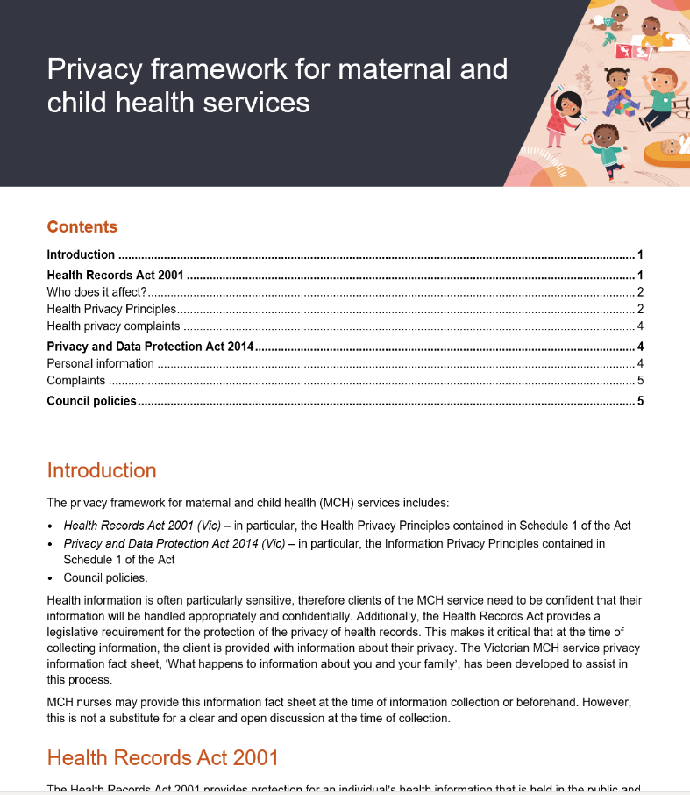
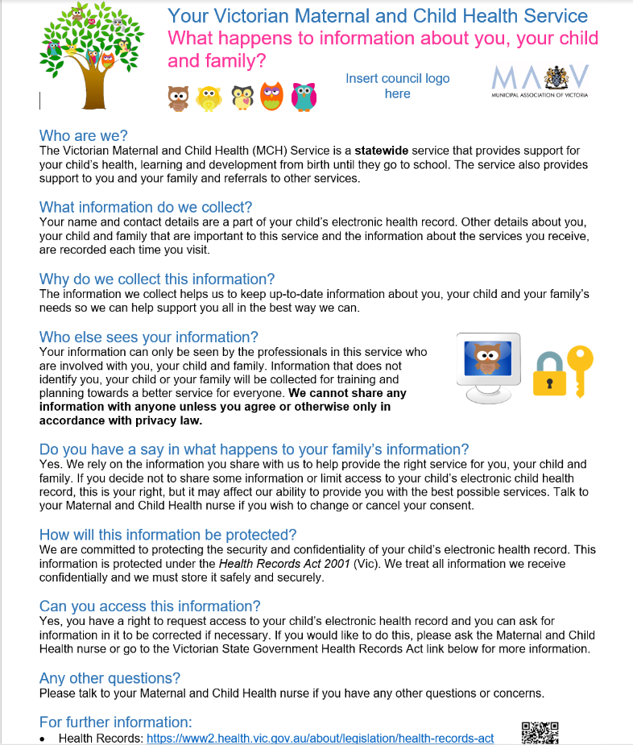
Consent to store client information on CDIS
Clinical Only
Consent is not about the history being in CDIS it is about the parents understanding of how the information is used
https://www.mav.asn.au/what-we-do/policy-advocacy/social-community/children-youth-family/maternal-and-child-health-children-0-6-years/maternal-and-child-health-resources
Notes:
If a family decline storage of information on CDIS – we cannot provide a MCH service.
Services are obligated to make a history in CDIS following the receipt of the BN and record what you do, the family doesn't get a choice in that.
You then record that the client declined storage of information, encourage family to see GP and to contact if they ever decide to reengage with MCH.
Keep the CDIS record open in case they reengage.

Slide 9
Recording Consent on CDIS
From within the Hx
Client Details > Consent
History Notes > Attachments

Slide 10
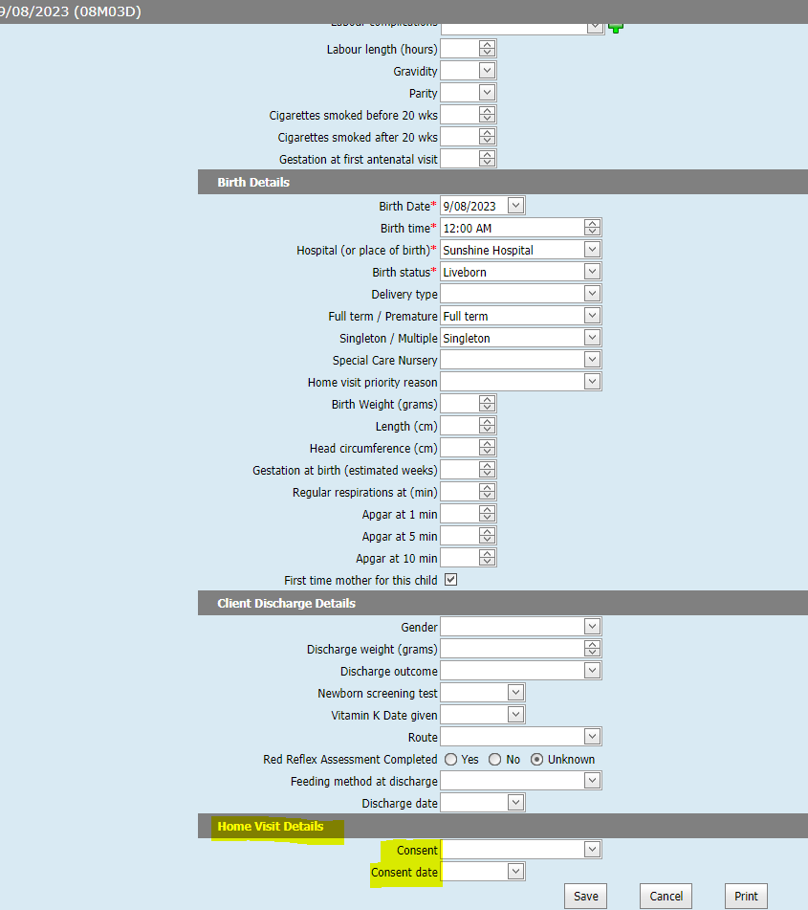
Consent on the Pregnancy & Delivery screen
Clinical Only
This refers to consent for
the home visit
Notes:
Clinical only

Slide 11
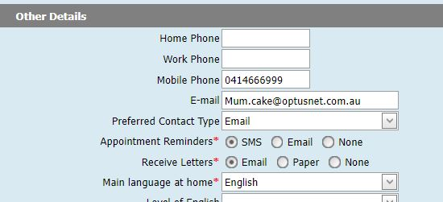
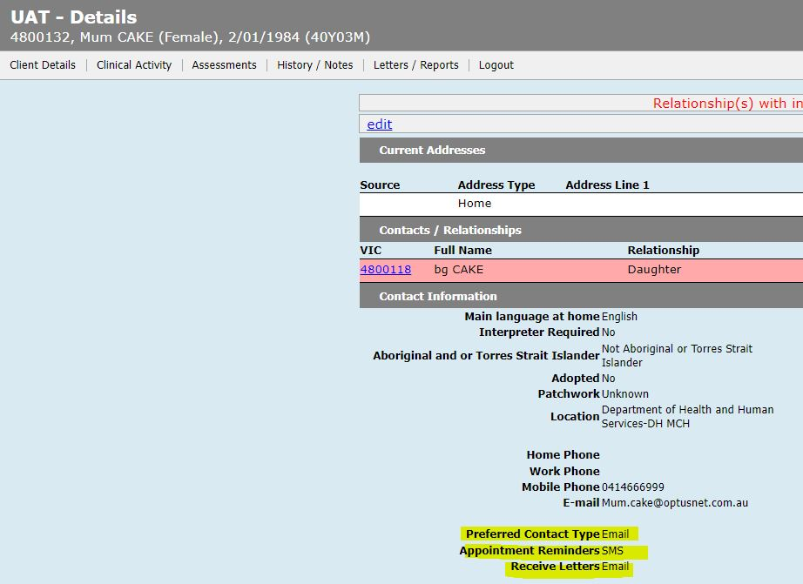
Setting appointment reminders
Client Details > Update Client details (Other details)
View summary page –regarding client wishes to be contacted
Best practice is to review and update with each interaction with a family

Slide 12
Demonstration of the sites / centre functionality of adding multiple sites/centres to an CDIS user
Notes:
Simone to demonstrate on UAT – share screen

Slide 13
Q&A
Dad calls the service to make an appointment, but he is not marked as a caregiver or contactable, what do I do?
Any person who has the care of a child aged 0- school age can call and make a MCH appointment.
When the non PCG calls to make an appointment best practice is for admin/MCHN to ask who will attend the appointment and record that in the appointment notes.
Practice Tip: For MCH Admin teams – refer to MCH clinician if further clarification required regarding information sharing.
Practice Tip: Refer to your internal policy and procedure for MCH services regarding information sharing.
Practice Tip: At first contact with family calling to confirm HV – admin staff or MCHN confirm address, contact details, and relationships. Clarifying the other parents' details and their role with the child will help this.
Practice Tip: For MCHN attending first HV establish relationships and review parent’s information sharing status and update accordingly on CDIS (this is essential for future communication with family members)

Slide 14
Q&A
What is best practice when using interpreters?
In applying culturally responsive practice, MCH nurses who have engaged clients within the MCH service need to effectively communicate with them. CALD clients may, present with complex communication requirements (due to their pre or post arrival experiences), which could result in a need t
The need for an interpreter should be determined prior to an appointment, wherever possible.
Assessing how well a person can understand English is the first step in identifying the need for an interpreter. Remembering that a stressful or unfamiliar situation where new language, acronyms or nursing/medical terminology is used may affect a client’s ability to communicate effectively.
Engaging an interpreter is recommended if:
The client requests an interpreter
The client cannot comprehend or respond to basic questions in English such as explain their health or their child’s health
The MCH nurse is experiencing difficulty understanding their client, or the client can only respond in a limited way such as a few word answers
The client relies on family or friends to communicate
The client prefers to speak in their own language
The client speaks English as an additional language, and is in a stressful, complex or unfamiliar situation.
https://www.health.vic.gov.au/publications/safe-and-effective-use-of-interpreters

