Slide 1
CDIS User Groups
June 2025
CDIS User Group – June 2025

Slide 2
Agenda
Role of CDIS Champion
Reschedule/Cancel/DNA Appts
CDIS is a medical record
Clarifying creating CDIS records for older siblings and access to these records.
Open/Change/Close
Closing Clients
Important Data from HV
Merging
Data Cleansing
Consent & recording in CDIS
Recording Ethnicity
SMS question - clarified
CDIS Support
CDIS User Group – June 2025

Slide 3
Role of CDIS Champion
Representing your team.
Resource in your team for CDIS education, questions and troubleshooting.
Note any common themes or questions from your team to report to the group.
Gather information from your team to be addressed in the User Group meetings or followed up by the CDIS Reference group and highlight education needs.
Attend User Group meetings every 6-8 weeks.
Contribute to User Group meetings conversations re your teams CDIS practice, questions and ideas.
Sharing information learned at the CDIS user group meetings with your team ie sharing slides or presenting at team meetings (eg CDIS tips and tricks)
Prompting your team use of CDIS resources such as the vimeo’s and CDIS education through the Help & Support tab on CDIS.
CDIS User Group – June 2025

Slide 4
Managing MCH Appointments: Rescheduled, Cancelled and DNA appointments
1. Rescheduled Appointments
The caregiver contacts the service to change the date or time.
The MCH nurse or admin team needs to reschedule the appointment due to availability or other factors.
Action:
Update the appointment in the system with the new agreed time/date.
No attendance record is required until the new appointment occurs.
2. Cancelled Appointments
The caregiver notifies the service they no longer wish to attend.
The service or nurse needs to cancel the appointment for a valid reason (e.g., family is away).
Action:
Record the cancellation in the system.
Re book appointment with the family and document.
CDIS User Group – June 2025

Slide 5
Managing MCH Appointments: Rescheduled, Cancelled and DNA appointments
3. DNA – Did Not Attend
The caregiver does not attend the scheduled appointment without notifying the service.
Action:
Record as DNA in the system.
Follow-up may be required depending on:
The child’s age.
Risk factors or previous history.
Local protocols (e.g., phone call, letter, or home visit).
Best Practice
Always document reasons, follow up and outcomes of changes to appointments.
Consistent recording helps ensure continuity of care and risk management.
DNA follow-up should be in line with local policy and professional judgment
CDIS User Group – June 2025

Slide 6
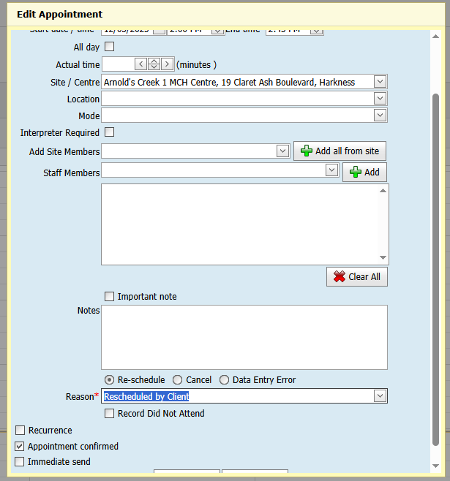
Managing MCH Appointments: Rescheduled and Cancelled
Best Practice when rescheduling or cancelling appointment that has been advised by the primary caregiver
Document a note if required.
NB - Always edit from the calendar
This ensures documentation in the client notes.
CDIS User Group – June 2025

Slide 7
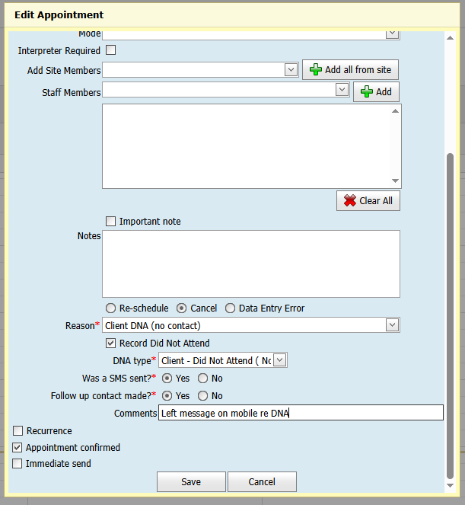
Managing MCH Appointments: DNA appointments
Best Practice when a family does not attend the scheduled appointment
NB - Always edit from the calendar
This ensures documentation in the client notes and in the DNA report.
CDIS User Group – June 2025
Notes:
Share Melton's new practice

Slide 8
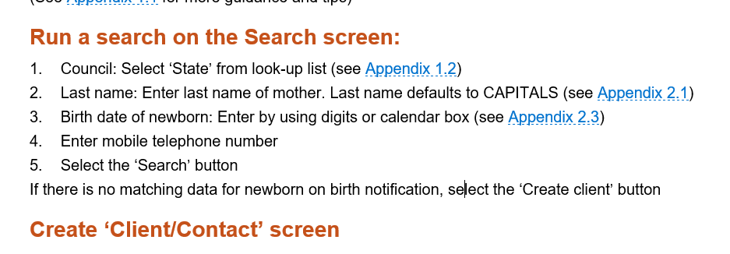
CDIS is a Medical Record
Always complete a State Search for newborn and parents when adding a birth notice to reduce and prevent duplicate histories
Reference: CDIS Birth Notification Process
CDIS User Group – June 2025

Slide 9
Key Points – Health Records Act 2001 & MCH Services
The Health Records Act 2001 provides a framework to protect the privacy of individuals' health information in Victoria.
It applies to personal health information collected in the course of providing a health service.
The Act:
Promotes fair and responsible handling of health information in both public and private sectors.
Gives individuals the right to access their health information.
Offers a framework for resolving complaints about mishandling of health information.
Complaints are managed by the Health Services Commissioner.
Implications for MCH Services
MCH service providers are subject to the Health Records Act 2001.
Each organisation must have clearly expressed privacy policies aligned with the Act.
Sharing information under the Child Information Sharing Scheme (CISS) or Family Violence Information Sharing Scheme (FVISS) is not a breach of the Health Records Act.
MCH staff should address privacy concerns:
With support from their line manager(s).
In line with their organisation’s privacy policy.
MCH Guidelines 2021 pg 12
CDIS User Group – June 2025

Slide 10
Legal advice re creating a CDIS record for siblings who are too old for MCH service
It is permissible under the Health Records Act to create health records for family members of a child receiving MCH services. Where consent can be obtained from the family members this should be done. However, it is recognised this may not always be possible or safe in some circumstances. The collection and recording of this information will still be permissible under Health Privacy Principle 1.1 (HPP 1.1) of the Health Records Act in certain circumstances. In this instance, it is our view that it will be permissible as it is required, authorised or permitted by law
The Department of Health identifies the collection of the child’s family information and history as being fundamental to the provision of the MCH services. This is recognised in the Department of Health’s MCH Service Guidelines, which identifies aspects of the child’s family health and lifestyle as being critical to the health and wellbeing outcomes of the child , and being integral to their health, wellbeing, safety, learning and development. In the EMCH guidelines family assessment is identified as the first step in the clinical management stage of EMCH care. Accordingly, it is our view the collection of this information satisfies HPP 1.1 as being ‘required, authorised or permitted’ by law. The information collected must be necessary for one or more of the functions or activities of the MCH service.
Best Practice Point - this CDIS record should be closed to service and not used for documentation purposes.
MAV Legal/Insurance Counsel
CDIS User Group – June 2025

Slide 11
Using an Older Child’s CDIS History to Assess Family History of Genetic Conditions or Family Violence?:
Access Restrictions:
MCH services can only access records for currently eligible children and their caregivers.
Children over the age of 6 or those attending school are not eligible for MCH services.
Privacy and Legal Considerations:
Accessing records of ineligible children may breach the Health Records Act.
(Details provided in the following slide.)
Best Practice:
Conduct a comprehensive family assessment with the primary caregiver.
Document findings in the primary caregiver’s record to support future family assessments.
CDIS User Group – June 2025

Slide 12
Open/Change/Close Client
Always check this field in Client Details tab is updated
This should be checked with every consult with a new client.
Clients need to be open for data collection and referral to any Integrated Programs.
CDIS Open/Change/Close Process
CDIS User Group – June 2025

Slide 13
Closing of clients
As per the 2019 MCH Service guidelines:
“The MCH Service is a free universal primary health service for all Victorian families with children from birth to school age.”
There is no requirement to close the history once a child is outside the service age range. They will not be included in any CDIS reporting.
Remember your funding is population based and all children eligible for MCH should be open to ensure full funding is provided for the service.
As per the CDIS Open/Close/Change Process 2020:
All children under six years old should be open to service
All Primary Caregivers
Any other caregiver who is actively receiving an MCH service – then close the record when the ‘episode of care or service’ is finished. For example, a caregiver’s record would be open if they have been referred by MCH (which is recorded from the child’s record then notes entered in the caregiver’s record) until the referral has been followed-up and no further service is required. Then the caregiver’s record would be closed.
Note: primary caregivers’ records always remain open.
CDIS User Group – June 2025

Slide 14
Reasons to close CDIS Hx include:
childhood record
client has moved interstate
client has moved overseas
client has declined service (if client temporarily declined keep open)
client is receiving service from another care provider
change in primary care giver status
no longer receiving MCH service
still birth, client is deceased
primary caregiver of stillborn or deceased child
data entry error
CDIS Open/Change/Close Process
CDIS User Group – June 2025

Slide 15
Important Data Entry from HV:
Important Points:
Recording Aboriginal or Torres Strait Islander identification
Recording First Time mother in the Pregnancy and Delivery (after the APGARS)
Recording of consent (see slide 18)
Using the Edit tab on the details page for information prompts/reminders
CDIS User Group – June 2025

Slide 16
Merging of duplicate histories:
Merging of duplicate histories is recommended to be completed by two MCH Clinicians one a Coordinator or Team Leader to ensure correct information of client's details when merging
What is the process at your council when duplicate histories are found?
See Merging Duplicate Records in the CDIS Birth Notification process
https://www.health.vic.gov.au/maternal-child-health/child-development-information-system?rid=159900253
CDIS User Group – June 2025

Slide 17
Data Cleansing:
Every time a CDIS record is open practitioners should review and clean up data as needed.
See MCH CDIS Education – Data Cleansing Training
Data Cleansing Vimeo
Draft Consultation – clinicians have a legal responsibility to ensure notes/consultations are complete and saved at the end of a working day. The Draft Consultation Report is a good way to check this
Best practice is to check this daily.
CDIS User Group – June 2025

Slide 18
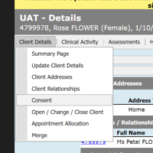
Consent & recording in CDIS
As per MCH Service Guidelines (2021):
MCH services obtain and record informed consent from families, including ensuring that families understand how their information will be collected, stored, used or disclosed in accordance with law.
Consent in CDIS client details page is for consent to MCH service and how their information will be collected, stored, used or disclosed in accordance with law.
Consent on the birth details page is for the home visit.
Privacy factsheet for families
CDIS User Group – June 2025

Slide 19
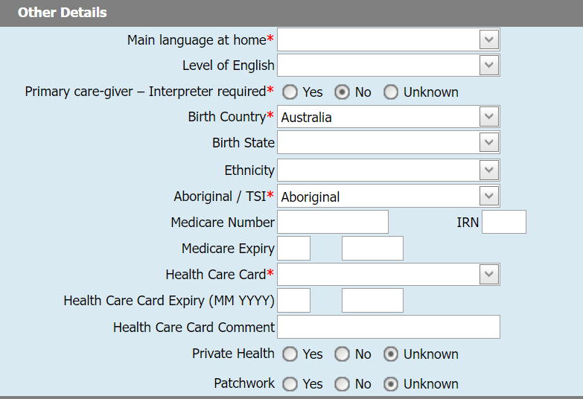
Defining Ethnicity
Not a mandatory field.
Mandatory fields are asterixis in red
NB. Don’t forget the CALD program if you would like to track families for ESK, AEL or CALD worker support.
CDIS User Group – June 2025

Slide 20
Have been approached by an internal council department to send group SMS to families with a link to an external health survey, can I send this out via CDIS SMS to families?
Any use or disclosure of client information that is not directly related to the provision of the Maternal and Child Health (MCH) service, and not expressly covered by the consent currently held, would likely fall outside the permissible scope under the Health Records Act. In particular, Health Privacy Principle 2 (Use and Disclosure) restricts the use and disclosure of health information to the primary purpose for which it was collected, unless an exception applies eg where the individual has provided further informed consent.
If the request appears to be a valuable initiative worth promoting. A recommendation would be to advertise it through additional channels, such as the Council’s social media platforms or other publicly accessible outlets.
Please consult with your MCH Leadership for further clarification from the MCH Leadership Packs.
Health Records Act 2001 (Vic) and Health Privacy Principle 2
CDIS User Group – June 2025

Slide 21
CDIS Support (continued)
CDIS Support Hours
Monday to Friday between 8:30am to 5:30 pm
Contact
1300 856 183
cdis@support.vic.gov.au
CDIS User Group – June 2025

