Slide 1

Preventing violence against women

Slide 2
Moreland City Council
12 Month Achievements
Family Violence Prevention Strategy 2011-2015 and Action Plan 2011-2012 endorsed by Council in March
Moreland City Council Family Violence Policy
Moreland hosted the Northern Region White Ribbon Leaders Lunch

Slide 3
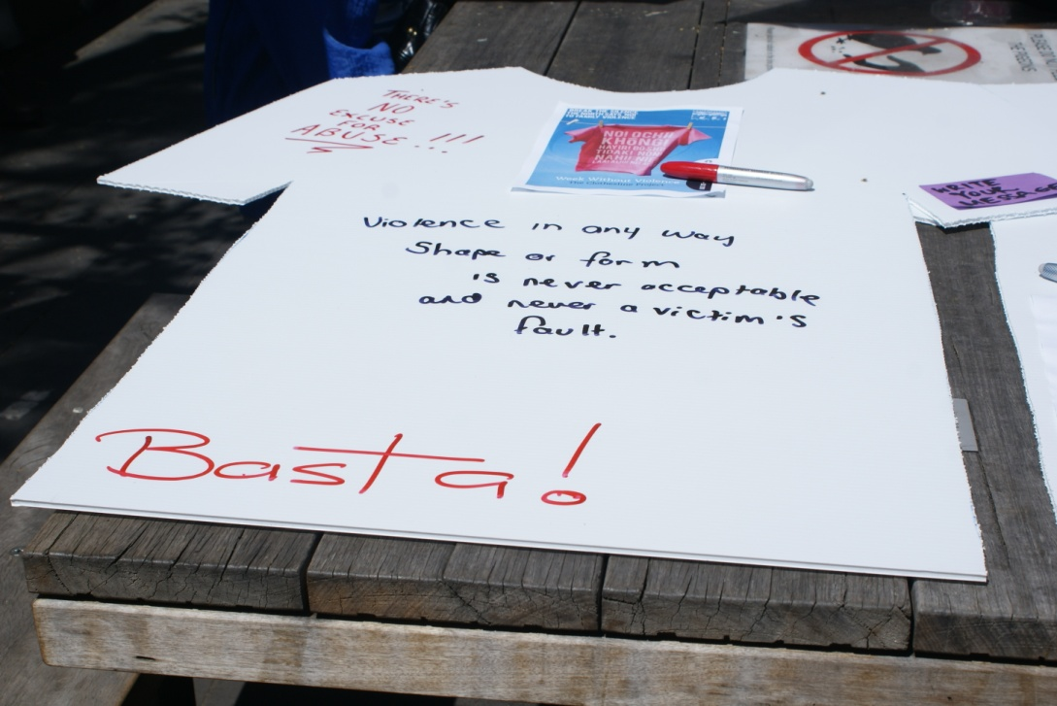
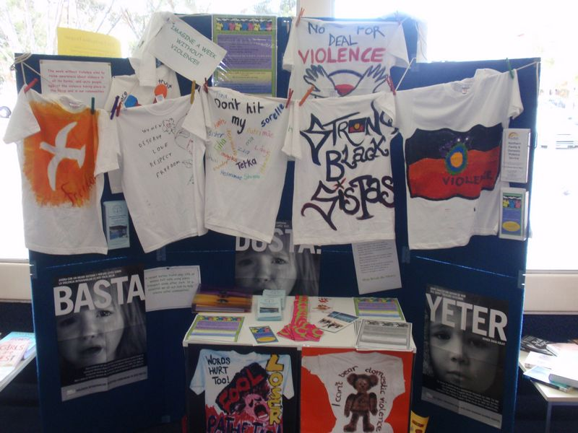
Week Without Violence Library Display

Slide 4
Moreland City Council
12 Month Achievements
2010/11 Mayor, CEO and other prominent staff members are White Ribbon Ambassadors
Active Women and Girls in Moreland Strategy
Allocation of Sporting Grounds and Pavilions Policy – gender equity in sports

Slide 5
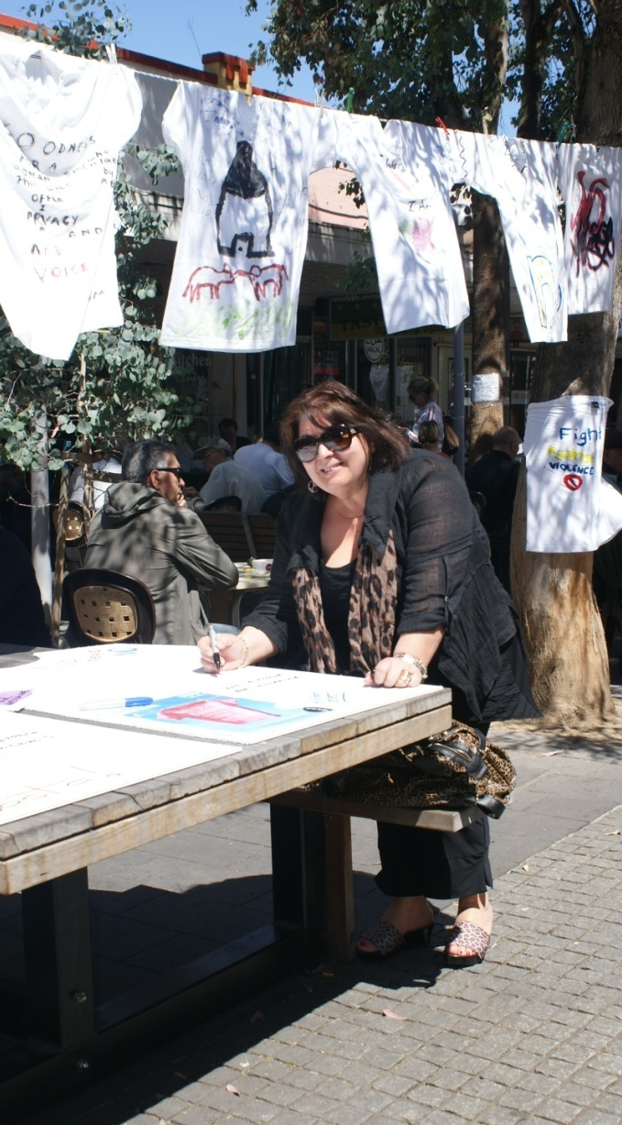
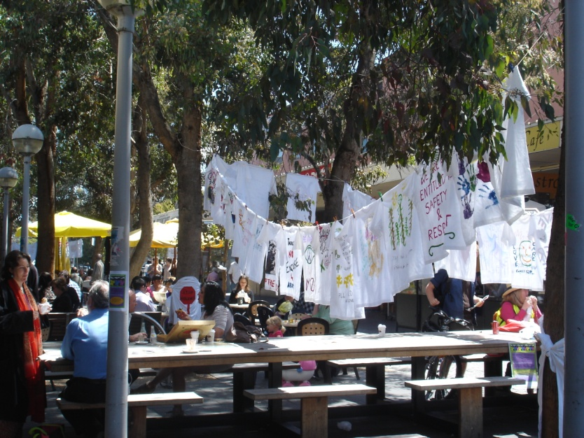
Moreland City Council’s Councillor Stella Kariofyllidis at the Week Without Violence Clothesline event

Slide 6
Moreland City Council
12 Month Achievements
Clothesline event in Week Without Violence
Support for regional Week Without Violence activities
Convene Moreland Family Violence Network
Help stickers for both men and women in six languages

Slide 7
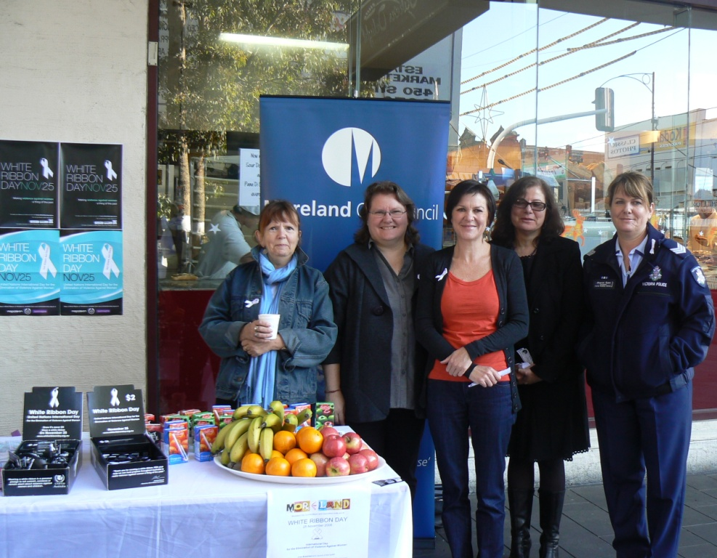
White Ribbon Breakfast in Coburg Mall

Slide 8
Moreland City Council
12 Month Achievements
White Ribbon Action Team established in 2011
Events for White Ribbon Day included Morning Tea for staff, Coburg Night Market Stall, White Ribbon Bookmarks in all library loans in November

