Slide 1
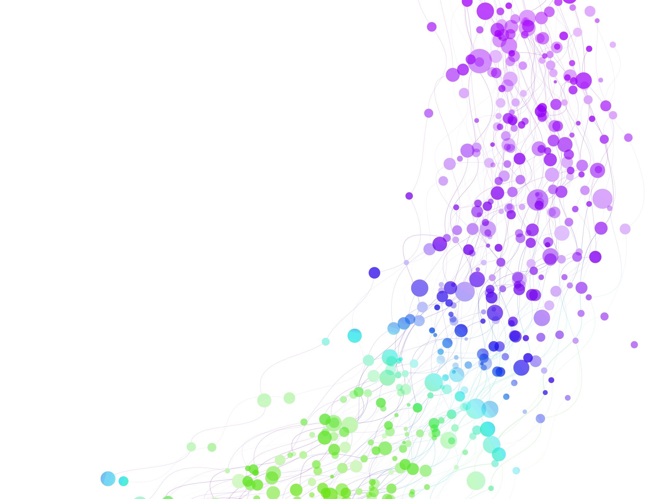
Child Development Information System (CDIS)
CDIS User Group – Admin
October 2024

Slide 2

Agenda
Tips & Tricks
  Bulk SMS reschedule - scenario
Changes to Add/Edit Address workflow
Transfers
Q&A

Slide 3
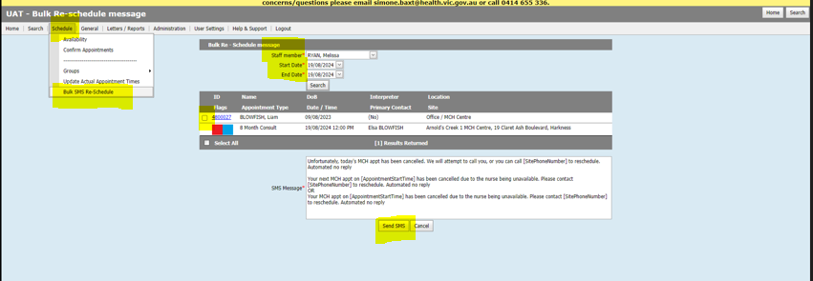
Tips & tricks
Bulk SMS Reschedule Process:
Select Bulk SMS reschedule
Add clinicians name and date
Select the clients using all to receive SMS.
Cross check against calendar to ensure you are sending the SMS to the correct clients.
Any clients that are not on the list may have no clinician or the wrong clinician allocated to the appointment.
Notes:
Need to ensure relationships are set up correctly and need a process for interpreters.

Slide 4
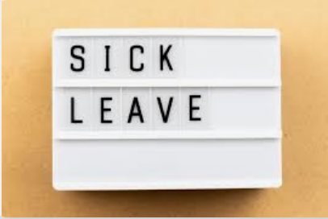
Scenario
Responding to clinician's sick leave and cancelling the clients' consultations via CDIS SMS – a few clients still show up for their appointments.
I can clearly see in the send history that the SMS had been sent but clients are stating they haven’t received my new SMS
Does anyone else have the same problem?
Response……
If immediate send, then the SMS should be received by the parents/caregivers.
Is it a timing issue?
Are the parents not reading their SMS in time.
Tips shared:
Phone calls to client the morning of a cancellation
Send SMS after call (individual immediate send SMS)
SMS templates that include - PLEASE DISREGARD ANY REMINDER MESSAGE YOU MAY RECEIVE FOR THIS APPOINTMENT
E.g. Due to unexpected leave your MCH appointment at (centre) today has been cancelled. Please call 1300 368 333 to reschedule if you have any concerns and you are needing to speak to the nurse, alternatively we will contact you to reschedule. We sincerely apologise for the inconvenience and if this appointment has already been rescheduled previously. NO SMS REPLY

Slide 5
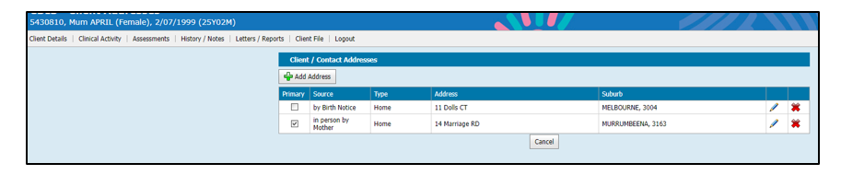
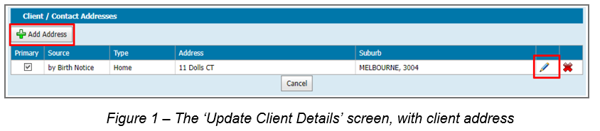
Changes to Add/Edit Address workflow
To ensure that address remain on the client CDIS history this workflow was updated – see below
1. Add new address in the client's health record

Slide 6
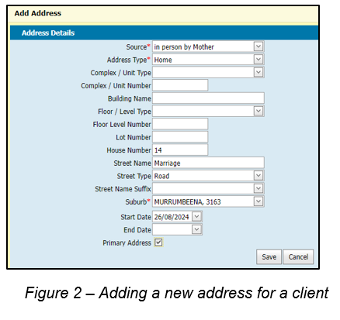
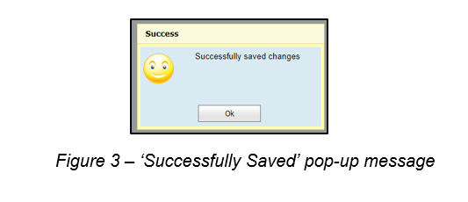
Changes to Add/Edit Address workflow
2. Add the new address and click save
3. A pop- up message will appear
that it was successfully saved.

Slide 7
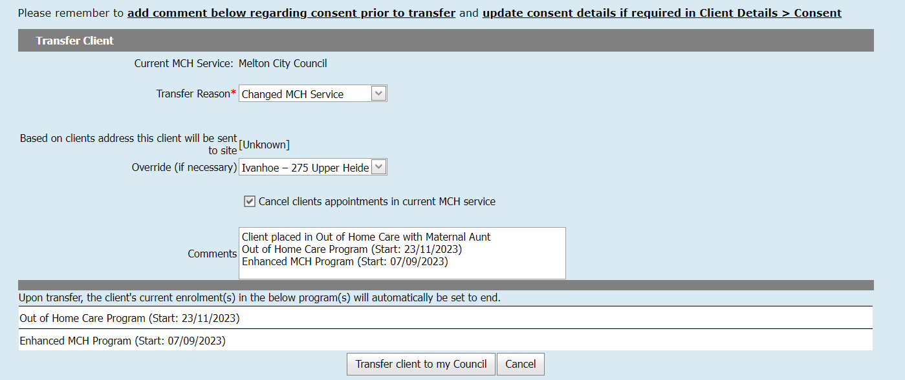
Transfers
Always transfer histories into your LGA service
Best Practice is to contact MCH service and advise of transfer and if you pulled in the wrong CDIS history
Note in the comments EMCH or S&S programs as they will close on transfer
Notes:
Careful note should be taken when transferring adults that have a current enrolment in an Enhanced or S&S program as these programs will be closed and information forfeited when transferred.
Best practice would be to have the MCH team leader contact the relevant council prior to transfer.
Best Practice is to always pull histories, never “push” or transfer a file away from your council.

Slide 8
Question: Scenario
How can I keep track of refugee families, if they attend their appointments, DNA and need to be rebooked?
Suggestions:
Use important note with booking -
This is a booking note – so when you reschedule, the comment disappears, but there is a note made in the history/notes that the appt is rescheduled.
If you select data entry error, the note is not seen on screen when editing, but is maintained, and any new note, appended and dated. These notes are only visible on the Home screen in the calendar, when clicking on the appt and viewing the right-hand side where the details of the appt are listed, along with notes.
Use edit note at top of client details page
Using a program (one not being used by your service) to track these clients – important that this is managed by clinician/MCH leader.

