Slide 1
Working Together Against Violence
Women’s Health Victoria
December 2011
Developed by Women’s Health Victoria with funding from VicHealth.
© Women's Health Victoria 2011. All rights reserved.

Slide 2
Background
Women’s Health Victoria is committed to the prevention of violence against women.
Women’s Health Victoria works in the primary prevention of violence, that is, we aim to prevent violence before it occurs, by influencing or eliminating the underlying determinants of violence against women.
Our work in the primary prevention of violence against women includes advocacy, innovative health promotion projects, capacity building, information and resource development.

Slide 3
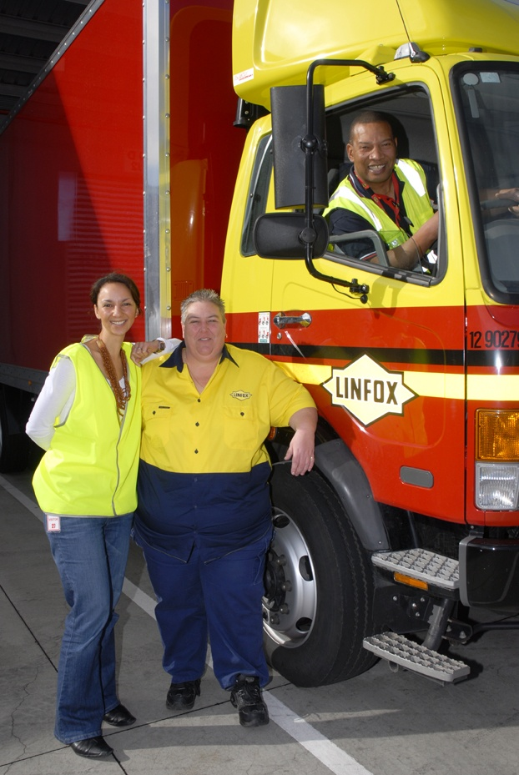
Working Together Against Violence
Working Together Against Violence Project ran from 2007-2011
VicHealth Respect, Responsibility and Equality: preventing violence against women program grant funding
Aimed to strengthen the organisational capacity of a male-dominated workplace (Linfox) to promote gender equality and non-violent norms.

Slide 4
Women's Health Victoria
A health promotion,
information and advocacy
organisation
Linfox
A transport and logistics
company with more than
18,000 employees
Working Together Against Violence
Developed by Women’s Health Victoria with funding from VicHealth.
© Women's Health Victoria 2011. All rights reserved.

Slide 5
Ecological approach
Developed by Women’s Health Victoria with funding from VicHealth.
© Women's Health Victoria 2011. All rights reserved.

Slide 6
How are we going to bring more men – many more men – into a conversation about sexism and violence against women?
And how are we going to do this without turning them off, without berating them, without blaming them for centuries of sexist oppression?
Jackson Katz, The Macho Paradox (2006)
Developed by Women’s Health Victoria with funding from VicHealth.
© Women's Health Victoria 2011. All rights reserved.

Slide 7
Working Together Against Violence
Linked in to organisational health and safety program; ongoing policy development
Promotional and educational materials
Information for managers about supporting staff exposed to DV
Presentations to senior managers to educate and recruit worksites to deliver program
Delivery of training across 11 worksites in Victoria
Total of 515 Linfox employees participated in the training, including warehouse workers, managerial and admin staff, and truck drivers
89% of participants were men
Male and female facilitator working together modelled respectful relationships

Slide 8
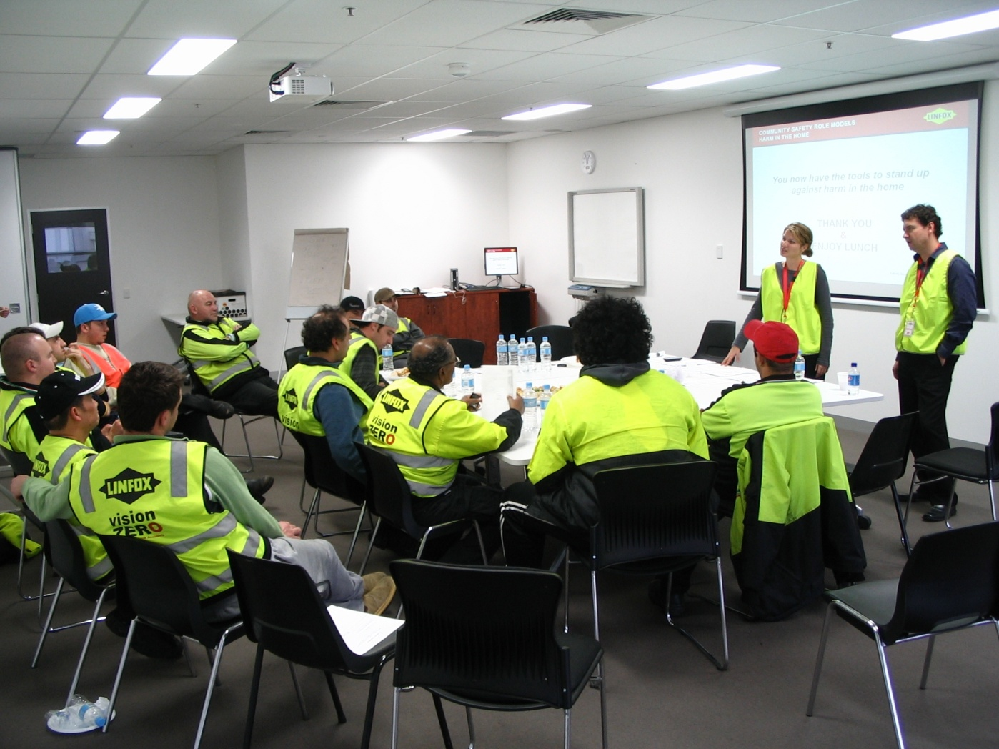
Developed by Women’s Health Victoria with funding from VicHealth.
© Women's Health Victoria 2011. All rights reserved.

Slide 9


Developed by Women’s Health Victoria with funding from VicHealth.
© Women's Health Victoria 2011. All rights reserved.

Slide 10
The training adds a personal perspective and brings the home into the workplace. This is really important. It’s about supporting the guys however we can and building a good rapport between management and staff.
Worksite manager
Developed by Women’s Health Victoria with funding from VicHealth.
© Women's Health Victoria 2011. All rights reserved.

Slide 11
(Benefits were) indirect, intangible things, like a happier workforce, better productivity and less leave because of disenchantment. The training has a flow on effect. Workers are more conscientious and the efforts you put in come back to you.
Worksite manager
Developed by Women’s Health Victoria with funding from VicHealth.
© Women's Health Victoria 2011. All rights reserved.

Slide 12
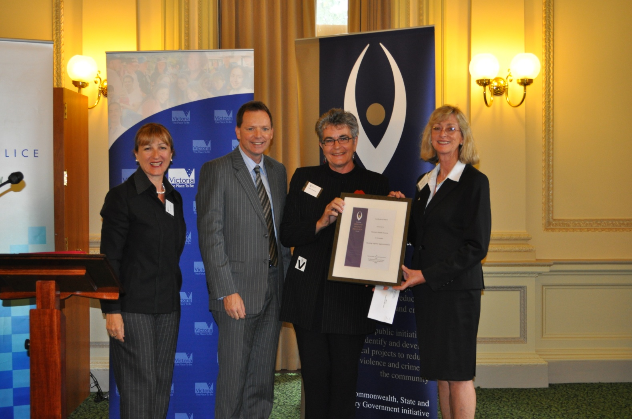
Certificate of Merit, 2009 Australian Crime and Violence Prevention Awards
Developed by Women’s Health Victoria with funding from VicHealth.
© Women's Health Victoria 2011. All rights reserved.

Slide 13



Sustainable outcomes
Take a Stand against violence. It’s everyone’s business
workplace program
Everyone’s business
professional development package
Developed by Women’s Health Victoria with funding from VicHealth.
© Women's Health Victoria 2011. All rights reserved.

Slide 14

www.takeastand.org.au ph 9664-9300
Developed by Women’s Health Victoria with funding from VicHealth.
© Women's Health Victoria 2011. All rights reserved.

Slide 15

Silence = complicity, a form of consent
All that is necessary for the triumph of evil is that good men do nothing.
Edmund Burke (1729 - 1797)

Slide 16

Bystander theory
Men are perpetrators co-workers, team members, allies
Women are victims co-workers, team members, allies
Focus on the bystander
Silence is a form of consent

Slide 17
Issues for businesses
  2002/03 = $175.2 million
  absenteeism
  productivity
  turnover

Slide 18
Lead
Train
Promote

Slide 19


Slide 20

Everyone’s Business professional development package
Recommended for local government, community and women’s health organisations interested in designing and delivering their own primary prevention workplace program.
Comprises full-day workshop, copy of the Everyone’s Business guide and membership of a supportive practice network.
Provides practitioners with the necessary theoretical base and practical skills to start planning, developing and implementing a new workplace program aimed at the primary prevention of violence against women.
Workshop is run as part of the Women’s Health Victoria annual training calendar and can be delivered in regional Victoria.
Further information at http://whv.org.au/what-we-do/violence-against-women
Developed by Women’s Health Victoria with funding from VicHealth.
© Women's Health Victoria 2011. All rights reserved.

Slide 21
