Slide 1

End of Life – think tank
Jill Taylor- Banyule City Council
Older Persons’ Liaison Officer

Slide 2
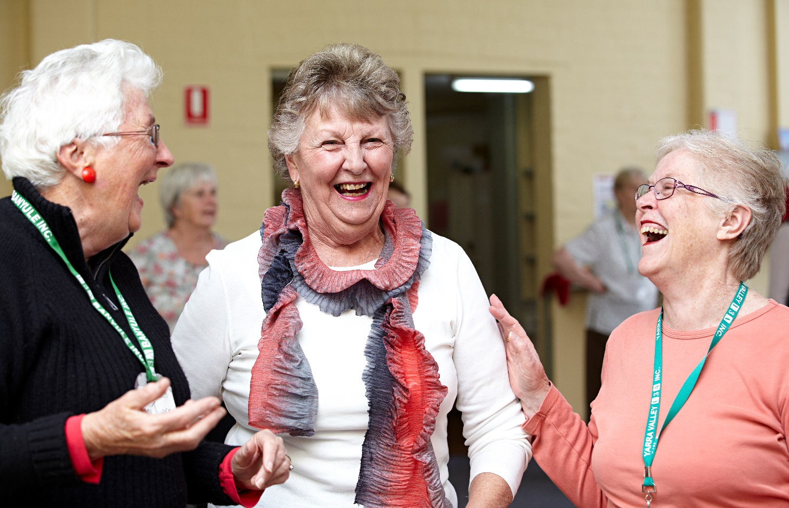
Outline
Context
Purpose
Who attended
Themes identified
What we found
Possibilities

Slide 3
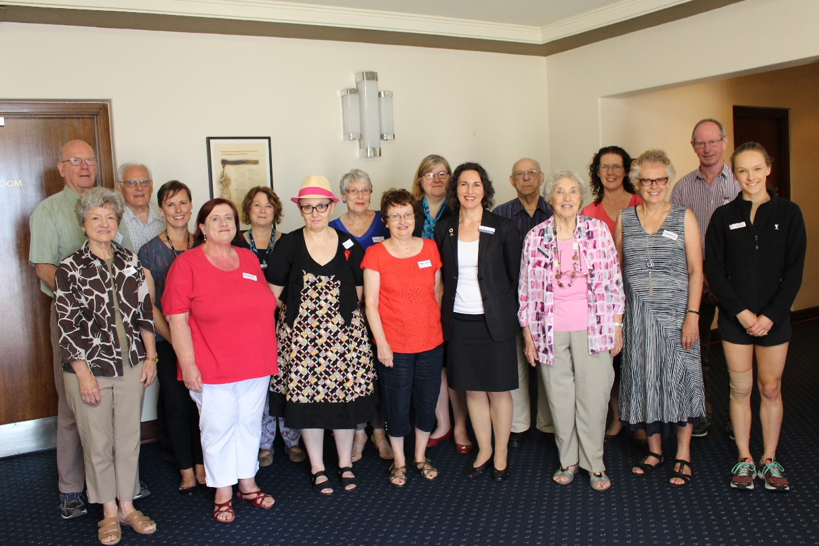
Context
Came out of the Age Friendly Advisory Group discussion.
Banyule has regular ‘think tanks’.
Steering committee:
5 Age friendly champions
2 Council staff – Jill and Glenda
Consultant - Andrea Grindrod - La Trobe University’s Palliative Care Unit
Notes:
We needed to get the AFC champions on board as they had very diverse reasons for being on the steering committee. Needed Andrea to present to the group to get them on the same page to plan the day.

Slide 4
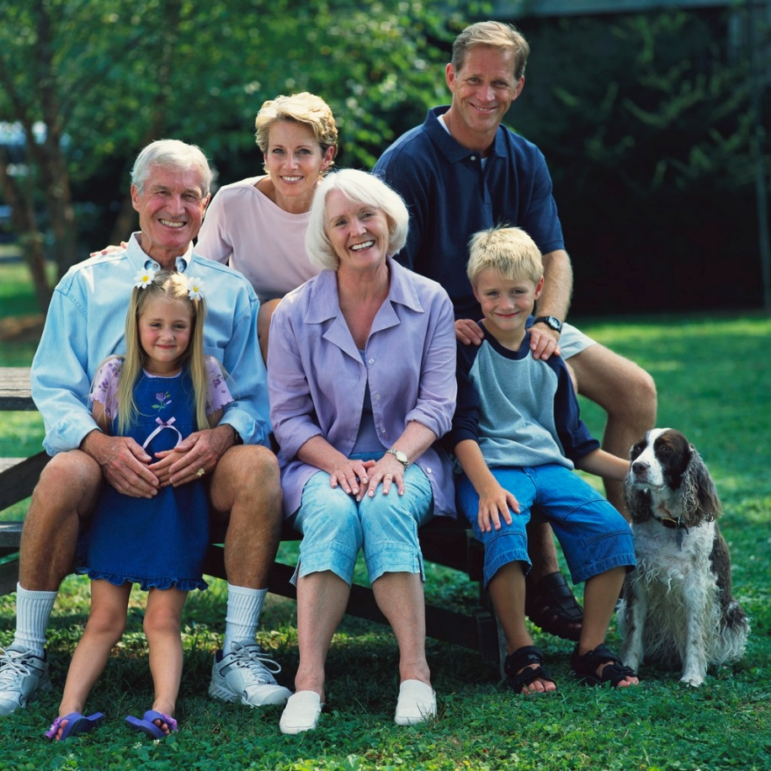
Purpose
To explore the level of community interest in End of Life planning.
To provide information to the community around building capacity around this topic.
How can we as a community:
a) raise local awareness and improve knowledge?
b) increase community support for local people at the end of life?

Slide 5
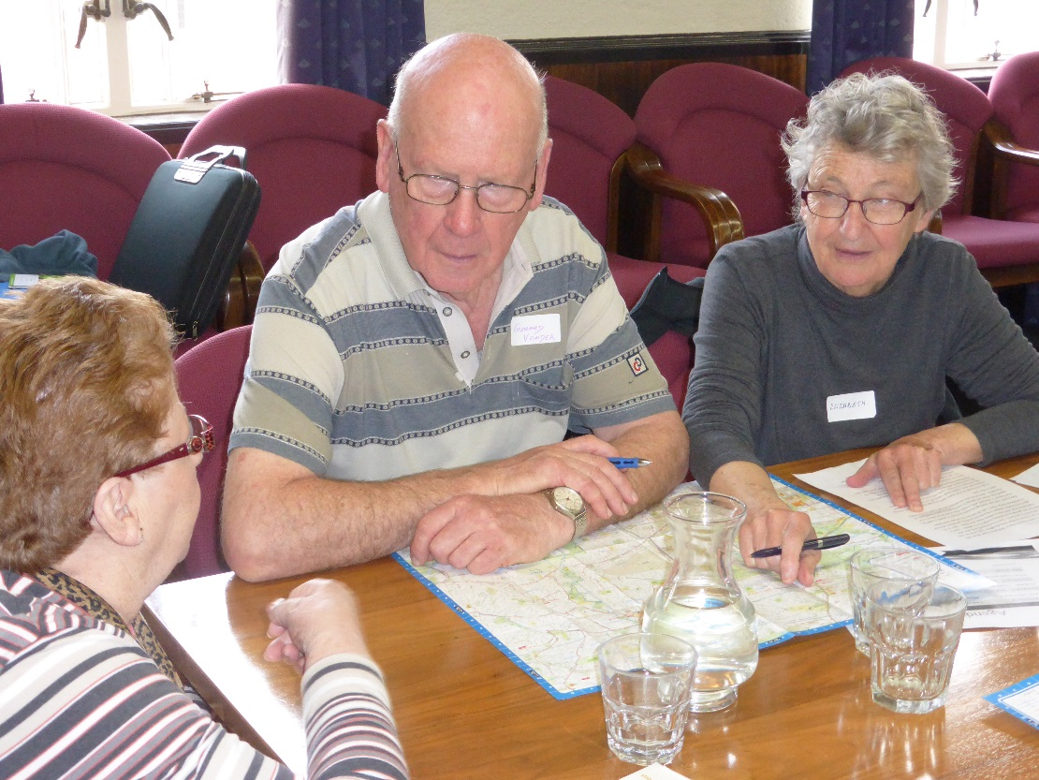
Who attended
30 attendees
1 AF advisory committee member
1 AF Champion
26 residents from the community and/or local clubs
1 representative from Relationships Australia, and
Katherine -MAV committee on End of Life Project.
Notes:
We ran the event as part of the Banyule Seniors Festival so we had 4000 copies of the program available throughout the community
On the flyer we tried to get people interested to come – ‘What’s in it for me’
Lunch was included as an incentive
We organised for counsellors to be present in case any content triggered some unexpected emotional responses. (not needed)

Slide 6
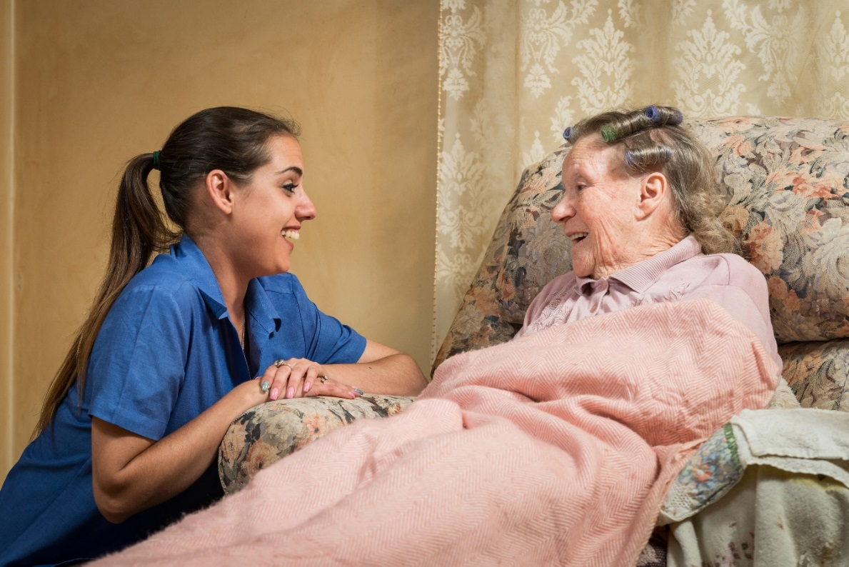
Themes identified
Information
Identify ‘needs’
Education
Resources
Partnerships
Carers concerns
Role of Council
Notes:
Information – Advanced care plans and legalities
Identify ‘needs’ - how to meet them
Education – make people/families comfortable to talk, ask, accept help and remove fear
Resources – educate, support, services, people
Partnerships – U3A, men’s sheds, libraries, legal profession, Council, Living and learning centres. (Encourage community groups to establish networks
Carers concerns
Who are they, personal thoughts around caring such as guilt, anger and carer burnout
Role of Council
Information dissemination
List of reliable contacts
Role in creation of services – advocate/provider?
Monitor quality of service
Advertise – Banyule Banner, web page

Slide 7
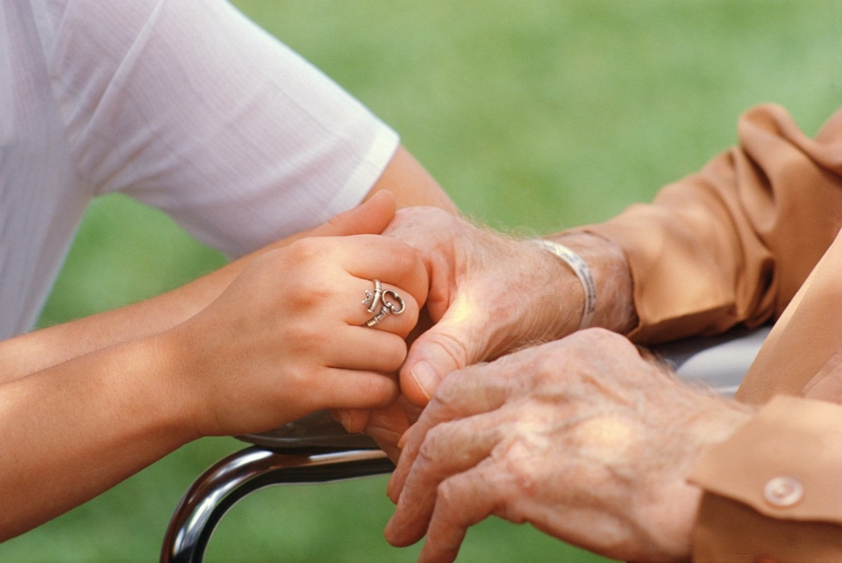
What we found:
Level of Community interest - some interest, if limited, in the concept of End of Life and the need for a personal and a community response.
‘Community support and caring at the End of Life’ -There was some trepidation around the subject and questions around ‘trust’ in its many forms when putting the concept into action.
Notes:
There is a long way to go!!

Slide 8

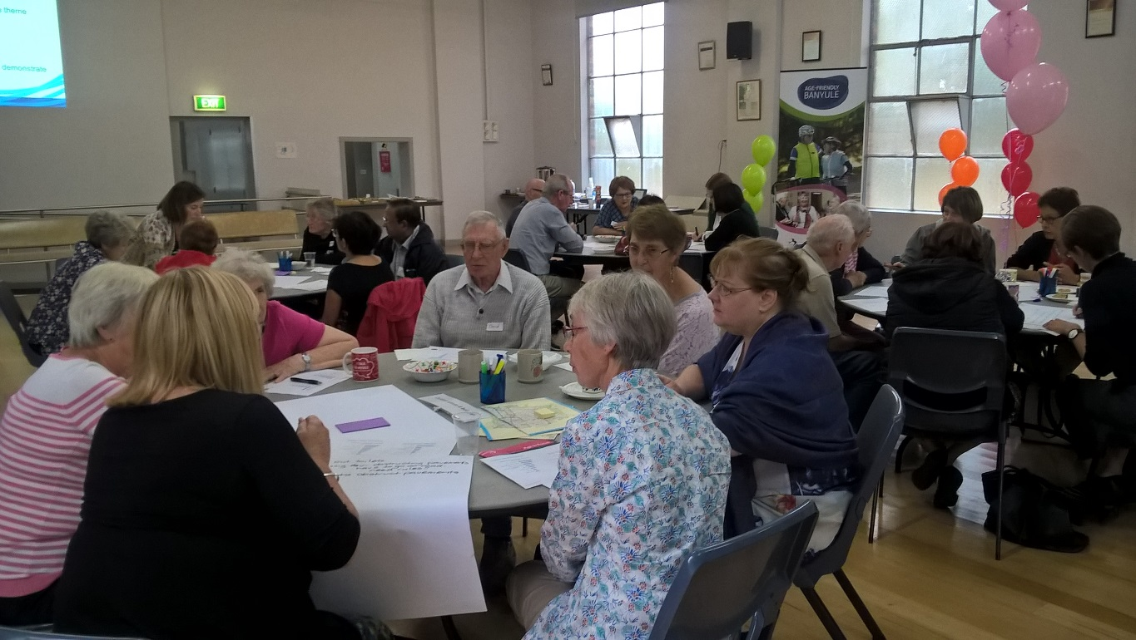
What we found:
Council Role - Residents want Council to have the information (or provide guidance) on finding out about the topic. Accessing information and appropriate communication identified as a gap.

Slide 9
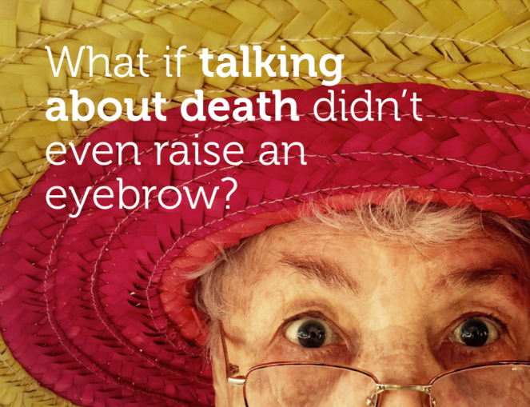

Possibilities:
Identification of agencies/groups, funded on not, who already support residents and carers on end of life issues.
Council website could direct and provide residents with information.
Use Council publications to disseminate information. E.g. “How to help the carer”. Could be linked to the Neighbour Day celebrations

Slide 10
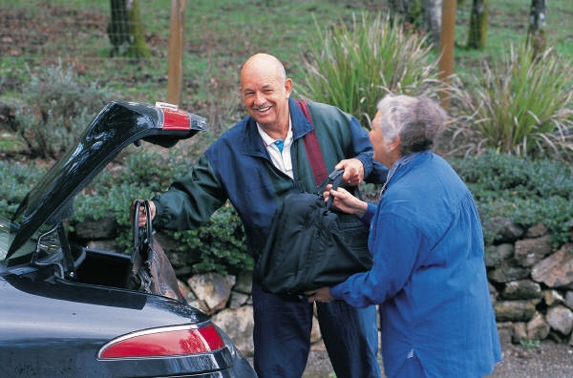
Possibilities:
Further exploration of the support needs of Carers.
Provide the findings from the think tank to local agencies/groups including libraries and neighbourhood houses to see if they would have the opportunity to support awareness raising discussions/events on end of life care issues.
Notes:
Some level of guilt expressed around not wanting to care for their loved one at home – feeling pressured to keep people at home

Slide 11
Questions?

