Slide 1
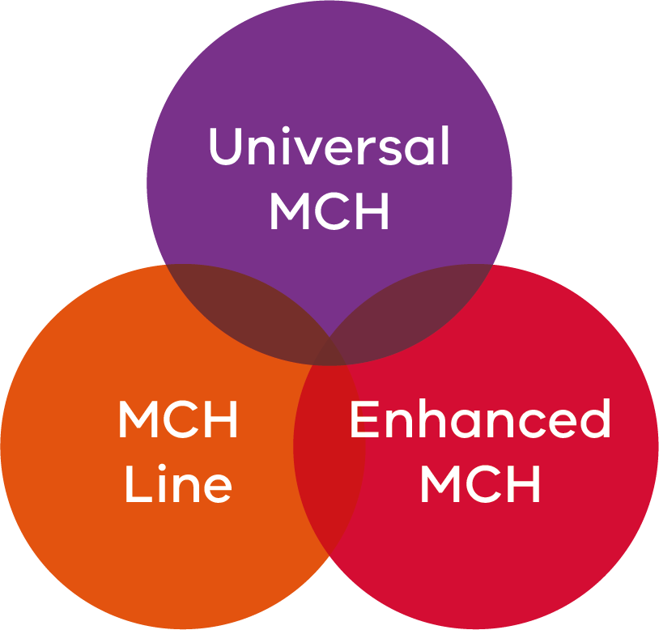
MCH Service Update
Marcia Armstrong
Principal MCH Nurse Advisor
Notes:
The MCH framework provides a integrated service delivery architecture for the Victorian MCH Service. The framework brings together contemporary theory and best practice. The MCH framework consists of:
Maternal and Child Health Service guidelines (2019)
Maternal and Child Health Service standards (2011)
Maternal and Child Health Service clinical practice guidelines
Maternal and Child Health Universal program guidelines – currently Maternal and Child Health Service: practice guidelines (2009)
Enhanced Maternal and Child Health program guidelines (2017)
Maternal and Child Health Line program guidelines
It supports the delivery of consistent and high-quality MCH services by MCH Service providers for all Victorian children and families.
The framework embraces the operational delivery component of the service through the MCH Service guidelines with clinical practice supported by the overarching MCH Service standards and MCH Service clinical practice guidelines (CPGs).
The Victorian MCH Service is provided through three intergrated programs: the Universal MCH (UMCH) program, the Enhanced MCH (EMCH) program and the MCH Line. The MCH program guidelines inform service provision.

Slide 2
Welcome
Notes:
Welcome SWAN HILL, SALE , Warrnambool, Horsham ,Wangaratta, Mildura, Melbourne
Thank you to the MCH Line is supporting parents across the state whilst at conference

Slide 3
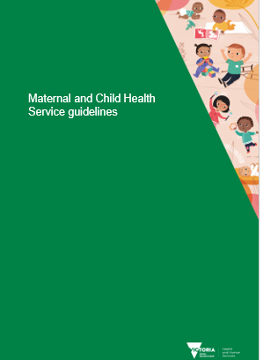
Maternal and Child Health Service guidelines
Notes:
Consultation with face to face input through focus groups 250 participants, expert reference group inclusive of ANMF and internal department
available on website, updated and inclusive of MCH framework, governance, MCH workforce, policy, legislation, funding, performance measures and data collection obligations to support the delivery of professional, safe and high-quality care within the MCH Service.
New inclusions are aboriginal children and families and diversity
The MCH framework provides a integrated service delivery architecture for the Victorian MCH Service. The framework brings together contemporary theory and best practice. The MCH framework consists of:
Maternal and Child Health Service guidelines (2019)
Maternal and Child Health Service standards (2011)
Maternal and Child Health Service clinical practice guidelines
Maternal and Child Health Universal program guidelines – currently Maternal and Child Health Service: practice guidelines (2009)
Enhanced Maternal and Child Health program guidelines (2017)
Maternal and Child Health Line program guidelines
It supports the delivery of consistent and high-quality MCH services by MCH Service providers for all Victorian children and families.
The framework embraces the operational delivery component of the service through the MCH Service guidelines with clinical practice supported by the overarching MCH Service standards and MCH Service clinical practice guidelines (CPGs).
The Victorian MCH Service is provided through three intergrated programs: the Universal MCH (UMCH) program, the Enhanced MCH (EMCH) program and the MCH Line. The MCH program guidelines inform service provision.

Slide 4
MCH Framework

Slide 5
UMCH, EMCH and MCH Line
EMCH 2018/19
209,397 hours
EMCH 2019/20
238,172 hours
Notes:
Notes: * All data on this page for North-Western Victoria region does not include data for Swan Hill. Due to difficulties in transitioning to a new system, Swan Hill is
unable to provide this data for 2017-18.
Caution should be taken when using this report data for time series analysis.

Slide 6
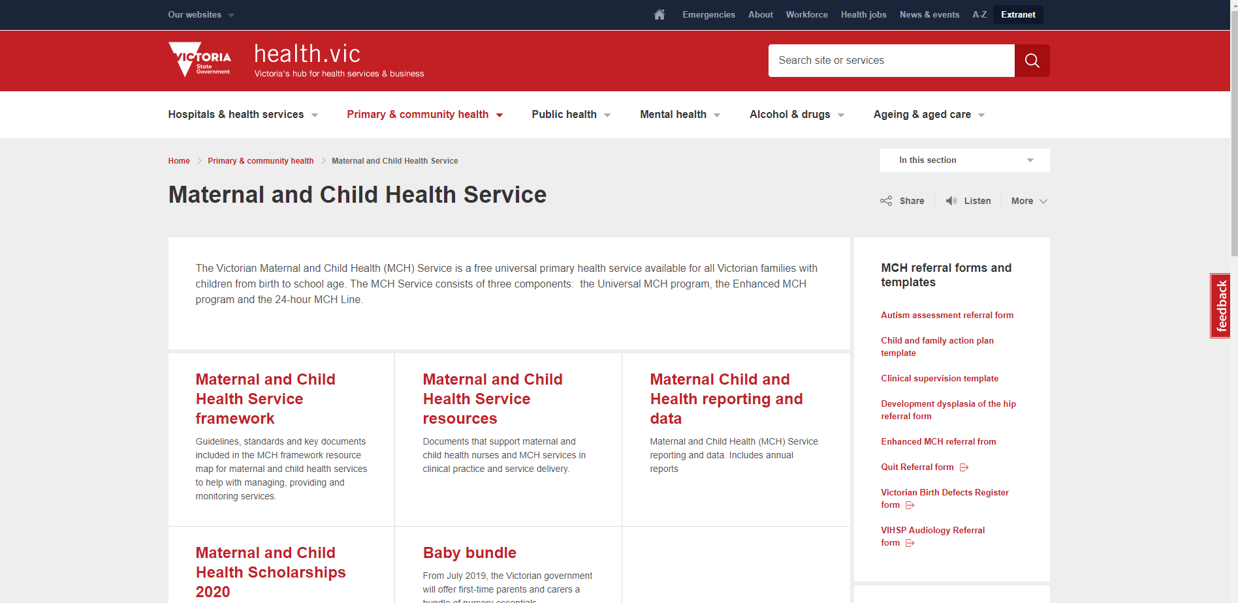
For us: https://www2.health.vic.gov.au/mch
Notes:
< Cheryl’s comments
All you key documents in one place
The instructions for the desk top icon will be in the next MCH newsletter
Please email mch@dhhs.vic if you would there are any documents to be added to the MCH service resources >

Slide 7
For families: https://www.betterhealth.vic.gov.au/healthyliving/child-health-0-6
Notes:
Parents can access KAS resources from here rather than a paper copy

Slide 8
MCH Program Standards
Revision
Revision
Internal and External Stake holders
Expert Maternal and Child Health and Parenting Reference Group
Revision
MCH Statewide Consultation
Statewide survey
Revision
Revision
Statewide MCH Survey Revision
Notes:
Please email

Slide 9
MCH Standards Survey
MCH Standards Survey closes on Monday 4th November
Email now to receive the link today and ensure your thoughts and ideas are heard
mch@dhhs.vic.gov.au

Slide 10
Aboriginal Cultural Safety Professional Development
The department is in the process of developing an Aboriginal cultural safety training package for MCH services.
Updates on developments will be provided through:
MCH bulletin
Coordinator meetings.
The Aboriginal Cultural Safety Framework and tools are currently unavailable please email aboriginalstrategyandoversight@dhhs.vic.gov.au to register your interest and the resource will be emailed to you

Slide 11
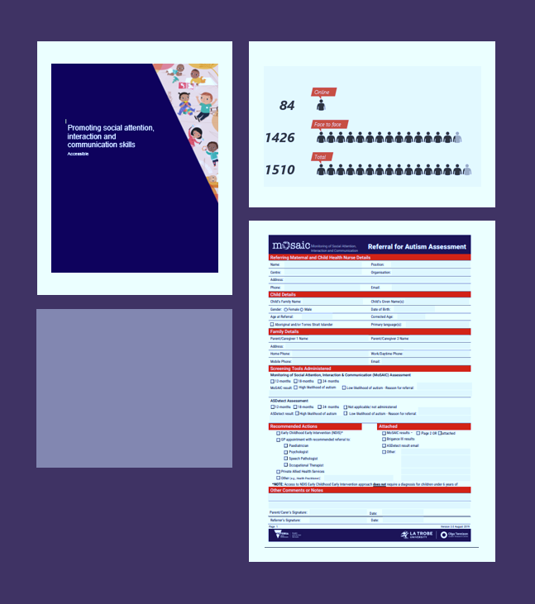
Ongoing Professional Development
Autism Spectrum Disorder
https://www2.health.vic.gov.au/mch
Autism Spectrum Disorder
enquiries@mertil.net.au
https://www2.health.vic.gov.au/mch
Notes:
Mini MERTIL provides an interactive, engaging 2 hr summary of the full MERTIL course (MERTIL’s Greatest Hits!), and should be of great value for all Maternal and Child Health Nurses and coordinators.
MiniMERTIL is strongly encouraged to be completed by all nurses who completed the original MERTIL training between 1 November – 6 December as this data is important to contribute to high level research and reporting about the success of the training.
The MERTIL team will be sending a reminder email with full login details shortl to those who completed the original MERTIL training. If your email address has changed since completing MERTIL, please contact enquiries@mertil.net.au to have your registration details updated to ensure you can complete the MiniMERTIL module

Slide 12
Family Violence and Child Information Sharing Schemes e-learn
MCH specific e-learn module on Family Violence and Child Information Sharing Schemes
The department’s online training module assists MCH Nurses to understand how to apply the Information Sharing Schemes and other related reforms and meet their legal obligations in Victorian MCH
Look out for more information about the MCH e-learn module from the Department of Health and Human Services in coming weeks

Slide 13
Sleep and Settling
Consultation
Families
MCH nurses
EPCs
ANMF
Universities
Model of care
Parent resources
Professional Development
Notes:
The Victorian Government has invested in sleep and settling as part of its broader 2018 election commitment ‘More help for new mums and dads’. This commitment included $51.2 million over four years for the sleep and settling initiative to be implemented across three of the Maternal and Child Health Service platforms of: additional information sessions at key developmental ages, outreach support for vulnerable families and additional support through the MCH Line.
A co-design process was undertaken, facilitated by KPMG, to develop a sleep and settling model of care.
The Model of Care will provide evidence informed information on sleep and settling across three platforms (information sessions, outreach and MCH Line).
The Model of Care will be supported by a number of parent resources normalising sleep and settling, along with providing guidance on how to develop positive sleep environments and evidence informed approaches to managing parent identified sleep concerns.
Training will be provided on the new Model of Care, with the Department about to go through a RFT process to appoint a training provider. It is anticipated that training will commence early next year.
We hope that the Model of Care and parent resources will be released in the coming month and further information and funding provided to Councils by the end of 2019.
I would like to thank those Councils, MCH nurses, Coordinators, ANMF, VAMCHN, EPCs, Universities and others who have assisted the Department with this work.

Slide 14
MCH Scholarships
Priorities for scholarship recipients for 2020 include:
residing in rural and remote regions.
culturally and linguistically diverse (CALD) backgrounds:
identify as being of Aboriginal and Torres Strait Islander heritage.
residing in known high growth areas and/or areas with increasing demand for MCH services, a
demonstrated financial need, Government tested low income benefit or who hold a HCC
Funding for scholarship recipients for 2020 :
$10,000 Full-time students over one year or Part-time students over two years
New Application Process:
Latrobe University: https://www.latrobe.edu.au/scholarships/maternal-and-child-health-mch-nursing-scholarships-program
RMIT University: https://www.rmit.edu.au/students/work-study-opportunities/scholarships/browse-scholarships/mchn#close
applications close on 20 November, 2019.

Slide 15
Thank you mch@dhhs.vic.gov.au

