Slide 1
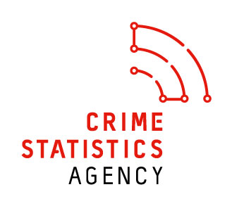

Crime Statistics Agency
Presentation to Municipal Association of Victoria
December 2017

Slide 2
Who we are
Crime Statistics Agency (CSA) was established in 2014 and commenced public operations on 1 January 2015
Business unit within the Department of Justice & Regulation
Crime Statistics Act 2014 establishes the role of the Chief Statistician to:
  publish and release statistical information relating to crime in Victoria
  undertake research into and analysis of crime and criminal justice issues and trends in Victoria
Chief Statistician
Operations: Quarterly crime statistics and custom data request
Development: Justice data linkage program
Development: Family violence data improvement program
Research and evaluation: Supporting evidence based approaches to criminal justice policy

Slide 3
Brief history of our family violence data program
August 2015 - Commissioned to produce an update to the Family Violence Database for the Royal Commission into Family Violence
March 2016 – Royal Commission into Family Violence handed down recommendations relating to family violence data collection
December 2016– Family violence data improvement program initiated at the CSA
January to December 2017– The team have been updating and maintaining the Family Violence Database, releasing information in May and December 2017

Slide 4
Royal Commission into Family Violence
Data related recommendations
Family Violence Database
Recommendation 205
Maintain and develop the Victorian Family Violence Database and consider what additional data sets should be incorporated in the database, and how links between all relevant data sets can be created
Family Violence Data Framework
Recommendation 204
Develop a state-wide data framework with a particular focus on older people, people with disabilities, CALD and LGBTI communities
Explore opportunities for data linkage
Recommendation 152
Improve the collection of Indigenous-specific data relating to family violence
Recommendation 174
Adopt a consistent and comprehensive approach to the collection of data on people with disabilities

Slide 5
Family Violence Database 2015-16
Most recent release – December 2017
Covers five year period from July 2012 to June 2017
Incorporated data from:
  Victoria Police
  Magistrates’ Court
  Children’s Court
  Victoria Legal Aid
  Men’s Behaviour Change Programs (IRIS)
  Family Violence Services for Women and Children (IRIS)
  Victorian Emergency Minimum Dataset
  Victim Support Agency

Slide 6
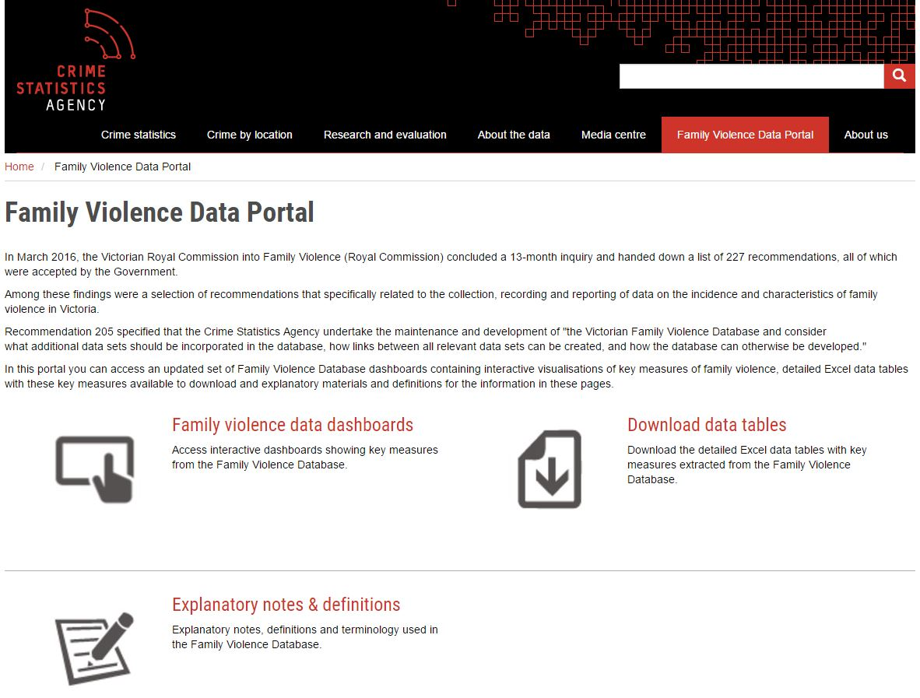

Slide 7
Further work
Ongoing maintenance of the database
  Regular release each December for the financial year reference period
Thematic analysis using existing data sources
Expanding the database
  Coroner’s Court of Victoria
  Child protection
  Ambulance Victoria
  Homelessness services
  Community Legal Centres
Linking datasets
  Linking data at the person level to track a person’s experience through the system

Slide 8
Fiona Dowsley
Chief Statistician
fiona.dowsley@crimestatistics.vic.gov.au
03 8684 1808
Courtney Van Tongeren
Family Violence team
courtney.vantongeren@crimestatistics.vic.gov.au
03 8684 1803
www.crimestatistics.vic.gov.au

