Slide 1

Co-Sleeping
and
Bed Sharing
J Jane Wiggill – Manager Health, Education and Advocacy
rednose.com.au

Slide 2


Objectives
Definitions
Infant mortality in Australia / Vic
SUDI and SIDS
Six safe sleeping recommendations
Bed sharing and co-sleeping
Benefits of Co-sleeping
Strategies for reducing the risk(s)
Stakeholder statements
rednose.com.au

Slide 3
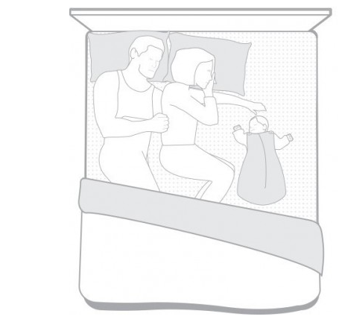
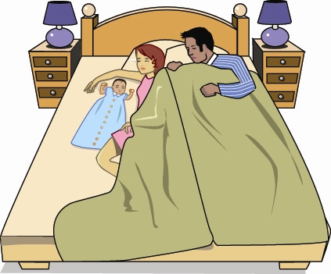
Definitions
Bed – Sharing
Bringing a baby onto a sleep surface
Sharing the same sleep surface
Includes the practice of bed-sharing and co-sleeping on the same sleep surface
Co-sleeping
A parent, or both parents being asleep on the same sleep surface as the baby
rednose.com.au

Slide 4
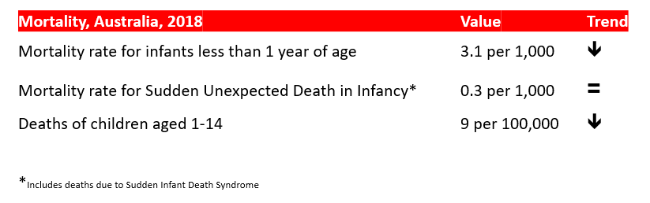
Infant Mortality in Australia
rednose.com.au

Slide 5
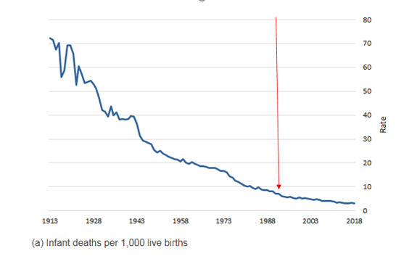
Infant Mortality in Australia
rednose.com.au

Slide 6
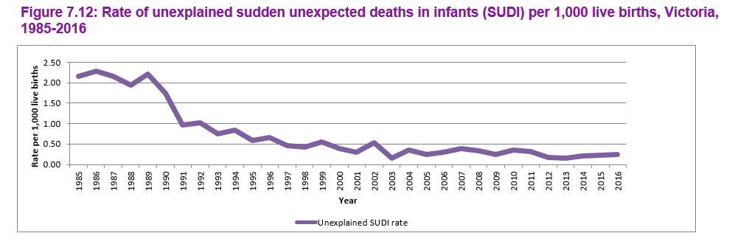
Infant Mortality in Victoria
Source: Victoria’s Mothers, Babies and Children Report (2016)
rednose.com.au

Slide 7
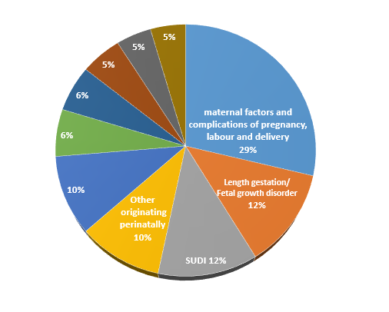
Categories of Infant Death
Australia, 2018
Australian Bureau of Statistics. (2019). 3303.0 - Causes of Death, Australia, 2018. Canberra
rednose.com.au

Slide 8
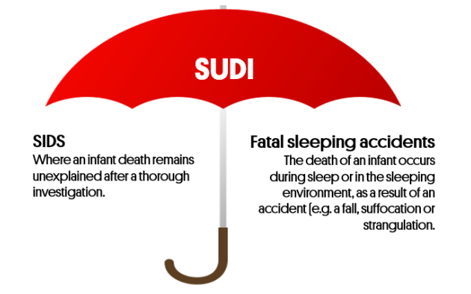
Sudden Unexplained Death in Infancy
rednose.com.au

Slide 9
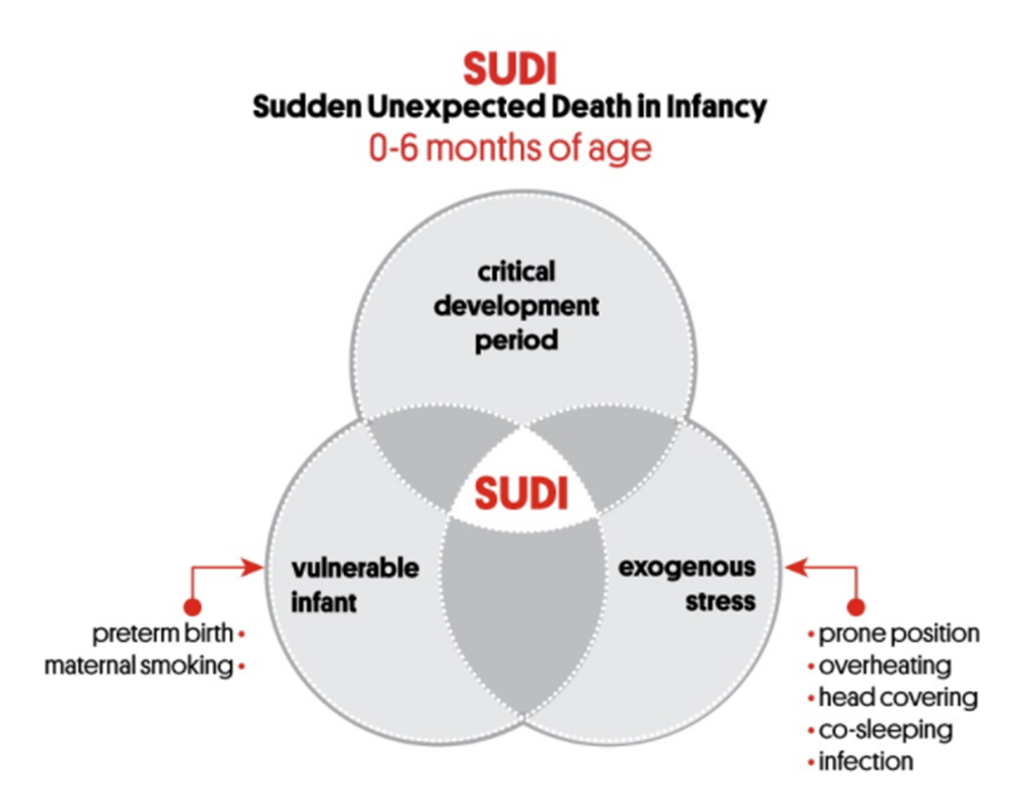
Triple Risk Model
rednose.com.au

Slide 10
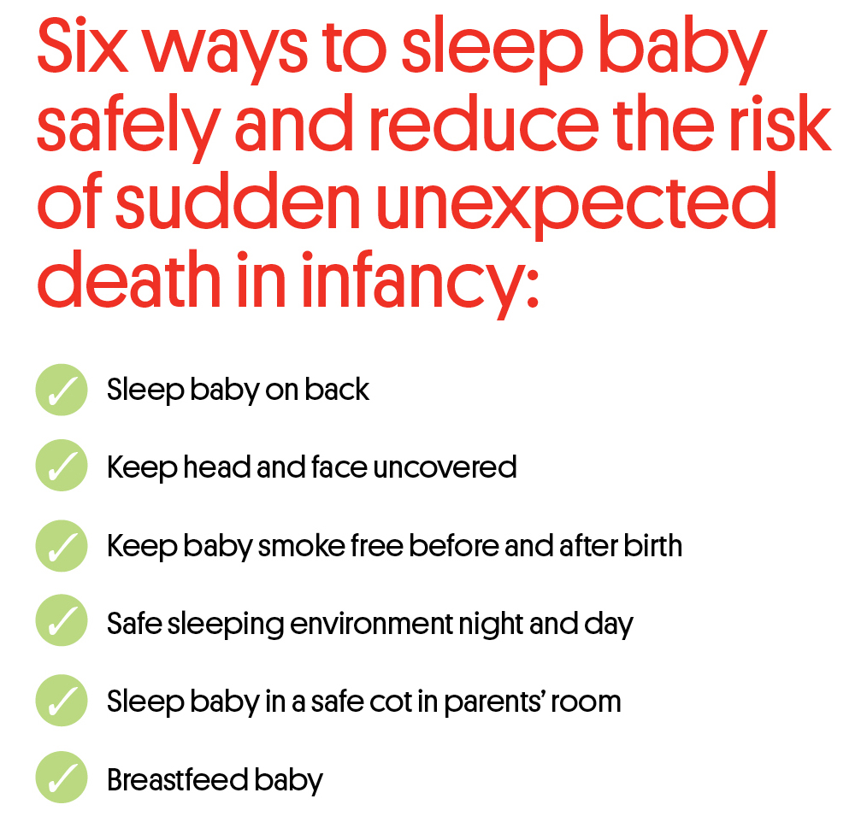
rednose.com.au

Slide 11
Co-Sleeping…Who is doing it?
Helen Cunningham MCHN
Bed-Sharing in the First 8 Weeks of Life: An Australian Study (2015)
Maternal and Child Health Journal. 22. 10. 2015
Sample size of 1144
Maternal-Child Health 8 week visit, Victoria
Results
66% (>twice/week)
Everyday: 29%
4-6/week: 13%
2-3/week: 24%
rednose.com.au

Slide 12
Co-Sleeping…Who is doing it?
Results
  45% had bed-shared
  Not planned: 77.5%
  Planned: 21.5%
Reasons
  Settling/Comforting (65%)
  Breastfeeding (23%),
  Bonding/Attachment (13%),
  Maternal Exhaustion (12%),
  Better Sleep (9.5%),
  Falling to sleep together after early morning feed (7.5%)
rednose.com.au

Slide 13
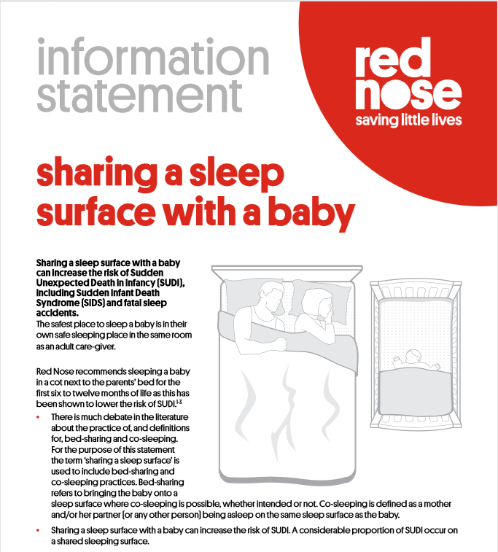
Red Nose: Risk Minimisation
rednose.com.au

Slide 14
Benefits of Co-sleeping
Improved breastfeeding outcomes
Reduced formula supplementation
Improved maternal sleep
Increased Infant arousals
Enhanced maternal bonding and responsiveness
Improved infant settling with less crying and reduced stress response
Higher self esteem, better social skills and emotional outcomes as young people and adults
Protective maternal behaviours
Increased likelihood of recommended supine position for sleep
rednose.com.au
Full reference list available: www.rednose.com.au

Slide 15

Strategies to reduce the risks
Place baby on the back to sleep
Firm and clean mattress
Make sure adult bedding cannot cover the baby’s face
Lightweight bedding only
Baby is NOT swaddled
Remove teething necklaces/jewellery
Place baby on one side of parent
Not too close to the edge of the bed
Long hair tied up
Avoid pushing bed up against the wall
Never leave baby unattended

Slide 16
Australian College of Midwives
The ACM
  supports the facilitation of women and their families making, including decisions about where their baby sleeps informed choices in maternity and child care
  advocates a risk minimisation approach in which the individual family’s circumstances are considered when providing advice about infant care practices parents will use in caring for their baby.
  believes that in ensuring the safety of babies, it is crucial to respect and support cultural norms and practices.
  does not support a risk elimination approach in which all parents are informed not to bed-share or co-sleep with their baby under any circumstances.
https://www.midwives.org.au/resources/acm-position-statement-co-sleeping-and-bed-sharing
rednose.com.au

Slide 17
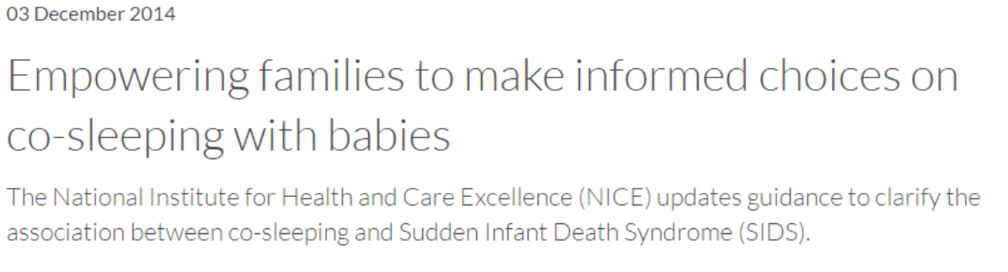
UNICEF and NICE
UNICEF 2016
rednose.com.au

Slide 18
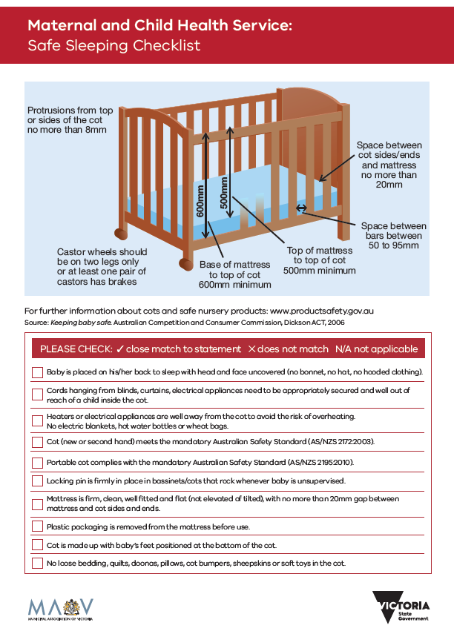
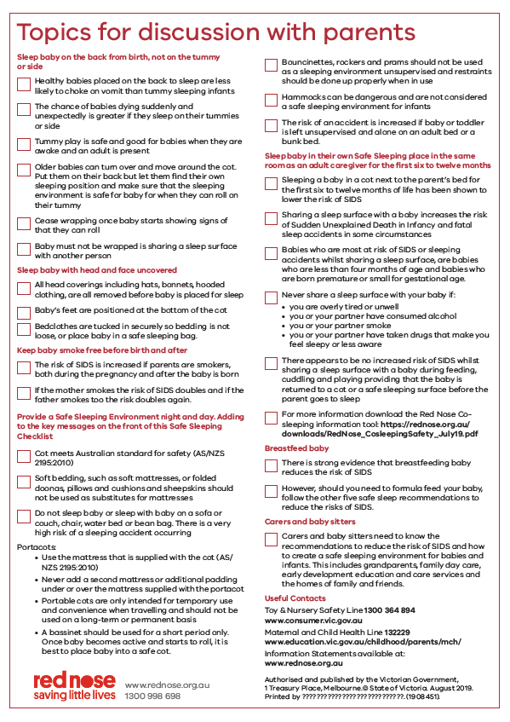
KAS Safe Sleeping Checklist
rednose.com.au

Slide 19
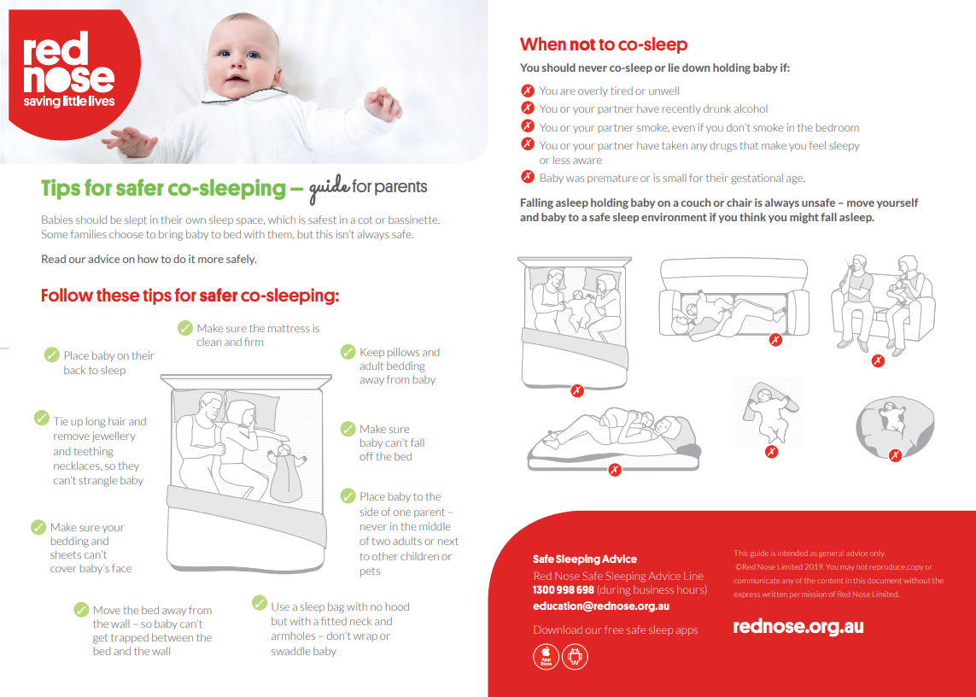
Red Nose tips for safer Co-sleeping

Slide 20
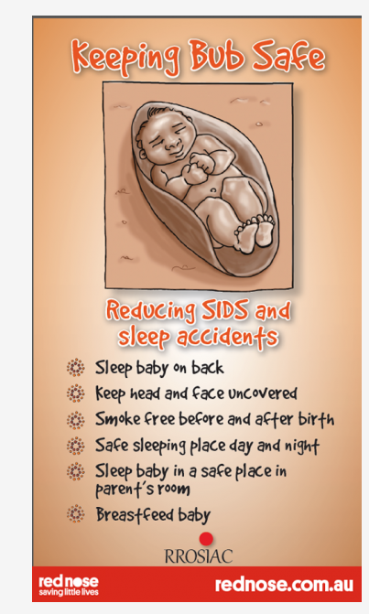
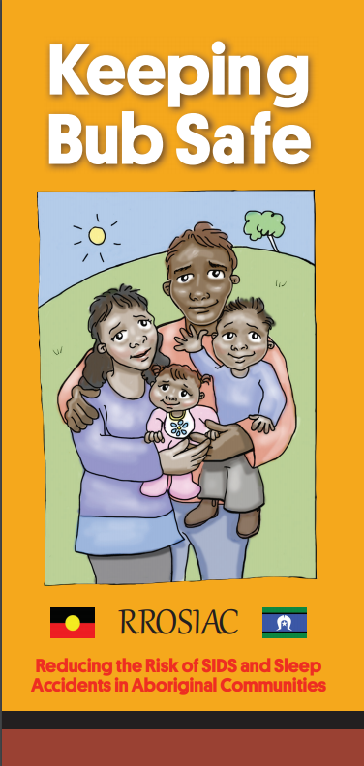
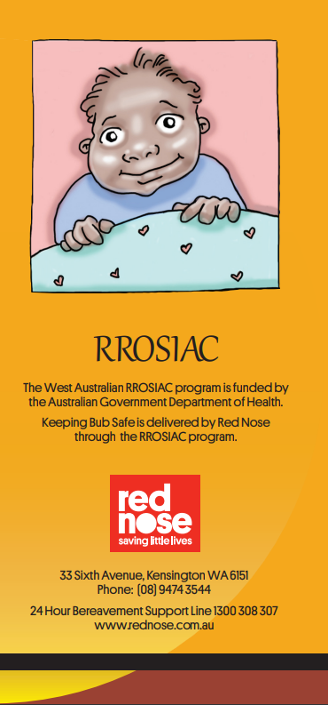
Watch this space…
rednose.com.au

Slide 21
References
Baddock, S.A., Galland, B.C., Bolton, D.P., Williams, S.M., & Taylor, B,J. (2012). Hypoxic and hypercapic events in young infants during bed-sharing. Paediatrics, 130(2), 237-244
Blair, P.S. (2006). Sudden infant death syndrome epidemiology and bed sharing. Paediatrics and Child Health, 11 (Supplement SA), 29-31
Cunningham, Helen & Vally, Hassan & Bugeja, Lyndal. (2018). Bed-Sharing in the First 8 Weeks of Life: An Australian Study. Maternal and Child Health Journal. 22. 10.1007/s10995-017-2424-7.
Demosthenous, C., & Demosthenous, H. (2011). Controversy in relation to SIDS. Bed sharing and breast feeding.
Paediatric Respiratory Review.
Galbally, M., Lewis, A.J., McEgan, K., Scalzo, K., & Islam, F.M. (2013). Breastfeeding and infant sleep patterns: an Australian population study. Journal of Paediatrics and Child Health, 49(2), E147-E152
McKenna, J.J., & McDade, T. (2005). Why babies should never sleep alone: a review of co-sleeping, 6(2), 134-152.
Paediatric Reparatory Review. (2005). June, 6(2): 134-52
Mosko, S., Richard, C., & McKenna, J.J (1997)., Infant arousals during mother-infant sleep proximity and breastfeeding in a laboratory setting. American Journal of Physical Anthropology, 144(3), 454-462
The Indigenous Safe Sleeping Project: Closing the Gap on Knowledge, Resources and Access in Queensland, 1–168
Victoria’s Mothers, Babies and Children Report (2016) Consultative Council on Obstetric and Paediatric Mortality and Morbidity (CCOPMM).
UNICEF UK Baby Friendly Initiative 2004
Young, J., Pollard, K.S., Blair, P.S., Fleming, P.J. & Sawczenko, A. (1998). Night-time behaviour and interactions between mothers and infants of low SIDS risk: A longitudinal study if room-shring and bed-sharing. Paediatric Pulmonology, 26(6): 447

Slide 22
Notes:
Just to conclude – it’s been a wonderful opportunity to come here again and speak to you and I thank you for your attention and interest in the Red Nose and the work that we are doing to help and support our families.
Thank you for the invaluable contributions that you make to the families you work with everyday – they are lucky to be in your safe hands.

Slide 23




| Thank you
Make an enquiry or book a training session:
educationbookings@rednose.com.au
1300 998 698
rednose.org.au

