Slide 1
Child Development Information System (CDIS)
CDIS Admin Users Group
Thursday 23rd March 202311am – 12pm

Slide 2
Contents
Tips and Tricks QR code
SMS appointments reminders and templates
How to remove a client who is incorrectly on the birth notice list.
Correcting for Prematurity for booking appointments
MS Teams MCH Admin team site/chat Q&A

Slide 3
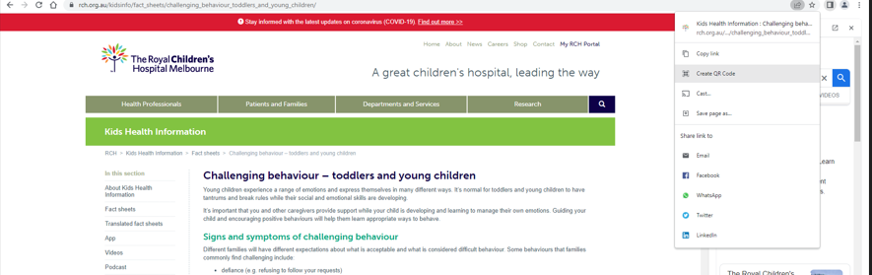
Tips and Tricks
How to Create a QR Code for Desktop Computers Using Chrome
Either copy the QR link, click download to download the QR code, or scan the QR code with a camera on another device
Open Chrome on your desktop.
Go to the URL you want to share.
For Linux, Windows, and Mac computer users, navigate to the right-hand side of the address bar, click Share, and select QR code.
For Chromebook users, navigate to the address bar and then QR code.

Slide 4
Tips and Tricks
How to Create a QR Code on an Android Device (mobile)
Creating a QR code on an Android device is simple with the Chrome app. You can only make QR codes for URLs, but this is a handy tool for when you need to quickly share product pages or blog posts with someone.
Download the Google Chrome app from the Google Play Store.
Navigate to the URL you want to share.
Click the three ellipses i.e. vertical dots (⋮) on the top toolbar.
Tap Share.
On the pop-up, select QR Code.
Either click Download at the bottom or hold your phone up for someone to scan the code.

Slide 5
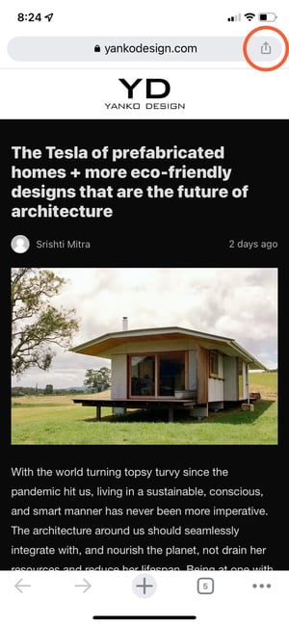
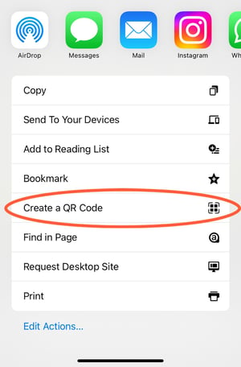
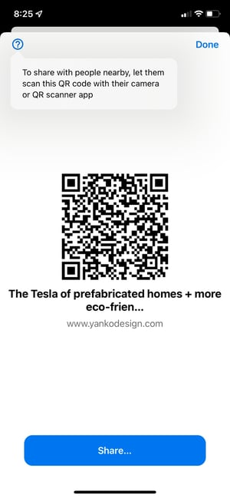
Tips and Tricks (continued)
Step 3 Step 4 Step 5
How to Create a QR Code on iOS Mobile Device
Just like in Android, you can easily make QR Codes on any iPhone or iPad. Here's how:
Download the Google Chrome app from the App Store. NB: You can't create QR Codes from the Google search app, only the Chrome app.
Navigate to the URL you want to share.
Tap the Share button on the upper right-hand corner.
Select Create QR code
Either hold it up for someone to scan or tap share. This option will allow you to print your QR code, save the image to your camera roll, or save it to your files.

Slide 6
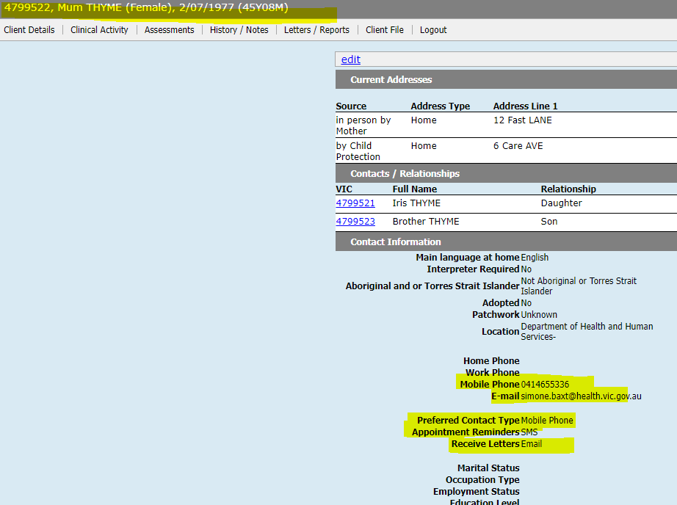
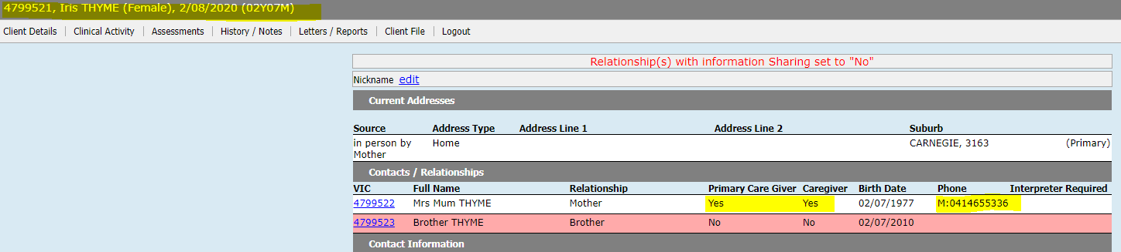
Client Appointment Reminders
SMS / E-mails can be sent to clients from various screens within CDIS
The client’s Hx contains the details of their Primary (PCG) and other Caregivers (CG)
The ‘Contact Information’ in the PCG or CG record is
Recorded or updated in the ‘Update Client Details’
screen, under the ‘Client Details’ menu

Slide 7
Client Appointment Reminders (continued)
Appointment Reminders are generated when the client appointment is scheduled.
The timing of when the reminder is sent to the depends on both;
  The Appointment Reminder Settings, configured for each MCH Service Provider, and
  CDIS requires 1 day to send the reminder into the ‘SMS Cloud’ (then it is sent via carrier to the telecommunications provider)
Depending how far in advance a client appointment is being scheduled, there will either be “generate reminder” or “immediate send” checkbox

Slide 8
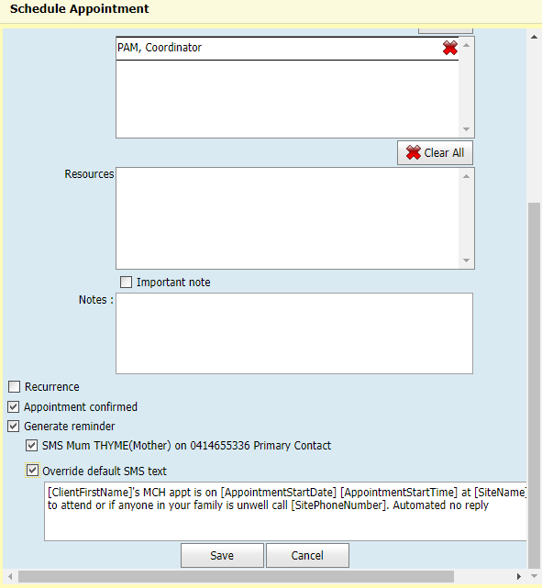
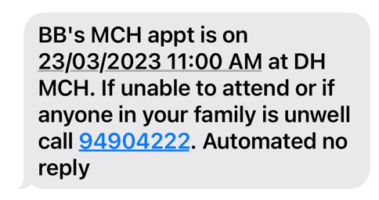

Client Appointment Reminders (continued)
[ClientFirstName]'s MCH appt is on [AppointmentStartDate] [AppointmentStartTime] at [SiteName]. If unable to attend or if anyone in your family is unwell call [SitePhoneNumber]. Automated no reply

Slide 9
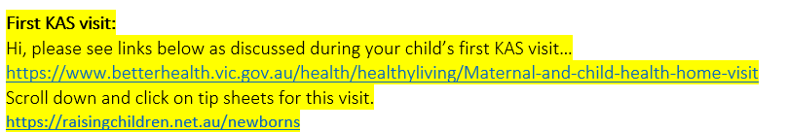
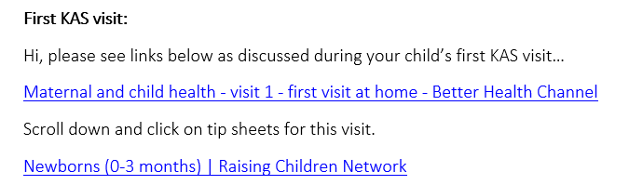
Client Appointment Reminders (continued)
If you want to send details from an SMS appointment reminder, you should be mindful of the limitations and costs
QR codes cannot be sent from CDIS at this time
Only full web, TinyURLs, or email addresses can be received by clients receiving SMS
Use https://www.vic.gov.au/govic-url-shortener or other in house services
Do send complete web addresses as seen here, or any smaller URLs you have generated
Hyperlinks wont work

Slide 10
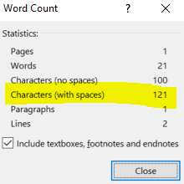
SMS and Using Appointment Reminders
Each character in the reminder message is counted (for SMS), and this means a long Appointment reminder could be 2 or even 3 SMS
Best Practice: Use WORD to draft your template. Then highlight all the words and punctuation, and go to Review menu, then “word count”. See below the character count in this highlighted sentence.

Slide 11
SMS and Email Templates
Admin staff don’t have access to the ‘Correspondence History’ screen as this is part of the client health record and access is controlled by Legislation. This is the screen where the correspondence is saved once it is sent to the client.
Admin staff do have access to schedule appointments and send appointment reminders and send Bulk SMS or Bulk SMS Reschedule emails.
Each of these screens is available on different menus
  Calendar (Home) > Appointment reminders
  General > Bulk SMS
  Schedule > Bulk SMS Re-Schedule

Slide 12
SMS and Email Templates
Templates are centralised, meaning everyone has the same template
Clients receive correspondence based on their individual settings
Each screen where client correspondence is available, may have one or several templates
Each templates contains both text (which can be left or edited), and variables. The variables are [inside square brackets]. These will be different for each screen and each template. They act as automated inputs into the message, from other areas of the system

Slide 13
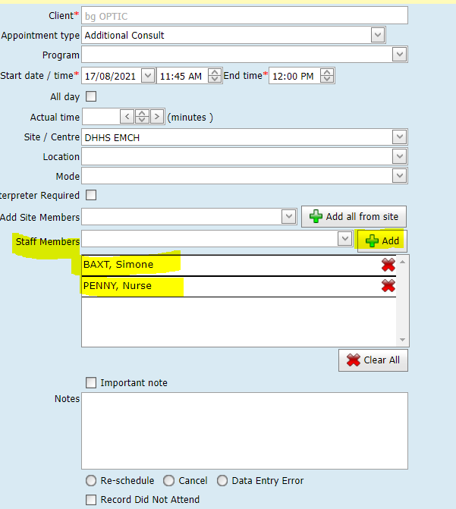
Bulk SMS Reschedule
NB: This process will only work for Service Delivery when staff members names are being added to appointments when scheduled and corrected when appointments are changed.
NB: It is understood that the practice of adding Staff names to appointments is not a practice everyone follows.
This image highlights where staff members can be added to client appointments.

Slide 14
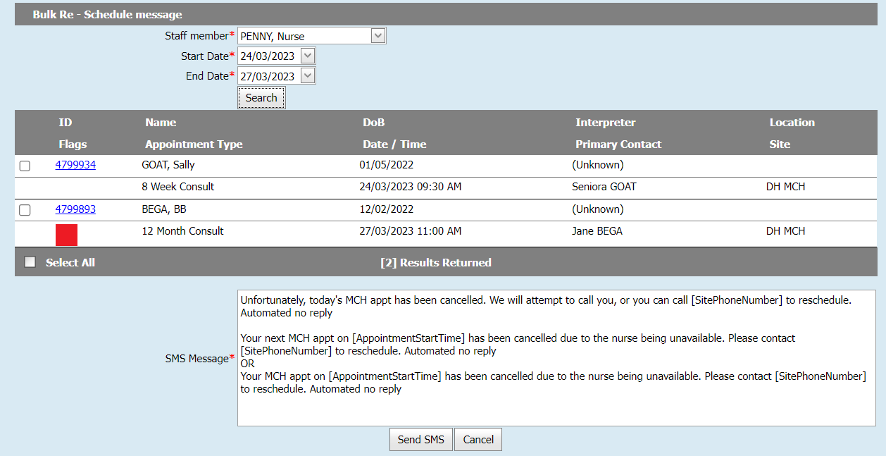
SMS and Templates – Bulk SMS Reschedule
From the Home screen, Select menu Schedule > Bulk SMS Re-Schedule, to open this screen.
If client appointments include staff members, the staff member’s name is used in the search criteria, along with the dates requiring scheduling changes due to staff unavailability.
Select the clients you wish to send updates to ticking the checkboxes.
Choose the relevant text that fits the scenario for your message and delete the other message.
NB: This process will only work for Service Delivery when staff members names are being added to appointments when scheduled and corrected when appointments are changed.
NB: It is understood that the practice of adding Staff names to appointments is not a practice everyone follows.

Slide 15
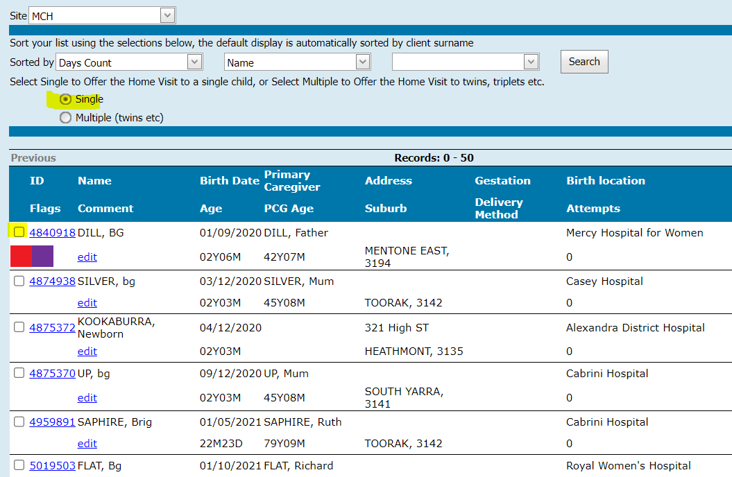
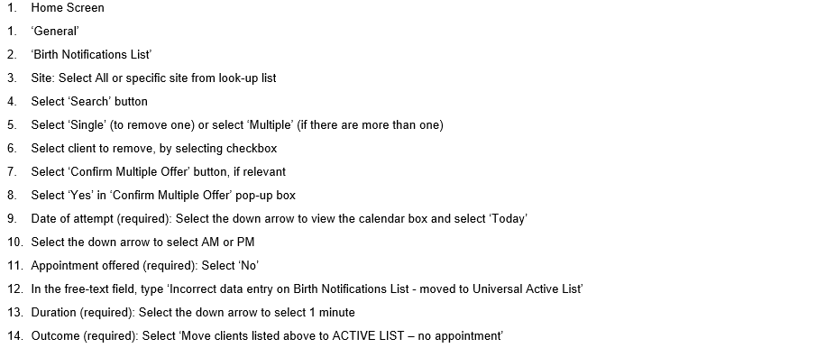
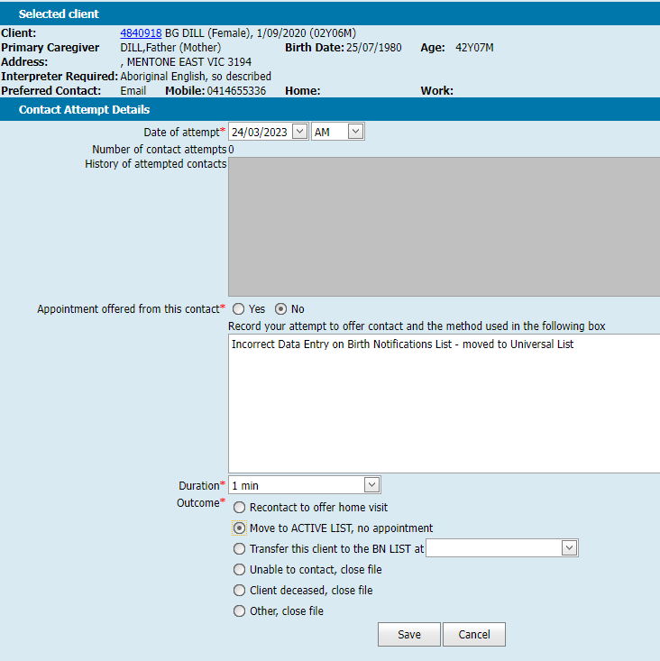
How to remove a client who is incorrectly on the birth notification list

Slide 16
Correcting for Prematurity
Corrected age: what is it?
Corrected age, or adjusted age, is a premature baby’s chronological age minus the number of weeks or months early they were born.
For example, a 1-year-old who was born 3 months early would have a corrected age of 9 months.
Why corrected age is important
Corrected age can help if you’re trying to work out whether a premature baby’s development is tracking in a typical way. For example, if someone notices that a baby is 6 months old but not sitting up yet, you could explain that your baby was born 3 months early. If you look at your baby’s corrected age, they’re really only 3 months old and they’re doing everything a 3-month-old usually does.
Corrected age is most relevant during your child’s early years, because it might explain things that look like delays in development in these years.
https://raisingchildren.net.au/newborns/premature-babies-sick-babies/development/corrected-age#:~:text=to%20have%20immunisations-,Corrected%20age%3A%20what%20is%20it%3F,corrected%20age%20of%209%20months

Slide 17
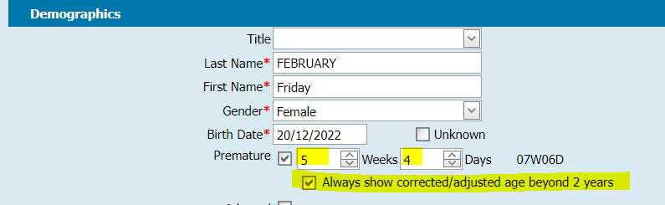
Correcting for Prematurity
As per Maternal and Child Health Service – Practice Guidelines (2009 reissued 2019)
CDIS corrects for prematurity, but you must do the following when entering a birth notice:
Premature (required): Select checkbox if relevant (if known).
Enter prematurity in weeks and days premature (not gestation). (See Appendix 1.4)
Example: For a baby at 34.2 weeks gestation, calculated by 40 weeks (term for the purposes of CDIS) subtract 34 weeks and 2 days therefore 5 weeks and 5 days premature
TIP – MCHN should check the details entered re prematurity are correct to ensure that corrected age is right.

Slide 18
Correcting for Prematurity
Correcting age for prematurity needs to be considered in the following context:
If a child is born under 37 weeks gestation
All assessments under 2yrs of age
Professional judgement of MCH Nurse to determine if there is a need for:
  additional consultations
  further assessment/ activities
  more flexible approach to service delivery
  follow-up – this may be by phone or appointment
  referral to secondary services.
  Service provider policy/procedure

Slide 19
MCH Administration online group
(MAV MS TEAMS)
Supported from the MCH Vic Coordinators group
MAV has now set up the MS Teams site MCH Administration online group
  To have your details added to this group, please ask your MCH coordinator to collate all the relevant staff names and send one collated list with staff details and individual emails (no group emails)
  Helen Lees : hlees@mav.asn.au
  Melissa Ryan: mryan@mav.asn.au
  Naree Atkinson: natkinson@mav.asn.au
  Don’t forget the EMCH Online group (MAV MS Teams)

Slide 20
Q&A
Your questions, thoughts and discussions☺
Should we continue to cleanse data knowing there is a new MCH system?
Yes very important to keep data cleansing to keep medical records up to date and reflective of the client situation.
Also good to keep on top of data cleansing for the eventual migration of data to new system☺
Issue:
Staff are reporting they are logging into CDIS, and on the Home calendar, in addition to their "current site" are adding calendars.
Then walking away / undertaking other tasks and returning (sometime later) and the added sites/calendars are gone from the Home page
Response (CDIS vendor):
We cannot reproduce his issue – we have multiple calendars open all day and don’t have issues. We have also reviewed the code and cannot see any auto-refresh functionality.
One possibility is that users are clicking the 'Home' button (top right of the screen) to refresh the calendars. However, doing this will revert the calendar to just display their default calendar.
Recommendation: Using the 'Refresh' button instead (Just under the 'Timeline' button) will refresh all the calendars and also keep them open.

