Slide 1
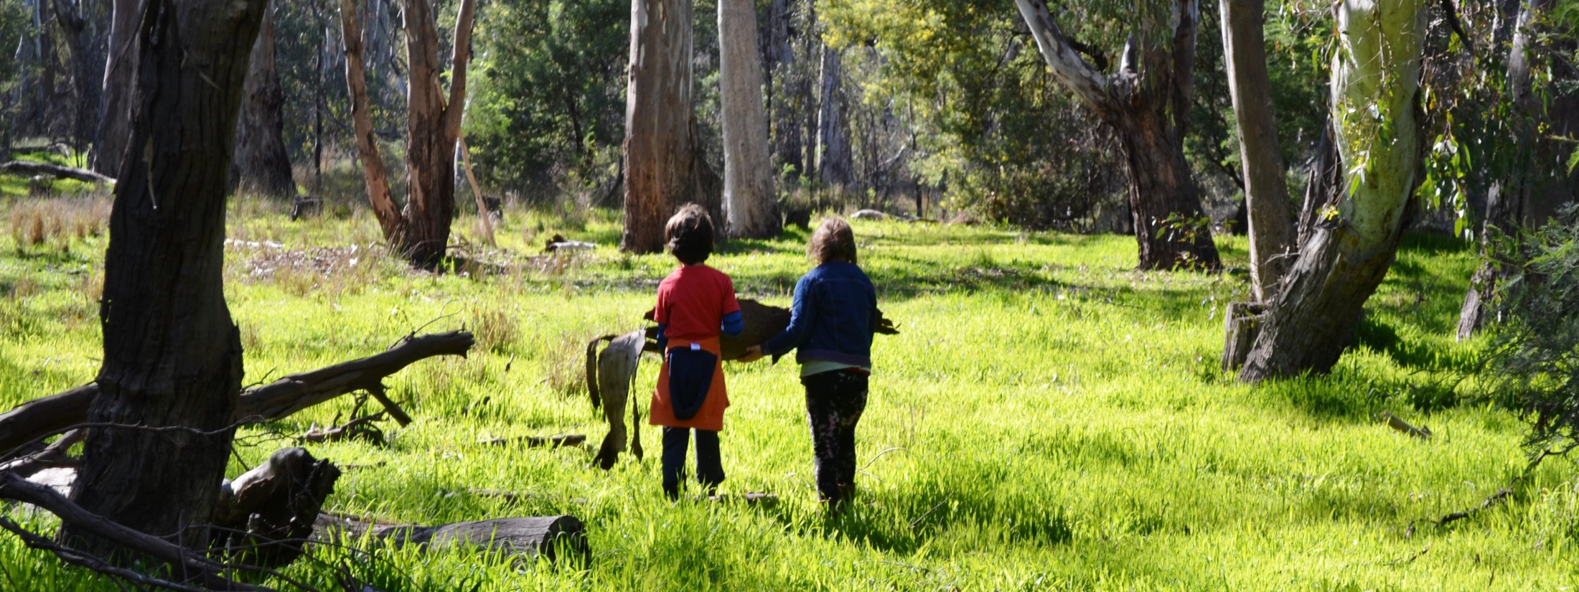
First Nations Childrearing
MISHEL MCMAHON
Yorta Yorta
Latrobe University, Shepparton

Slide 2
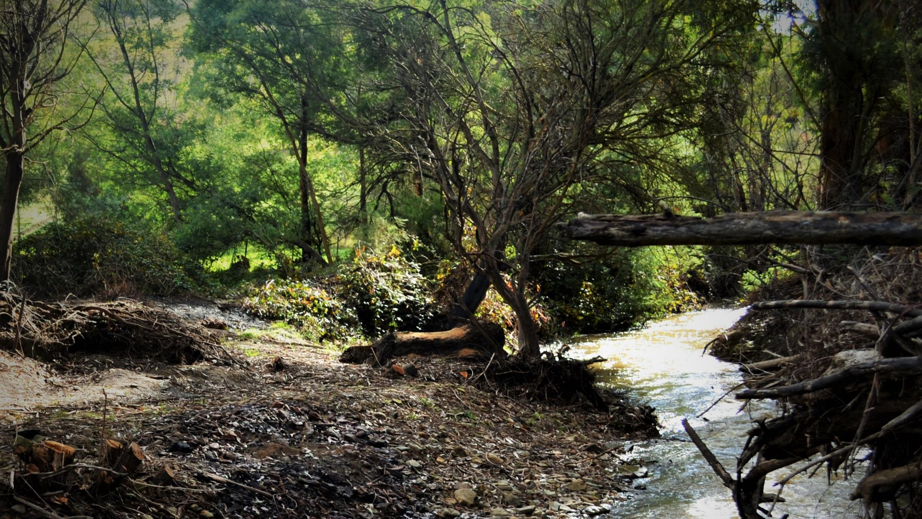
Acknowledgements
Dja Dja Wurrung, Yorta Yorta in Victoria; Erub Island in Torres Strait Islands; Wergaia in Victoria; Yolngu in Arnhem Land; Central Australia; Palm Island; Nunga in South Australia; Burarra in Northern Territory; Noonuccal in Queensland and Anangu and Yapa in Northern Territory.

Slide 3
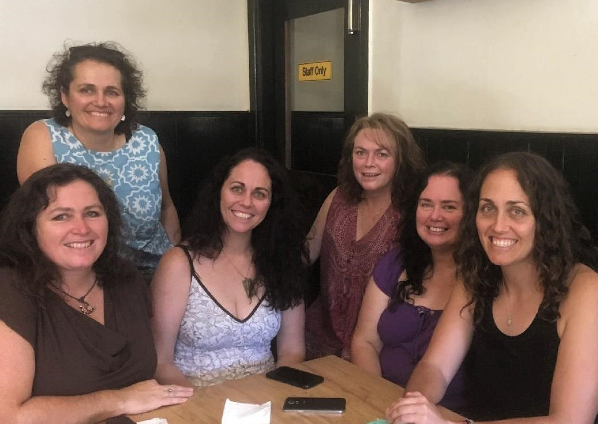
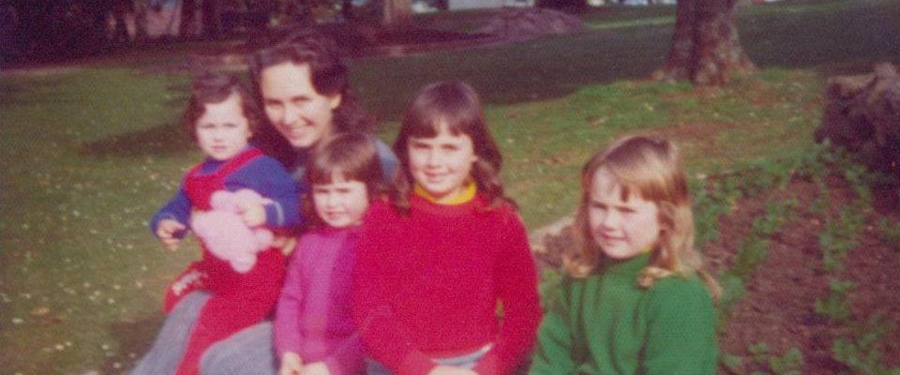
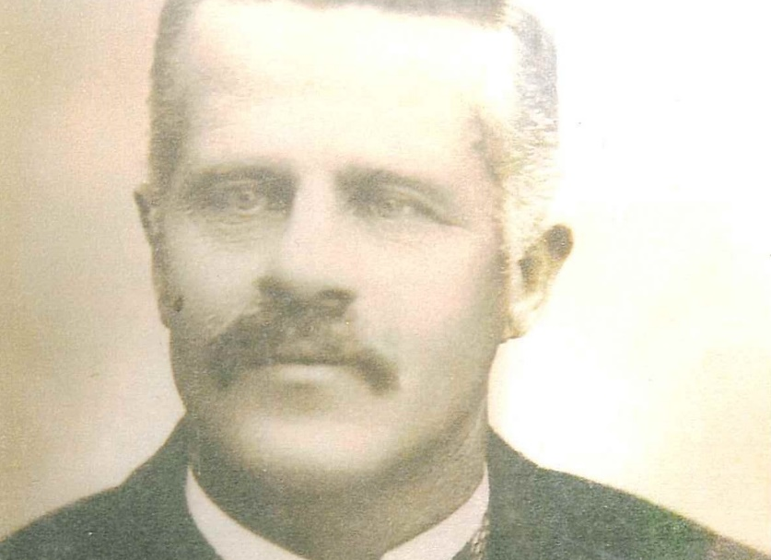
My Family

Slide 4
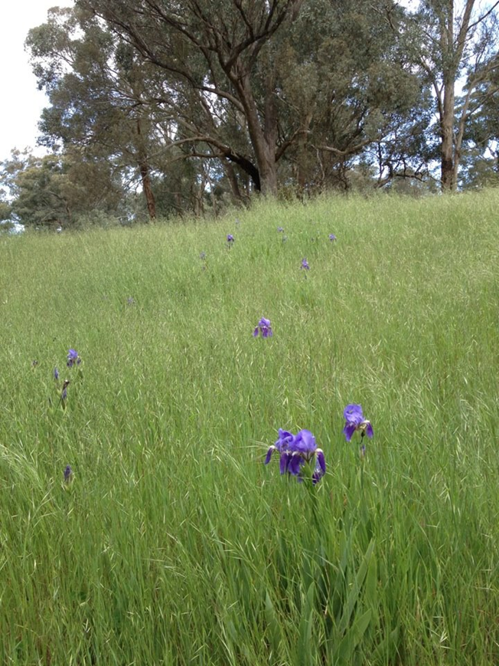
What happened to First Nations worldviews in Australia?
Aust. First Nations from their own worldviews hold intellectual sovereignty for engineering, science, agriculture, fisheries, health, astrology, mathematics, governance, wellbeing & childrearing for thousands of years.
British colonization, invasion & settlement 1788.
British doctrine of ‘terra nullius’ labelled Australia ‘nobody’s land’, ignoring existing Nations. From this doctrine First Nations worldviews, knowledges and concepts have been ignored. Labelled by current Aboriginal researchers as ‘epistemic violence’.
Aust High Court 1992 overturn terra nullius, however Australian research has not asked enough…if terra nullius is wrong, what is right?
Does Australia have a terra nullius hangover?

Slide 5
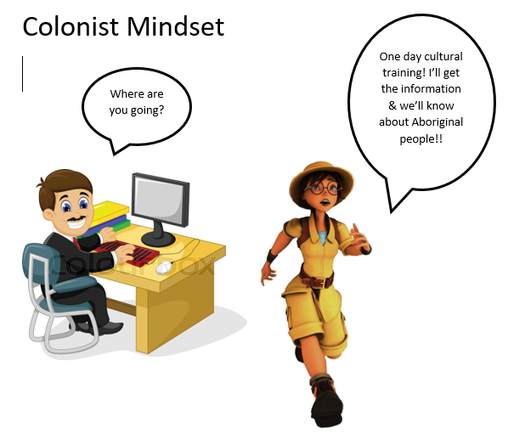

Slide 6
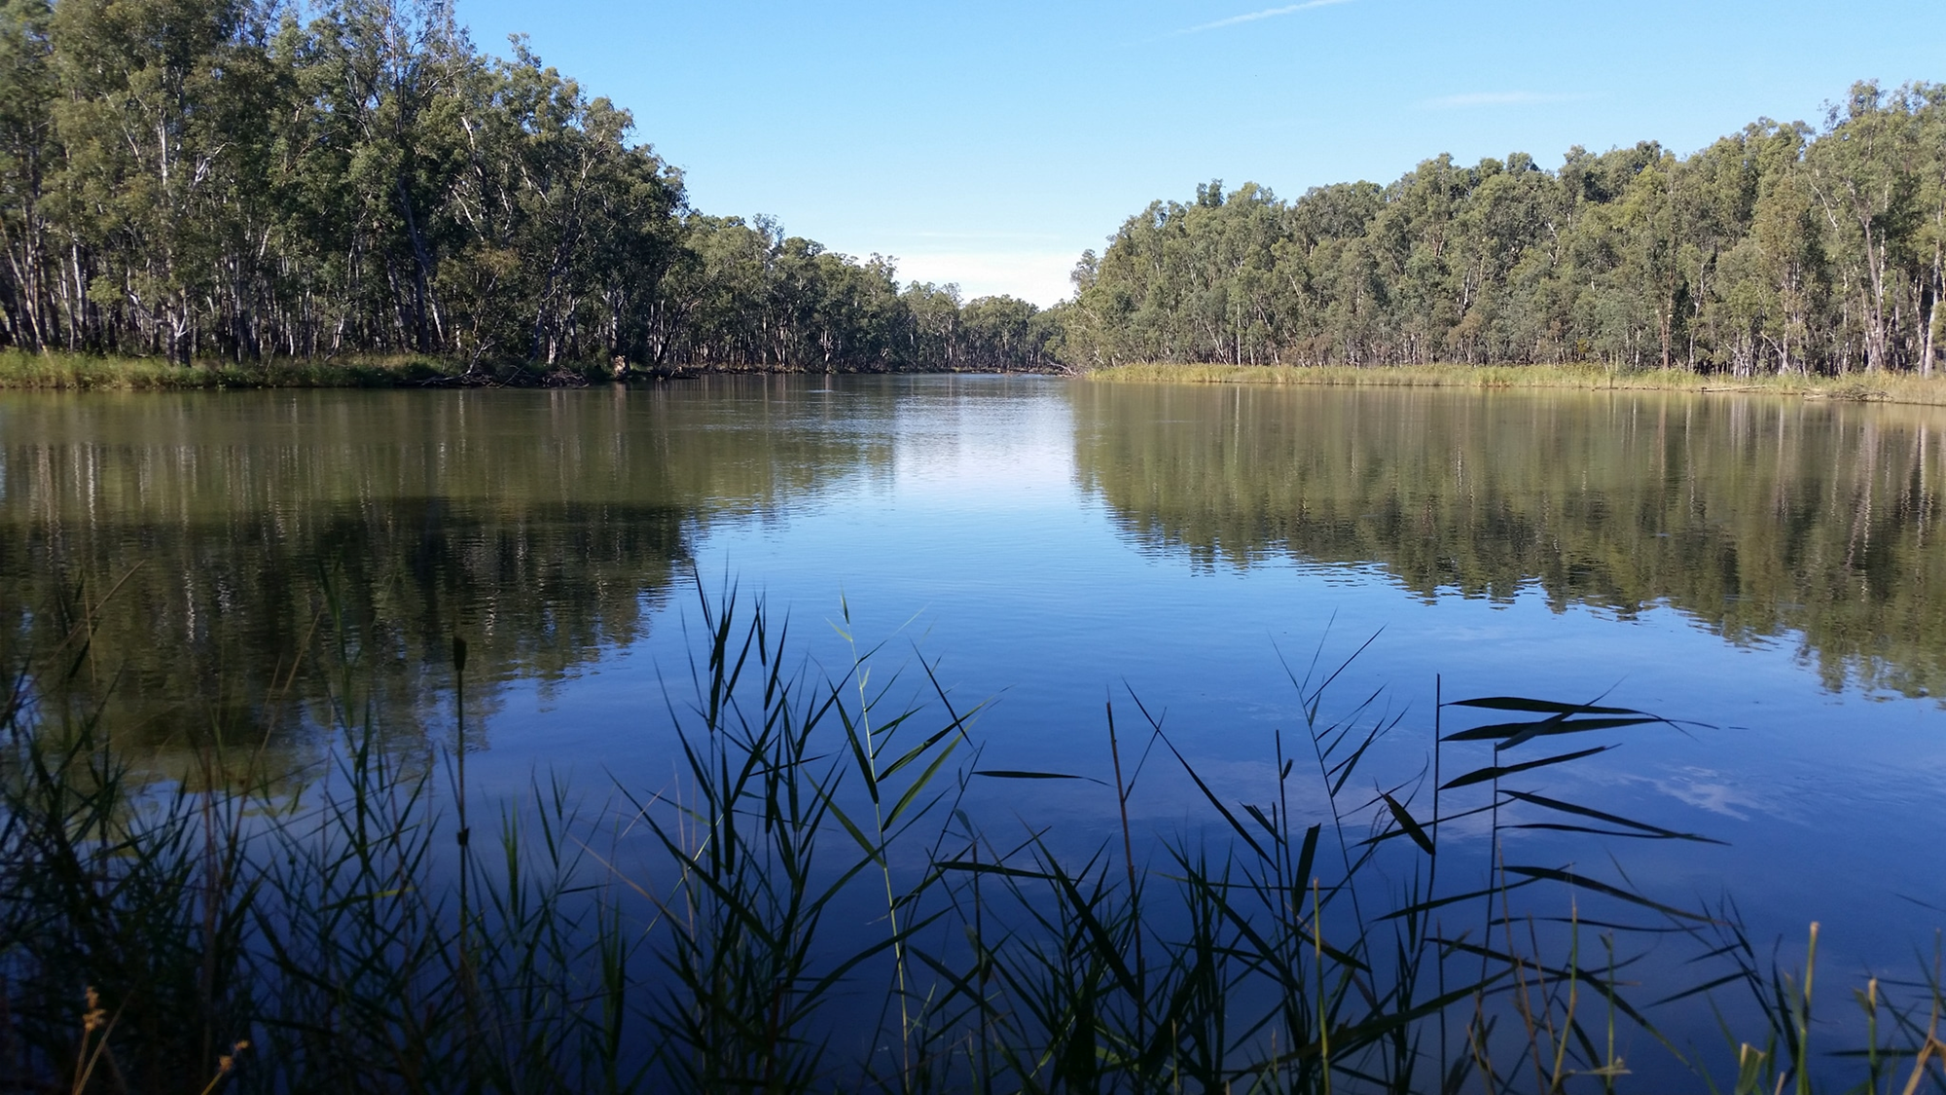
WESTERN FIRST NATIONS RELATIONAL
Ancestral knowledge
Country knowledge
Community knowledge
Human-led
Knowledge
Knowledge is learned and experienced by humans & can held by different people, different places.
Knowledge is learned, experienced & revealed. Knowledge is held by Community, Country & Ancestors.

Slide 7
Worldviews: Different ideas about reality (Scotland, 2012).
Scientific
Realism
There is knowledge to be discovered
Human researcher discovers absolute knowledge
Trees have knowledge about ‘treeness’.
Quantitative Research
Interpretive
Relativism
Human experience creates knowledge.
Reality changes from person to person.
Trees have meaning when the human mind interacts with them.
Qualitative Research
Critical
Social construction
Reality is shaped by social, political, cultural, economic, ethnic & gender.
Knowledge is constructed by power relations.
Different groups form different ideas about trees for their purpose.
Qualitative Research
Relational
First Nations
Knowledge is measured, experienced & revealed to humans.
All things are animate, equal, stakeholders in knowledge construction human & non human .
Trees hold knowledge about treeness but also many other teachings.
First Nations Relational Research

Slide 8
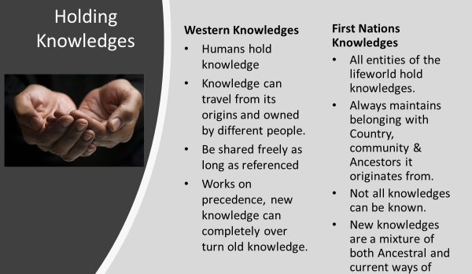
Relational worldviews
All things are animate
All entities are equal stakeholders in knowledge construction
All things are infused with spirit and in constant motion.
Relationships between all entities exist and must be maintained.
All entities human and non-human hold knowledge about the Lifeworld.
Understandings come from observing the whole to reveal cyclical patterns.
Renewal, all entities exist in a narrow gap of ideal conditions which must be maintained.
Knowledge is learnt, observed but also revealed through dreams, visions and intuition from Ancestors and relationship with Country.

Slide 9
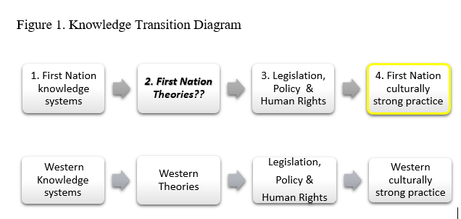
Current Situation…

Slide 10
Methodology - BANBURRA - to dig
Standpoint | First Nations Relational Research
Theoretical Framework | First Nations Emancipative Perspective Lester Irabinna-Rigney - Indigenist Research Protocols. Aileen Moreton-Robinson- Whiteness Theory, shifting the sociological lens. Martin Nakata- Locatedness, situating the study in Both Worlds.
Method | Gulpa Ngawal, deep reflective listening Bogong Moth hunting, Biyala (Red Gum) Knowledge & Garraba wait a little. Relational Discourse Analysis (RDA) of ten texts about childrearing written by First Nations Australians to reveal continuing discourses of childrearing. Minamda to ask. Interview current Indigenous leaders to weave findings & researcher perspective back into Ancestral knowledge . A First Nations process where old knowledges are used to reframe current issues.

Slide 11
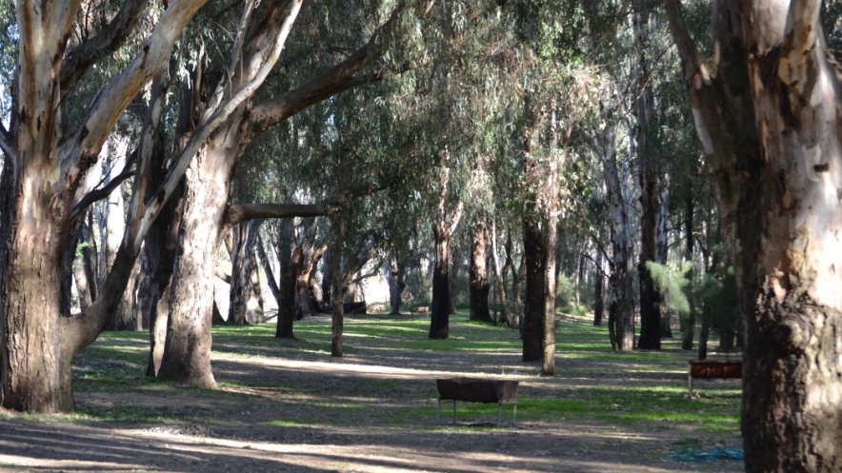
Significance of this study
First Nations Australian childrearing concepts are an alternate but equal body of knowledge to Western childhood development theories.
Terra nullius was wrong, our intellectual sovereignty is right.
This study is informed by First Nations Relational worldview. It is not outside academia, nor is it an add on to Western academia. The roots of this research grew from our continuing intellectual sovereignty.

Slide 12
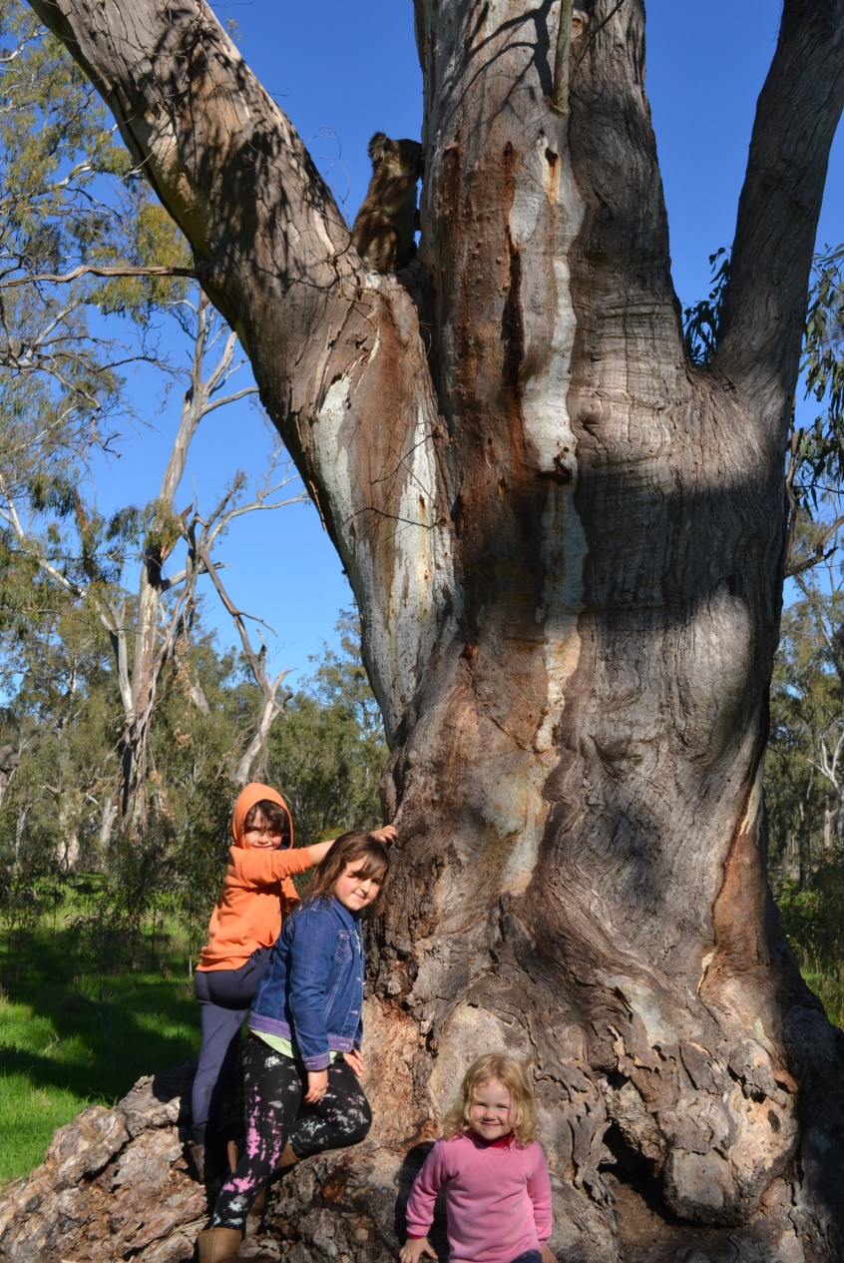
Lifespan Relatedness
Relatedness is relationship between entities, human and non human. It is grown by learning about an entity and then holding responsibility to that entity.
Children have equality with whole Lifeworld
Spirit Children come up from Country.
Babies are centre of community from birth.
Physical closeness, skin to skin.
Sounds, whistles and non verbal communication are used to develop Lifespan Relatedness.
Children have a Shared Social World.
Children taught stillness (listening).
Relational identity, both collective and individual.
Community responsibility from increasing Relatedness.
‘Naming’ used to grow Relatedness.

Slide 13
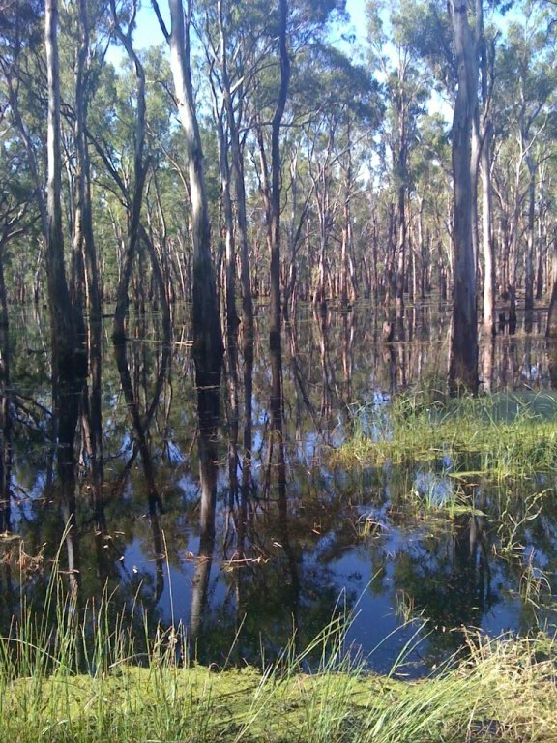
Relational Parenting
Ancestral, Country, Community and Kid Mob Parenting.
Broad definition of Family, children are ‘fitted in’.
Singing during pregnancy & childhood.
Cultural attachment with Ancestors, Country & Community
Mothers are central for about first three years for breastfeeding.
Care of children is responsive.
Children are born capable and good from Ancestral memory.
Children born compassionate.
Inappropriate behaviour is regarded as silly, temporary.
Fathers dream of Spirit child before pregnancy, story telling and fitting in all children.

Slide 14
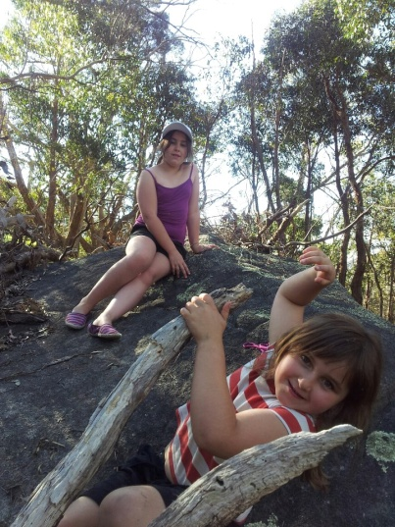
STRONG KIDS
First Nations childrearing creates resilient kids.
Children from their Ancestral knowledge and equality are capable of making their own decisions since before birth, this is termed Child Agency.
Children born with their own rhythm.
During perinatal period babies are transitioning from spirit self, need special care.
Development is child-led, not age related.
Children encouraged to regulate their own behaviour
Learning language and knowledge about ‘who is family’ is encouraged.
Behaviour modification is indirect through teasing, scaring, loaded questions, mirroring and stories. Hardiness encouraged.
Consequences are learnt not punishment dealt out.
Exploration & risk taking is encouraged for confidence, self-efficacy and increased Relatedness with their environment.
The personal attribute of ‘nurturance’ carries status in community

Slide 15
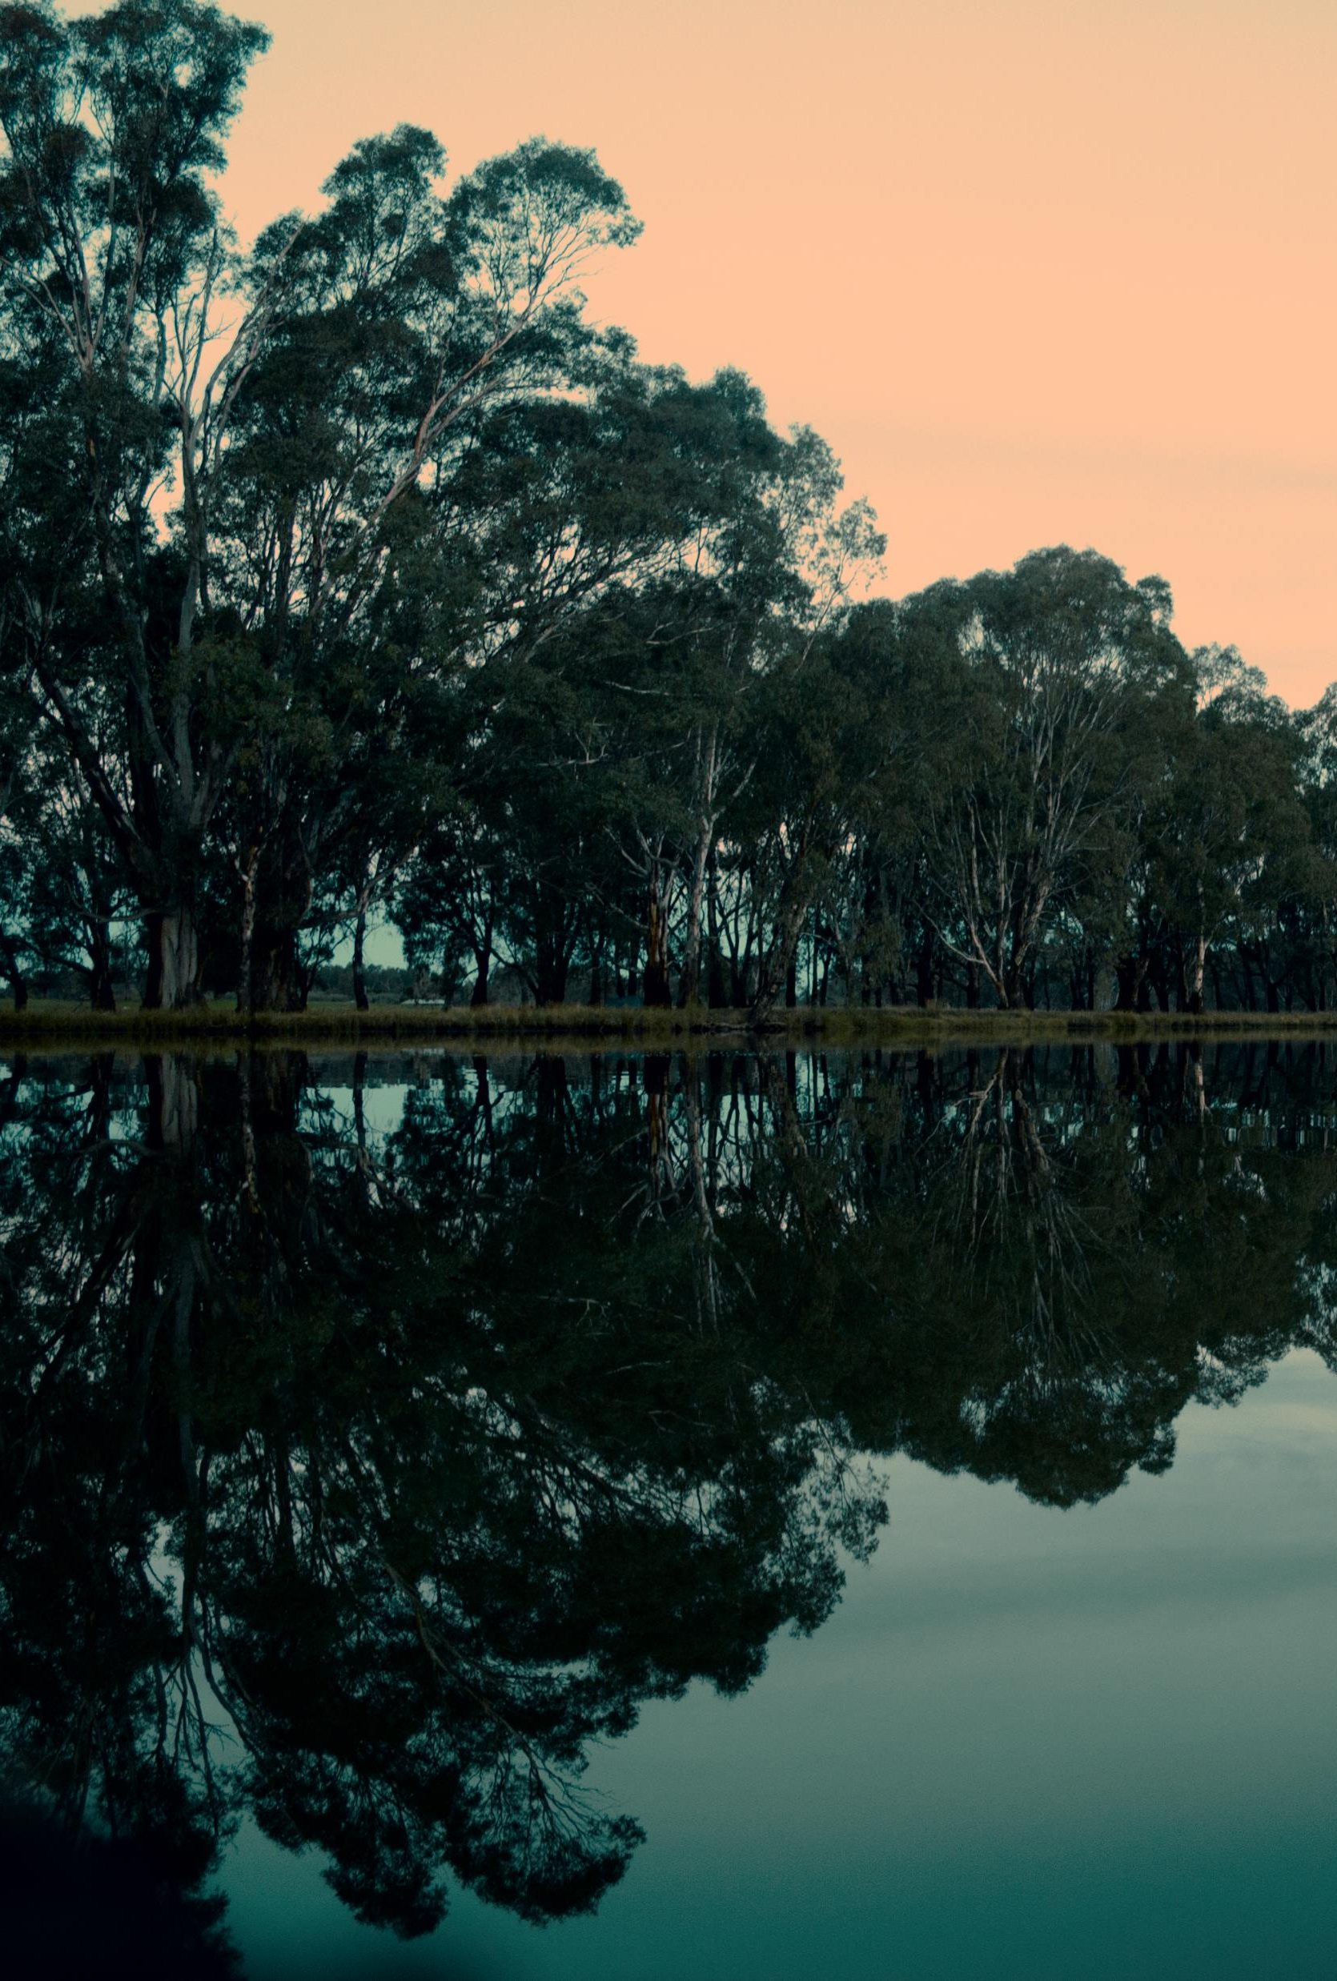
Tracks of Australian First Nations Childrearing
First Nations childrearing is Ancestral knowledge thousands of years old developed to be correct principles for childrearing.
Government policies create generational trauma for Aboriginal children, families and our Tribes.
Aust. First Nations childrearing has common principles even though we are different as well.
Western childhood development principles are very different to our principles.
Misunderstandings between Indigenous / non-Indigenous people occur a lot and cause continuing trauma.
Our communities want our childrearing integrated as equal but different to Western childhood development theories.

Slide 16
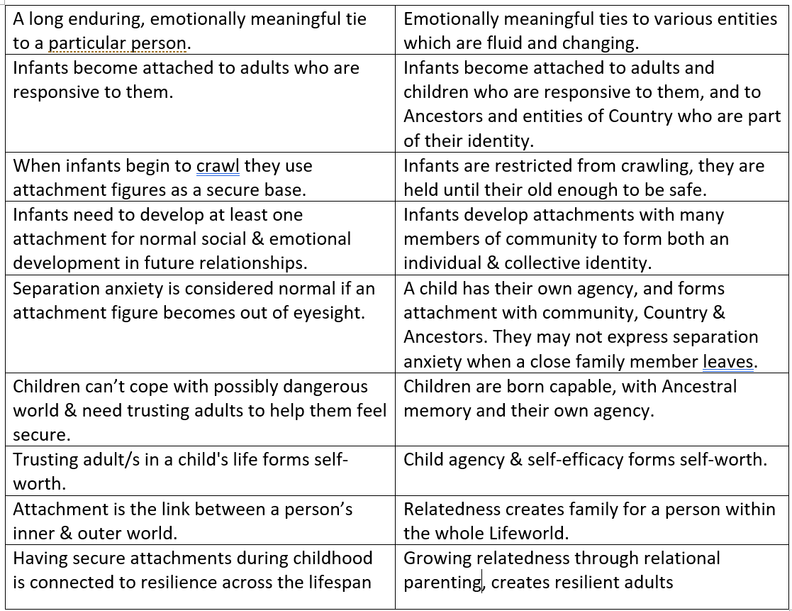
First Nations Relational Attachment

Slide 17
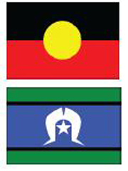
Our childrearing principles and concepts are accorded their legitimate position within Universities, as First Nations Australian concepts.
The Victorian Child, Youth and Families Act (2005) states Aboriginal principles and concepts also informs how our children are cared for and investigated.
The Seven Developmental Domains of the Best Interests model (DHS, 2013) include information about our child-rearing principles and concepts.
Documentation which is used for assessment of Aboriginal children includes language and concepts from First Nations child-rearing.
Non-Aboriginal people who work with Aboriginal children can demonstrate an understanding of Aboriginal childrearing principles so a ‘both ways’ approach informs decisions.

