Slide 1
The first women’s cricket match in Australia
#puthernameonit
7 April 1874

Slide 2
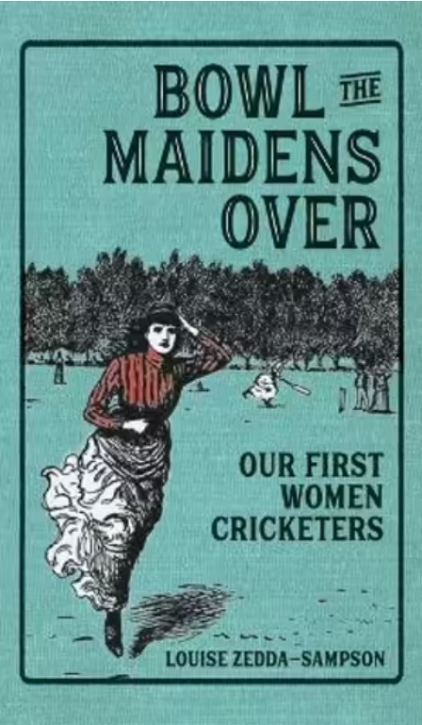

Slide 3
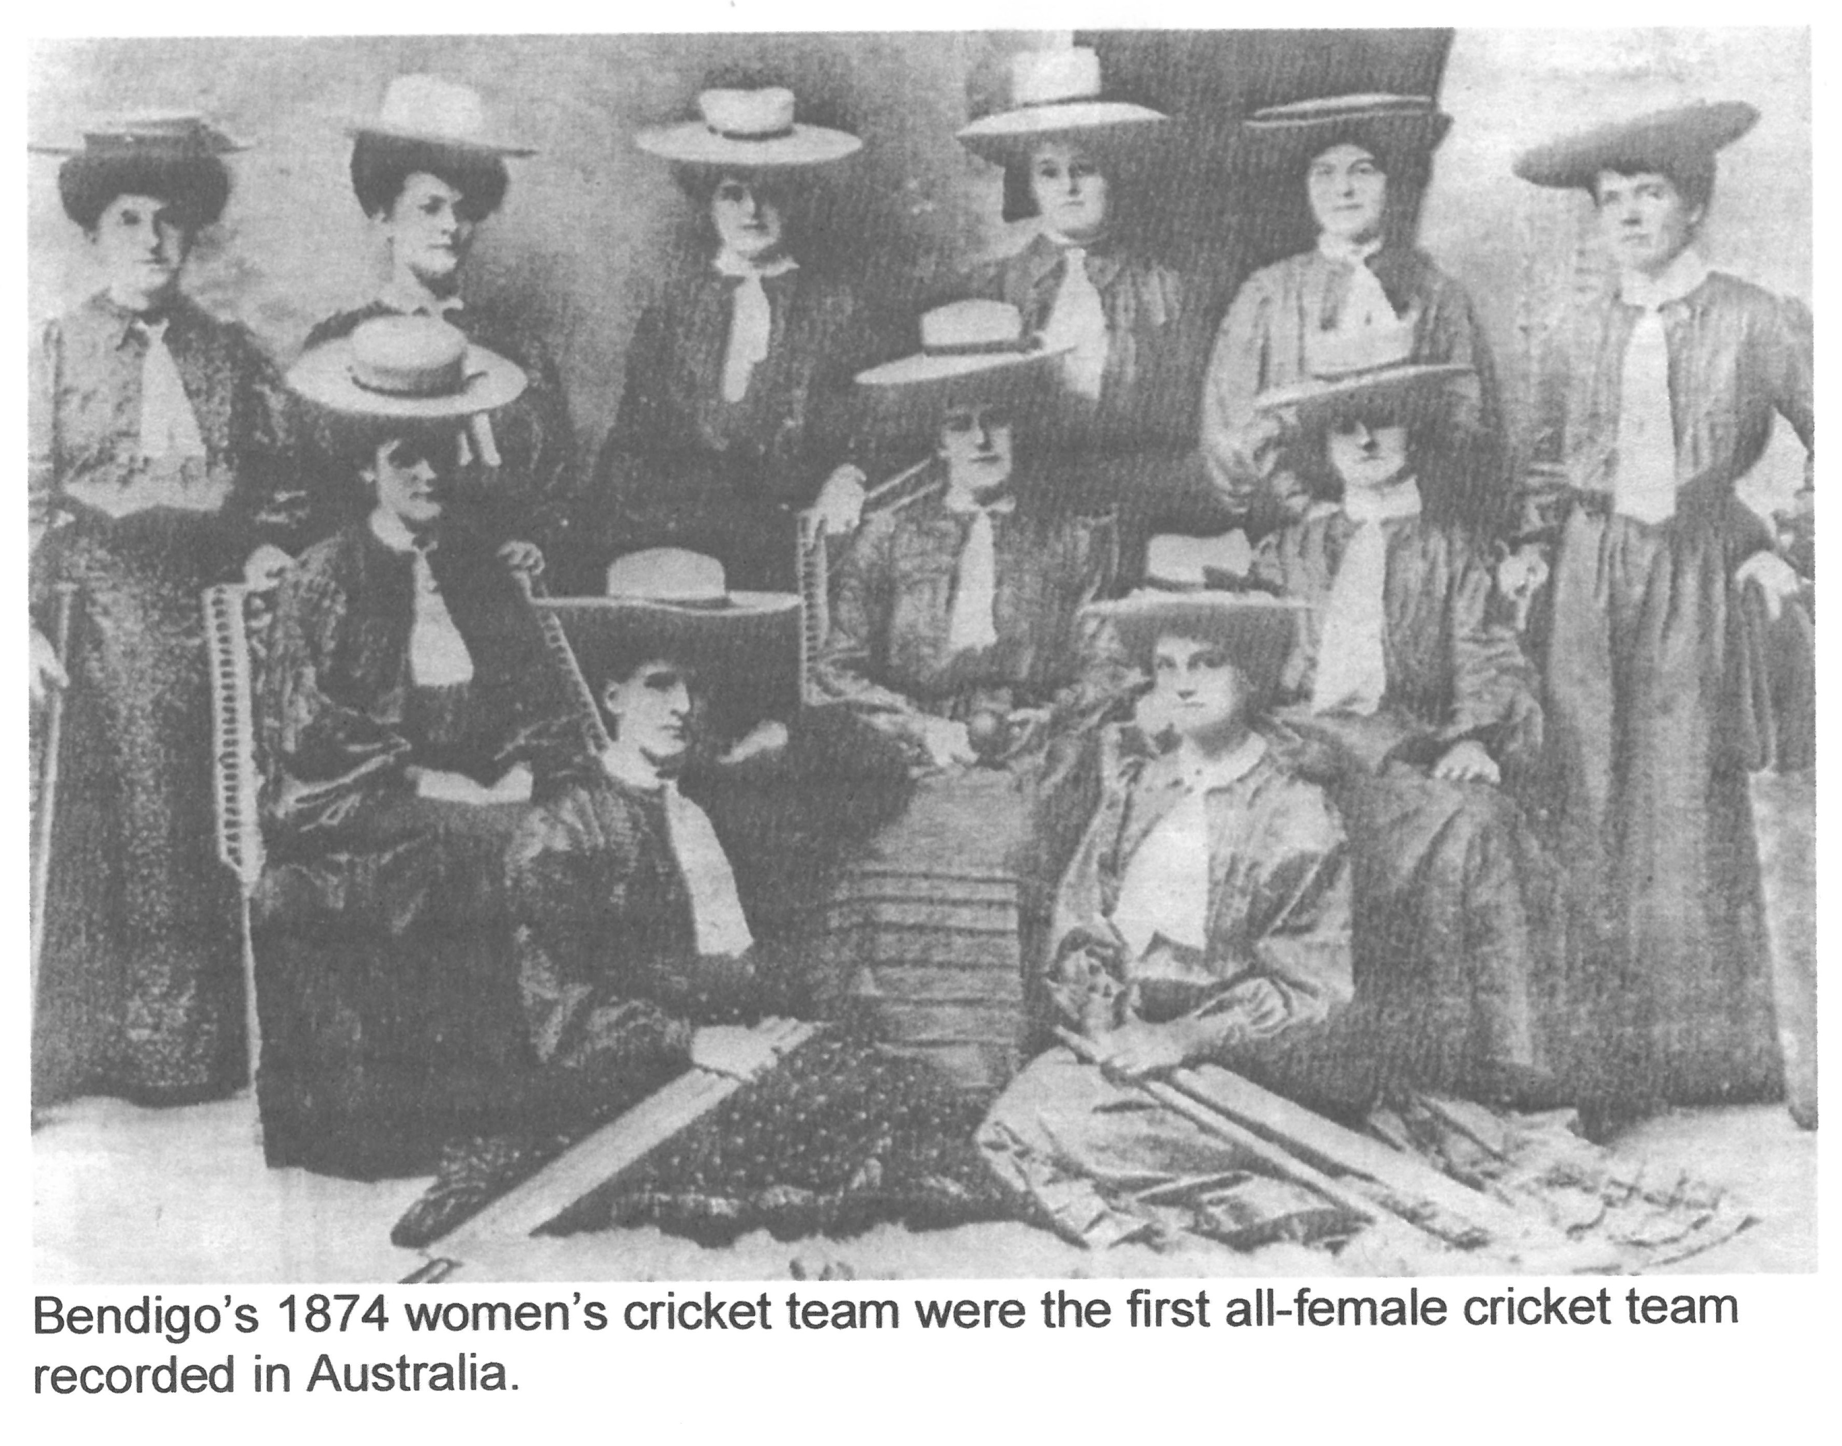
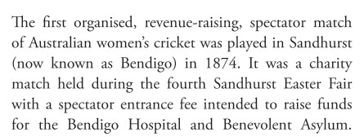

Slide 4
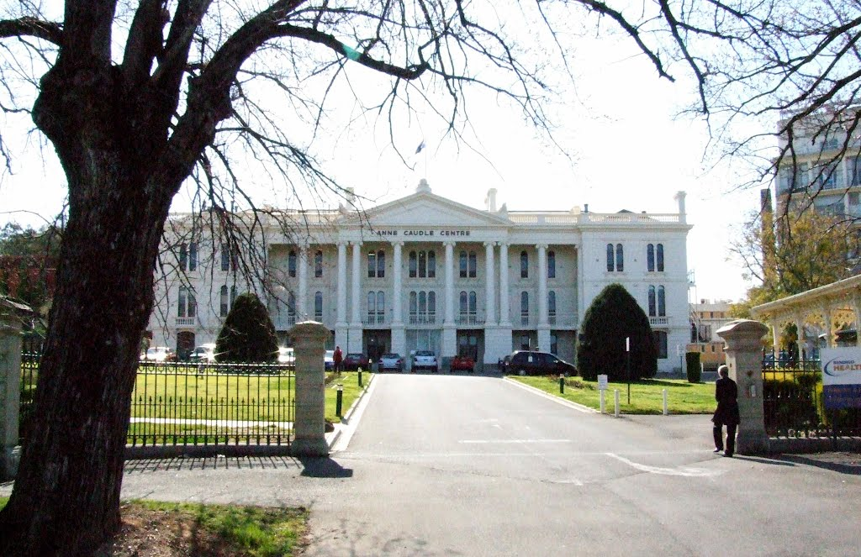

Slide 5
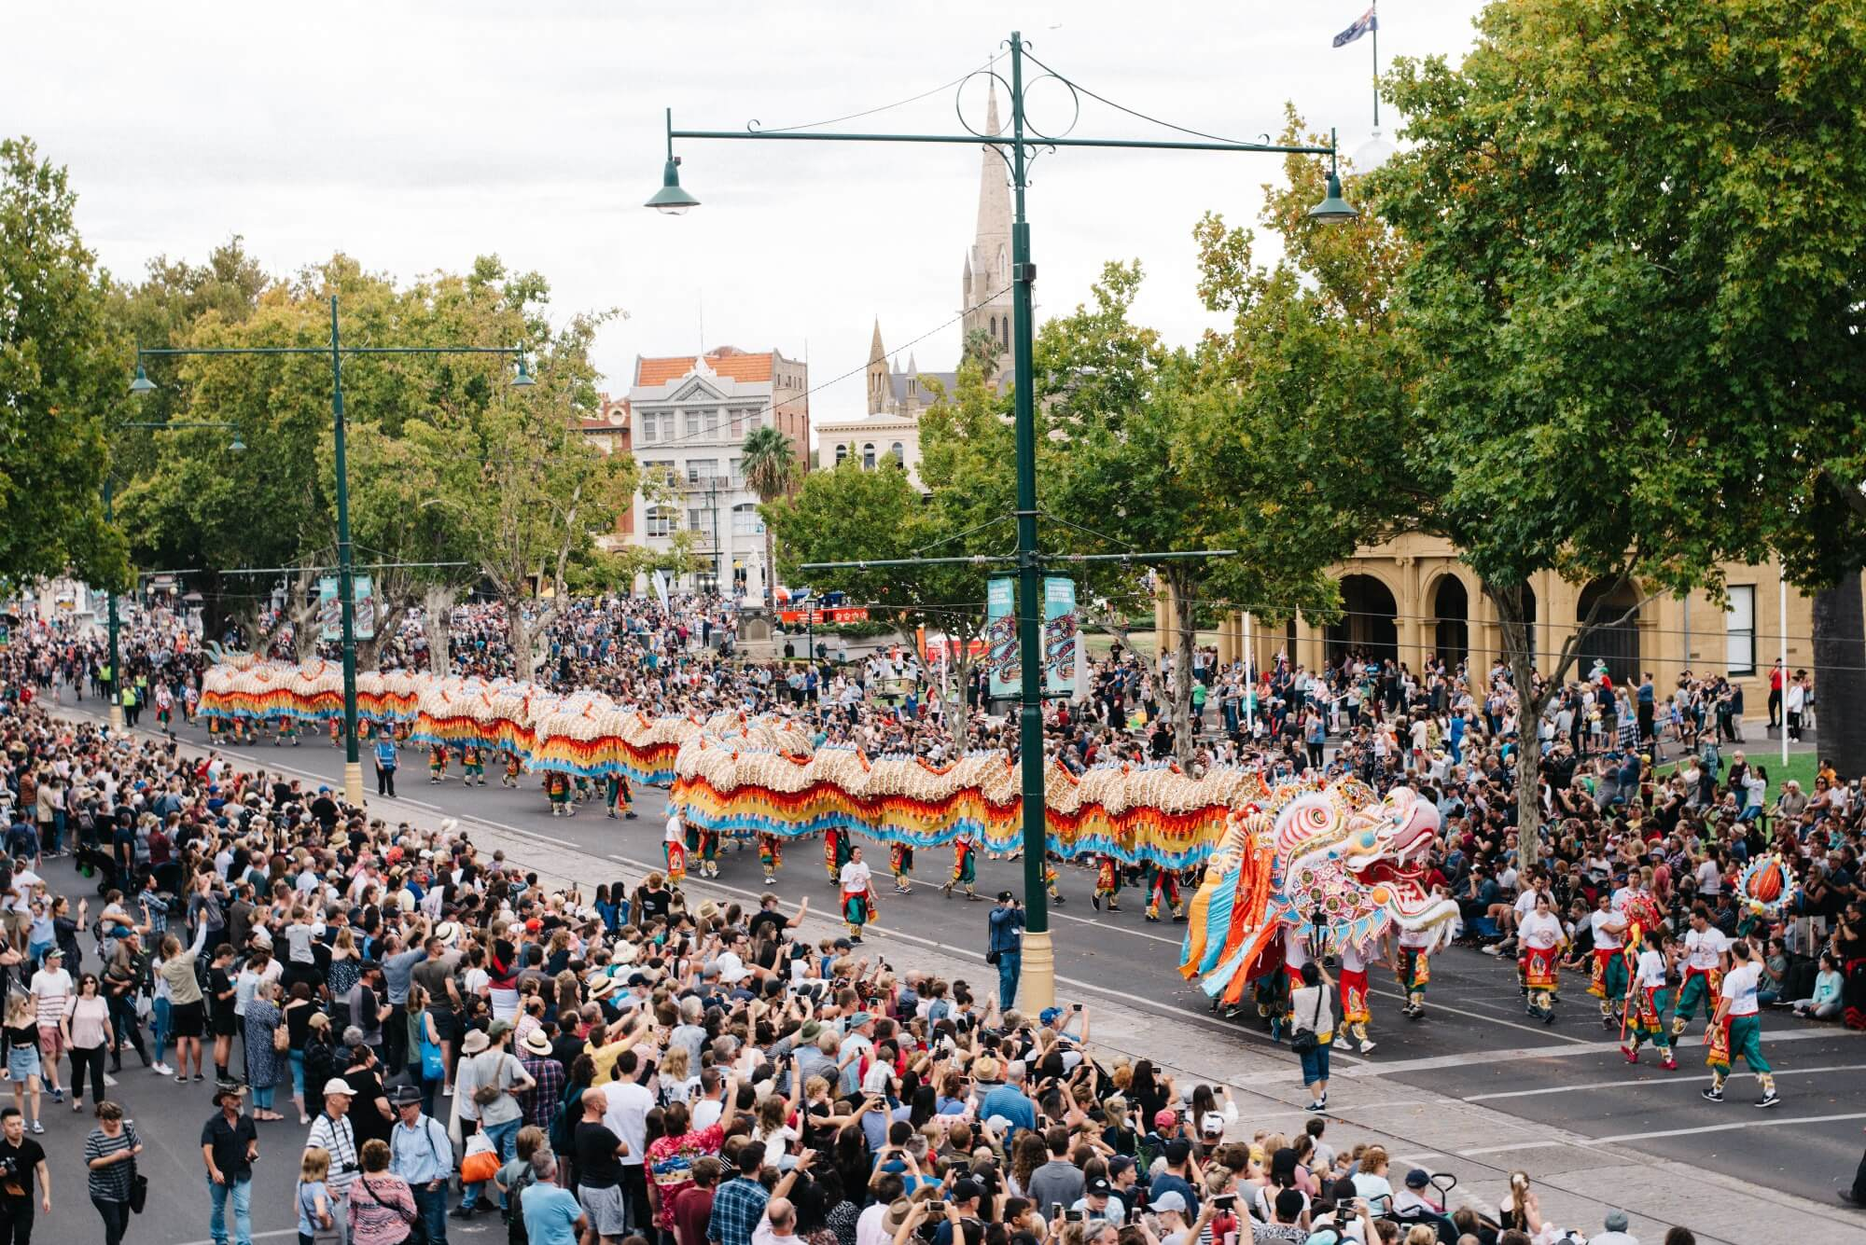
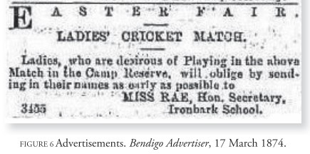

Slide 6
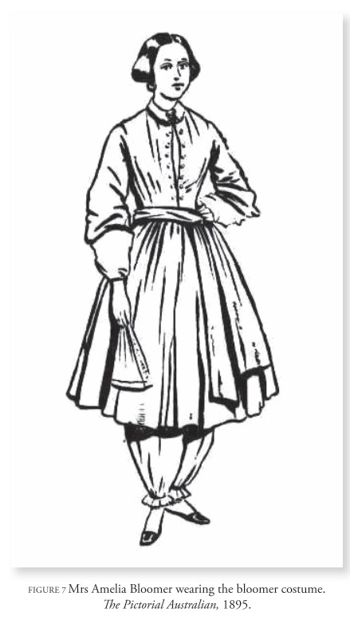
‘The suggestion that the ladies cricket team would favour the attire of wearing bloomers over the usual neck-to-toe dresses worn by ladies at all times brought society to a standstill’ Bowl the Maidens Over, pg11
LADIES’ CRICKET MATCH –
We are requested by the honorary secretary of the ladies’ cricket match to correct a mistake which has been made in regard to the costume in which they are to appear in the field. The “Bloomer costume” was never thought of. The dresses are to be…of white calico, the full length, the distinguishing bade being a Zouave jacket of pink for one side, and blue for the other.’
Bendigo Advertiser 26 March 1874.

Slide 7
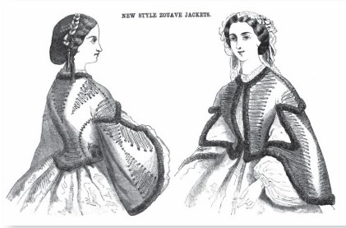

Slide 8
‘The match is altogether one of a most novel description and is, as we believe, the first of the kind ever played in Australia. That it will attract a great crowd to witness is pretty certain. The ladies have been practising hard, and will astonish the spectators by the skill with which they wield the bat. Their fielding, too, will be certain to call forth admiration.’
Morning of the match, Bendigo Advertiser, 7 April 1874

Slide 9
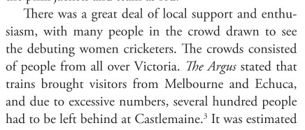
‘At one o’clock the ladies, in full costume, arrived in three carriages…Their appearance was very pretty and picturesque and they were loudly applauded by the onlookers.’

Slide 10
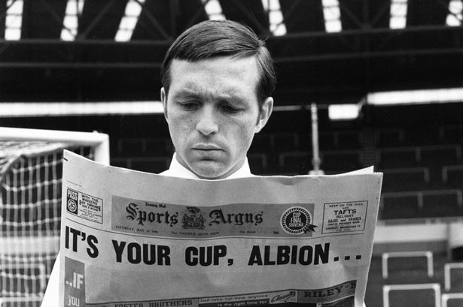
‘Women’s cricket results appeared in The Argus under the heading “Cricket”. It was completely unheard of to have women’s sporting results appear in such a publication, let alone appear next to the men’s results.’
Bowl the Maidens Over, pg25

Slide 11
‘It certainly required a very considerable amount of courage on the part of the ladies to undertake to play a cricket match in public. The thing was unprecedented as far as Australia was concerned…
The cause in which they were engaged however overcame all scruples and they came nobly forward to aid the destitute and the suffering.’
Bendigo Advertiser, 8 April 1874

Slide 12
‘Indeed the exhibition they made in the field yesterday would go to lead to the belief that the game of cricket is completely compassable by the female form, and very possibly by the female intellect.’
Bendigo Advertiser, 1 April 1875

Slide 13
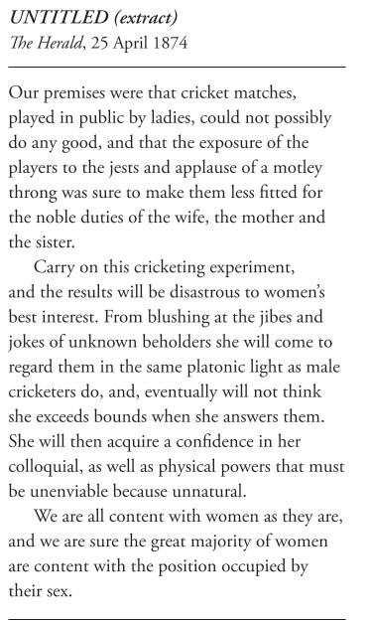
‘This unfeminine trial of masculine skill at Sandhurst, in which frisky matrons took part with forward spinsters, was engaged as – we are told in the cause of “heaven-born” charity. Nothing else could extort money from the pockets of the male public, but this unwomanly exhibition on a public holiday.’
The Maryborough and Dunnolly Advertiser 13 April 1874
‘Let our women keep their own places in our homes in this day of growing disregard…’
The Herald 11 April 1874

Slide 14
#puthernameonit in 2024
Finding Her Walking Tour
150th Anniversary Match Re-creation

