Slide 1
EMCH Workshop 15/8/2023
How to make CDIS reflect our work with families in the Enhanced MCH Program

Slide 2
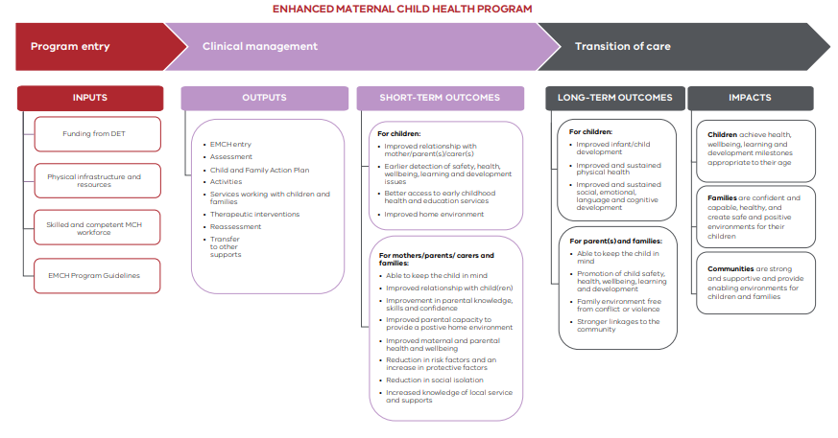

Slide 3
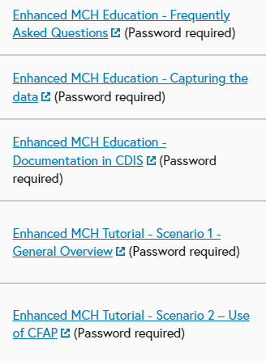
Resources
MAV MCH Resource page EMCH Education vimeos by Maria McKinnon (password cdis)
https://www.mav.asn.au/what-we-do/policy-advocacy/social-community/children-youth-family/maternal-and-child-health-children-0-6-years/maternal-and-child-health-resources#top
https://www.health.vic.gov.au/publications/enhanced-maternal-and-child-health-program-guidelines

Slide 4
Referral process refresh
Internal referral to EMCH integrated program on CDIS
External referrals need to be added to the internal program
Requires minimum of 2 EMCH criteria
Bypass function for referral not encouraged as does not count as referral.
Select CG as the lead client
Add family members as required
Assess referral – does it meet EMCH guidelines?
Accept and allocate referral.
EMCH referral flags have been decommissioned as a part of the flag review by the CDIS reference group

Slide 5
Recording of EMCH Consultation

Slide 6
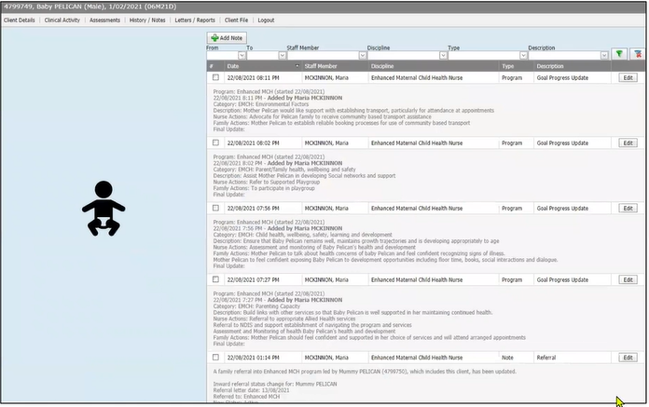
Documentation of EMCH referral, goals in both PCG and family members histories.
1

Slide 7
Actions & Interventions – select minimum of one, documented in all notes.

Slide 8
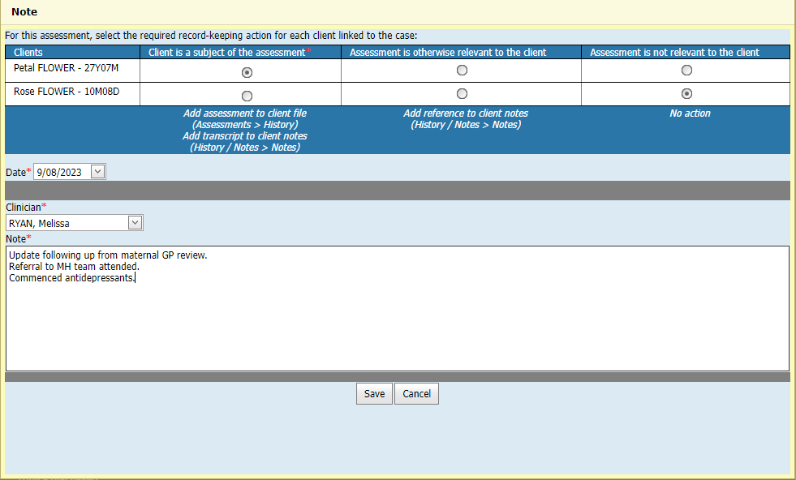
Assessments – documented in relevant histories
3
All assessment screens and tools can be accessed from within the lead client consultation.
Select the family members who the assessment is relevant to this will then record the notes in the appropriate hx.

Slide 9
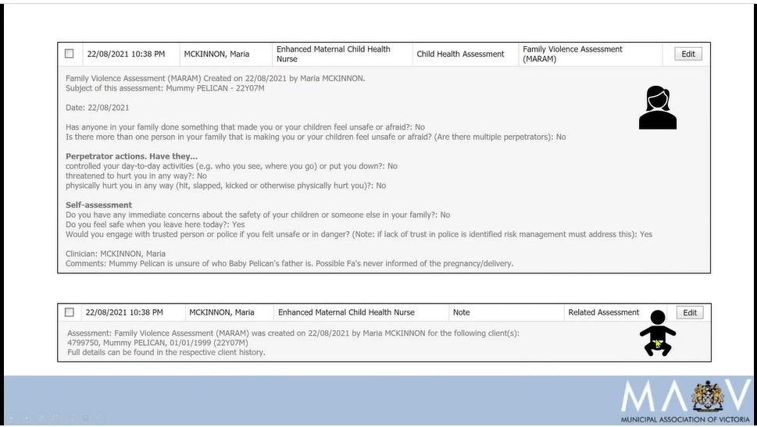
Example – MARAM assessment

Slide 10
Referrals – recorded in Lead caregiver history
4

Slide 11
Documentation of notes recorded in all relevant histories
5

Slide 12
Child & Family Action Plan
Goals and Outcomes should address issues related to the four areas:
Infant/child development, wellbeing, safety, learning and development
Parenting capacity
Parent/family health, wellbeing and safety
Environmental factors
These are aligned with the EMCH guidelines, outcomes and identified risk and protective factors

Slide 13
Child & Family Action Plans (CFAP) Tips
Review at a minimum of 10hrs of service
Flexible with hours required by families – some families will need less hours and some may need extend hours with new the birth of new babies.
Long-term cases need review of CFAP every 10hrs to meet outcomes and assess need for EMCH support.
No need to close a case at 20 or 22.67hrs.
Actively involve the family with the CFAP using family centered practice principles.
Add or review goals at any interaction with family as identified by family and practitioner.
Following CFAP examples found https://vimeo.com/609703440

Slide 14
Documentation in CDIS
Documentation
Communication
Medical Record
Legal Document
CDIS is a secure cloud-based program that stores medical records as per Health Records Act 2001 Victoria.
Pre-filled Field/Heading Templates can be used as a guide however pre-filled notes are not encouraged due to risk of documentation errors such as incorrect name, sex, incorrect data entered. This questions the reliability of the Medical Record.
Notes:
Documentation is important as its our means of communication, it’s a medical record and a legal document.

Slide 15
Heading Templates for notes
Observations & Discussion:
Environment/Presentation:
Parent Child Interaction:
Review of previous issues/advice/referrals:
MATERNAL WELLBEING:
Family wellbeing:
Child
Presentation:
Nutrition:
Sleep:
(Growth, physical assessment, developmental assessment refer to child’s notes/consult)
Current concerns:
Health and Education and Recommendations (additional discussion after tick boxes completed)
Discussions: see ticked boxes for topics discussed.
Anticipatory guidance as per MCH guidelines.
Further Discussions:
Management Plan
PLAN:
Next review:

Slide 16
Documenting baby/child’s physical assessments

Slide 17
Recording of EMCH time
Consultation (Enhanced only)
Client Not Present
Telephone consult
Referral time
Email correspondence
Case conference
Clinical supervision
Retrospective Admin set up time (data adjustment)
Group (data adjustment)
Tip: We tend to underestimate our time especially the indirect time we spend supporting families

Slide 18
How to capture “client not home” time
Notes:
Here are a few scenarios that we thought we would mention to ensure correct data collection for EMCH.
Always remember to click program when using Client not Present feature in CDIS so that the time is reflected in EMCH time.

Slide 19
How to capture “clinical supervision” specific to the client
Notes:
This could also be when you seek a secondary consult from your team leader or colleague on a case.

Slide 20
How to capture initial administration case setup time if accepted into EMCH program.

Slide 21
For further CDIS support
Please contact your MCH Leadership and CDIS champion with questions in the first instance.
Look at the resources on the MAV MCH resource page (slide 3)
Remember the EMCH MS Teams site for engaging with other services and benchmarking sharing resources.
Happy for you to reach out and email me for any further support with CDIS.
Also, if enough interest we can host an online drop-in session for EMCH & CDIS.
CDIS workshops at your LGA is also a possibility.
Please email mryan@mav.asn.au

Slide 22
Resources for further professional development
https://www.menthaconsulting.com.au/events/motivational-interviewing-foundation-skills
https://www.thermh.org.au/news/events/mhtdu-motivational-interviewing-4-5-sep-2023

Slide 23
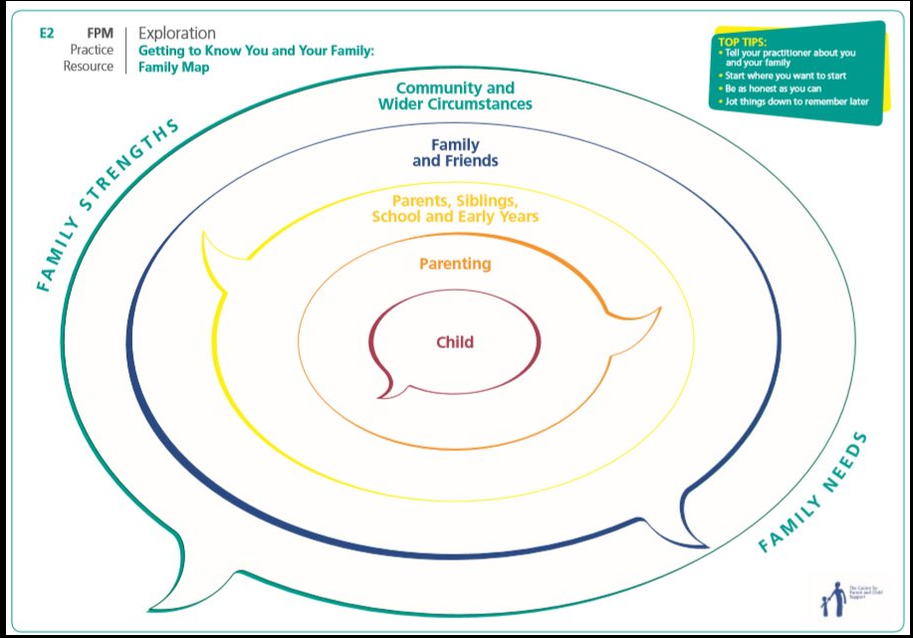
Resources for further professional development
Working in partnership course is an introduction to Family Partnership model
November 2023 option
https://www.rch.org.au/ccch/training-dev/Working_in_partnership/
https://www.rch.org.au/ccch/training-dev/Family_partnership_training/##communityofpractice
https://www.facebook.com/groups/2078927572416418/permalink/3052947525014413
Centre for Community Child Health have upcoming courses available.

Slide 24
Resources for further professional development
Notes:
No current training available for Bridges out of Poverty but is the book is a good read if you can get hold of one.

