Slide 1


CDIS Leadership Session:
Reflecting on annual reporting
Helen Lees & Melissa Ryan
Thursday 19th September 2024

Slide 2


Agenda
MCH/DH Annual Report Mapping Document
KAS Report Mapping
Questions
03
Notes:
We have based this on feedback from annual reporting and requests for the mapping document to be updated and explored.
You should have all received a draft copy of the documents
Please have documents available as we work through this session together.
Might also be helpful to have a copy of your annual report and KAS report available.

Slide 3
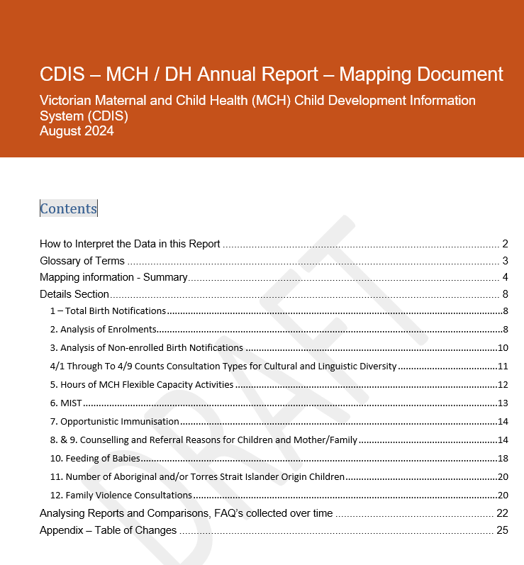
MCH/DH Annual
Report Mapping Document
Note: This document is still under review and will have further updates to ensure it is correct.
04
Notes:
You should have all received a draft copy of the documents
We will explore each section today and take questions at that time.

Slide 4
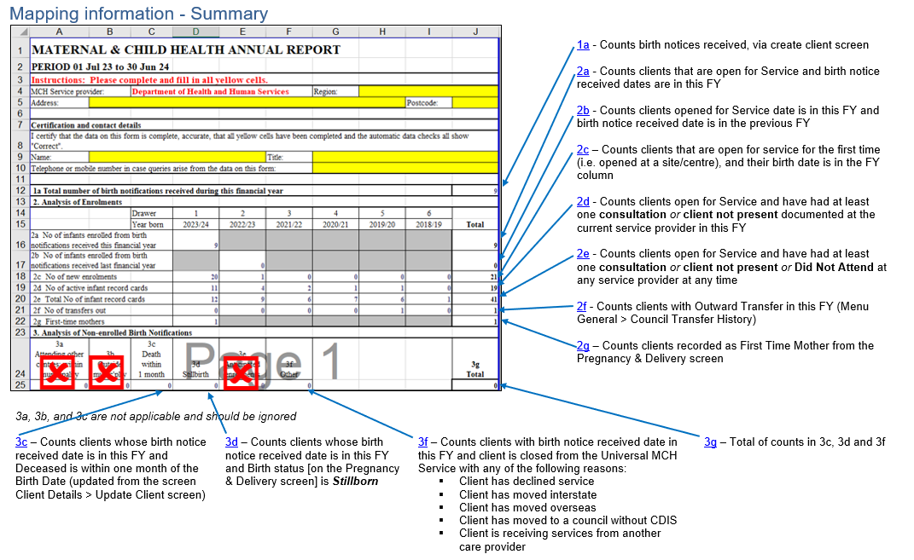
Section 1 – 3 Birth Notices & Enrolments
05
Notes:
Helen and Ann speak to the history of this document
1a – Total Number of birth notifications received during this financial year
Counts birth notices received within the reporting period.
To be counted, clients must be created via the Create Client screen. This is accessed from the Search or Advanced Search screens, after ensuring the client record doesn’t already exist. NB: If clients are created via the add contact screen (accessed within the Client record during the creation, clicking the green plus button under Create Relationships), they are not counted.
2. Analysis of Enrolments
Figures in Section 2 are broken down by date of birth counting children by Drawer. See Glossary of Terms.
Section 2 of this report provides information based on the financial year of the child's birth up to 6 years of age.
2b will always be zero

Slide 5
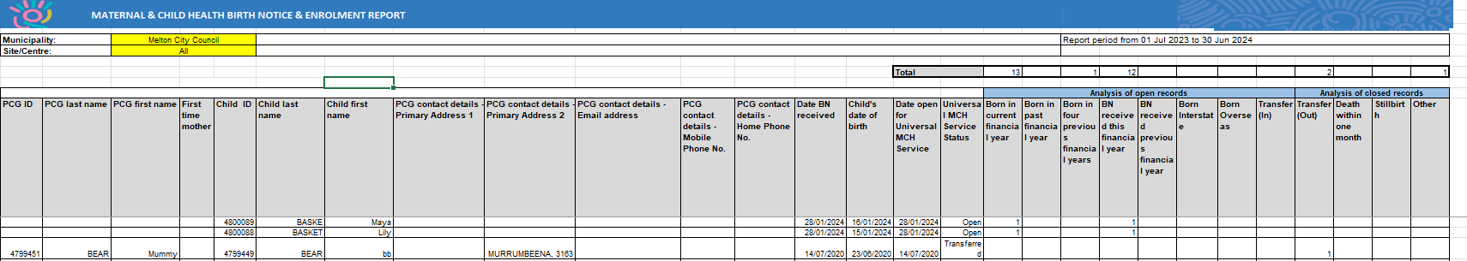
Birth Notice and Enrolment Report
06
Notes:
The Birth Notice and Enrolment report is a good way to check your data in annual report.
Can clarify:
BN received and site
Transfers in and out
Missing BN
open to service
Additional discrepancies

Slide 6
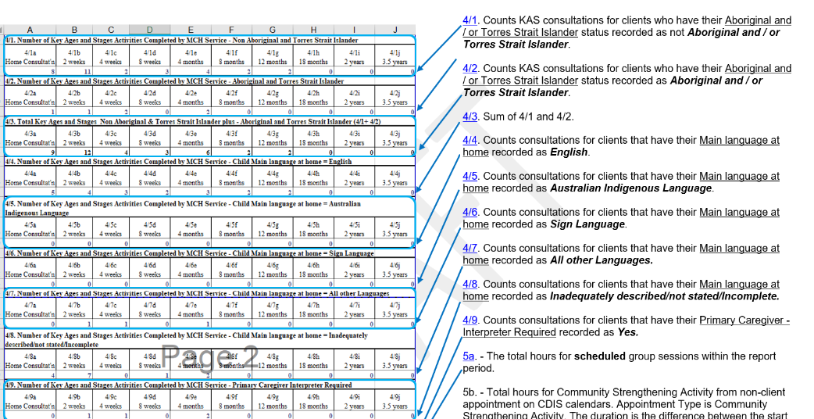
Section 4 Consultations for CALD families
07
Notes:
Counts all clients whether open or closed for service, with completed KAS consultations, by their recorded “Service Date” within the reporting period, where “Consultation Type” is recorded on the Child Health Assessment screen, and for respective cultural and linguistic information, where it is recorded for clients in the Client Details > Update Client screen, in the section ‘Other Details’. See image 8 – next slide
Self explanatory – any questions on this section

Slide 7
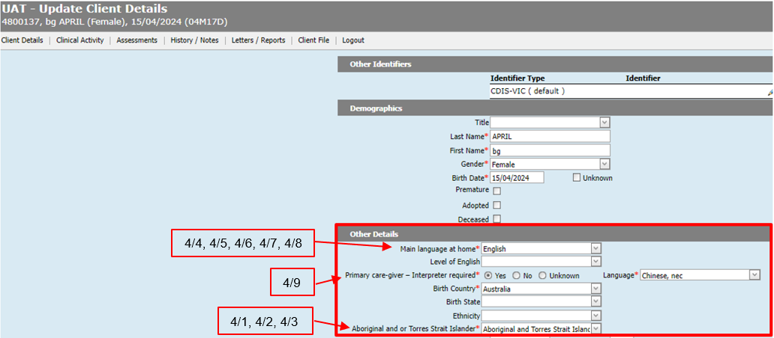
Section 4
08

Slide 8

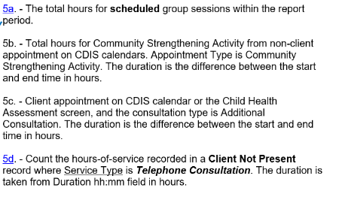
Section 5 Flexible Capacity Activities (HOURS)
09
Notes:
Note this is all in hours
5A - The total hours for scheduled group sessions in the report period; does not include cancelled group sessions.
Hours is the number of minutes between the session start and end time, converted to decimal hours (e.g. from 15:00 to 15:15 is 0.25 hours).
The duration of each Group Session in hours (Schedule > Groups > Group Templates, Expand the group using + and this counts the sessions scheduled. new sessions, click Save). See images 10 and 11.
This does NOT record attendance. It is purely the hours scheduled, in the chosen site/centre when the group sessions are created and saved. This is prior to any facilitator, or clients being added.
5D - Count the hours-of-service recorded in a Client Not Present record where Service Type is Telephone Consultation

Slide 9
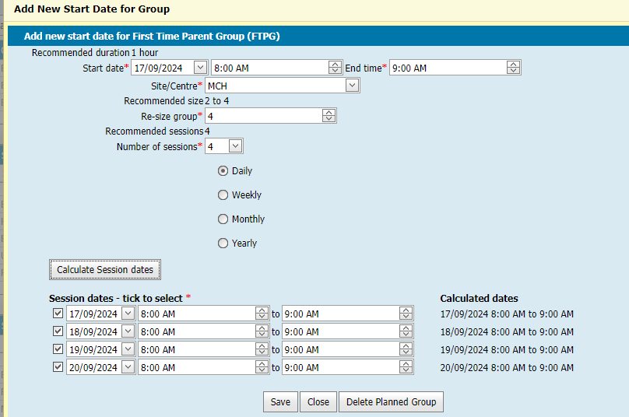
Section 5
10
Notes:
.
Hours is the number of minutes between the session start and end time, converted to decimal hours (e.g. from 15:00 to 15:15 is 0.25 hours).
The duration of each Group Session in hours (Schedule > Groups > Group Templates, Expand the group using + and this counts the sessions scheduled. new sessions, click Save). See images 10 and 11.
This does NOT record attendance. It is purely the hours scheduled, in the chosen site/centre when the group sessions are created and saved. This is prior to any facilitator, or clients being added.

Slide 10

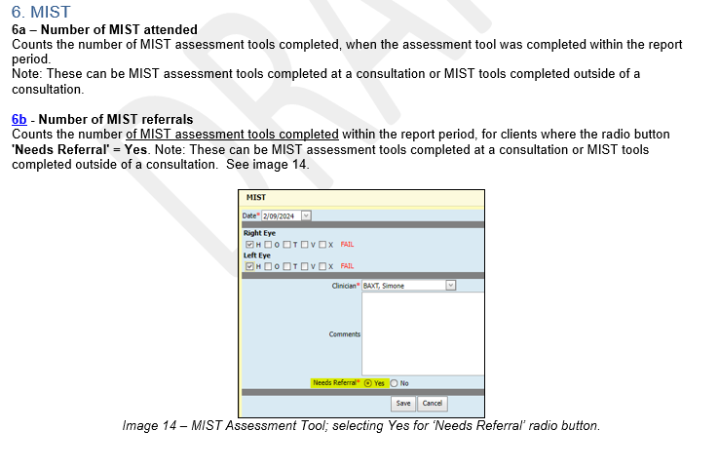
Section 6 MIST
11
Notes:
Provides data on MIST - These can be MIST assessment tools completed at a consultation or MIST tools completed outside of a consultation.

Slide 11
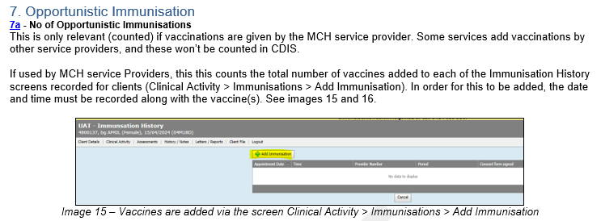
Section 7 Opportunistic Immunisation
12

Slide 12
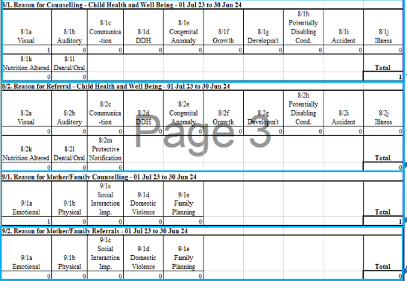
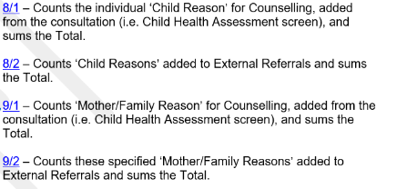
Section 8 & 9 Counselling and Referrals
13
Notes:
Encourage teams to record this when counselling outside of the prescribed health promotion activities of KAS and with a referral.
Note: the Protective Notification as this should reflect any reports made to CP by your teams. Ie external referral.

Slide 13

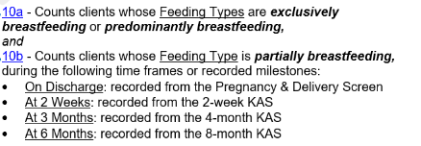
Section 10 Feeding of babies
14
Notes:
The data is recoded at the site where the KAS is recorded, not the site that the client is open for service.

Slide 14
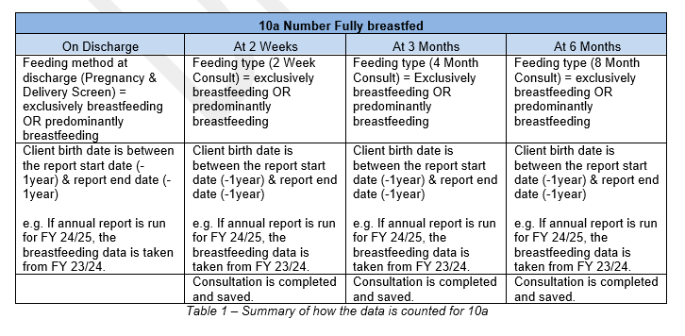
Section 10
15
Notes:
10a – Counts clients whose birth dates are in the previous year report period, when either Feeding Types of exclusively breastfeeding or predominantly breastfeeding is recorded:
10b - Counts clients whose birth dates are in the previous year report period, when Feeding Type of partially breastfeeding is recorded:
See snip in document

Slide 15
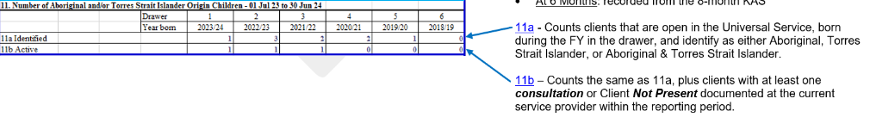
Section 11 Open and Identified Aboriginal & Torres Strait Islander families
16
Notes:
Counts Identified and active clients who are open to universal service identifying as Aboriginal or Torres Strait Islander

Slide 16
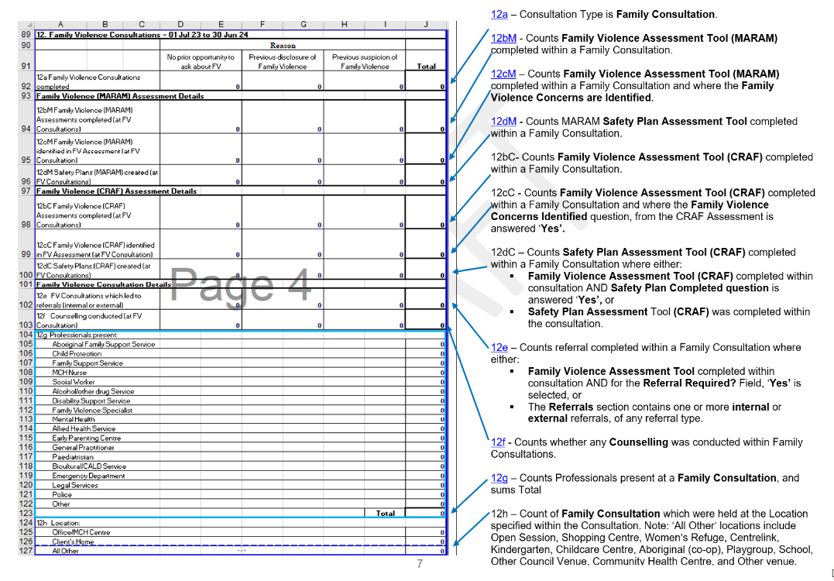
Section 12 Family Violence Consults
17
Notes:
The recommendation is the Family Consultation be completed in the Caregiver’s record, who is disclosing any family violence.
The recommendation for MARAM Assesment tools (Family violence, and Safety Plan), is these can be completed in a child’s KAS Consultation (i.e. Child Health Assessment screen), and any sensitive detailed information should be saved within the appropriate record.
This section counts all data regardless of whether the consultation is completed for the PCG or the child.
Might need to walk through the document details section on this one.
Then tea break???

Slide 17
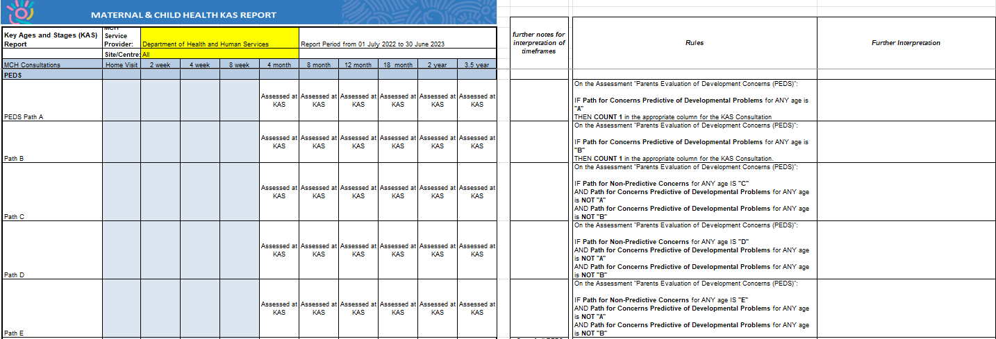
MCH KAS Report
18
Notes:
Reports on the prescribed assessments within the KAS.
We are aware this is not complete as an assessments is attended at a non prescribed KAS or additional KAS.
Important to know that the data is stored in CDIS though.

Slide 18
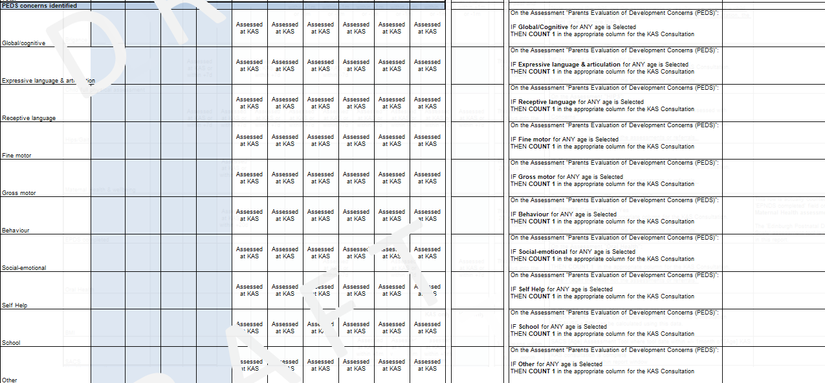
PEDS Concerns
19

Slide 19
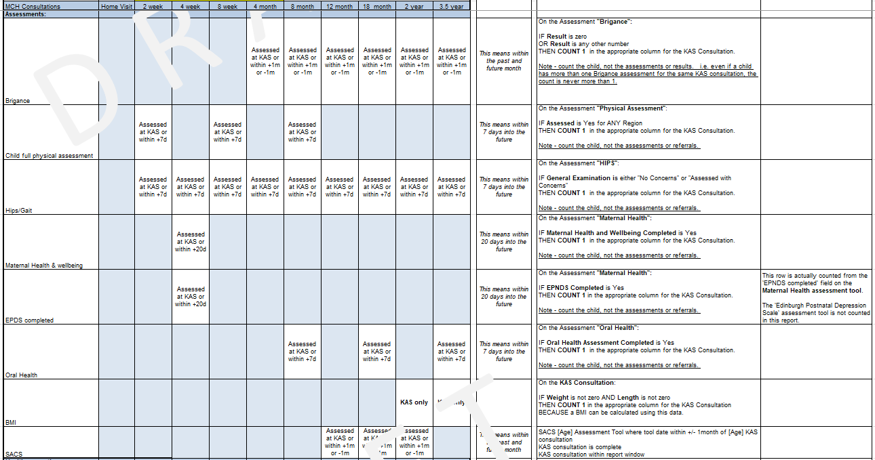
Assessments
20

Slide 20
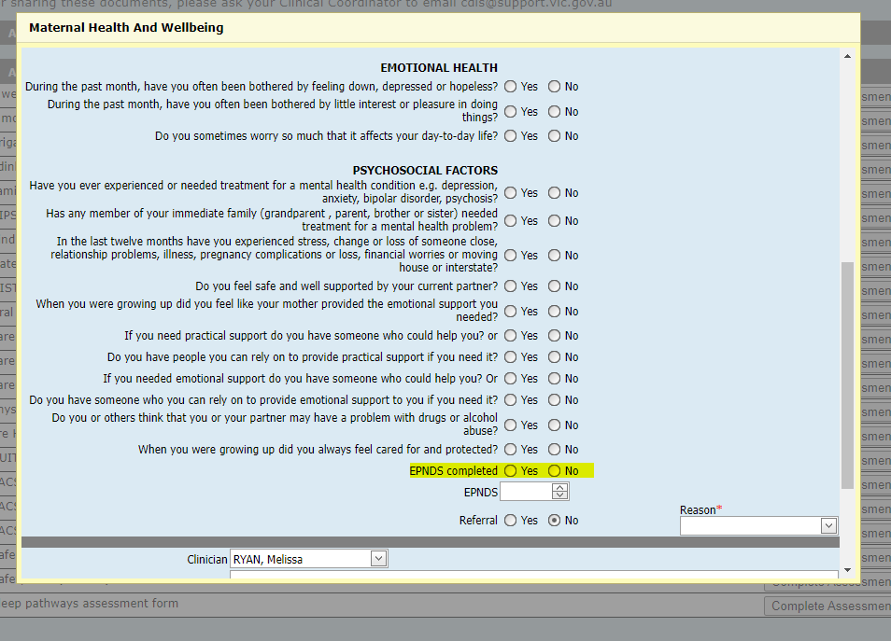
EPNDs
21
Notes:
The 'EPDS completed' row in the KAS report is actually counted from the 'EPNDS completed' field on the Maternal Health assessment tool if yes is selected.
The 'Edinburgh Postnatal Depression Scale' assessment tool is not counted in the report.

Slide 21
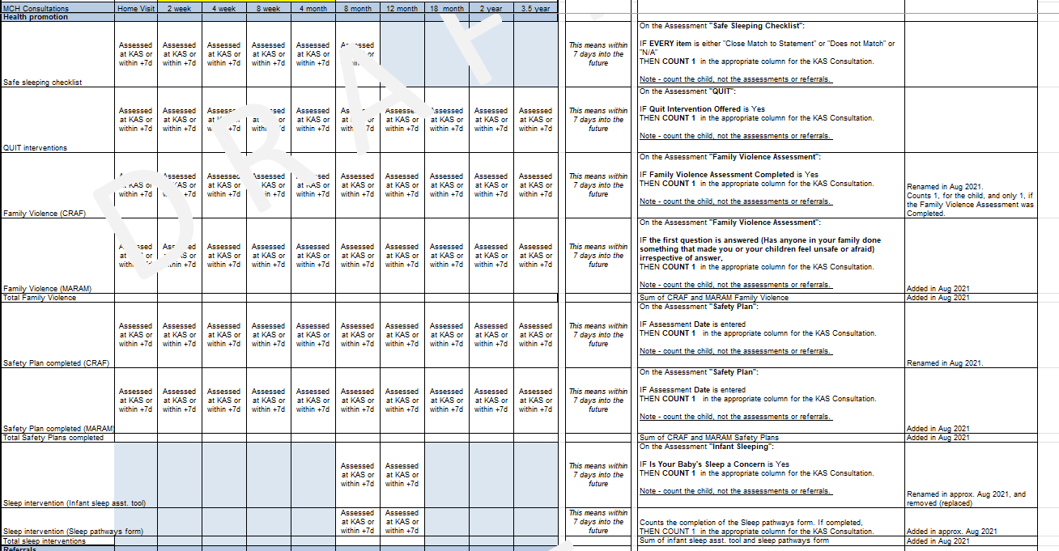
Health Promotion
22

Slide 22
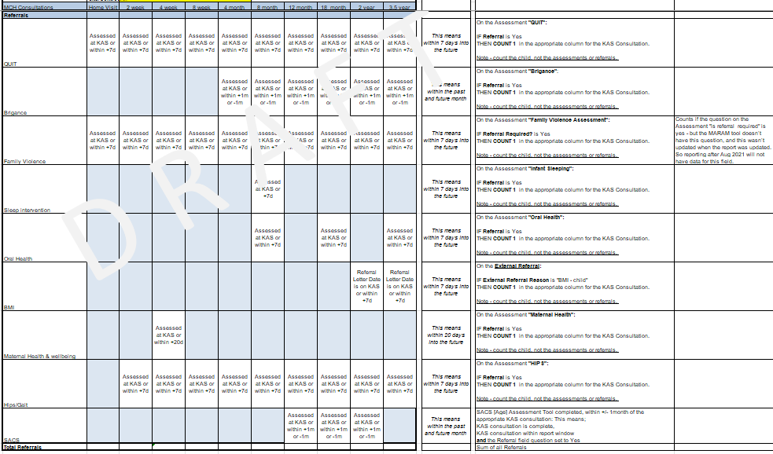
Referrals
23

Slide 23
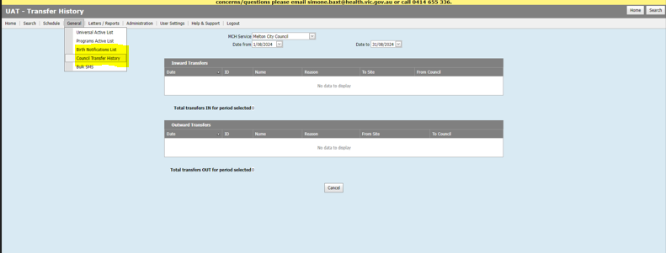
How to count transfers in and out
24
Notes:
If you run any of the Annual reports, for a month period you will get a view of enrolments for your service/centres
If you run the birth notice report you will also receive enrolment details, with more detail about transfers out
If you navigate to the screen General > Council Transfer History, you can search for transfers in or out for any period and this list (numbers), could be used to compare to any of these reports.
Note this includes adults as well as children within the 0-6yr age range.

Slide 24
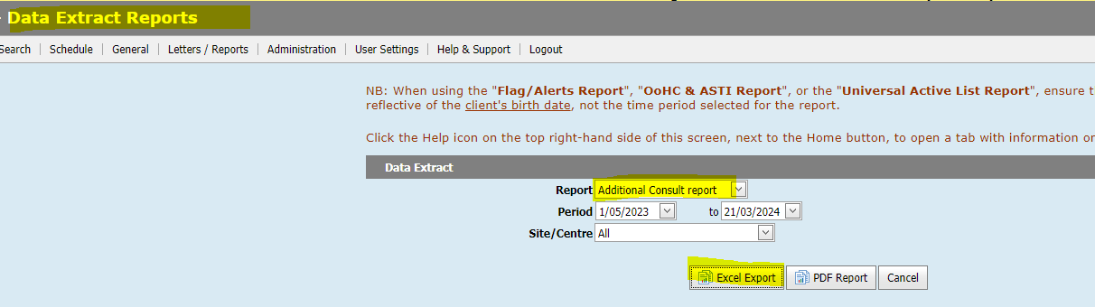
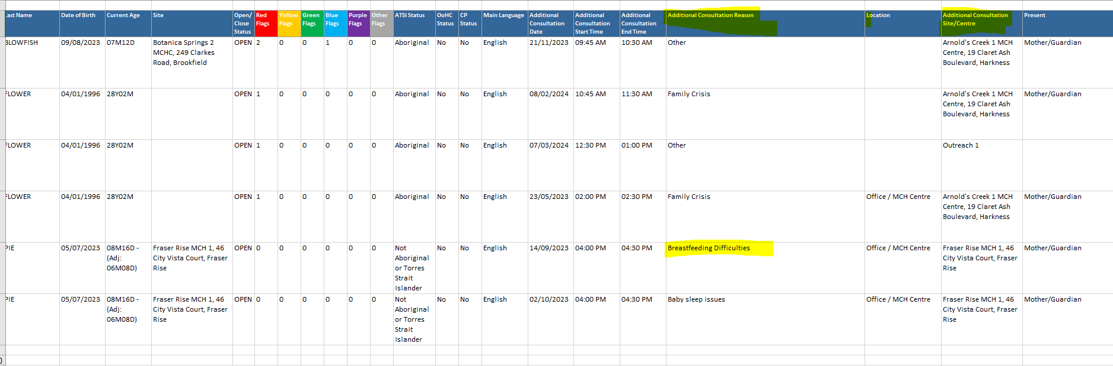
How do I get additional Consults data
25
Notes:
Data Extract Reports and filter excel

Slide 25

Questions

