Slide 1
Prevention of Violence Against Women in Emergencies
ACTION PLAN
Jill Karena,
Manager of Community & Culture
Municipal Recovery Manager

Slide 2
Macedon Ranges was a partner in the Central Victorian PVAW in Our Community Cluster (2011-2014) project with City of Greater Bendigo and Mt Alexander.

Slide 3
Project goal:
To prevent violence against women by building local community, cultures and organisations that are gender equitable and support respectful and equal relationships and non-violent norms between men and women.

Slide 4
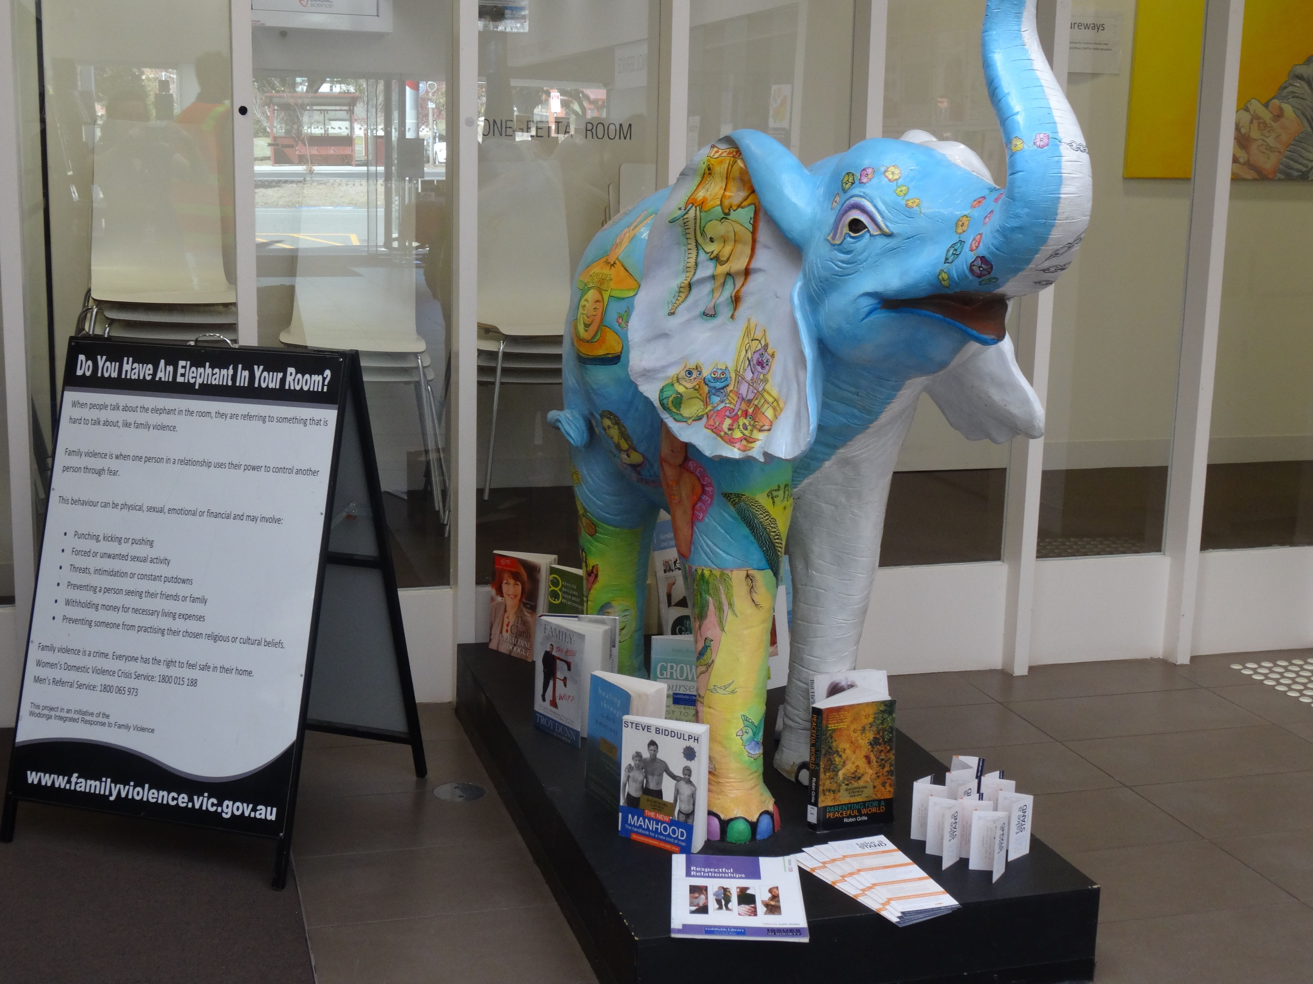
Project Outcomes included:
Family Violence Leave Clause in the MRSC EBA
‘Gender lens’ Review of the Macedon Ranges MEMP
Family Violence training-Local Laws Officers
Bystander Training offered to all staff
Statement of Commitment to PVAW
White Ribbon Day Activities
Media Advocates Training
Elephant in the Room

Slide 5
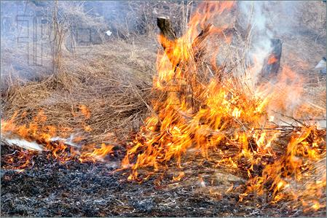
How Emergency Management and violence against women are linked

Slide 6
Evidence emerging:
Relationship violence, child abuse and divorce increase after disasters
Men are more likely to die in floods and bushfires than women
Men strongly influence family decisions to stay and defend homes
Men often have more knowledge of formal emergency procedures
There is generally an increased burden of care-giving in the recovery and reconstruction phases and this is disproportionately shouldered by women

Slide 7
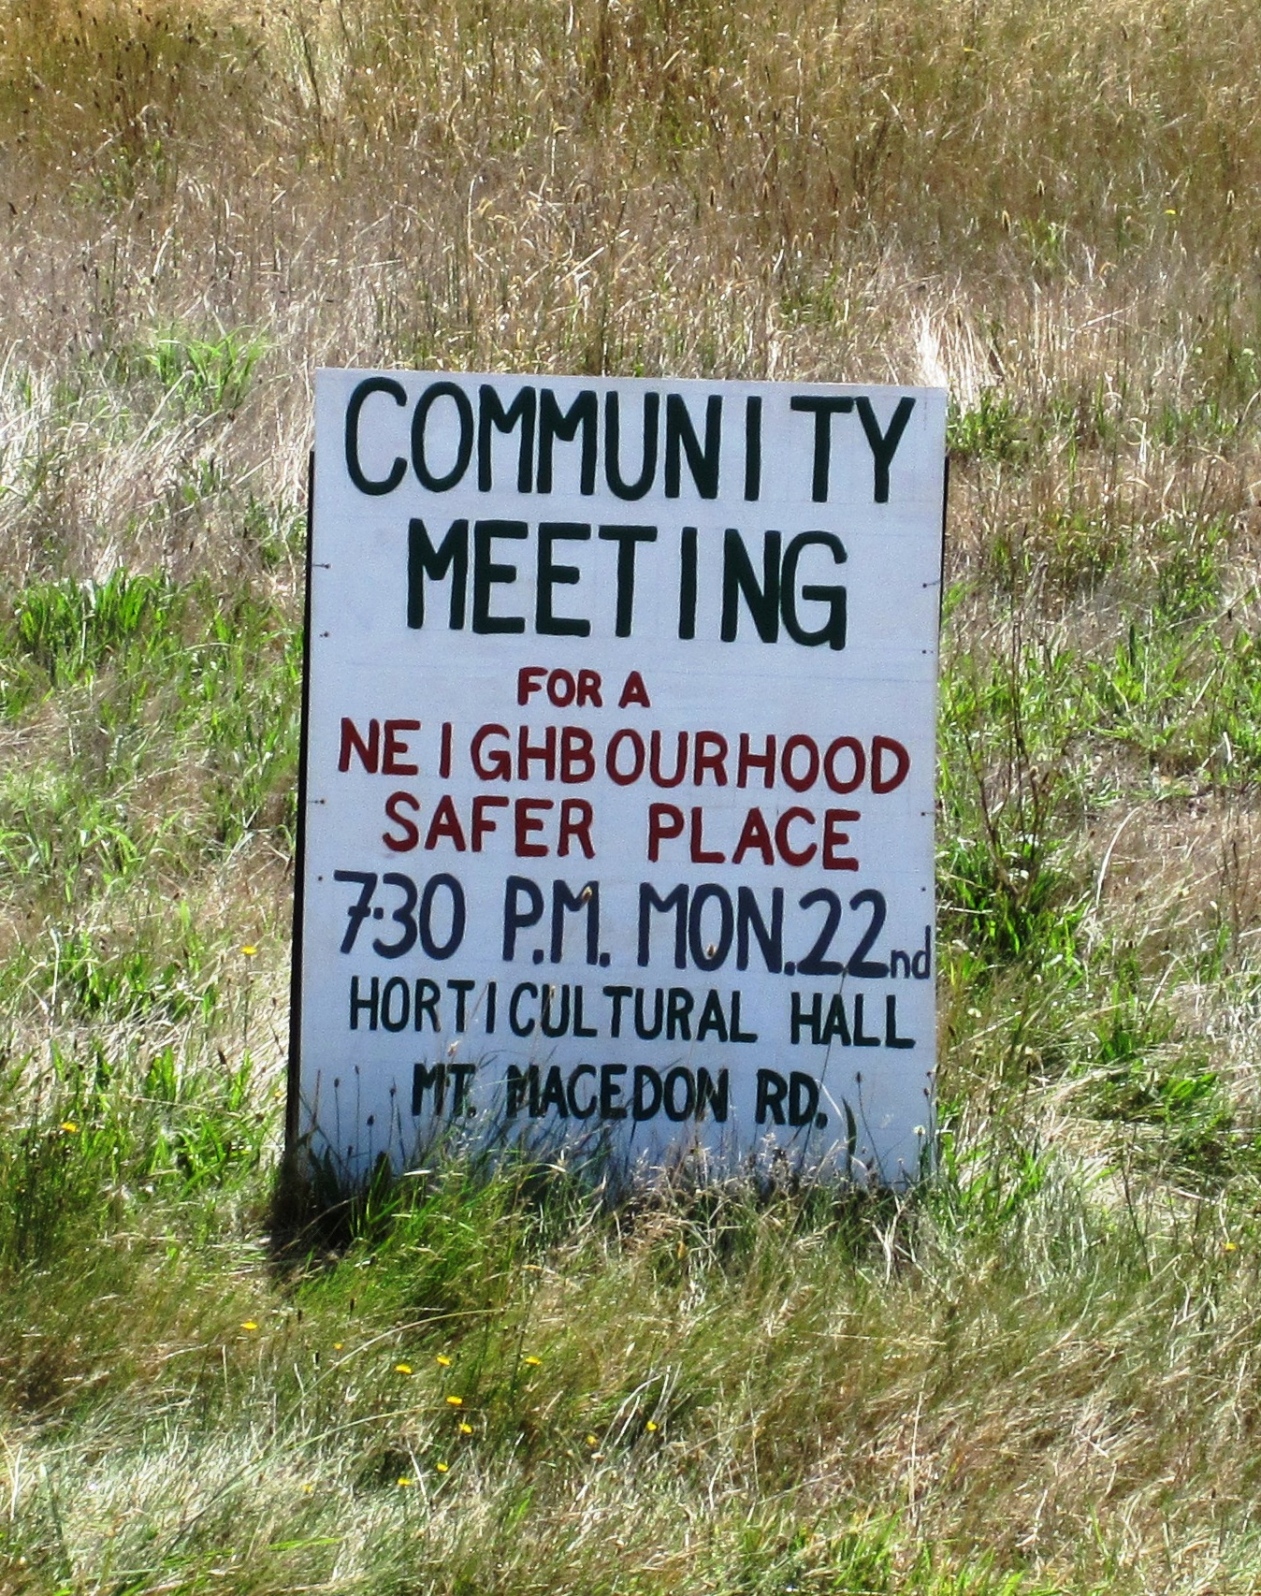
Timeline

Slide 8
2009 – A US study shows a 4x increase in intimate partner violence following Hurricane Katrina. The increase was driven by first-time occurrences of violence amongst displaced people. New Zealand police also reported a 53% increase in call-outs to domestic violence incidents over the weekend of the Christchurch earthquake on 4 Sept 2010.

Slide 9
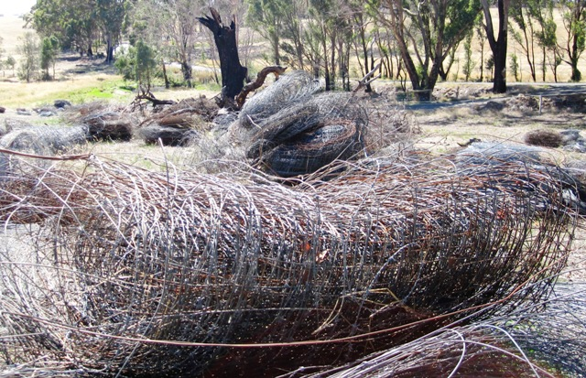
2011 - The research paper “The Way He Tells It” was developed by Women’s Health Goulburn North East. The paper captured the experience and knowledge of women who survived Black Saturday.

Slide 10
2012 - Based on the learnings and recommendations of the “As He Tells It” report, the Macedon Ranges Municipal Emergency Management Planning Committee set up a subcommittee that works to raise awareness, and reduce the incidence of violence against women during and after significant emergency incidents.

Slide 11
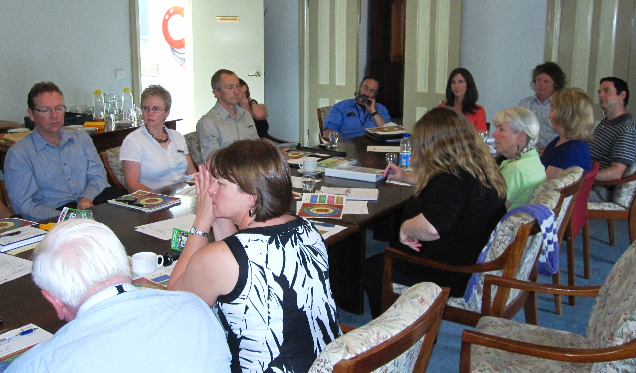
Initial subcommittee membership:
PVAW Cluster Coordinator Municipal Recovery Manager (MRM) Municipal Emergency Resource Officer (MERO) MRSC Councillor Council’s Emergency Management Coordinator Victoria Police – Inspector Victoria Police – FVLO | Cobaw Community Health Save The Children Australia Commonwealth Government (Centrelink) Victorian Council of Churches Emergency Ministry Red Cross DHS CFA SES

Slide 12
2013 – A few false starts and negotiation required to determine scope and ToR for the subcommittee.
Report released : ’Moving Beyond “women are the problem”: How Can We Better Understand the Gendered Nature of Bushfire in Australia?’ focussing on the lack of female volunteers and decision makers in emergency management.

Slide 13
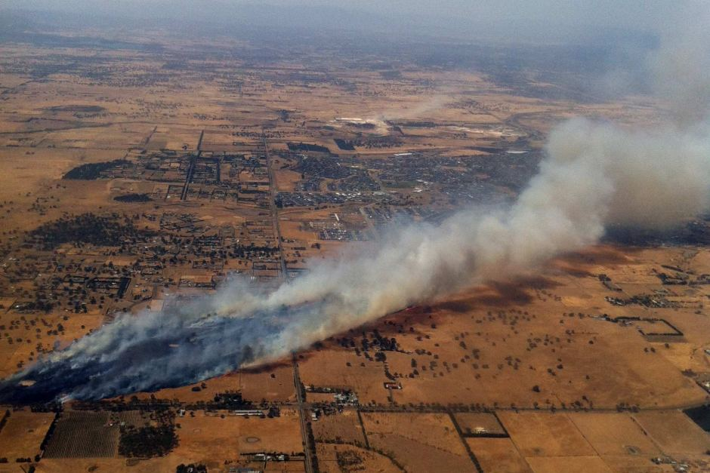
2014 - The Subcommittee explore how emergency planning, response and recovery can incorporate gender considerations and decide to develop an action plan.
Planning interrupted
by the significant fires
in the Macedon Ranges
in Feb 2014 –
(Mickleham Fire and
the South Gisborne fire).

Slide 14
2014 Cont….
MAV develops a Gender and Emergency Management strategy that aims to reduce the negative consequences of gender-blind practices and establishes a state-wide advisory group.
Vic Govt Gender and Disaster Taskforce established.
Co-chaired by Craig Lapsley.
CFA North West Region Violence Prevention Advisory Group established.

Slide 15
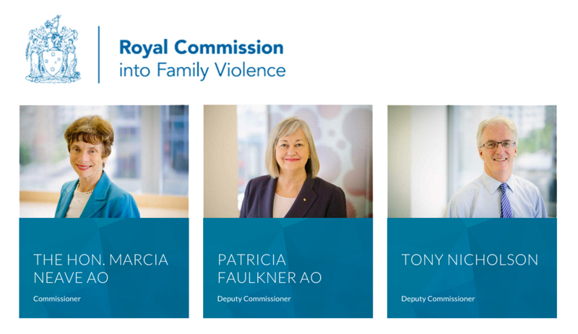
2015
Draft action plan developed by the subcommittee – endorsed by Macedon Ranges Shire Councillors
Royal Commission conducted into the Prevention of Violence Against Women.

Slide 16
Why is Local Government Involved?
LGAs have a critical role in creating and supporting environments that enable everyone in our community to achieve optimal health and wellbeing.
Legislation:
Public Health and Wellbeing Act (2008) Section 24.
The Local Government Act 1989 (3c) (3d)
Victorian Equal Opportunity Act 2010
Commonwealth Sex Discrimination Act 1984
Vic Charter of Human Rights and Responsibilities Act 2006

Slide 17
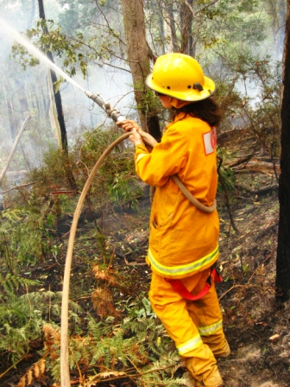
What we learned:
There are no experts or info on how to do it. Learn as we go.
Two aspects need addressing
– women impacted by
emergencies and women in
emergency response agencies.

Slide 18
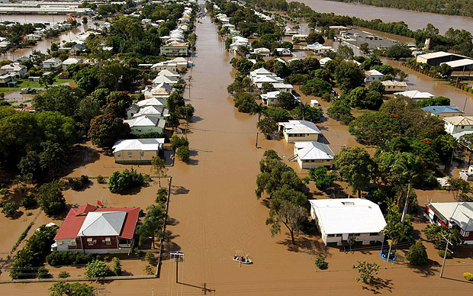
What we learned cont…..
Low understanding in the community on the gendered nature of violence against women.
  Whilst we acknowledge men can experience family violence, the focus of this plan is on men’s violence against women in the context of intimate partner relationships during and after emergencies.

Slide 19
What is the Plan?
12-month plan focussing mainly on partnership activities (reviewed and renewed annually)
Activities
- achievable and measurable
- appropriate for the maturity and capacity of the
partnership
- aligned with 3 phases – before, during and after
emergencies

Slide 20
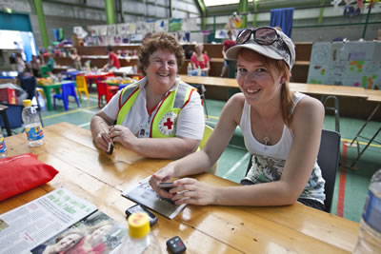
Priority Areas:
Advocacy
Culture change in emergency related organisations
Engagement and Recognition of women in volunteer emergency services organisations
Building resilience and capacity of communities

Slide 21
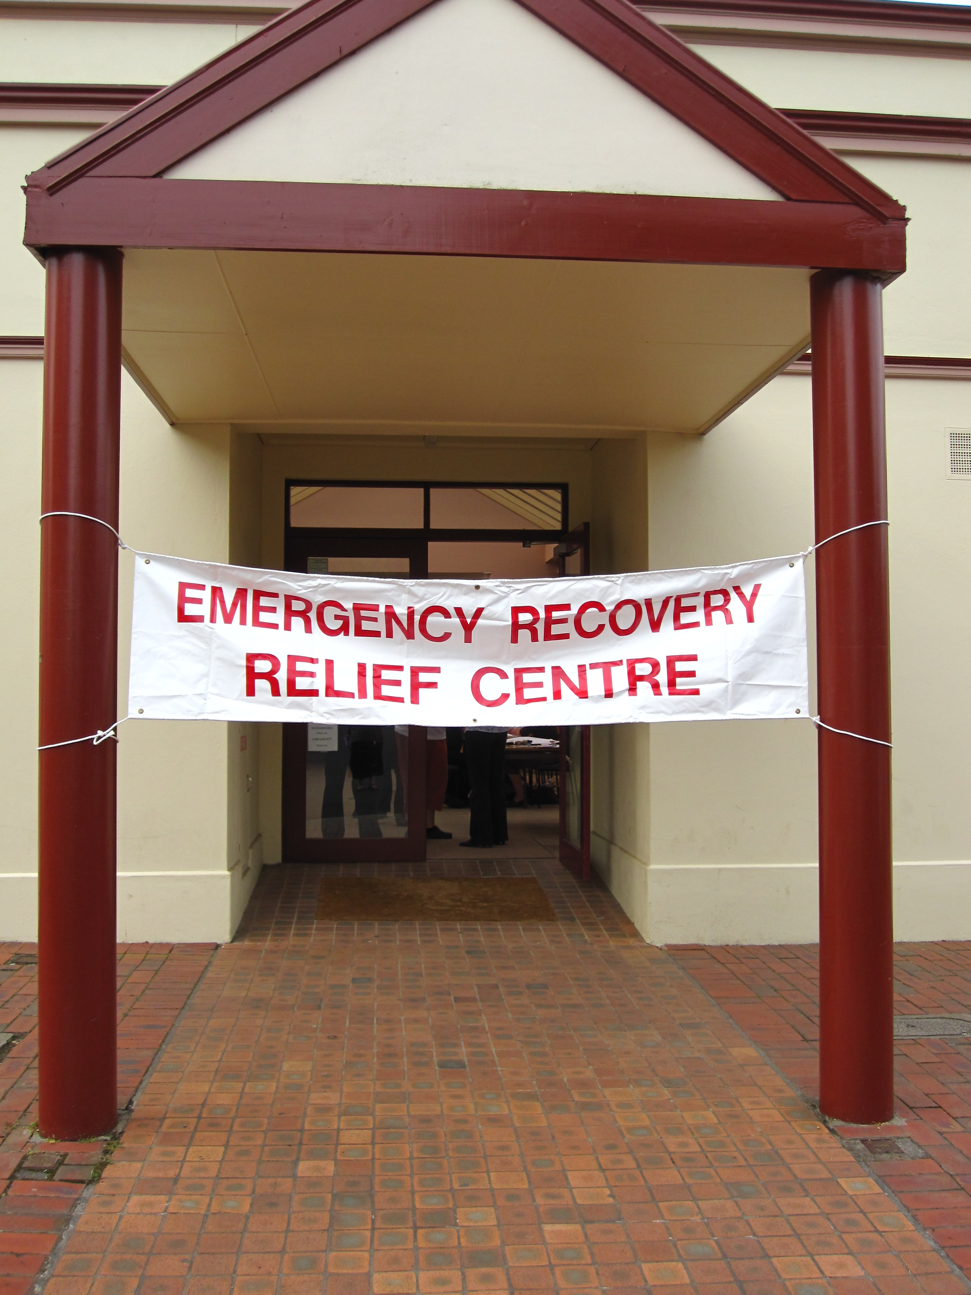
Implementing the Plan
Macedon Ranges MEMPC Prevention of Violence Against Women sub-committee will oversee implementation of the plan and report outcomes to the MEMPC.
Annually, the agencies that work together to deliver the action plan will review outcomes and develop a new annual plan for the coming year.

Slide 22
Examples of Actions from the Plan
Undertake literature review to identify any practical recommendations, strategies, actions or processes to assist in preventing family violence in emergencies.
Advocate to existing providers for improved and flexible access to services and support for people experiencing family violence during and after emergencies in the Macedon Ranges.
Annual IWD and White Ribbon Days events to recognise and encourage women’s involvement in emergency management
Support and promote emergency response agency initiatives to train women in emergency management roles – e.g.: women only training/recruitment days.

Slide 23
More Actions….
Review Emergency Relief Centre (ERC) handbook to ensure women and children’s safety is considered and investigate the development of a Relief Centre family violence protocol with the Integrated Family Violence Consortium.
Build skills of women to respond to emergencies using the arts – e.g.: Ladies Chainsaw Club in which a group of women are skilled up in the safe use of chainsaws, generator, fire pump and ute tie down, and use these skills to carve a sculpture for themselves – combined with high tea.
Ensure staff and volunteers who may be involved in outreach to affected communities are trained in recognising and responding to family violence.

Slide 24
Thank You
Action Plan should be available on Council’s website soon
www.mrsc.vic.gov.au
For more information contact
Jill Karena - Ph (03) 5422 0249, or
Karen Dunstan - Ph (03) 5421 9605

