Slide 1



Prevention of Violence Against Women in our Community
Central Victorian Cluster
Teresa Dowd
Prevention of Violence Against Women in Our Community

Slide 2
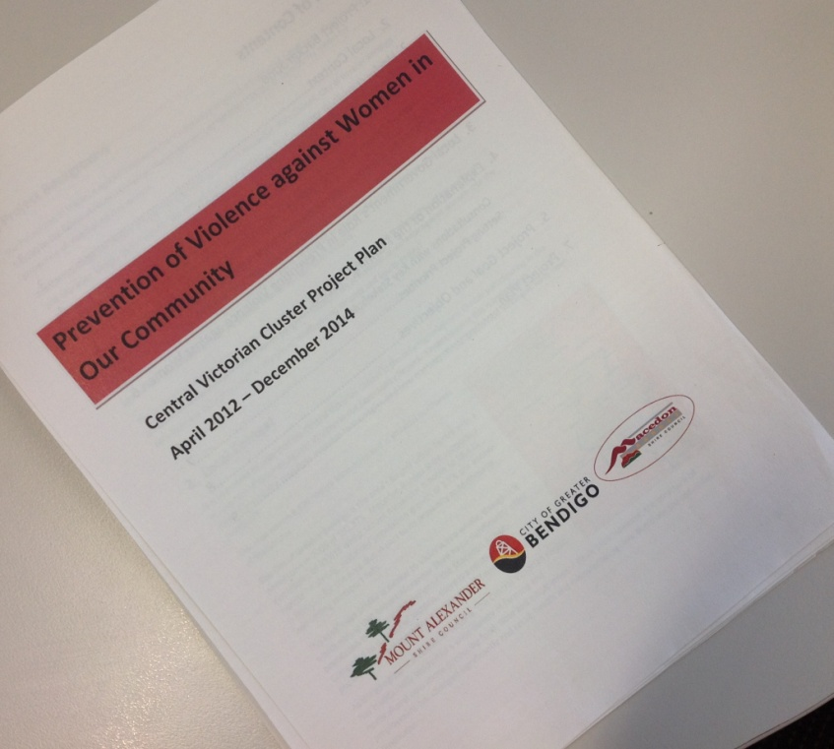
Jan Cooper
Teresa Dowd

Slide 3

Corporate management
Infrastructure
Tourism and Economic Development
Community Activity and Culture
Emergency Management
Gender equity

Slide 4
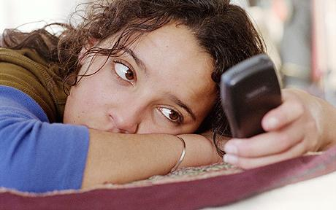
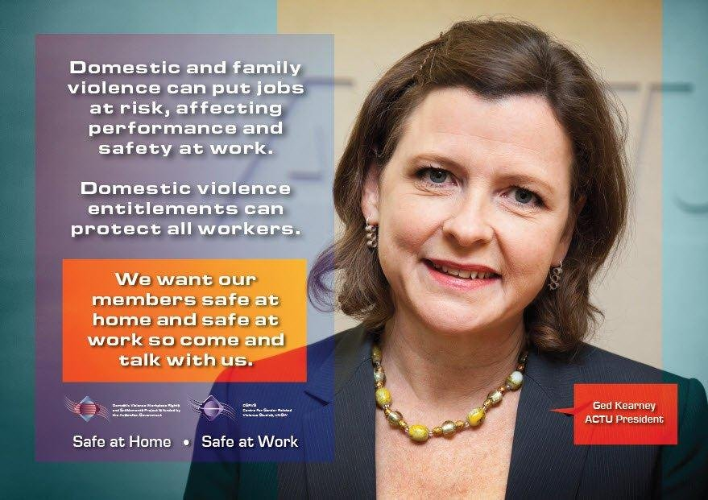
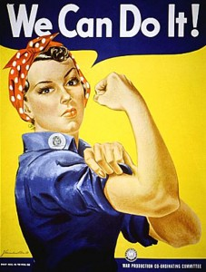
Sexting - parliamentary inquiry
Equity Inclusions - EBA
Media Advocacy

Slide 5

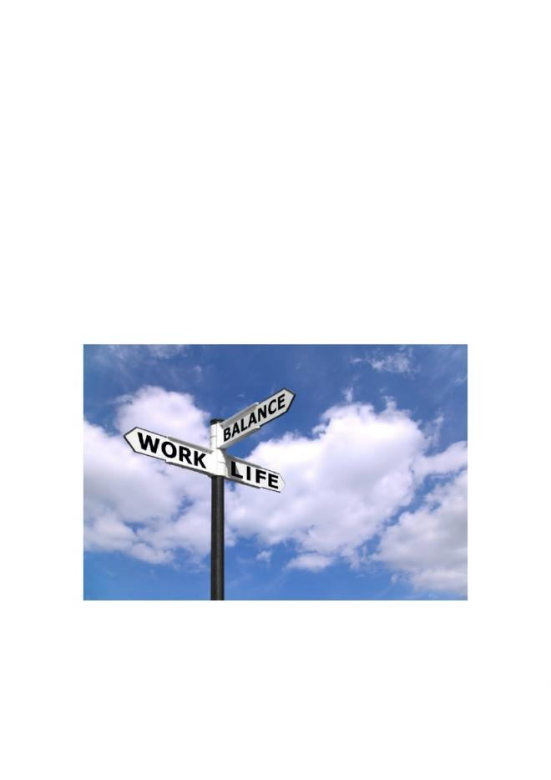
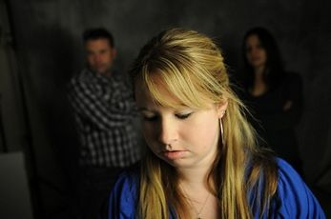
Health and Wellbeing plan
Living safer sexual lives
Loddon Mallee Takes a Stand

Slide 6

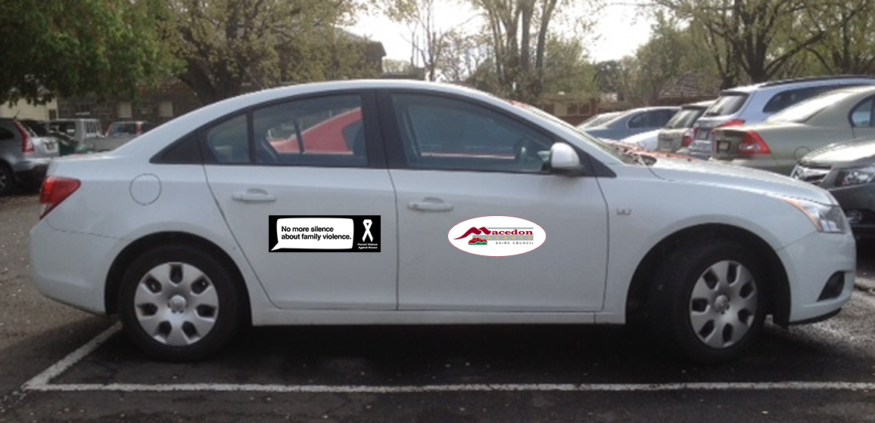


Vehicles

Slide 7
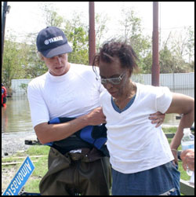
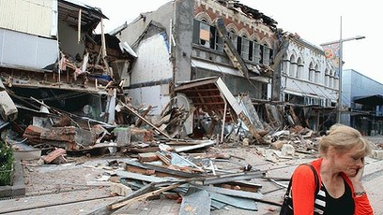

Emergency Management
Christchurch earthquake
Hurricane Katrina
53%
Australians have a 1 in 6 chance of being exposed to natural disaster in their lifetime.
46%

Slide 8
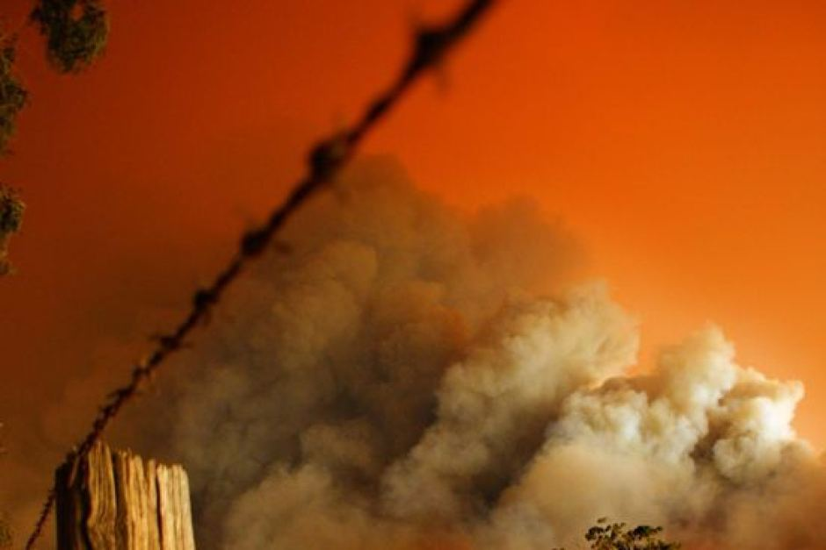
The Way He Tells it

Slide 9
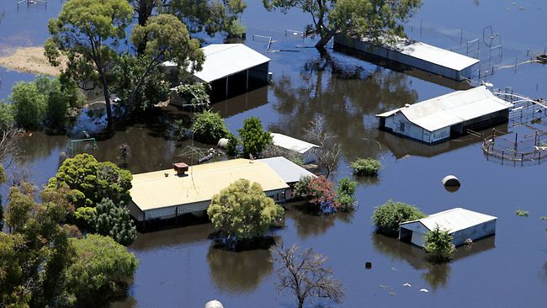
The Way He Tells it

Slide 10
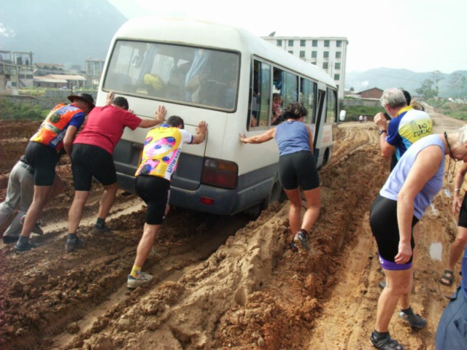
This is slow work.......

Slide 11

Gender lens

Slide 12



Arts

Slide 13
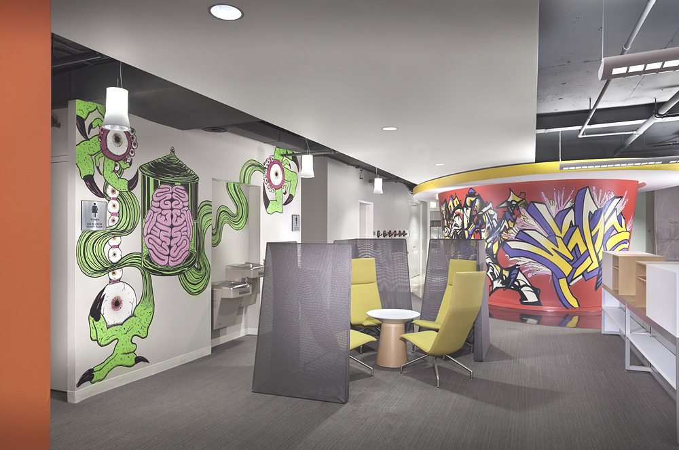
Arts initiatives

Slide 14
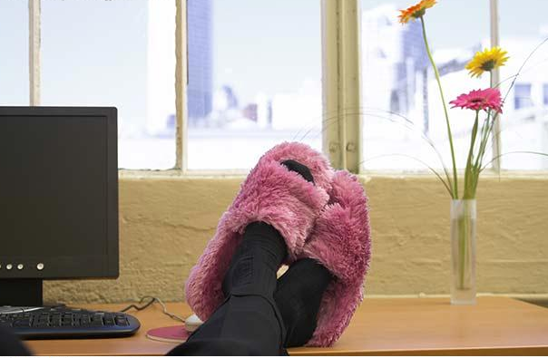
Thank you

