Slide 1
Child car seats
Transporting children safely
Zora Marko
RSE Project Manager
ELAA

Slide 2
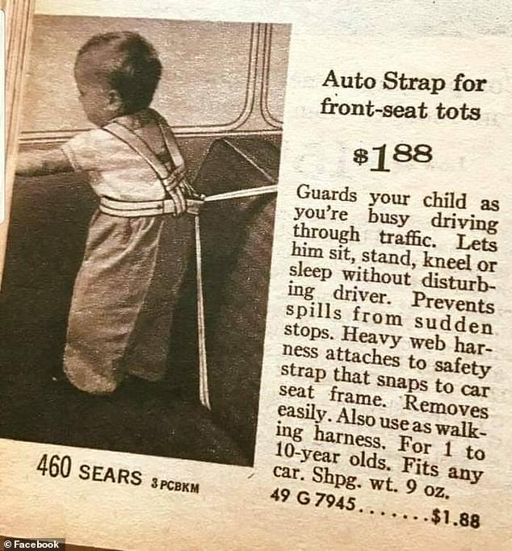
We’ve come a long way
Sears Catalogue 1961

Slide 3
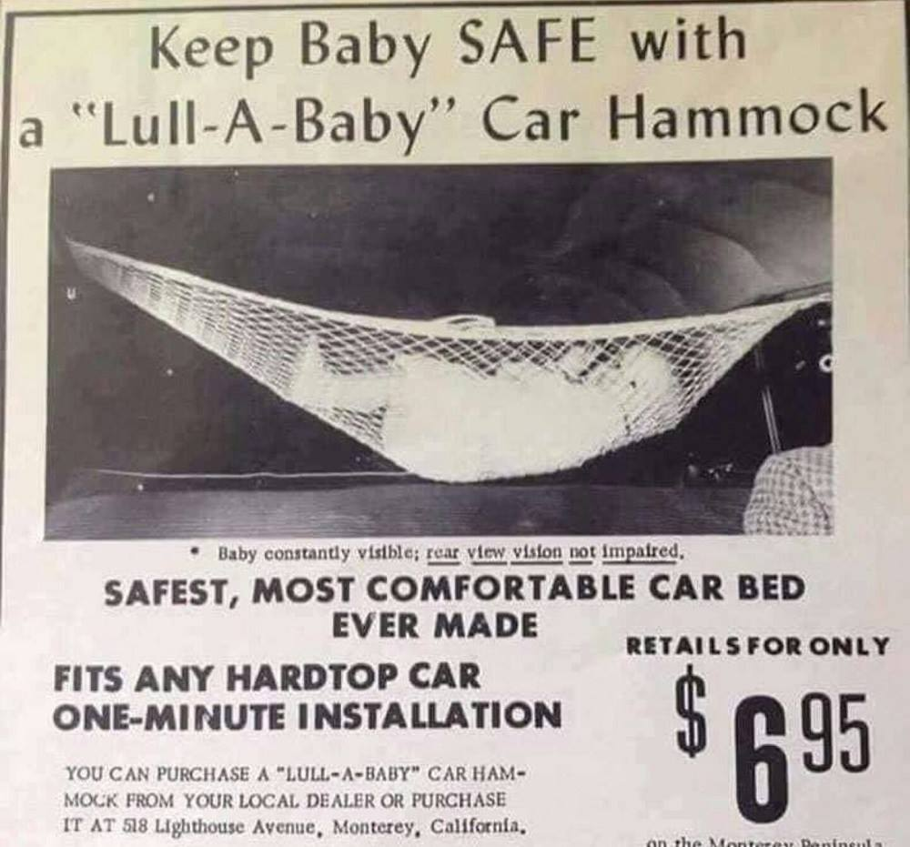

Slide 4
Lives Lost Calendar Year to 27 October 2019
226
32.9% increase in lives lost

Slide 5
Children involved in a Crash
In 2018, 1712 Victorian children under 16 were in a vehicle involved in a crash in which 1 or more occupants were killed or injured.
Note the figures for children 7 to 12 years of age – 43.7% involved in these crashes were injured

Slide 6
Victorian motorists are 5 times more likely to die on country roads than on metropolitan roads.

Slide 7
Child car seats safe lives
Child car seats save lives and prevent injuries
But … safest use of child car seats maximises gain through
1. appropriate child car seat choice – matching the car seat to the size of the child for best fit
2. correct installation and use.

Slide 8
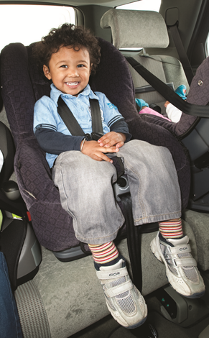
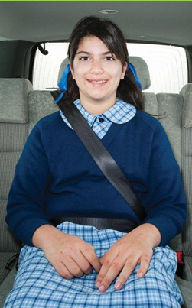
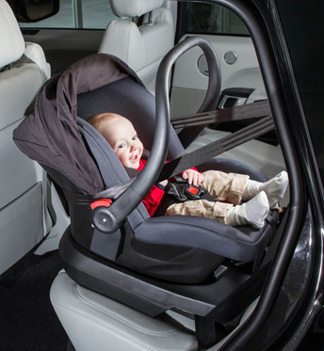
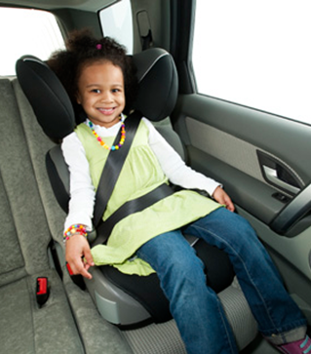
Types of child car seats
Rearward (back) facing child car seat
Booster seat
Adult seatbelt
Forward (front) facing child car seat

Slide 9
Babies up to 30 months
Rearward facing child car seat

Slide 10
Rearward Facing

Slide 11
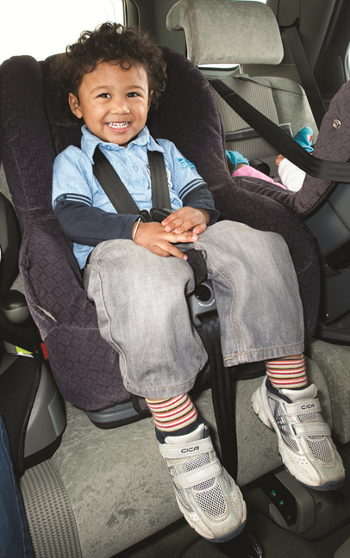
Children from 30 months to 4 years
or

Slide 12
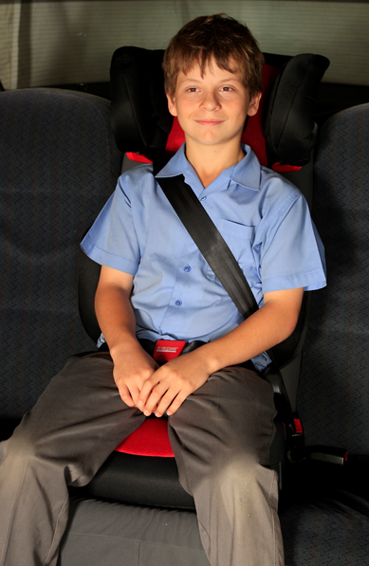
Children up to 4 years to 10 or 12 years old

Slide 13
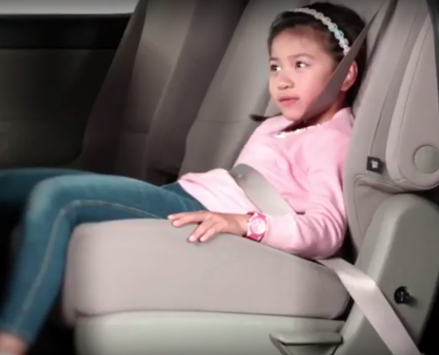

Slide 14
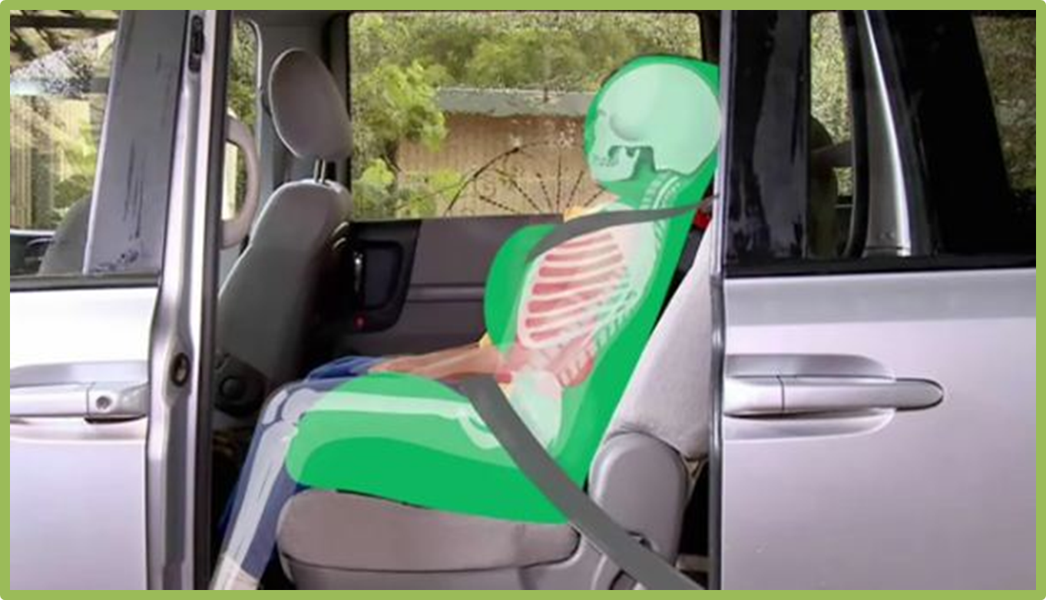

Slide 15
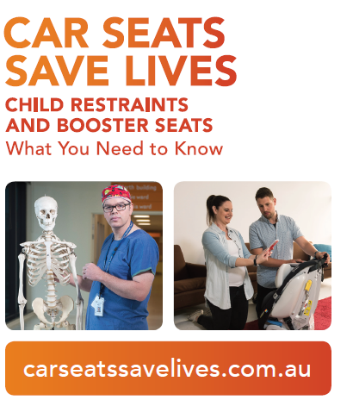

Slide 16
Starting Out Safely – what we have delivered
Over 4,200 ThingleToodle sessions delivered to over 100,000 Victorian children
Over 400 Professional Development sessions delivered to educators
Over 250 child restraint sessions delivered to over 3,500 participants (MCH, child protection, fitters, retailers, VicRoads, Department of Justice, DET, LGA and conferences)
Expos and agricultural field days

Slide 17
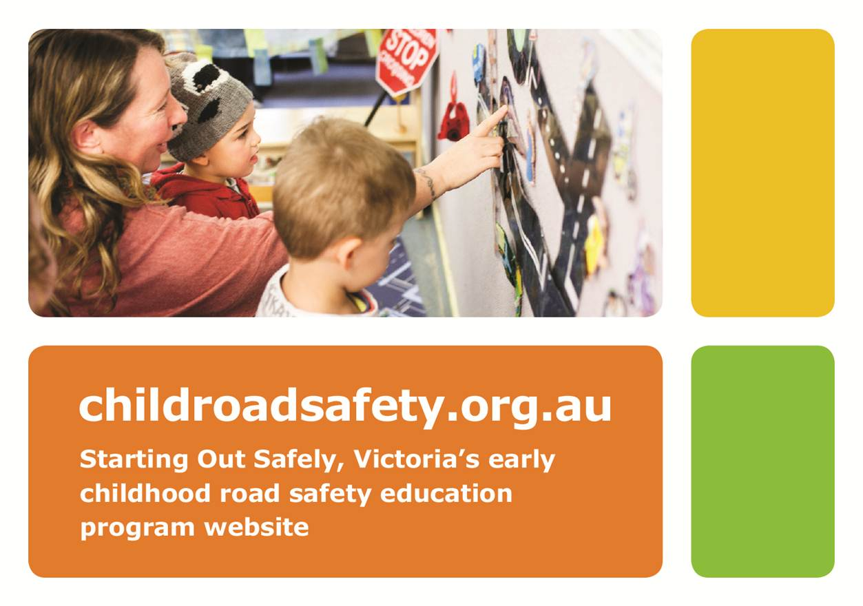
Notes:
Our new website

Slide 18
Thank you

