Slide 1
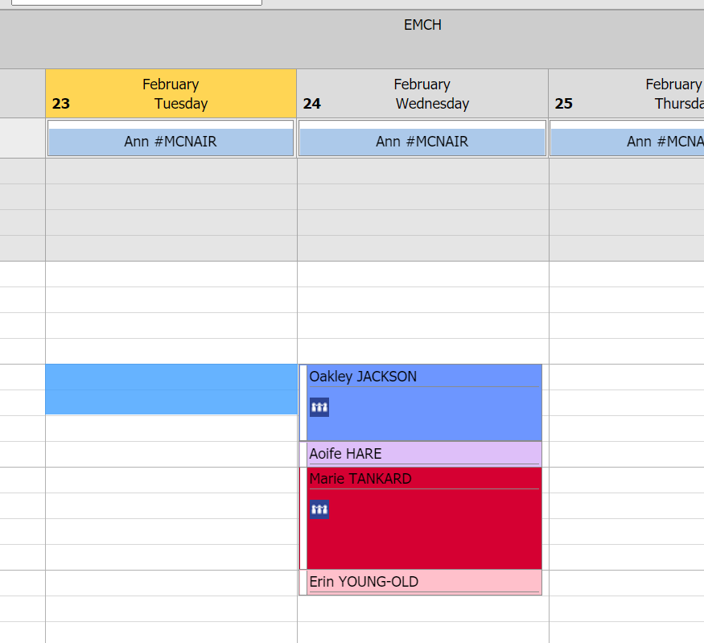
Marie Tankard - Lead Client
Oakley is due for an 18 mth KAS – you put into the KAS consultation the entire consultation time for the KAS
Aoife is the youngest child and you need to complete a Family Consult as the Universal MCH have not been able to undertake the MARAM assessment as the partner has always been present. The time for the family consult can be very short as the number of Family Consultations are counted not the time (YET)
When undertaking the Enhanced Consult with Marie, Marie asks about Erin’s rash so you need to do an Additional appointment for Erin. (The time for the Additional consultation might be only 4 minutes)
The update of the calendar would/might normally be done once you leave the home as part of your documentation about the entire visit.
Total appointment time 135 minutes
Times | CDIS Record | Direct | Indirect | Travel | Total mins | Funding
18 mth KAS | Oakley | 38 | 5 |  | 43 | Universal
Additional | Erin | 2 | 2 |  | 4 | Universal
Family Consult | Aoife | 2 | 2 |  | 4 | Family Violence
Enhanced | Marie | 34 | 10 | 40 | 84 | Enhanced

