Slide 1
Expansion of the EMCH Program
22 April 2021
Marcia Armstrong – Principal MCH Advisor

Slide 2
About us
Safer Care Victoria is the state’s healthcare quality and safety improvement specialist
Established in 2017, we bring a determinedly fresh and independent-minded approach to helping health services improve
Our range of programs and projects may seem incredibly broad, but they all have the same goal – to support health services to get better and to help keep Victorians safe

Slide 3
Principal MCH Advisor
The Principal Maternal and Child Health Nurse Advisor, Safer Care Victoria, (SCV) is responsible for supporting the Chief Nurse and Midwifery Officer in providing strategic clinical leadership and advice on issues related to maternal and child health nursing services as well as broader health system matters in relation to safety and quality improvement.

Slide 4
Expansion
Over 3 years
2020/21- final year of expansion
Doubled hours in EMCH
2017/18 - 123,288 hours (prior to expansion)
2018/19 - 186,298 hours (50%)
2019/20 - 205,183 hours (25%)
2020/21 - 248,000 hours (25%)

Slide 5
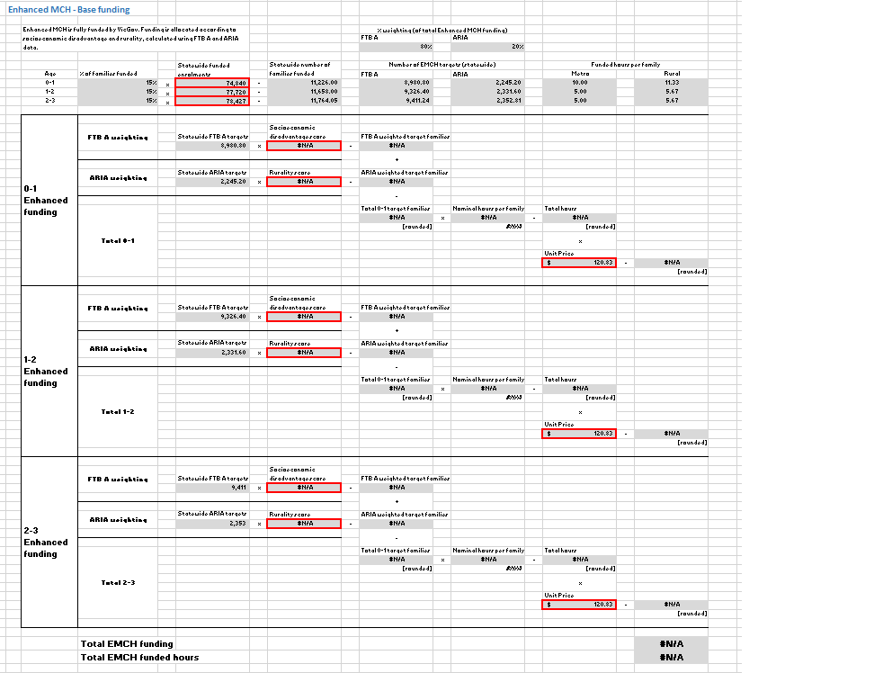
Funding
Enhanced MCH is fully funded by VicGov. Funding is allocated according to socioeconomic disadvantage and rurality, calculated using FTB A and ARIA data
20 hours or 22.67 hours
(10/5/5 or 11.33/5.67/5.67)
EMCH funded hours x Unit Price = Total EMCH funded hours
Workforce Support - Clinical Supervision based on head count of EMCH nurse
Funding Letter/Service Agreement (Funded Agency Channel)

Slide 6
Funding Letter – CEOs, Directors, Managers/Coordinators
Unit Price $120.83
This funding is ongoing, and will be adjusted each year according to
recent service delivery data for the LGA
recent socio-economic disadvantage and rurality data for LGA
unit price
fully expanded EMCH program
Funding must be used to support the delivery of MCH services. Any unspent funding in 2020-21 must be carried over into 2021-22 to support further MCH service delivery
Service providers are strongly encouraged to recruit staff to ongoing positions to deliver MCH services, reflective of the ongoing nature of this funding

Slide 7
Unit Price is what is paid for one hour of MCH service delivery
1. Salaries, qualification, uniform allowances, and oncosts for clinical staff
2. The remainder is used for everything else that supports the clinical service hours
Management support
Vehicle expenses
Information technology and data
Telephone and data
Materials (Brigance kits etc)
Equipment (scales etc)
Consumables – food and drink
Rent and accommodation
Cleaning and security
Building maintenance
Utilities
Payroll/personnel
Finance
Insurance
Professional development
Staff/clinical supervision (EMCH funding also provides specific additional funding for this)
Travel and accommodation
Memberships

Slide 8
The horse and the cart
The horse represents everything that is required for the MCH nurse and supporting staff to undertake their role
The cart provides the clinical staff and also contains the goods that are required to undertake service delivery
If you are wanting to increase your clinical hours, it is of no use employing clinical staff without the infrastructure to support the service delivery, i.e. no use putting the cart before the horse
The horse is required in front of the cart for the cart to be able to move,
otherwise the cart will go know where, with the horse behind it.

Slide 9
Calculation of deliverable hours per FTE
Example
1 FTE = 52 wks x 38 hrs = 1976 hours
52 wks – 4/5 wks annual leave -1 wk PD - 3 wks sick/carers leave = 44/43 wks
Assume 30 hours direct/indirect/travel clinical per wk per FTE
44/43 wks x 30 hrs = 1320 hrs or 1290 hrs
Number of service hrs / 1320 hrs or 1290 hrs = FTE required

Slide 10
Reporting
Data in IRIS utilised for 2020/21 year
Q1-Q3 data to be extrapolated to full year
2021/22 + - data will be retrieved from CDIS
Reporting module in design

Slide 11
Questions?

Slide 12
Accessibility statement and publisher information
To receive this presentation in another format phone 0407 218 294, using the National Relay Service 13 36 77 if required, or email Safer Care Victoria <info@safercarevictoria.vic.gov.au>.
Authorised and published by the Victorian Government, 1 Treasury Place, Melbourne.
© State of Victoria, Australia, Safer Care Victoria, April 2021.
Available at the Safer Care Victoria website <https://www.bettersafercare.vic.gov.au>

