Slide 1
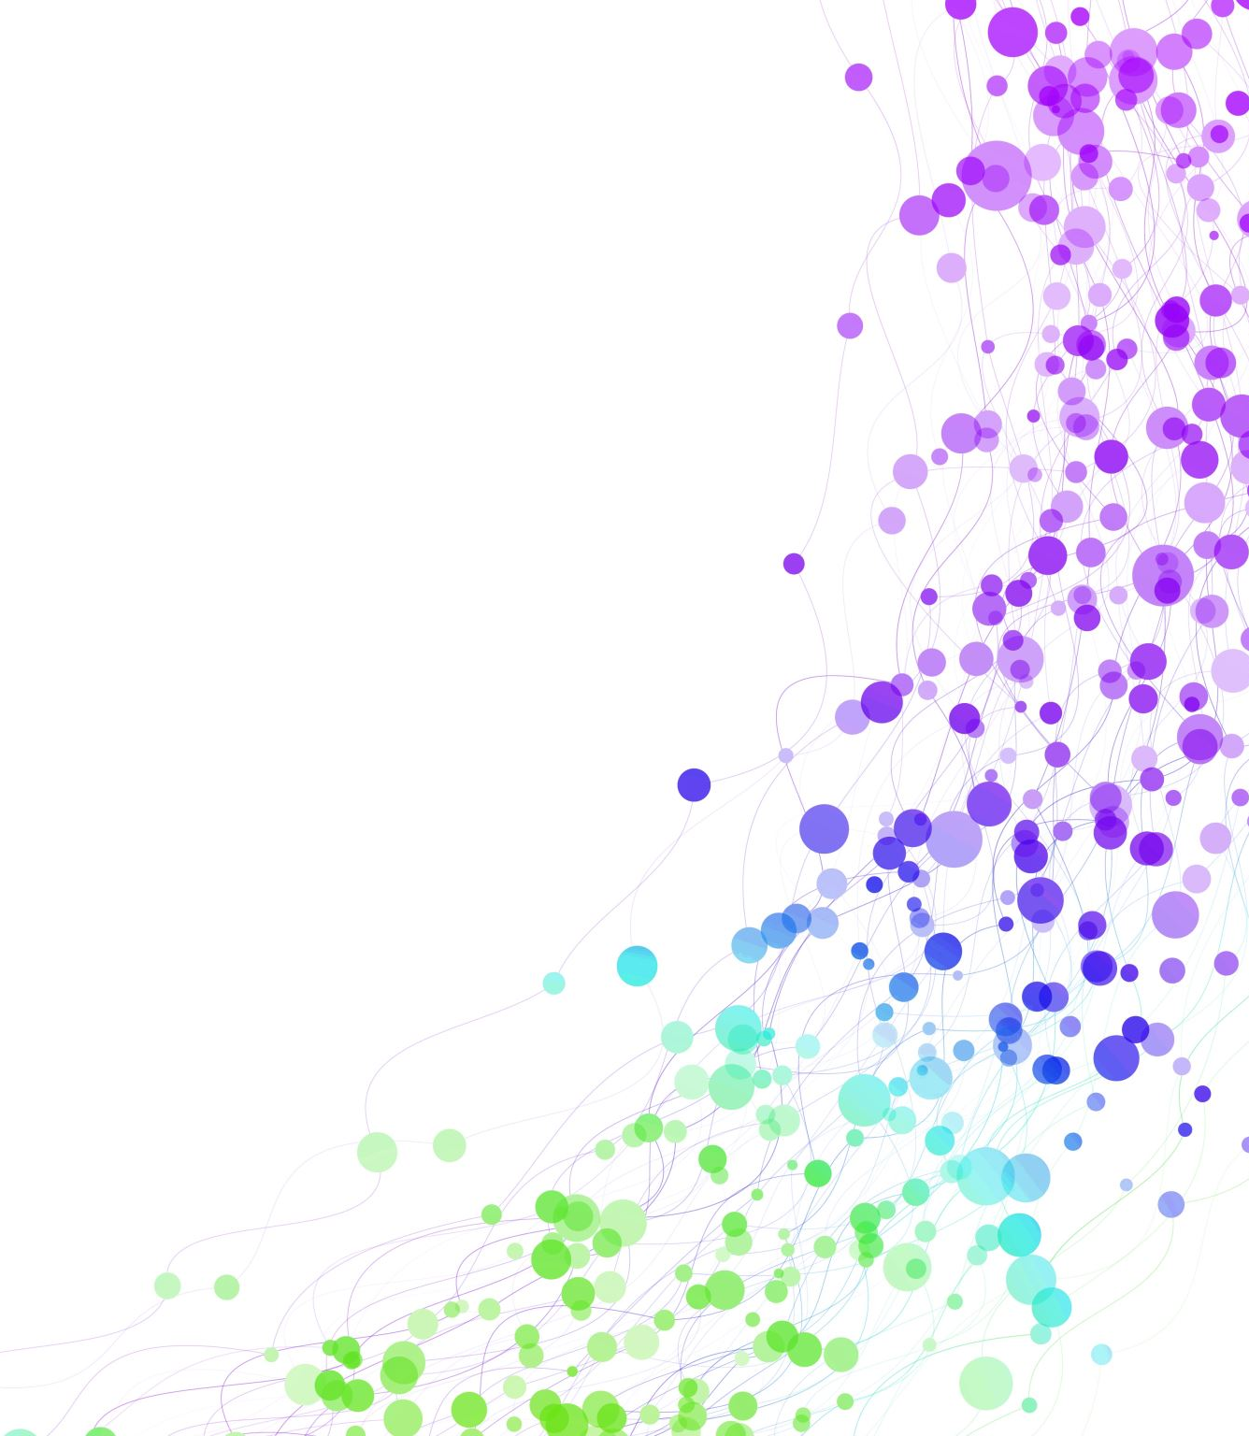
Child Development Information System (CDIS)
CDIS Clinical Users Group
Thursday 5th October 2023 8:30 am – 9:30am

Slide 2
Contents
Recording a consult.
Can I change a default site phone number to the central admin number?
Data extract Reports
Collaborative Service Delivery
EMCH case summary as a handover tool Birth Notice & Enrolment Report
Q&A

Slide 3
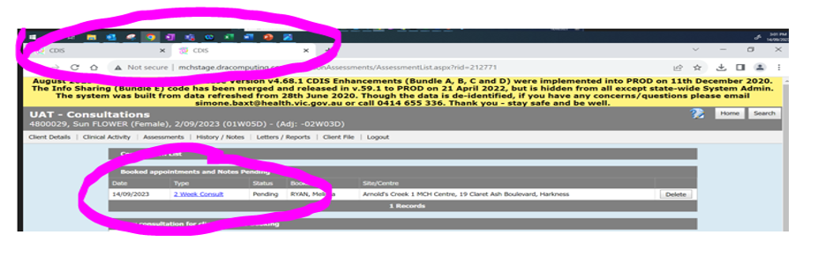
Recording a consultation
Ensure that when you open a consult that you only have it open in one tab.
All activity for the one client consultation should occur within one-tab e.g. 2-week KAS, history, assessments and notes.
When the client consultation is open in two tabs or windows:
notes can be inadvertently recorded twice
this is often an issue when you attend to assessment tools within the consultation opened in one tab/window and completing the consultation/notes from another tab or window – please do not do this.
if you save from these screens, you will be unable to save the complete consultation
Tip: Remember to save in draft until all notes are complete and finalise at the end of that workday by selecting save.
Notes:
CDIS helpdesk receiving multiple requests to fix consultations that have been saved but are incomplete.
Ensure that when you open a consult that you only have it open in one tab.
If the consult is open in two tabs notes can be inadvertently recorded twice, or saved as draft whilst other notes are simultaneously saved into the client’s health record.
Having 2 or more tabs can mean that the weight, length and HC are in one consultation record and the notes are in another consultation record. If you save the record with only the weight etc, then there will be no notes and if you save the record with the notes then there will be no weight etc recorded. The consultation record is permanent and cannot be altered.

Slide 4
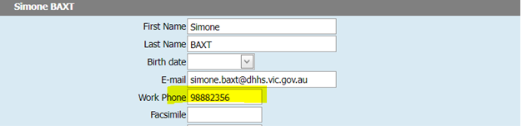
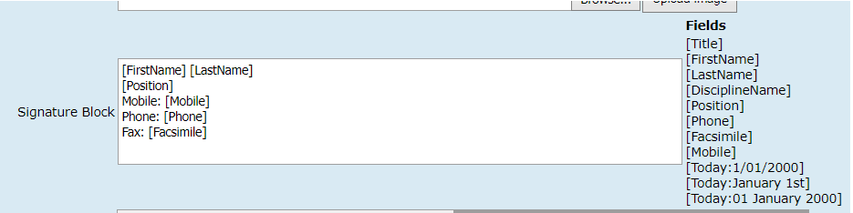
Can I change the default site phone number to the Central Admin Number?
For SMS client appointments: you need to complete a site request form signed by your Coordinator and email into CDIS support desk to change that contact number.
For Letter Templates:
Update their work phone number under Update Details > user settings to be the Central Admin number
2. Ask the person with the role of ‘System admin – council’ to go into Administration > Settings > Parameters and change/check the variables listed for the MCH service signature block and remove the info they don’t want. This will update what is displayed for ALL users though, based on individual’s user stetting

Slide 5
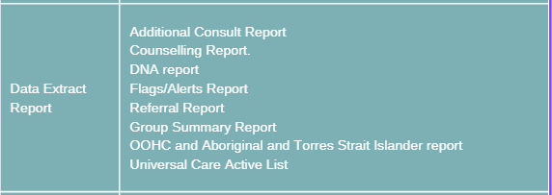
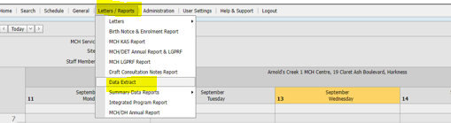
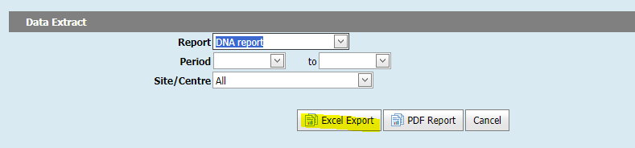
Data Extract Reports
Process:
Home Screen
Letters & Reports
Data Extract report
Choose your report
Add dates
Select Site/s
Excel Report

Slide 6
Data Extract Reports
Then filter Excel spreadsheet for your required data:
A data extract report walkthrough is available on the CDIS Data Cleansing webinar
https://vimeo.com/690719160

Slide 7
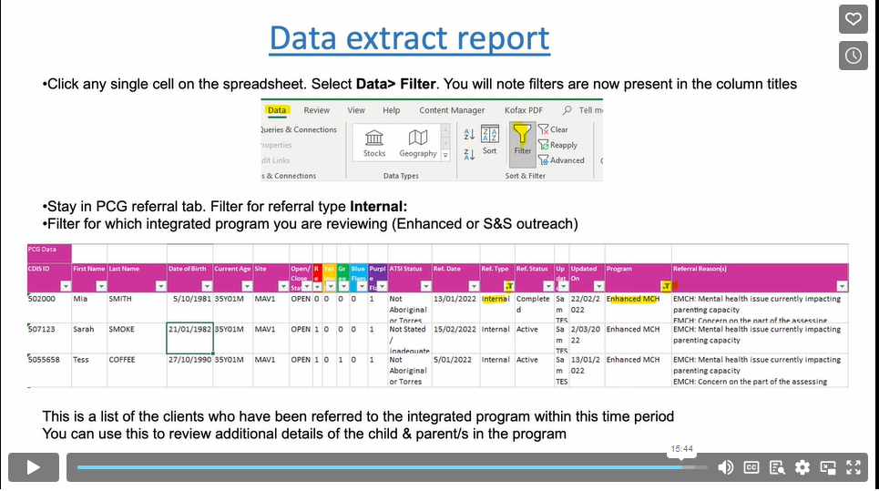
Data Extract Report

Slide 8
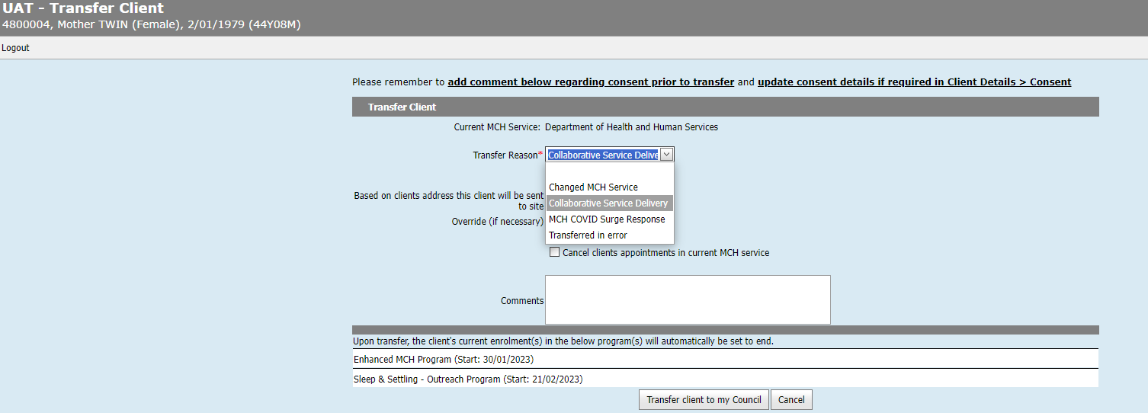
Collaborative Service Delivery
What does this option mean and what are the implications for transferring in under this option for groups/appointments/programs etc?
This transfer options is for LGAs working in partnerships with Aboriginal MCH services or other LGAs for service delivery.
When using this option, the collaborative provider will temporarily transfer the client into their service.

Slide 9
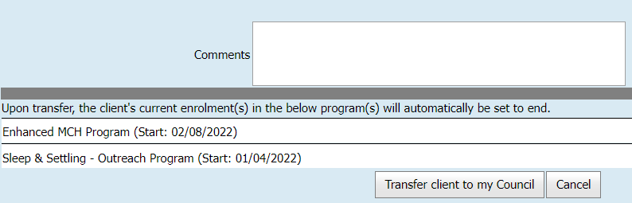
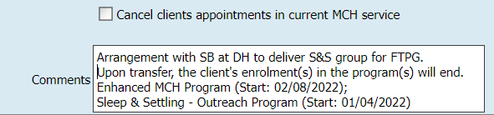
Collaborative Service Delivery
For lead clients, all programs (including integrated programs – EMCH and S&S) programs will be automatically closed on transfer.
For non-lead programs such as Breastfeeding support, NEP, etc they will be closed and any integrated programs they are included in will be removed.
Best Practice is for the Collaborative service to review any programs listed.
Copy and paste the Programs listed into the comments section prior to transfer.
Ensure communication with primary provider to ensure that programs are reinstated on transfer back to primary service.
Reference is Practice Note – group delivery from another service provider found on https://www.health.vic.gov.au/maternal-child-health/child-development-information-system?rid=212899

Slide 10
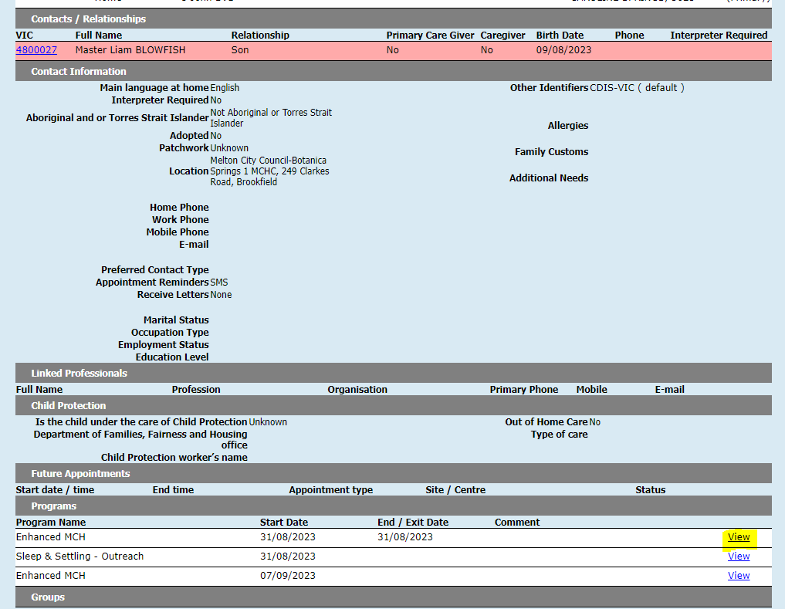
EMCH Case Summary
When supporting a family following EMCH support a good tip is to use the case summary as a handover tool.
On the client details page go to Programs and click on the view link for the closed case.

Slide 11
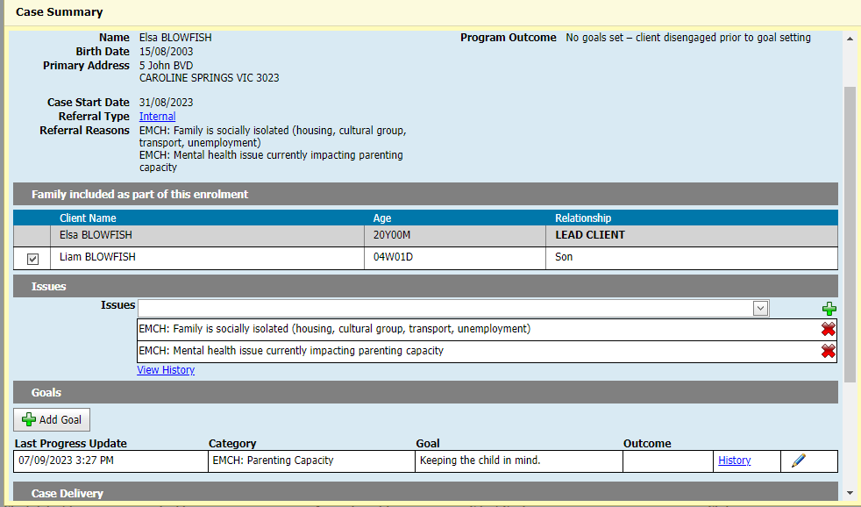
This will provide you with the summary that you can read
Notes:
You can click on the blue hyperlink to see what the internal referral said, what the history is of the issues and what changes were made, what the goal history was and what was changed

Slide 12
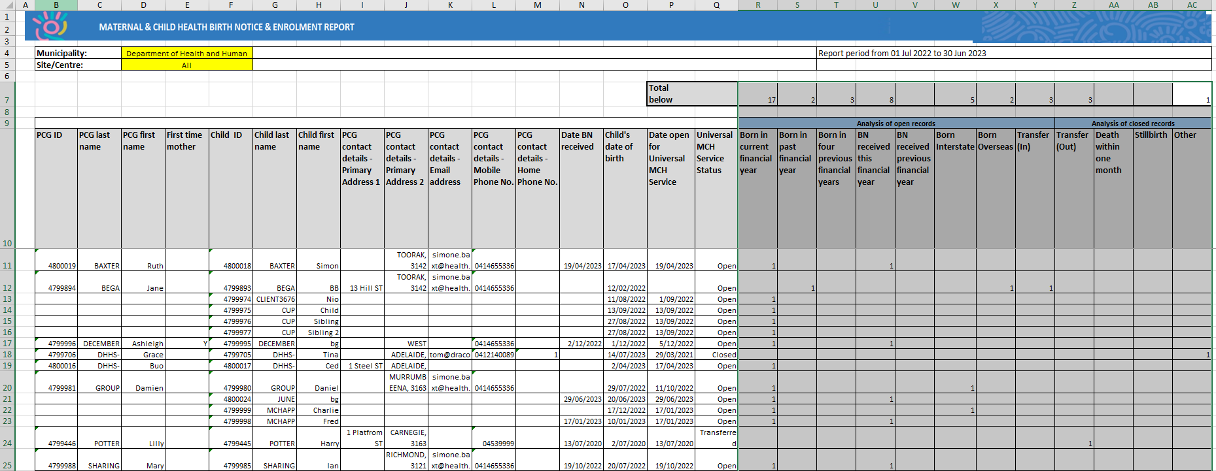
Birth Notice and Enrolment Report
Use this report to double check any queries on your annual report data in relation to your birth notices and enrolments - this report may indicate that there is data missing or inaccurate data in the health record.
Some questions have arisen about interpreting/understanding some data in this report.
If there are any concerns about the data best practice is to review and liaise with your Leadership team.
Notes:
from the Letter/Reports tab – data generated from the entry of birth notice so if not completed properly data will be missing. This can not be altered after the date of BN entered.

Slide 13
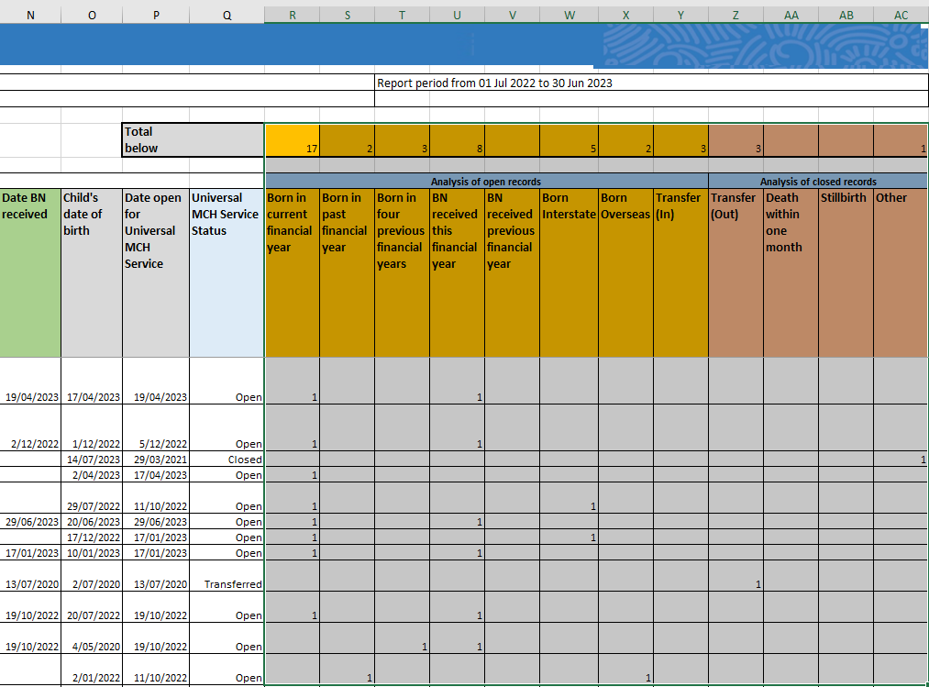
Birth Notice and Enrolment Report
Universal MCH Service status (column Q)
The status in this column, will determine the interpretation of data in the following columns;
Open: Review columns R - Y
Closed: Review columns Z – AC
Transferred: Review columns R-AC
Analysis of Open Records (columns R – Y)
A count will exist in one of these columns, corresponding with the data entry recorded for the Hx
Analysis of Closed Records
(columns Z - AC)
Transferred (Out): The client was transferred into another provider’s service (no longer in your service).
Death within one month: Based on correct entry in Hx.
Stillborn: Based on correct entry in Hx.
Other: The record was closed, and not because it has been ‘transferred out’, ‘stillborn’, or “death within one month”.
Date BN Received (column N)
This must be entered when the birth notice is added to CDIS. If it isn’t, there is no way to retrospectively update this, and the column will be blank
Notes:
BN date row cannot update. This will be blank if you do not receive a BN eg born interstate or O/S. Workaround here is to create another baby hx with BN and merge with original hx.
When the 2 records are merged make sure that the new record with the BN date in it is the record merged to/main record.
Universal – open/close/transfer – pick up your closed clients that may need to be opened.
Analysis – shows the active record status ie when opened/transferred etc. Shows status of closure.
This report may indicate that there is data missing or inaccurate data in the health record.
This will be expanded on in the reporting sessions for leadership.

Slide 14
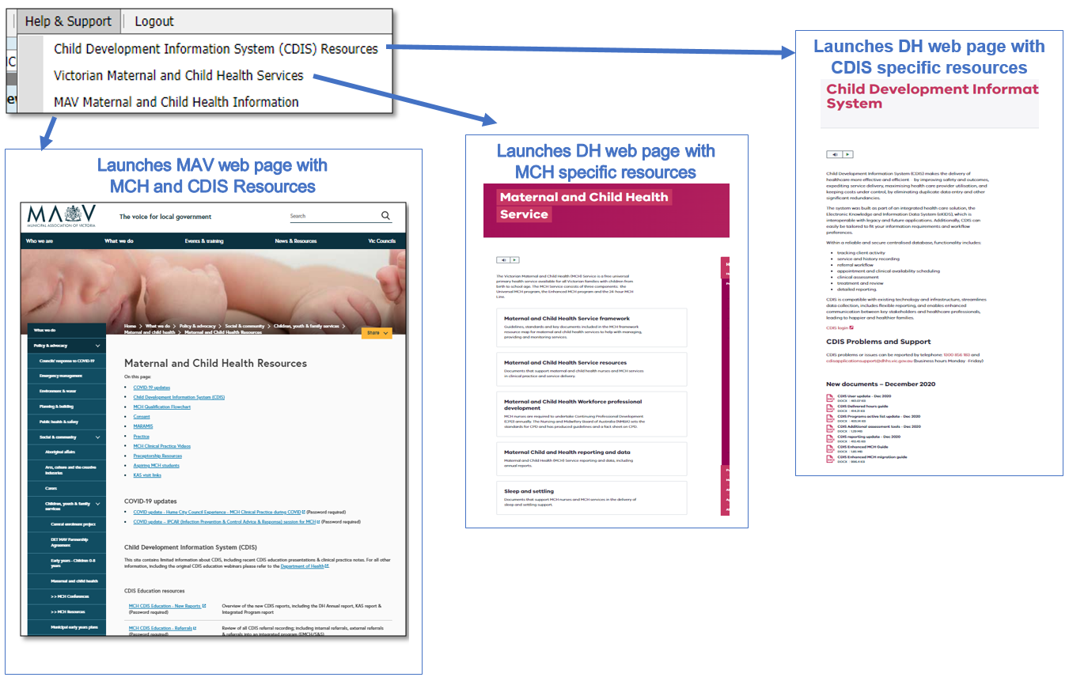
MCH Resources
Vimeo Password – cdis
MCH Clinical Practice videos password – mchvideos
Notes:
Password for vimeos = cdis

Slide 15
CDIS Support – CDIS User Responsibilities
When you are experiencing a CDIS issue / problem / question:
Check internally with your team leader / coordinator / CDIS Champions to validate what’s happening in CDIS. Include this in your request for support.
If your issue is connecting to CDIS, please check with your local IT professional if there is a network issue.
Are you the only one with the issue or are others experiencing this too? When was this problem first noticed? Include this in your request for support.
Check the online resources available to you, and if you're not closer to resolution, escalate to Contact CDIS Helpdesk on 1300 856 183 or cdis@support.vic.gov.au with the following important detail
In summary what is question or problem?
  What screen are you using / what actions are you doing in CDIS,
  What is the outcome you’re expecting?
  What is actually happening instead?
  NB: Client ID
Take a screen capture of the error or copy and paste the URL (web address),the name of the screen you’re using. For reports, detail the year or data range you’re using, and any other data selections, and capture the error message.

Slide 16
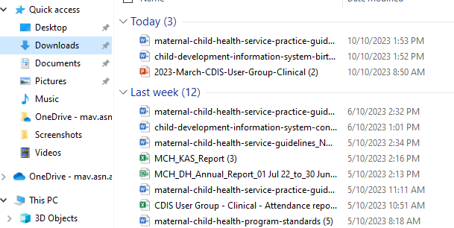
Question time
How secure are the reports you download from CDIS?
Your 'Browser Download History' is pulling the reports from the 'Downloads' folder on your device/computer. So, the security level is dependent on how secure your device is (encryption, password protection, MFA, IT processes for wiping devices etc.).
See snip on left of the Downloads storage – any service guidelines, reports and letters that you download are stored here.
You need to routinely empty your downloads folder on your device and then also empty from trash.
TIP: Check in with your IT department regarding security of these documents.

