Slide 1



PREVENTING VIOLENCE AGAINST WOMEN IN OUR COMMUNITY Project
A whole-of-community approach to the prevention of violence against women

Slide 2
Overview
Background and context
Approach to implementation
Key activities to highlight
Challenges
Resources to share
Questions and discussion

Slide 3
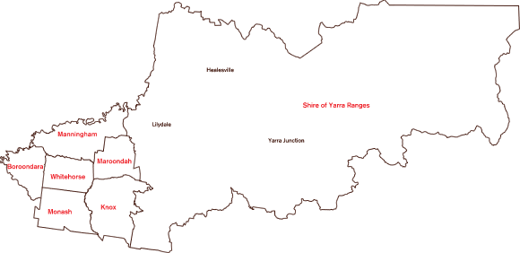
The three Outer East Councils
Knox City Council
Maroondah City Council
Yarra Ranges Council

Slide 4
Project Governance
Project Working Group
Nicole Hunter (Chair)
Coordinator Community Access & Equity, Knox
Helen Ruddell
Senior Program Manager – Economic Development, Knox
Isha Scott
Executive Officer Social & Community Planning, Yarra Ranges
Cathi Walker
Social Planning & Development Officer, Yarra Ranges
Noelene Greene
Program Manager Community Planning & Development, Maroondah
Robyn Williams
Community Safety Officer, Maroondah
Kristine Olaris
Chief Executive Officer, Women’s Health East
Eastern Region Family Violence Partnership
Denise Richards
Regional Integration Coordinator, Eastern Region Family Violence Partnership
Anna Stewart
Project Coordinator
Project Control Group
Kerry Stubbings (Chair)
Director Community Services, Knox
Kathy Parton (Program Manager)
Manager Community Wellbeing, Knox
Wendy King
Director Community and Leisure Services, Maroondah
Alison Cran
Director Social and Economic Development, Yarra Ranges

Slide 5
Approach to implementation
Working internally within council to have impact in community
Integrating gender equity into core council business
Mix of cluster-wide and individual council activity
Action, Research, Evaluation

Slide 6

Project delivery

Slide 7
Targeting specific teams
Depot / Operations Centre
Communications
Leisure Services
Facilities
Economic Development
Statutory Planning
Community Safety
Local Laws
Home & Community Care
Maternal & Child Health
Community Arts
Youth Services
Human Resources

Slide 8
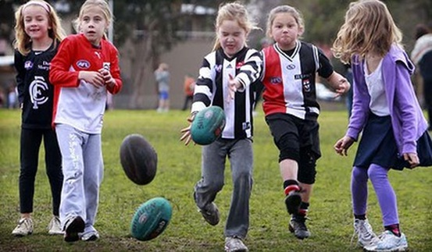
Leisure Services
Outer East Cluster PVAW Leisure Services Session: promoting the inclusion, safety and respect of women and girls in sport and recreation

Slide 9

Facilities
Audits of select facilities
Incorporating gender-sensitive principles into facility design.

Slide 10
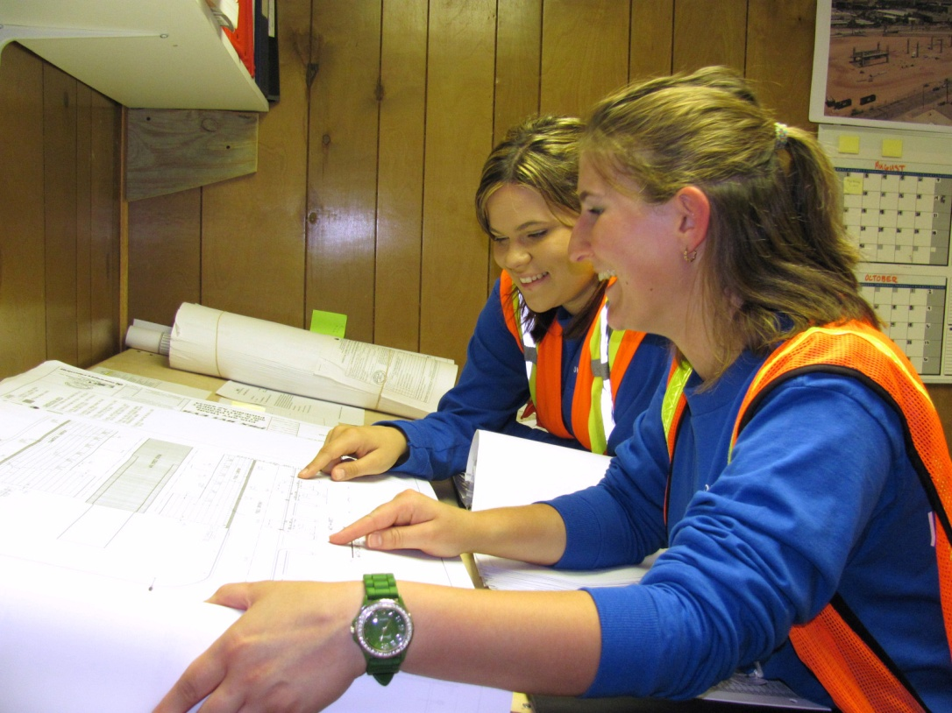
Depot / Operations Centre
Presentations to staff
Yarra Ranges Women’s Network

Slide 11
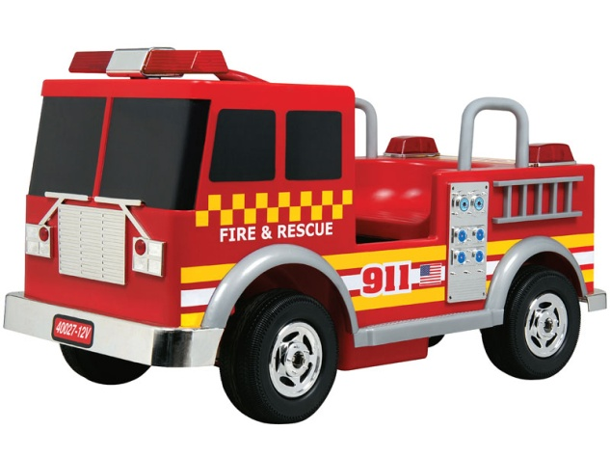


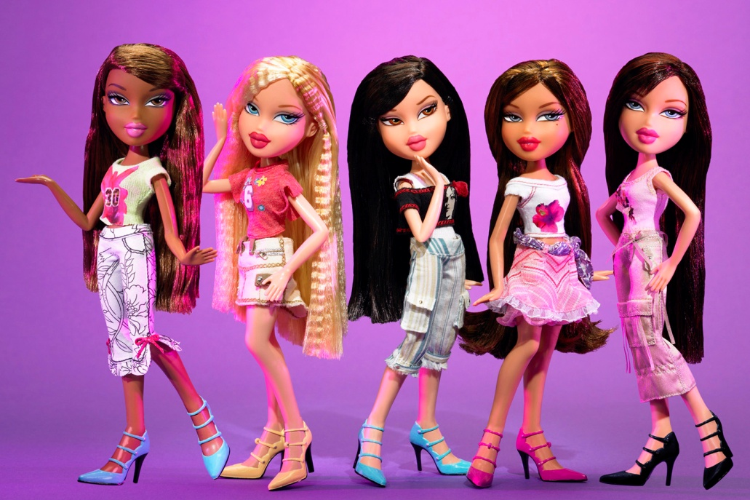
Gender Matters Workshop

Slide 12
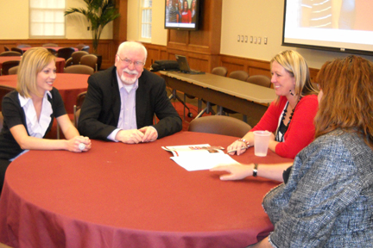
Garnering leadership support
Outer East MAV Promoting Gender Equity to Prevent Violence against Women Senior Leadership Engagement Session

Slide 13
Garnering leadership support
Reports to Senior Leader / Executive Management Teams
Presentations to Directorate Leadership Teams
Inviting leaders to speak at key campaign events
Drawing on Project Control Group influence

Slide 14
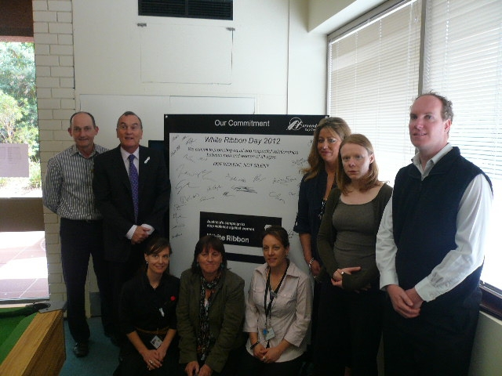
Maroondah City Council

Slide 15
Promoting the Project / PVAW
Sharing project updates via email, at internal meetings, network meetings, and invitations to council committees.
Communications teams:
  Social media
  Media releases
  Info posted on council website and staff intranet pages

Slide 16
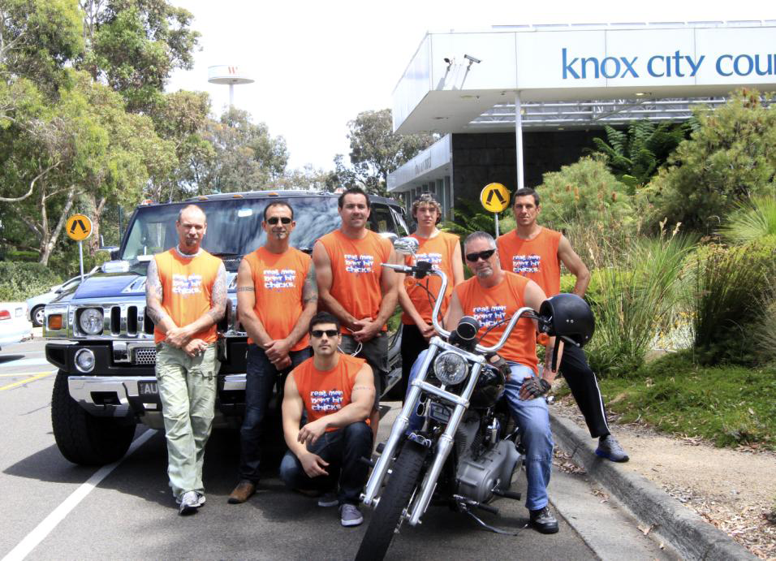
Knox Communications Team
“Real men don’t hit chicks” 16 Days of Activism Campaign

Slide 17

Emerging Champions
Project Working Group members
Events and contact with the project

Slide 18
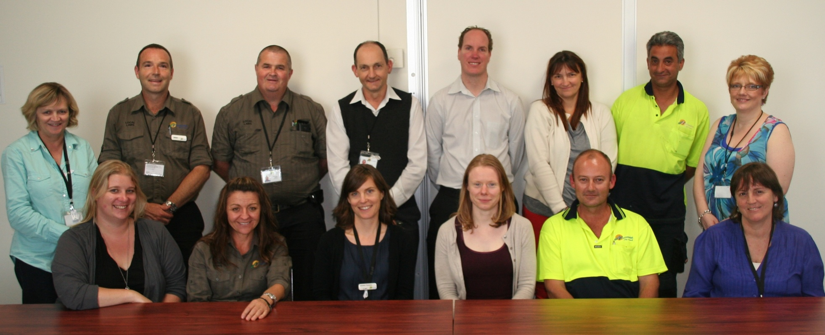
Maroondah White Ribbon Working Group

Slide 19
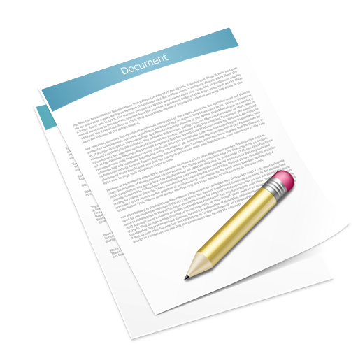
Influencing Plans and Policy
Participating in consultations
Contributing to Municipal Public Health and Wellbeing Plan development

Slide 20
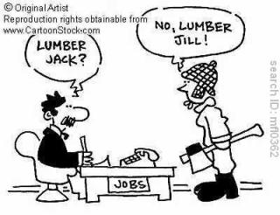
Stimulating interest in PVAW & Gender Equity

Slide 21
Maroondah City Council
Engagement with and support for the project has grown substantially.
Key factors:
  Staff awareness raising sessions
  Targeted engagement with teams
  Meeting with the Corporate Leadership Teams
  Senior Leader commitment
  Establishment of a White Ribbon Working Group

Slide 22
Challenges
Maintaining a focus on gender equity
Managing momentum and prioritising activity
Commitment and resourcing to progress project activities
Pressure to undertake projects externally
Responding to disclosures of violence and sexism

Slide 23
Resources to share
Generic PVAW Presentation
Shorter PVAW ‘Spiel’
List of PVAW activities by department/team area
Gender Analysis Questions
Gender Equity Statistics

Slide 24
Questions and Discussion
Anna Stewart
Preventing Violence against Women in Our Community
Project Coordinator
Ph: 0478 489 046
Email: Anna.Stewart@knox.vic.gov.au

