Slide 1
CDIS Enhanced MCH
January 2021

Slide 2
CDIS Enhanced MCH
CDIS has been enabled with a range of additional capabilities to support specific “Integrated” programs that are:
delivered in accordance with a Model of Care
include plans and goals, which are then worked on over a series of consultations
may be delivered to multiple members of a family, including multiple clients during a single consultation.
The additional capabilities include:
the ability to link consultations and ‘Client Not Present’ records to cases
the ability to link multiple family members to the one case
the ability to select multiple family members as the clients of a single consultation
a Case Summary Screen to manage and update case management plans, including:
managing issues and goals
reviewing previous and upcoming consultations

Slide 3
CDIS Enhanced MCH
Definitions:
Case – a program service delivery that has a start date and, when closed an end date
Whilst a program is active (from start date to end date), consultations and ‘Client Not Present’ actions that are part of the program are attributed to that program.
Family enrolments, lead clients and non-lead clients
Multiple clients enrolled in the same case, called a family enrolment.
Lead clients must be the primary carer or carer of another client in CDIS
Non-lead clients must have a relationship with the lead client
Each case must have one lead client and can then optionally have any number of non-lead clients.

Slide 4
CDIS Enhanced MCH
Clients can only lead one case of the Enhanced MCH program at any given time, however they can be enrolled as non-lead clients in multiple cases of the same program simultaneously.

Slide 5
CDIS Enhanced MCH
Referring a family:
Identify the related clients you wish to refer together into the Enhanced MCH Program (usually this will be at least one child under 3, and one parent/carer but may include a child over 3, EMCH Guidelines, 2018) and ensure they are related to each other.
Access the client record of the client who will be the lead client (must be a parent/carer).
Open the Internal Referral screen (Clinical Activity > Referrals > + Internal)
Select Enhanced MCH from the Program dropdown.
The referral screen will now have an extra section, called “Family included as part of this enrolment”. This section will list the lead client, and then all related clients. Click the checkboxes next to the names of all related clients you wish to enrol in this program as part of this case.

Slide 6
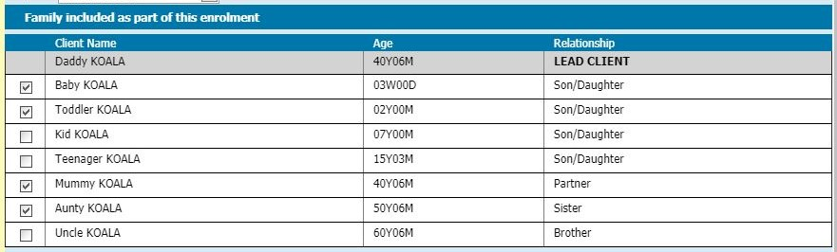
CDIS Enhanced MCH
Which family members should I add to a case?
Enrol any family members (adults and children) who are
actively involved in the goals of the case, and
usually present at case consultations.
  Example:
  Daddy Koala is the primary caregiver and has already been selected as the lead client.
  Baby Koala is experiencing issues that are the reason for this enrolment, so they will be enrolled.
  Toddler Koala experiences related issues, so they will also be enrolled.
  Mummy Koala is working and not present during consultations, but will actively participate to meet the goals
  Aunty Koala lives with the family and will actively participate in the behaviours necessary to meet the goals

Slide 7
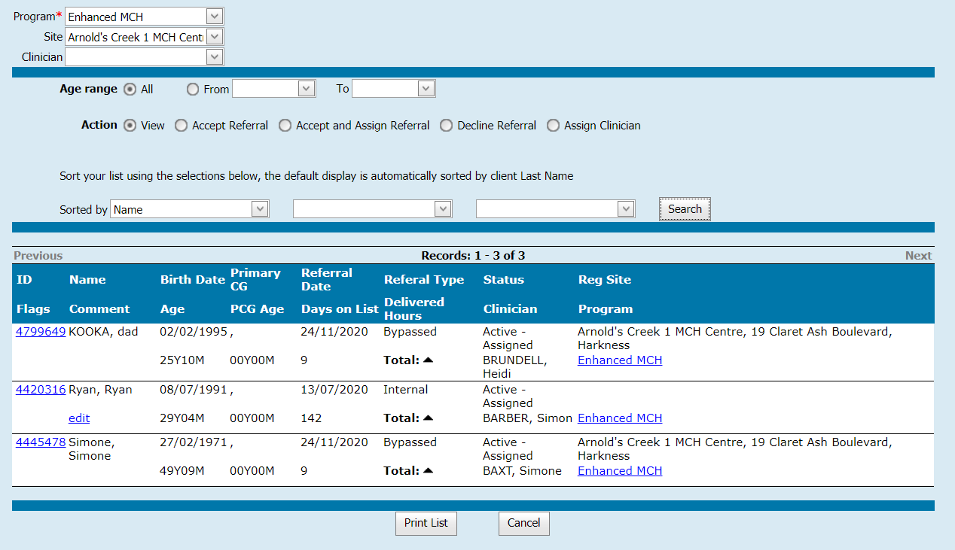
CDIS Enhanced MCH
Completing referral:
Complete the rest of the Internal Referral screen and click save
Program Active List:
Follow current practice for accepting/assigning/declining referrals on the Programs Active List.

Slide 8
CDIS Enhanced MCH
Managing a case - Case Summary Screen:
The Case Summary Screen shows the details of an Enhanced MCH case.
It is a place to record the details of a Child and Family Action Plan, replacing the need to keep a separate document outside of CDIS.
The Case Summary Screen can be accessed in the following ways:
From a client record: Access the client record of any client involved in the case.
Go to Client Details > Summary Page.
Go to the Programs section, identify the relevant case, and click the View link on the right side of the screen.
From the Programs Active List: Access the Programs Active List
Use the filters to search for and display the case (listed under the name of the lead client).
Under the Program column on the right side of the screen, click the Enhanced MCH link.

Slide 9
CDIS Enhanced MCH
Managing a case - Case Summary Screen :
Open a new Consultation Screen (either scheduled or without booking) for a lead client who is already active in an Enhanced MCH case.
Select Enhanced MCH as the Consultation Type.
Click the View Case Summary link, which will have appeared near the top of the screen.
Layout of the Case Summary Screen:
At the top of the Case Summary Screen it will say Enhanced MCH and case status; either Active or Closed.
Case
Conclusion (only visible once case has been closed)
Family included as part of this enrolment
Issues
Goals
Case Delivery
Scheduled appointments (upcoming Program appointments, made with lead client)
To exit the Case Summary Screen, click “Close” to save all changes and return to previous screen.

Slide 10
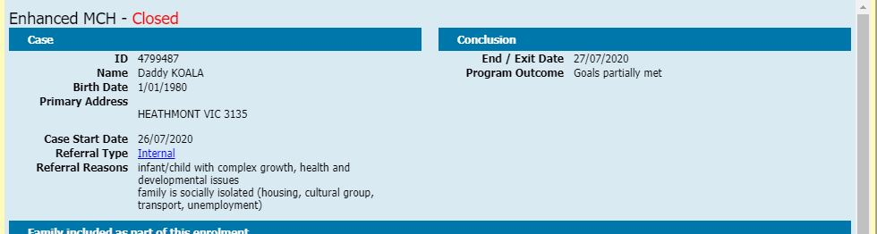
CDIS Enhanced MCH
Managing a case - Case Summary Screen:
Case
This shows:
details of the lead client,
case start date, and
(if case was opened from referral) details, including a link to view the Referral screen.
Conclusion appears only if the case has been closed.
It shows the end date program outcomes:
Goals fully met
Goals partially met
Goals not met.

Slide 11
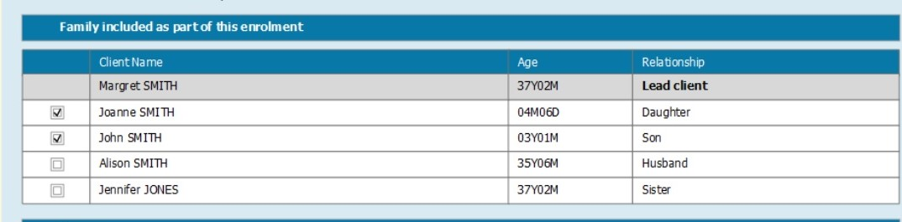
CDIS Enhanced MCH
Managing a case - Case Summary Screen:
Family included as part of this enrolment
Lists the lead client, and then all clients linked via the client relationship screen.
Click or unclick the checkboxes next to the names of any related clients you wish to add or remove from this case.
When you close the Case Summary Screen, any case changes you have made will be reflected in the client notes.

Slide 12
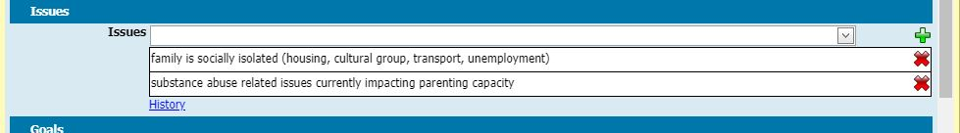
CDIS Enhanced MCH
Managing a case - Issues:
This section lists categories of issues of why the family has been enrolled (EMCH program guidelines, 2018).
These are the same Referral Reasons that can be added to an Internal Referral, and initially will be pre-populated with these Reasons (minimum of two for EMCH referrals).
Issues can be added or removed from the Case Summary screen at any time.
The list reflects the current understanding of the issues being addressed by the case, if an issue is not relevant to the case, it should be removed.
To add an Issue, select from the Issues dropdown list and click the green plus symbol on the right. It will be listed as seen in the image below, if correctly added.
To remove an Issue, click red cross.
To view all additions and deletions click the History link below the Issues dropdown.

Slide 13
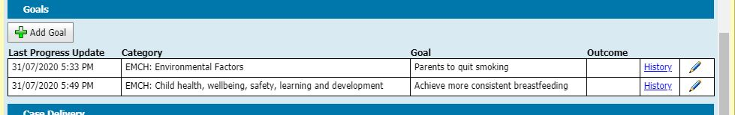
CDIS Enhanced MCH
Managing a case - Goals
The goals that have been identified and agreed to as part of the Child and Family Action Plan.
To add a new goal, click the Add Goal button and a new Add/Edit Goal screen will popup.
To edit an existing goal, click the pencil icon on the right of the goal you wish to edit.
Once created, goals cannot be deleted, but all the fields within a goal can be edited.
To view a log of all changes to a goal, click the History link on the right of the goal.

Slide 14
CDIS Enhanced MCH
Managing a case - Goals (Add/Edit)
These fields are completed/edited when a goal is first created, and can be edited at any time.
Category: This dropdown offers a list of high-level categories for each Integrated Program. Enhanced MCH categories are the domains as specified in the EMCH program guidelines (2018), and are prefaced in the list with “EMCH:”
Select the category that best aligns with the goal you are adding.
This field is mandatory.
Description: This free text field describes the goal.
This field will appear on the Case Summary Screen so you can identify the goal.
This field is mandatory.

Slide 15
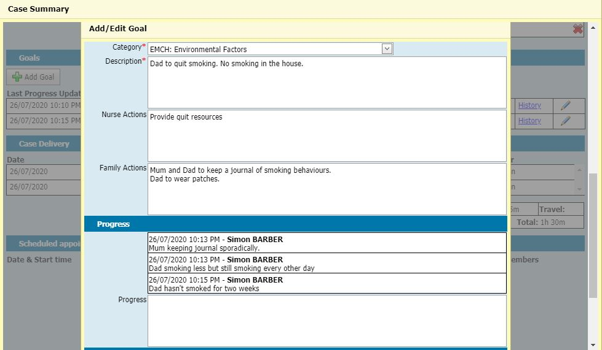
CDIS Enhanced MCH
Managing a case - Goals (Add/Edit)
Nurse Actions: Add any actions that have been agreed the practitioner will undertake in pursuit of achieving this goal.
Family actions: Add any actions that it has been agreed the family will undertake in pursuit of achieving this goal.
Actions added here need to be reviewed, further actions can be added, and agreed actions can be edited or removed
Goal (Update fields)
Progress: This free text field notes the progress towards the goal.
After a goal has been created but before it is finalised, this field is the main field that nurses document to update the goal.
Once the Add/Edit Goal screen is saved, any notes typed into this field will be in the Progress section.

Slide 16
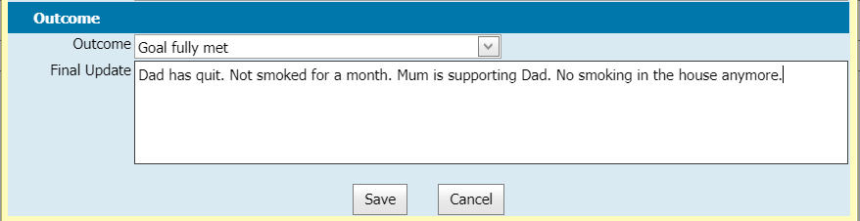
CDIS Enhanced MCH
Managing a case - Goals (Closure fields)
Goal closure fields are used to close the goal.
Outcome:
Goal fully met
Goal partially met
Goal not met.
Final update: Type your final update/summary here, when no further work will be undertaken on this goal.

Slide 17
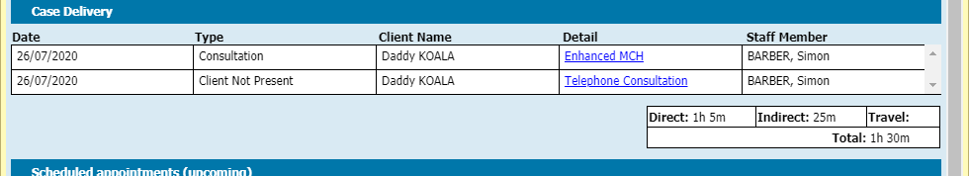
CDIS Enhanced MCH
Managing a case - Case Delivery
This section lists all completed consultations & ‘Client Not Present’ actions associated with case.
To view the record of a completed consultation or ‘Client Not Present’ action, click the link in the Detail column.
This section shows the accumulated time spent on the listed events, as Direct time, Indirect time, Travel time, and the total of all three.

Slide 18
CDIS Enhanced MCH
Delivering consultations as part of an active case:
Do not enter weight and growth/nutrition as this will be recorded for the Lead client in an active case
Additional Consultation
If you need to add data to a child’s growth chart or nutrition status as part of this consultation, you must open an additional consultation in another browser tab/window.
In the new tab/window:
• Access the child’s client record and create a new consultation without booking
• Select ‘Additional Consult’ as the consultation type
Record just 1 minute of Indirect time in the additional consultation screen and all other time in EMCH consultation
KAS consultation
In some MCH services the UMCH and EMCH programs are delivered simultaneously as a combined program, however KAS consultation and time are recorded in the KAS consultation accurately.

Slide 19
CDIS Enhanced MCH
Delivering consultations as part of an active case:
Selecting Consultation Type
Open the consultation screen (Child Health Assessment), select Enhanced MCH as the Consultation Type, from within the Assessment Details section.
Note 1: If open client record is a parent/carer, but not lead client in an active case, CDIS will not allow you to save this consultation. Cancel the consultation screen and undertake an Internal Referral process for a new program enrolment.
Note 2: If the open client is not a parent/carer, you will see a screen with guidance.
Family included as part of this enrolment
When an Enhanced MCH consultation type is selected, a table with clients linked through client relationships appears.
It lists the lead client, and then all related clients.
Click or unclick the checkboxes next to the names of any related clients you wish to add or remove from this case.

Slide 20
CDIS Enhanced MCH
Delivering consultations as part of an active case:
Enhanced MCH consultations must be created against the client record of the lead client in the EMCH case. Once completed, the consultation record will be recorded in the clients records of all clients (lead and non-leads) enrolled in the case.
Schedule appointment as Enhanced MCH
Note:
If you wish to record information that:
relates only to a specific family member (e.g. KAS or additional for growth review); AND
is not related to the Issues and Goals of this case
All non EMCH consultations are to be recorded from the child record – only in extenuating circumstances should a ‘consultation’ be recorded from the parent/carers record.
Schedule consultations back-to-back in the calendar to accurately reflect service delivered

Slide 21
CDIS Enhanced MCH
Delivering 'Client Not Present' actions as part of a case:
Time spent on an Enhanced MCH case (outside of delivering a consultation) should be recorded in CDIS as a Client Not Present action.
The Program dropdown lists all programs that the client is currently enrolled in. Select Enhanced MCH.
Complete all other fields as appropriate, then click save.
The Client Not Present record is recorded in the client’s Enhanced MCH case.
Accurately record time taken for the direct, indirect and travel when delivering different consultation types for the same client. Estimate the time taken for each consultation The total time for the consultations contribute to the delivered hours for that case.

Slide 22
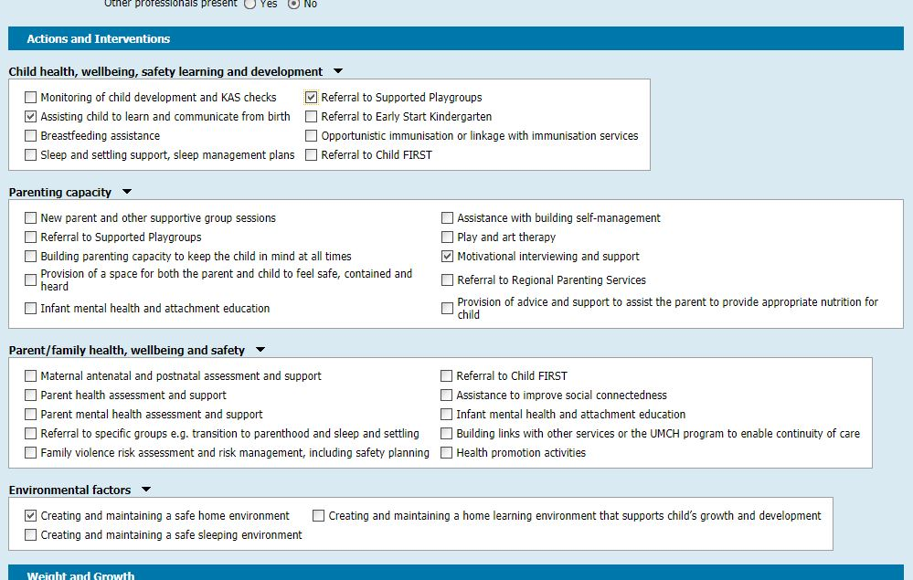
CDIS Enhanced MCH
Delivering consultations as part of an active case: Actions and Interventions
When Enhanced MCH consultation type is selected, this will appear below the Assessment Details. Actions and interventions that can be undertaken as part of an Enhanced MCH consultation, are listed as documented in the EMCH Guidelines (2018).
It is mandatory to select at least one action or intervention from this section when completing an Enhanced MCH consultation.

Slide 23
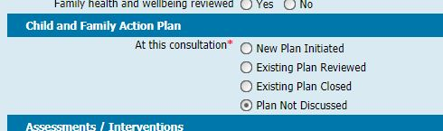
CDIS Enhanced MCH
Delivering consultations as part of an active case:
Child and Family Action Plan
Once the Enhanced MCH consultation type has been selected,
this section appears above the Assessments / Interventions
section and requires users to indicate the type of action that is
being undertaken at this consultation.
New Plan Initiated - at the first consultation of a new case. Ensure you undertake the necessary plan in line with EMCH program guidelines (2018). Issues and Goals are recorded on the Case Summary Screen for this case.
Existing Plan Reviewed - when a program plan is:
  being formally reviewed, potentially amended or updated, and
  the case is expected to continue with further consultation(s).
Existing Plan Closed - when enrolment in the program will be closed at completion of consultation.
Plan Not Discussed - when an existing plan is being carried out, but is not being initiated, closed, or actively reviewed

Slide 24
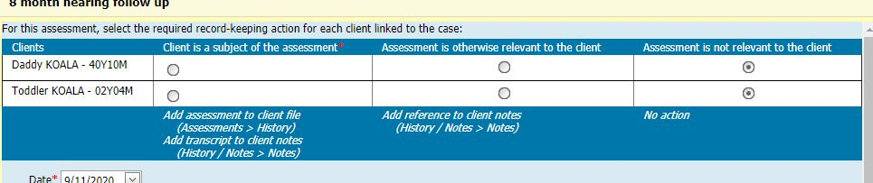
CDIS Enhanced MCH
Assessments/Interventions
In an EMCH consultation, the Assessment Tool will have an extra box at the top of the form. This box will list all clients linked to the case, and for each client, will allow the user to indicate how the Assessment Tool should be recorded against client records.
Client is a subject of the assessment: the Assessment Tool will appear in the client’s Assessment history (Assessments > History). A transcription will be added as a note in the client’s History / Notes. Generally this option is used for the subject of the Assessment Tool. It is mandatory that at least one client in the list has this option selected.
Assessment is otherwise relevant to the client: this will only add a reference to the Assessment Tool as a note to the client’s History / Notes.
Assessment is not relevant to the client: the Assessment Tool will not be recorded against the client’s record and is the default option for all clients in the list.

Slide 25
CDIS Enhanced MCH
Counselling
Any counselling added in this section will be included in the consultation record, which will be recorded in the clients records of all clients (lead and non-leads) enrolled in the case.
When adding counselling, specify the family members, who this applies to in the Comments/Notes.
Referrals from this assessment
Any internal or external referrals created in this section will be referrals for the lead client. Referrals for child clients cannot be created from within this consultation.
If you need to create a referral for a child as part of this appointment, you will need to access the client record for the relevant child, and then go to Clinical Activity > Referrals. You can do this by either:
logging into CDIS in a second tab/window, whilst still delivering this consultation; or
waiting until the consultation has been completed.
Note:
Remember when adding notes that this consultation will be added to the records of all family members.
Take care when entering information in the notes to specify which client or clients the notes pertains to.

Slide 26

CDIS Enhanced MCH
Next Program Steps:
This is below the Time section at the bottom of the Consultation screen.
Continue in program: should be selected program/ case is expected to continue with further consultations.
Exit from program: should be selected when the program enrolment / case will be closed
The case will be automatically closed, with an exit/end date matching the date of this consultation.
The case will be removed from the Programs Active List
When Exit from program is selected, a dropdown box will appear.
Program Outcome:
Goals fully met
Goals partially met
Goals not met
Select the option that best reflects the extent to which this program achieved or did not achieve the goals.

Slide 27
CDIS Enhanced MCH
Closing a case
There are two ways to close a case; via a consultation screen or via the Edit Program screen.
Edit Program Screen
Access the client record of any one of the clients enrolled in the program you wish to end.
Open the Programs screen (Clinical Activity > Programs)
Click the Edit button for the relevant case.
Select an End / Exit Date. This can be a date in the future or the past.
Remember to close the Flag for Enhanced.
Note: Only Enhanced MCH Services that occur between the program Start and End dates will be included in the delivered hours for that case.
Exit from program: should be selected when the program enrolment / case will be closed
The case will be automatically closed, with an exit/end date matching the date of this consultation.
The case will be removed from the Programs Active List
When Exit from program is selected, a dropdown box will appear with the Program Outcome to be completed.

